Slide 1
Analysis of Dividend Stocks Using PCA and LDA Methods
Presented By:
Ravish Kamath, Vi Nguyen, George Zhu & Yutong Pan

Slide 2


Analysis of Dividend Stocks Using PCA and LDA Methods
Ravish Kamath, Vi Nguyen, George Zhu & Yutong Pan
Presented by:
Introduction
Results
Conclusion
Objective and Data Set
Principal Component Analysis
Data Set: 200 stocks with 6 continuous features and 1 binary variable of interest
Objective: We want to classify whether a stock pays dividend or not.
 | PC1 | PC2 | PC3 | PC4 | PC5
Fcfps | -0.4910 | 0.0514 | -0.1035 | -0.7707 | 0.3894
Earn | -0.2747 | -0.9110 | 0.2843 | 0.1038 | 0.0549
DE | 0.4075 | -0.3970 | -0.7960 | -0.2017 | -0.0447
MC | -0.5342 | 0.0345 | -0.2363 | -0.0349 | -0.8102
CR | -0.4817 | 0.0930 | -0.4679 | 0.5944 | 0.4324
Cum. proportion | 0.4273 | 0.6129 | 0.7615 | 0.8943 | 1.0000
Feature Details:
Dividend: 0 for dividend; 1 for no dividend
Fcfps (Free cash flow per share $): Useful to gauge the return a shareholder receives after buying a stock.
Earnings Growth (year %): Change in an entity’s reported net income.
Debt to Equity Ratio: Measure of the extent to which a company covers its debt.
Market Cap: Measure worthiness of a company in stock market.
Current Ratio: Measures company’s ability to pay its short-term obligation.
Method
Statistical Software: R
Principal Component Analysis
Goal: Reduce the dimension of our explainable features.
Process: Eigendecomposition on the scaled explanatory variables. The eigen vectors will be our principal components, which is a linear combination of our explanatory variables. We will choose the component that best explains the variation in our data through a Scree plot and the cumulative variation proportion.
Equations:
${ Y}_{1}$ = ${PC}_{11}Fcfps+ {PC}_{21}Earn+ {PC}_{31}DE+ {PC}_{41}MC+ {PC}_{51}CR$
$$Y_{2}= {PC}_{12}Fcfps+ {PC}_{22}Earn+ {PC}_{32}DE+ {PC}_{42}MC+{PC}_{52}CR$$
${ Y}_{3}$ = ${PC}_{13}Fcfps+ {PC}_{23}Earn+ {PC}_{33}DE+ {PC}_{43}MC+ {PC}_{53}CR$
$$Y_{4}= {PC}_{14}Fcfps+ {PC}_{24}Earn+ {PC}_{34}DE+ {PC}_{44}MC+{PC}_{54}CR$$
$$Y_{5}= {PC}_{15}Fcfps+ {PC}_{25}Earn+ {PC}_{35}DE+ {PC}_{45}MC+{PC}_{55}CR$$
Strengths & Limitations
Linear Discriminant Analysis
Purpose: Classification and dimension reduction. Calculates a linear combination of independent features to classify data into classes by maximizing separation between projected samples.
Requirement:
1) Data set must be continuous.
2) Distance between 2 projected classes must be large. Projection variance is small.
Process: Given the requirement above, it projects the observations into 2 classes on a line.
Calculate the means of the 2 classes’ projections $μ_{1}$ and $μ_{2}$
Calculate average of $μ_{1}$ and $μ_{2}$which is the cut-off value. This is the linear boundary which is perpendicular to the projection line, separating the classes.
Projected sample can be classified by observing which side of the line it falls in.
References

Slide 3
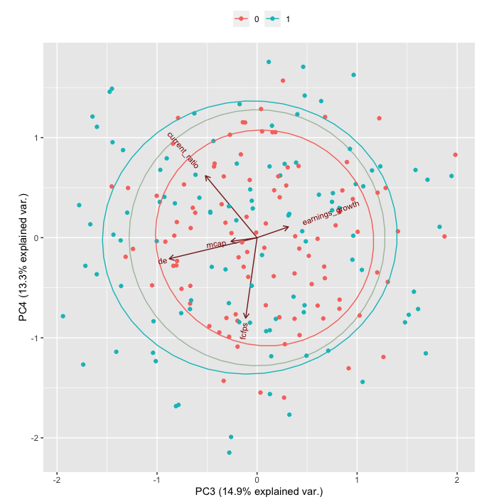
Analysis of Dividend Stocks Using PCA and LDA Methods
Ravish Kamath, Vi Nguyen, George Zhu & Yutong Pan
Presented by:
Introduction
Results
Conclusion
Objective and Data Set
Principal Component Analysis
Data Set: 200 stocks with 6 continuous features and 1 binary variable of interest
Objective: We want to classify whether a stock pays dividend or not.
Feature Details:
Dividend: 0 for dividend; 1 for no dividend
Fcfps (Free cash flow per share $): Useful to gauge the return a shareholder receives after buying a stock.
Earnings Growth (year %): Change in an entity’s reported net income.
Debt to Equity Ratio: Measure of the extent to which a company covers its debt.
Market Cap: Measure worthiness of a company in stock market.
Current Ratio: Measures company’s ability to pay its short-term obligation.
Method
Statistical Software: R
Principal Component Analysis
Goal: Reduce the dimension of our explainable features.
Process: Eigendecomposition on the scaled explanatory variables. The eigen vectors will be our principal components, which is a linear combination of our explanatory variables. We will choose the component that best explains the variation in our data through a Scree plot and the cumulative variation proportion.
Equations:
${ Y}_{1}$ = ${PC}_{11}Fcfps+ {PC}_{21}Earn+ {PC}_{31}DE+ {PC}_{41}MC+ {PC}_{51}CR$
$$Y_{2}= {PC}_{12}Fcfps+ {PC}_{22}Earn+ {PC}_{32}DE+ {PC}_{42}MC+{PC}_{52}CR$$
${ Y}_{3}$ = ${PC}_{13}Fcfps+ {PC}_{23}Earn+ {PC}_{33}DE+ {PC}_{43}MC+ {PC}_{53}CR$
$$Y_{4}= {PC}_{14}Fcfps+ {PC}_{24}Earn+ {PC}_{34}DE+ {PC}_{44}MC+{PC}_{54}CR$$
$$Y_{5}= {PC}_{15}Fcfps+ {PC}_{25}Earn+ {PC}_{35}DE+ {PC}_{45}MC+{PC}_{55}CR$$
Strengths & Limitations
Linear Discriminant Analysis
Purpose: Classification and dimension reduction. Calculates a linear combination of independent features to classify data into classes by maximizing separation between projected samples.
Requirement:
1) Data set must be continuous.
2) Distance between 2 projected classes must be large. Projection variance is small.
Process: Given the requirement above, it projects the observations into 2 classes on a line.
Calculate the means of the 2 classes’ projections $μ_{1}$ and $μ_{2}$
Calculate average of $μ_{1}$ and $μ_{2}$which is the cut-off value. This is the linear boundary which is perpendicular to the projection line, separating the classes.
Projected sample can be classified by observing which side of the line it falls in.
References

Slide 4
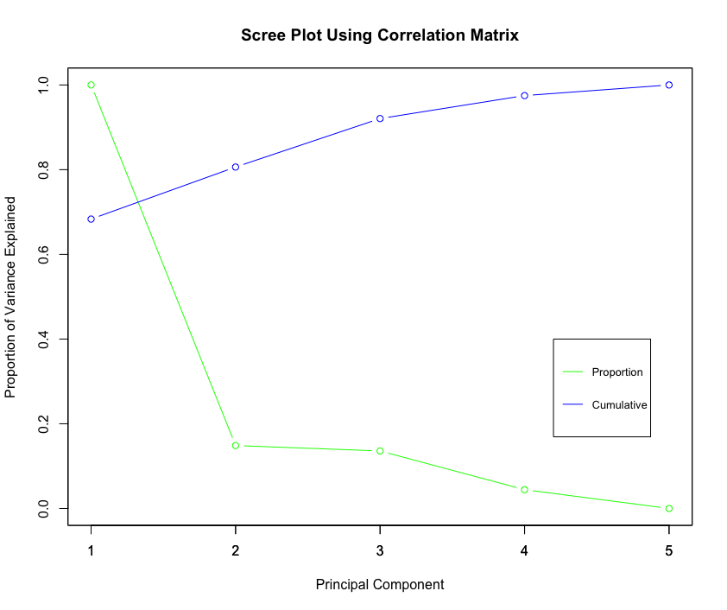
Analysis of Dividend Stocks Using PCA and LDA Methods
Ravish Kamath, Vi Nguyen, George Zhu & Yutong Pan
Presented by:
Introduction
Results
Conclusion
Objective and Data Set
Principal Component Analysis
Data Set: 200 stocks with 6 continuous features and 1 binary variable of interest
Objective: We want to classify whether a stock pays dividend or not.
Feature Details:
Dividend: 0 for dividend; 1 for no dividend
Fcfps (Free cash flow per share $): Useful to gauge the return a shareholder receives after buying a stock.
Earnings Growth (year %): Change in an entity’s reported net income.
Debt to Equity Ratio: Measure of the extent to which a company covers its debt.
Market Cap: Measure worthiness of a company in stock market.
Current Ratio: Measures company’s ability to pay its short-term obligation.
Method
Statistical Software: R
Principal Component Analysis
Goal: Reduce the dimension of our explainable features.
Process: Eigendecomposition on the scaled explanatory variables. The eigen vectors will be our principal components, which is a linear combination of our explanatory variables. We will choose the component that best explains the variation in our data through a Scree plot and the cumulative variation proportion.
Equations:
${ Y}_{1}$ = ${PC}_{11}Fcfps+ {PC}_{21}Earn+ {PC}_{31}DE+ {PC}_{41}MC+ {PC}_{51}CR$
$$Y_{2}= {PC}_{12}Fcfps+ {PC}_{22}Earn+ {PC}_{32}DE+ {PC}_{42}MC+{PC}_{52}CR$$
${ Y}_{3}$ = ${PC}_{13}Fcfps+ {PC}_{23}Earn+ {PC}_{33}DE+ {PC}_{43}MC+ {PC}_{53}CR$
$$Y_{4}= {PC}_{14}Fcfps+ {PC}_{24}Earn+ {PC}_{34}DE+ {PC}_{44}MC+{PC}_{54}CR$$
$$Y_{5}= {PC}_{15}Fcfps+ {PC}_{25}Earn+ {PC}_{35}DE+ {PC}_{45}MC+{PC}_{55}CR$$
Strengths & Limitations
Linear Discriminant Analysis
Purpose: Classification and dimension reduction. Calculates a linear combination of independent features to classify data into classes by maximizing separation between projected samples.
Requirement:
1) Data set must be continuous.
2) Distance between 2 projected classes must be large. Projection variance is small.
References
Process: Given the requirement above, it projects the observations into 2 classes on a line.
Calculate the means of the 2 classes’ projections $μ_{1}$ and $μ_{2}$
Calculate average of $μ_{1}$ and $μ_{2}$which is the cut-off value. This is the linear boundary which is perpendicular to the projection line, separating the classes.
Projected sample can be classified by observing which side of the line it falls in.

Slide 5
Analysis of Dividend Stocks Using PCA and LDA Methods
Ravish Kamath, Vi Nguyen, George Zhu & Yutong Pan
Presented by:
Introduction
Results
Conclusion
Objective and Data Set
Principal Component Analysis
Data Set: 200 stocks with 6 continuous features and 1 binary variable of interest
Objective: We want to classify whether a stock pays dividend or not.
 | PC1 | PC2 | PC3 | PC4 | PC5
Fcfps | -0.4910 | 0.0514 | -0.1035 | -0.7707 | 0.3894
Earn | -0.2747 | -0.9110 | 0.2843 | 0.1038 | 0.0549
DE | 0.4075 | -0.3970 | -0.7960 | -0.2017 | -0.0447
MC | -0.5342 | 0.0345 | -0.2363 | -0.0349 | -0.8102
CR | -0.4817 | 0.0930 | -0.4679 | 0.5944 | 0.4324
Cum. proportion | 0.4273 | 0.6129 | 0.7615 | 0.8943 | 1.0000
Feature Details:
Dividend: 0 for dividend; 1 for no dividend
Fcfps (Free cash flow per share $): Useful to gauge the return a shareholder receives after buying a stock.
Earnings Growth (year %): Change in an entity’s reported net income.
Debt to Equity Ratio: Measure of the extent to which a company covers its debt.
Market Cap: Measure worthiness of a company in stock market.
Current Ratio: Measures company’s ability to pay its short-term obligation.
Figure 1: Principal Components
Figure 2: Biplot
Method
Statistical Software: R
Principal Component Analysis
Goal: Reduce the dimension of our explainable features.
Process: Eigendecomposition on the scaled explanatory variables. The eigen vectors will be our principal components, which is a linear combination of our explanatory variables. We will choose the component that best explains the variation in our data through a Scree plot and the cumulative variation proportion.
Equations:
${ Y}_{1}$ = ${PC}_{11}Fcfps+ {PC}_{21}Earn+ {PC}_{31}DE+ {PC}_{41}MC+ {PC}_{51}CR$
$$Y_{2}= {PC}_{12}Fcfps+ {PC}_{22}Earn+ {PC}_{32}DE+ {PC}_{42}MC+{PC}_{52}CR$$
${ Y}_{3}$ = ${PC}_{13}Fcfps+ {PC}_{23}Earn+ {PC}_{33}DE+ {PC}_{43}MC+ {PC}_{53}CR$
$$Y_{4}= {PC}_{14}Fcfps+ {PC}_{24}Earn+ {PC}_{34}DE+ {PC}_{44}MC+{PC}_{54}CR$$
$$Y_{5}= {PC}_{15}Fcfps+ {PC}_{25}Earn+ {PC}_{35}DE+ {PC}_{45}MC+{PC}_{55}CR$$
Strengths & Limitations
Figure 3: Scree Plot
Based on the Scree Plot, we have decided to use PC4 as our choice of dimension reduction due to the 89% cumulative proportion.
Linear Discriminant Analysis
Purpose: Classification and dimension reduction. Calculates a linear combination of independent features to classify data into classes by maximizing separation between projected samples.
Requirement:
1) Data set must be continuous.
2) Distance between 2 projected classes must be large. Projection variance is small.
References
Process: Given the requirement above, it projects the observations into 2 classes on a line.
Calculate the means of the 2 classes’ projections $μ_{1}$ and $μ_{2}$
Calculate average of $μ_{1}$ and $μ_{2}$which is the cut-off value. This is the linear boundary which is perpendicular to the projection line, separating the classes.
Projected sample can be classified by observing which side of the line it falls in.

Slide 6
Analysis of Dividend Stocks Using PCA and LDA Methods
Ravish Kamath, Vi Nguyen, George Zhu & Yutong Pan
Presented by:
Introduction
Results
Conclusion
Objective and Data Set
Principal Component Analysis
Data Set: 200 stocks with 6 continuous features and 1 binary variable of interest
Objective: We want to classify whether a stock pays dividend or not.
 | PC1 | PC2 | PC3 | PC4 | PC5
Fcfps | -0.4910 | 0.0514 | -0.1035 | -0.7707 | 0.3894
Earn | -0.2747 | -0.9110 | 0.2843 | 0.1038 | 0.0549
DE | 0.4075 | -0.3970 | -0.7960 | -0.2017 | -0.0447
MC | -0.5342 | 0.0345 | -0.2363 | -0.0349 | -0.8102
CR | -0.4817 | 0.0930 | -0.4679 | 0.5944 | 0.4324
Cum. proportion | 0.4273 | 0.6129 | 0.7615 | 0.8943 | 1.0000
Feature Details:
Dividend: 0 for dividend; 1 for no dividend
Fcfps (Free cash flow per share $): Useful to gauge the return a shareholder receives after buying a stock.
Earnings Growth (year %): Change in an entity’s reported net income.
Debt to Equity Ratio: Measure of the extent to which a company covers its debt.
Market Cap: Measure worthiness of a company in stock market.
Current Ratio: Measures company’s ability to pay its short-term obligation.
Figure 1: Principal Components
Figure 2: Biplot
Method
Statistical Software: R
Principal Component Analysis
Goal: Reduce the dimension of our explainable features.
Process: Eigendecomposition on the scaled explanatory variables. The eigen vectors will be our principal components, which is a linear combination of our explanatory variables. We will choose the component that best explains the variation in our data through a Scree plot and the cumulative variation proportion.
Equations:
${ Y}_{1}$ = ${PC}_{11}Fcfps+ {PC}_{21}Earn+ {PC}_{31}DE+ {PC}_{41}MC+ {PC}_{51}CR$
$$Y_{2}= {PC}_{12}Fcfps+ {PC}_{22}Earn+ {PC}_{32}DE+ {PC}_{42}MC+{PC}_{52}CR$$
${ Y}_{3}$ = ${PC}_{13}Fcfps+ {PC}_{23}Earn+ {PC}_{33}DE+ {PC}_{43}MC+ {PC}_{53}CR$
$$Y_{4}= {PC}_{14}Fcfps+ {PC}_{24}Earn+ {PC}_{34}DE+ {PC}_{44}MC+{PC}_{54}CR$$
$$Y_{5}= {PC}_{15}Fcfps+ {PC}_{25}Earn+ {PC}_{35}DE+ {PC}_{45}MC+{PC}_{55}CR$$
Strengths & Limitations
Figure 3: Scree Plot
Based on the Scree Plot, we have decided to use PC4 as our choice of dimension reduction due to the 89% cumulative proportion.
Linear Discriminant Analysis
Linear Discriminant Analysis
Purpose: Classification and dimension reduction. Calculates a linear combination of independent features to classify data into classes by maximizing separation between projected samples.
Requirement:
1) Data set must be continuous.
2) Distance between 2 projected classes must be large. Projection variance is small.
References
Process: Given the requirement above, it projects the observations into 2 classes on a line.
Calculate the means of the 2 classes’ projections $μ_{1}$ and $μ_{2}$
Calculate average of $μ_{1}$ and $μ_{2}$which is the cut-off value. This is the linear boundary which is perpendicular to the projection line, separating the classes.
Projected sample can be classified by observing which side of the line it falls in.

Slide 7

Analysis of Dividend Stocks Using PCA and LDA Methods
Ravish Kamath, Vi Nguyen, George Zhu & Yutong Pan
Presented by:
Introduction
Results
Discussion
Objective and Data Set
Principal Component Analysis
Data Set: 200 stocks with 6 continuous features and 1 binary variable of interest
Objective: We want to classify whether a stock pays dividend or not.
 | PC1 | PC2 | PC3 | PC4 | PC5
Fcfps | -0.4910 | 0.0514 | -0.1035 | -0.7707 | 0.3894
Earn | -0.2747 | -0.9110 | 0.2843 | 0.1038 | 0.0549
DE | 0.4075 | -0.3970 | -0.7960 | -0.2017 | -0.0447
MC | -0.5342 | 0.0345 | -0.2363 | -0.0349 | -0.8102
CR | -0.4817 | 0.0930 | -0.4679 | 0.5944 | 0.4324
Cum. proportion | 0.4273 | 0.6129 | 0.7615 | 0.8943 | 1.0000
Feature Details:
Dividend: 0 for dividend; 1 for no dividend
Fcfps (Free cash flow per share $): Useful to gauge the return a shareholder receives after buying a stock.
Earnings Growth (year %): Change in an entity’s reported net income.
Debt to Equity Ratio: Measure of the extent to which a company covers its debt.
Market Cap: Measure worthiness of a company in stock market.
Current Ratio: Measures company’s ability to pay its short-term obligation.
Figure 1: Principal Components
Figure 2: Biplot
Conclusion
Method
Statistical Software: R
Principal Component Analysis
Goal: Reduce the dimension of our explainable features.
Process: Eigendecomposition on the scaled explanatory variables. The eigen vectors will be our principal components, which is a linear combination of our explanatory variables. We will choose the component that best explains the variation in our data through a Scree plot and the cumulative variation proportion.
Equations:
${ Y}_{1}$ = ${PC}_{11}Fcfps+ {PC}_{21}Earn+ {PC}_{31}DE+ {PC}_{41}MC+ {PC}_{51}CR$
$$Y_{2}= {PC}_{12}Fcfps+ {PC}_{22}Earn+ {PC}_{32}DE+ {PC}_{42}MC+{PC}_{52}CR$$
${ Y}_{3}$ = ${PC}_{13}Fcfps+ {PC}_{23}Earn+ {PC}_{33}DE+ {PC}_{43}MC+ {PC}_{53}CR$
$$Y_{4}= {PC}_{14}Fcfps+ {PC}_{24}Earn+ {PC}_{34}DE+ {PC}_{44}MC+{PC}_{54}CR$$
$$Y_{5}= {PC}_{15}Fcfps+ {PC}_{25}Earn+ {PC}_{35}DE+ {PC}_{45}MC+{PC}_{55}CR$$
Figure 3: Scree Plot
Based on the Scree Plot, we have decided to use PC4 as our choice of dimension reduction due to the 89% cumulative proportion.
Strengths & Limitations
Linear Discriminant Analysis
Without Principal Components:
Strengths
Predictors | Estimate | Mean 0 | Mean 1
fcfps | 0.43381058 | 1.500102 | 3.001667
Earn | 0.02796535 | 5.908571 | 17.053627
DE | -0.27450660 | 2.585918 | 1.708431
MCap | 0.00514127 | 280.0408 | 550.4118
CR | 0.86400978 | 1.063171 | 1.924120
Simplicity and easy to understand and classify stocks that either pay or do not pay a dividend.
This data had no missing values, so we did not need to do an extensive exploratory analysis
Linear Discriminant Analysis
Limitations
Purpose: Classification and dimension reduction. Calculates a linear combination of independent features to classify data into classes by maximizing separation between projected samples.
Requirement:
1) Data set must be continuous.
2) Distance between 2 projected classes must be large. Projection variance is small.
Unable to identify the industry category for each stock. If we had this information, we can better identify whether the ratios (DE & current) are good or bad.
Reduction in dimension using PCA was little effect due to the small level of correlations between each feature.
LDA is more suited for multi-class variable. Better visualization through scatter plot.
Process: Given the requirement above, it projects the observations into 2 classes on a line.
Calculate the means of the 2 classes’ projections $μ_{1}$ and $μ_{2}$
Calculate average of $μ_{1}$ and $μ_{2}$which is the cut-off value. This is the linear boundary which is perpendicular to the projection line, separating the classes.
Projected sample can be classified by observing which side of the line it falls in.
Perform cross-validation with 80% data in training. Want to identify misclassification rate.
References

