Slide 1
Analysis of Dividend Stocks Using PCA and LDA Methods
Presented By:
Ravish Kamath,
Vi Nguyen
George Zhu
Yutong Pan

Slide 2
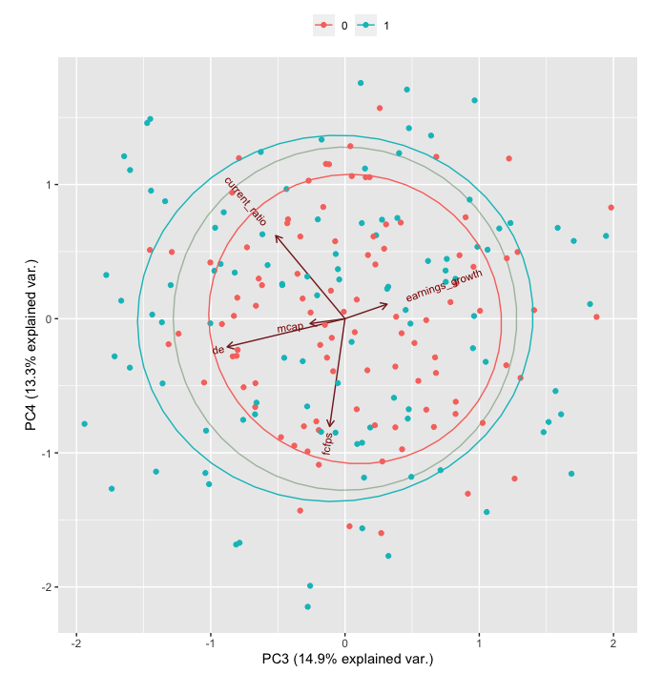
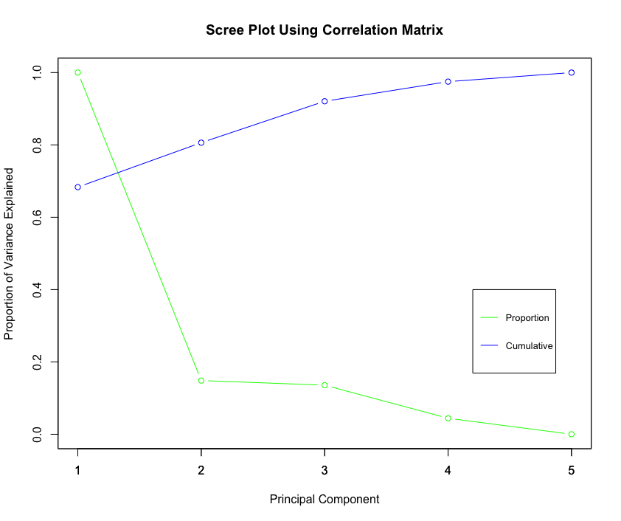


Analysis of Dividend Stocks Using PCA and LDA Methods
Presented by:
Ravish Kamath, Vi Nguyen, George Zhu & Yutong Pan
Introduction
Results
Discussion
Objective and Data Set
Principal Component Analysis
Data Set: 200 stocks with 6 continuous features and 1 binary variable of interest
Objective: We want to classify whether a stock pays dividend or not.
 | PC1 | PC2 | PC3 | PC4 | PC5
Fcfps | -0.4910 | 0.0514 | -0.1035 | -0.7707 | 0.3894
Earn | -0.2747 | -0.9110 | 0.2843 | 0.1038 | 0.0549
DE | 0.4075 | -0.3970 | -0.7960 | -0.2017 | -0.0447
MC | -0.5342 | 0.0345 | -0.2363 | -0.0349 | -0.8102
CR | -0.4817 | 0.0930 | -0.4679 | 0.5944 | 0.4324
Cum. proportion | 0.4273 | 0.6129 | 0.7615 | 0.8943 | 1.0000
Feature Details:
Dividend: 0 for dividend; 1 for no dividend
Fcfps (Free cash flow per share $): Useful to gauge the return a shareholder receives after buying a stock.
Earnings Growth (year %): Change in an entity’s reported net income.
Debt to Equity Ratio: Measure of the extent to which a co5mpany covers its debt.
Market Cap: Measure worthiness of a company in stock market.
Current Ratio: Measures company’s ability to pay its short-term obligation.
Figure 1: Principal Components
Figure 2: Biplot
Conclusion
Method
Statistical Software: R
Principal Component
Goal: Reduce the dimension of our explainable features.
Process: Eigendecomposition on the scaled explanatory variables. The eigen vectors will be our principal components, which is a linear combination of our explanatory variables. We will choose the component that best explains the variation in our data through a Scree plot and the cumulative variation proportion.
Equations:
$Y_{1}$ = ${PC}_{11}Fcfps+ {PC}_{21}Earn+ {PC}_{31}DE+ {PC}_{41}Mrkt+{PC}_{51}CR$
$$Y_{2}= {PC}_{12}Fcfps+ {PC}_{22}Earn+ {PC}_{32}DE+ {PC}_{42}MC+{PC}_{52}CR$$
${ Y}_{3}$ = ${PC}_{13}Fcfps+ {PC}_{23}Earn+ {PC}_{33}DE+ {PC}_{43}MC+ {PC}_{53}CR$
$$Y_{4}= {PC}_{14}Fcfps+ {PC}_{24}Earn+ {PC}_{34}DE+ {PC}_{44}MC+{PC}_{54}CR$$
$$Y_{5}= {PC}_{15}Fcfps+ {PC}_{25}Earn+ {PC}_{35}DE+ {PC}_{45}MC+{PC}_{55}CR$$
Strengths & Limitations
Linear Discriminant
Purpose: Classification and dimension reduction. Calculates a linear combination of independent features to classify data into classes by maximizing separation between projected samples.
Requirement:
1) Data set must be continuous.
2) Distance between 2 projected classes must be large. Projection variance is small.
Interpretation
PC1: Primarily a measure of DE. Low value stock tends to have high DE ratio
Decision
Use PC1, ... , PC4 for data reduction.
We chose this based on the cumulative proportion value.
It is the best PC that explains most of the variation.
References
Process: Given the requirement above, it projects the observations into 2 classes on a line.
Calculate the means of the 2 classes’ projections $μ_{1}$ and $μ_{2}$
Calculate average of $μ_{1}$ and $μ_{2}$which is the cut-off value. This is the linear boundary which is perpendicular to the projection line, separating the classes.
Projected sample can be classified by observing which side of the line it falls in.
Perform 1000-fold cross-validation with 80% data in training. Want to identify misclassification rate.
Perform real life data classification

Slide 3

Analysis of Dividend Stocks Using PCA and LDA Methods
Presented by:
Ravish Kamath, Vi Nguyen, George Zhu & Yutong Pan
Introduction
Results
Discussion
Objective and Data Set
Principal Component Analysis
Data Set: 200 stocks with 6 continuous features and 1 binary variable of interest
Objective: We want to classify whether a stock pays dividend or not.
 | PC1 | PC2 | PC3 | PC4 | PC5
Fcfps | -0.4910 | 0.0514 | -0.1035 | -0.7707 | 0.3894
Earn | -0.2747 | -0.9110 | 0.2843 | 0.1038 | 0.0549
DE | 0.4075 | -0.3970 | -0.7960 | -0.2017 | -0.0447
MC | -0.5342 | 0.0345 | -0.2363 | -0.0349 | -0.8102
CR | -0.4817 | 0.0930 | -0.4679 | 0.5944 | 0.4324
Cum. proportion | 0.4273 | 0.6129 | 0.7615 | 0.8943 | 1.0000
Feature Details:
Dividend: 0 for dividend; 1 for no dividend
Fcfps (Free cash flow per share $): Useful to gauge the return a shareholder receives after buying a stock.
Earnings Growth (year %): Change in an entity’s reported net income.
Debt to Equity Ratio: Measure of the extent to which a co5mpany covers its debt.
Market Cap: Measure worthiness of a company in stock market.
Current Ratio: Measures company’s ability to pay its short-term obligation.
Figure 1: Principal Components
Figure 2: Biplot
Interpretation
PC1: Primarily a measure of DE. Low value stock tends to have high DE ratio
Decision
Use PC1, ... , PC4 for data reduction.
We chose this based on the cumulative proportion value.
It is the best PC that explains most of the variation.
Conclusion
Method
Statistical Software: R
Principal Component
Goal: Reduce the dimension of our explainable features.
Process: Eigendecomposition on the scaled explanatory variables. The eigen vectors will be our principal components, which is a linear combination of our explanatory variables. We will choose the component that best explains the variation in our data through a Scree plot and the cumulative variation proportion.
Equations:
$Y_{1}$ = ${PC}_{11}Fcfps+ {PC}_{21}Earn+ {PC}_{31}DE+ {PC}_{41}Mrkt+{PC}_{51}CR$
$$Y_{2}= {PC}_{12}Fcfps+ {PC}_{22}Earn+ {PC}_{32}DE+ {PC}_{42}MC+{PC}_{52}CR$$
${ Y}_{3}$ = ${PC}_{13}Fcfps+ {PC}_{23}Earn+ {PC}_{33}DE+ {PC}_{43}MC+ {PC}_{53}CR$
$$Y_{4}= {PC}_{14}Fcfps+ {PC}_{24}Earn+ {PC}_{34}DE+ {PC}_{44}MC+{PC}_{54}CR$$
$$Y_{5}= {PC}_{15}Fcfps+ {PC}_{25}Earn+ {PC}_{35}DE+ {PC}_{45}MC+{PC}_{55}CR$$
Figure 3: Scree Plot
Linear Discriminant Analysis
Strengths & Limitations
Without Principal Components:
With Principal Components:
Predictor | Estimate | Mean 0 | Mean 1
Fcfps | 0.4338 | 1.5001 | 3.0017
Earn | 0.0280 | 5.9086 | 17.0536
DE | -0.2745 | 2.5859 | 1.7084
MC | 0.0051 | 280.0408 | 550.4118
CR | 0.8640 | 1.0632 | 1.9241
Predictor | Estimate | Mean 0 | Mean 1
PC1 | -1.3052 | 1.2617 | -1.2123
PC2 | -0.1479 | 0.0621 | -0.0597
PC3 | -0.2240 | 0.0753 | -0.0724
PC4 | 0.0084 | -0.0724 | 0.0024
Linear Discriminant
Figure 4: LDA information without PC
Figure 5: LDA information with PC
Purpose: Classification and dimension reduction. Calculates a linear combination of independent features to classify data into classes by maximizing separation between projected samples.
Requirement:
1) Data set must be continuous.
2) Distance between 2 projected classes must be large. Projection variance is small.
References
Process: Given the requirement above, it projects the observations into 2 classes on a line.
Calculate the means of the 2 classes’ projections $μ_{1}$ and $μ_{2}$
Calculate average of $μ_{1}$ and $μ_{2}$which is the cut-off value. This is the linear boundary which is perpendicular to the projection line, separating the classes.
Projected sample can be classified by observing which side of the line it falls in.
Perform 1000-fold cross-validation with 80% data in training. Want to identify misclassification rate.
Perform real life data classification

Slide 4
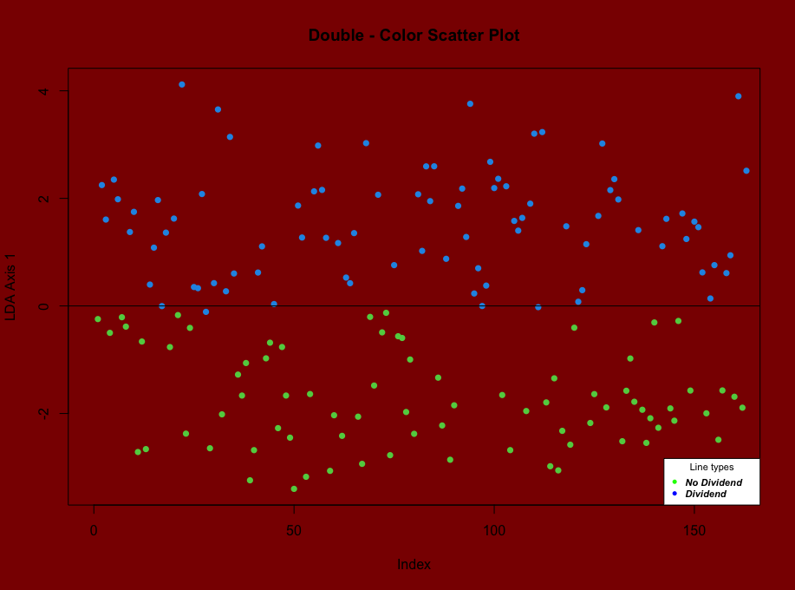
Analysis of Dividend Stocks Using PCA and LDA Methods
Presented by:
Ravish Kamath, Vi Nguyen, George Zhu & Yutong Pan
Introduction
Results
Discussion
Objective and Data Set
Principal Component Analysis
Data Set: 200 stocks with 6 continuous features and 1 binary variable of interest
Objective: We want to classify whether a stock pays dividend or not.
 | PC1 | PC2 | PC3 | PC4 | PC5
Fcfps | -0.4910 | 0.0514 | -0.1035 | -0.7707 | 0.3894
Earn | -0.2747 | -0.9110 | 0.2843 | 0.1038 | 0.0549
DE | 0.4075 | -0.3970 | -0.7960 | -0.2017 | -0.0447
MC | -0.5342 | 0.0345 | -0.2363 | -0.0349 | -0.8102
CR | -0.4817 | 0.0930 | -0.4679 | 0.5944 | 0.4324
Cum. proportion | 0.4273 | 0.6129 | 0.7615 | 0.8943 | 1.0000
Feature Details:
Dividend: 0 for dividend; 1 for no dividend
Fcfps (Free cash flow per share $): Useful to gauge the return a shareholder receives after buying a stock.
Earnings Growth (year %): Change in an entity’s reported net income.
Debt to Equity Ratio: Measure of the extent to which a co5mpany covers its debt.
Market Cap: Measure worthiness of a company in stock market.
Current Ratio: Measures company’s ability to pay its short-term obligation.
Figure 1: Principal Components
Figure 2: Biplot
Interpretation
PC1: Primarily a measure of DE. Low value stock tends to have high DE ratio
Decision
Use PC1, ... , PC4 for data reduction.
We chose this based on the cumulative proportion value.
It is the best PC that explains most of the variation.
Conclusion
Method
Statistical Software: R
Principal Component
Goal: Reduce the dimension of our explainable features.
Process: Eigendecomposition on the scaled explanatory variables. The eigen vectors will be our principal components, which is a linear combination of our explanatory variables. We will choose the component that best explains the variation in our data through a Scree plot and the cumulative variation proportion.
Equations:
$Y_{1}$ = ${PC}_{11}Fcfps+ {PC}_{21}Earn+ {PC}_{31}DE+ {PC}_{41}Mrkt+{PC}_{51}CR$
$$Y_{2}= {PC}_{12}Fcfps+ {PC}_{22}Earn+ {PC}_{32}DE+ {PC}_{42}MC+{PC}_{52}CR$$
${ Y}_{3}$ = ${PC}_{13}Fcfps+ {PC}_{23}Earn+ {PC}_{33}DE+ {PC}_{43}MC+ {PC}_{53}CR$
$$Y_{4}= {PC}_{14}Fcfps+ {PC}_{24}Earn+ {PC}_{34}DE+ {PC}_{44}MC+{PC}_{54}CR$$
$$Y_{5}= {PC}_{15}Fcfps+ {PC}_{25}Earn+ {PC}_{35}DE+ {PC}_{45}MC+{PC}_{55}CR$$
Figure 3: Scree Plot
Linear Discriminant Analysis
Strengths & Limitations
Linear Discriminant
Purpose: Classification and dimension reduction. Calculates a linear combination of independent features to classify data into classes by maximizing separation between projected samples.
Requirement:
1) Data set must be continuous.
2) Distance between 2 projected classes must be large. Projection variance is small.
Figure 6: LDA Scatter Plot (Similar results for both)
References
Process: Given the requirement above, it projects the observations into 2 classes on a line.
Calculate the means of the 2 classes’ projections $μ_{1}$ and $μ_{2}$
Calculate average of $μ_{1}$ and $μ_{2}$which is the cut-off value. This is the linear boundary which is perpendicular to the projection line, separating the classes.
Projected sample can be classified by observing which side of the line it falls in.
Perform 1000-fold cross-validation with 80% data in training. Want to identify misclassification rate.
Perform real life data classification
LDA Method | Accuracy Rate | Misclassification Rate
Without PC | 97.3% | 6.53%
With PC | 97.3% | 6.57%
Figure 7: Testing of Model Results
Decision
Based on Figure 7, since the model with the principal components gives us almost the same accuracy as the full model, we would choose that one as the best model to classify dividend stocks.

Slide 5
Analysis of Dividend Stocks Using PCA and LDA Methods
Presented by:
Ravish Kamath, Vi Nguyen, George Zhu & Yutong Pan
Introduction
Results
Discussion
Objective and Data Set
Principal Component Analysis
We can see that doing PCA has made the model simpler
We still get the same testing results when we try LDA on all the features.
Unfortunately, we could only reduce it by 1 dimension
Real Life Data Classification Test
We can test our data with a real-life stock: Jumia Technologies
Jumia is a publicly traded stock and does not issue dividend
Jumia: Fcfps = -1.84 ; Earn = 11.87; DE = 0.0629 ; MC= 474.42 & CR = 2.62.
Unfortunately, when we try to classify this stock, we get a misclassification
Clearly shows that data may be too old. Inflation and other factors may affect the accuracy of the model.
Data Set: 200 stocks with 6 continuous features and 1 binary variable of interest
Objective: We want to classify whether a stock pays dividend or not.
 | PC1 | PC2 | PC3 | PC4 | PC5
Fcfps | -0.4910 | 0.0514 | -0.1035 | -0.7707 | 0.3894
Earn | -0.2747 | -0.9110 | 0.2843 | 0.1038 | 0.0549
DE | 0.4075 | -0.3970 | -0.7960 | -0.2017 | -0.0447
MC | -0.5342 | 0.0345 | -0.2363 | -0.0349 | -0.8102
CR | -0.4817 | 0.0930 | -0.4679 | 0.5944 | 0.4324
Cum. proportion | 0.4273 | 0.6129 | 0.7615 | 0.8943 | 1.0000
Feature Details:
Dividend: 0 for dividend; 1 for no dividend
Fcfps (Free cash flow per share $): Useful to gauge the return a shareholder receives after buying a stock.
Earnings Growth (year %): Change in an entity’s reported net income.
Debt to Equity Ratio: Measure of the extent to which a co5mpany covers its debt.
Market Cap: Measure worthiness of a company in stock market.
Current Ratio: Measures company’s ability to pay its short-term obligation.
Figure 1: Principal Components
Figure 2: Biplot
Interpretation
PC1: Primarily a measure of DE. Low value stock tends to have high DE ratio
Decision
Use PC1, ... , PC4 for data reduction.
We chose this based on the cumulative proportion value.
It is the best PC that explains most of the variation.
Conclusion
Method
By using PCA and LDA, we were able to get a simpler and accurate model, based on the given data presented.
In the future, it is best to use the most recent data, in order to better classify current stocks that pay or don’t pay dividend.
Statistical Software: R
Principal Component
Goal: Reduce the dimension of our explainable features.
Process: Eigendecomposition on the scaled explanatory variables. The eigen vectors will be our principal components, which is a linear combination of our explanatory variables. We will choose the component that best explains the variation in our data through a Scree plot and the cumulative variation proportion.
Equations:
$Y_{1}$ = ${PC}_{11}Fcfps+ {PC}_{21}Earn+ {PC}_{31}DE+ {PC}_{41}Mrkt+{PC}_{51}CR$
$$Y_{2}= {PC}_{12}Fcfps+ {PC}_{22}Earn+ {PC}_{32}DE+ {PC}_{42}MC+{PC}_{52}CR$$
${ Y}_{3}$ = ${PC}_{13}Fcfps+ {PC}_{23}Earn+ {PC}_{33}DE+ {PC}_{43}MC+ {PC}_{53}CR$
$$Y_{4}= {PC}_{14}Fcfps+ {PC}_{24}Earn+ {PC}_{34}DE+ {PC}_{44}MC+{PC}_{54}CR$$
$$Y_{5}= {PC}_{15}Fcfps+ {PC}_{25}Earn+ {PC}_{35}DE+ {PC}_{45}MC+{PC}_{55}CR$$
Figure 3: Scree Plot
Linear Discriminant Analysis
Strengths & Limitations
Without Principal Components:
With Principal Components:
Predictor | Estimate | Mean 0 | Mean 1
Fcfps | 0.4338 | 1.5001 | 3.0017
Earn | 0.0280 | 5.9086 | 17.0536
DE | -0.2745 | 2.5859 | 1.7084
MC | 0.0051 | 280.0408 | 550.4118
CR | 0.8640 | 1.0632 | 1.9241
Predictor | Estimate | Mean 0 | Mean 1
PC1 | -1.3052 | 1.2617 | -1.2123
PC2 | -0.1479 | 0.0621 | -0.0597
PC3 | -0.2240 | 0.0753 | -0.0724
PC4 | 0.0084 | -0.0724 | 0.0024
Strengths
Simple model and easy to understand whether a company issues dividend or not.
This data had no missing values, so we did not need to do an extensive exploratory analysis
Reduced the features and still managed to get the same result, without loss of accuracy
Limitations
Linear Discriminant
Figure 4: LDA information without PC
Figure 5: LDA information with PC
Unable to identify the industry category for each stock. If we had this information, we can better identify whether the ratios (DE & current) are good or bad.
Reduction in dimension using PCA was little effect due to the small level of correlations between each feature.
LDA is more suited for multi-class variable. Better visualization through scatter plot.
Data set is quite old, since when we tried to predict with a real life data, it misclassified it.
Purpose: Classification and dimension reduction. Calculates a linear combination of independent features to classify data into classes by maximizing separation between projected samples.
Requirement:
1) Data set must be continuous.
2) Distance between 2 projected classes must be large. Projection variance is small.
References
Process: Given the requirement above, it projects the observations into 2 classes on a line.
Calculate the means of the 2 classes’ projections $μ_{1}$ and $μ_{2}$
Calculate average of $μ_{1}$ and $μ_{2}$which is the cut-off value. This is the linear boundary which is perpendicular to the projection line, separating the classes.
Projected sample can be classified by observing which side of the line it falls in.
Perform 1000-fold cross-validation with 80% data in training. Want to identify misclassification rate.
Perform real life data classification
Wikimedia Foundation. (2022, December 5). Linear discriminant analysis. Wikipedia. Retrieved December 5, 2022, from https://en.wikipedia.org/wiki/Linear_discriminant_analysis
Dash, S. K. (2022, August 5). Linear discriminant analysis: What is linear discriminant analysis. Analytics Vidhya. Retrieved December 5, 2022, from https://www.analyticsvidhya.com/blog/2021/08/a-brief-introduction-to-linear-discriminant-analysis/
Neuralnet: Train and Test Neural Networks using R. DataScience+. (n.d.). Retrieved December 5, 2022, from https://datascienceplus.com/neuralnet-train-and-test-neural-networks-using-r/
Zach. (2020, October 30). Linear discriminant analysis in R (step-by-step). Statology. Retrieved December 5, 2022, from https://www.statology.org/linear-discriminant-analysis-in-r/
What is the difference between PCA and Lda? 365 Data Science. (2022, July 15). Retrieved December 5, 2022, from https://365datascience.com/tutorials/python-tutorials/lda-vs-pca/
Wikimedia Foundation. (2022, November 10). Principal component analysis. Wikipedia. Retrieved December 5, 2022, from https://en.wikipedia.org/wiki/Principal_component_analysis
Team, T. A. I. (2022, January 26). LDA vs. PCA. Towards AI. Retrieved December 5, 2022, from https://towardsai.net/p/data-science/lda-vs-pca
Figure 6: LDA Scatter Plot (Similar results for both)
LDA Method | Accuracy Rate | Misclassification Rate
Without PC | 97.3% | 6.53%
With PC | 97.3% | 6.57%
Figure 7: Testing of Model Results
Decision
Based on Figure 7, since the model with the principal components gives us almost the same accuracy as the full model, we would choose that one as the best model to classify dividend stocks.

