Slide 1

MultiVerseTranslate: Beyond Boundaries
Ravish Sood
23MCS103

Slide 2
Agenda
1
2
3
4
5
OBJECTIVE
Model
Corpus Used
Process and Parameters
References

Slide 3
Objective
To build a robust neural machine translation (NMT) model for translating Hindi to English and vice versa and Facilitate seamless communication across language boundaries.

Slide 4
Model Used
Multilingual T5 (mT5)
Model Choice: Utilizing the pre-trained transformer-based model – google/mt5.
Why: State-of-the-art performance, pre-trained on a diverse multilingual corpus.
Model Type: Transformer Based.
Seq2Seq Neural Machine Translation

Slide 5
Implementation
Load the pretrained model and tokenizer
Load the dataset
Transform dataset into input
Train/fine tune the model on our dataset
Test the model

Slide 6
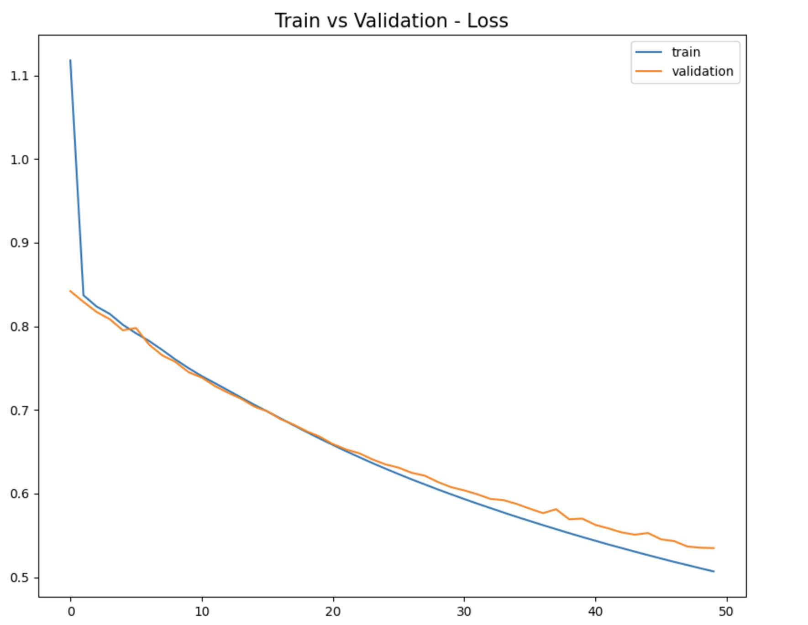
HyperParameters
Hyperparameters:
Batch Size: 64
Learning Rate: 1e-5
Epochs: 50
Validation Split: 0.1
Number of hidden layer in transformer encoder : 8
Number of hidden layer in transformer decoder : 8

Slide 7
Corpus
Corpus: Bilingual Parallel Corpus for Hindi – English Language.
Link: http://www.manythings.org/anki/
Why: Diverse, high-quality parallel sentences for training a robust translation mode
Corpus Size: 65000 sentences
Tokenization: Used Tokenizer for both Hindi and English

Slide 8
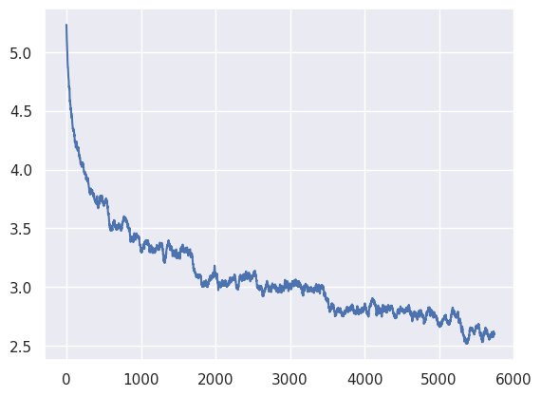
Loss Functions and Optimization
Optimizer: Using AdamW
Cross entropy
Training dataset loss: 2.164
Testing dataset loss: 2.322
Conclusion: No Overfitting

Slide 9
Performance Evaluation
Word Error Rate(WER): 1.0 Input Text : Hindi
BLEU Score: 4.233e-155 Output Text : English
ROUGE Scores:
ROUGE-1 Precision: 0.23
ROUGE-1 Recall: 1.0
ROUGE-1 F1 Score: 0.299~0.5
METEOR Score: 0.545

Slide 10
Conclusions
"In conclusion, our Hindi to English MT5 model showcases the power of multilingual transformers in breaking language barriers. Achieving high-quality translations, it fosters seamless cross-cultural communication. The project emphasizes the potential of advanced machine translation models for diverse linguistic applications, promoting global connectivity and understanding.

Slide 11
References
Banerjee, S. & Lavie, A. (2005). METEOR: An automatic metric for MT evaluation with improved correlation with human judgments. In Proceedings of the workshop on intrinsic and extrinsic evaluation measures for MT and/or summarization at 43rd ACL, Ann Arbor, Michigan.
Bernard, C. (1989). Language universals and linguistic typology. Chicago: The University of Chicago Press.

