Slide 1



Slide 2

Group Members
Kaish Panjwani (183168050)
Ravish Virani (173084290)
Sahil Lalani (183145550)

Slide 3

Table of Context
Introduction
Algorithms
Specifications
Architecture
Client Side Components
Server Side CGI Components
Database Tier Design, Data, Usage
New Features and Tools

Slide 4

Introduction
Family Oriented Social Media Application
Web Based, programmed in React (front-end) and Express (back-end)
Has features like sharing event details, recipes and much more among the family connection
An idea that can be wildly explored and could turn into a real project in future

Slide 5

Algorithms

Slide 6
Algorithms
Using SHA1 Encryption Algorithm to store passwords for security
Routing Algorithm to route through different pages including redirecting users to login page if they haven’t logged in
Storing Algorithm to fetch and store items from and to Database

Slide 7

Specifications

Slide 8

Running Specifications
Database: MongoDB Atlas
Front-end and UI: React JS
Back-end: NodeJS (Express JS for routing)
Browser Tested on: Google Chrome
Code Structure based on ESLint
HTML5 and CSS3 were used for creating structure and aesthetics of the application
The program follows the MERN Project standards

Slide 9

Architecture

Slide 10
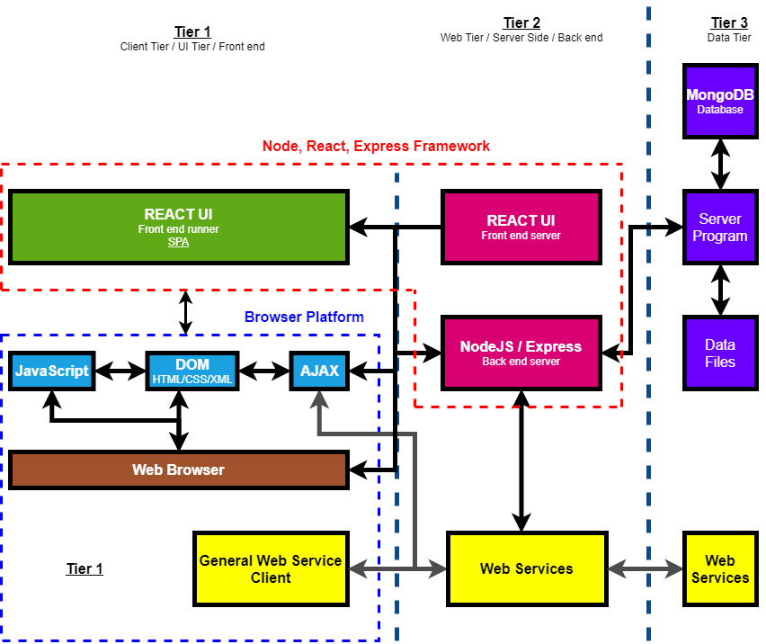

Slide 11
Client Side Components

Slide 12
Login/Signup UI and back-end calls
Local Storage and Session Storage for authentication
Home and Navigation UI and back-end calls
Create/Join Family UI and back-end calls
Recipe Zone UI, basic functionality and back-end calls
Calendar UI with complete functionality and back-end calls

Slide 13
Server Side CGI Components

Slide 14
Database connection and control
Processing requests and sending responses
Encrypting information before storage

Slide 15

Database Tier Design, Data, Usage

Slide 16
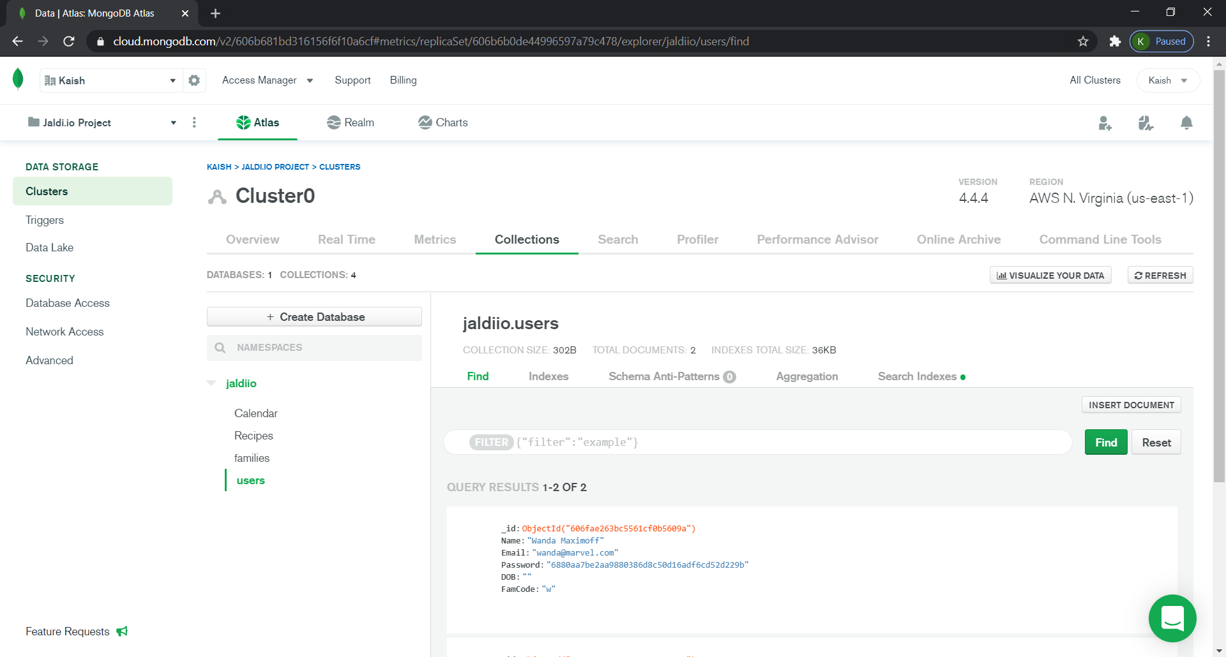
Using MongoDB Atlas for storing data

Slide 17

New Features and Tools

Slide 18

Family Connection Structure
Modal (ReactJS and Material UI)
Routing (react-router-dom and history.push)
MongoDB Atlas
Calendar
Recipe
Local Storage and Session Storage (Auth0)
Time zone Support

Slide 19
THE END

