Slide 1
Problem statement
The customer finance company wants to decide for loan approval based on the risk of the applicant's profile, For which based on the sample data available need to find out the driving factors behind the loan default. Company can use this information for conducting Risk Analysis

Slide 2
Analysis Approach
Understand all the columns from the data dictionary
Clean the data
Drop the columns if it has more than 70% rows are NA
Make Derived columns from existing columns for analysis
Remove the columns that are not useful for the analysis
If the columns has less than 5% NA , Replace it with mode of the respective column
Remove unwanted signs like %,years etc.. From the number columns and change the same to number format
Remove the outliers in data
Analyze the data
Make a list for continuous column and categorical column separately
Perform univariate analysis (histogram , box plot ,count plot)
Perform Bivariate analysis(Scatter plot , boxplot , bar plot)
Perform multivariate analysis(heatmap)
Understand the graphs and list the driving factors for Loan to become default

Slide 3
Univariate Analysis
Interest Rate is between 10 to 15%
Loan Amount is between 5000 to 15000
Installment is between 200 to 400
Annual income is between 40000 to 80000
Dti is between 10 to 20
Around 14.2% of Loan is charged off
Around 5000 applicants are charged off
Those who had taken loan to repay in 60 months had more % of number of applicants getting charged off as compared to applicants who had taken loan for 36 months.
The home ownership graph shows applicant with rented home or mortgage has more charged off
If the number of loans are increasing there is a more possibility of charged off number getting increased

Slide 4
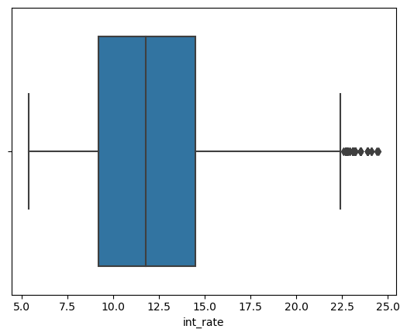
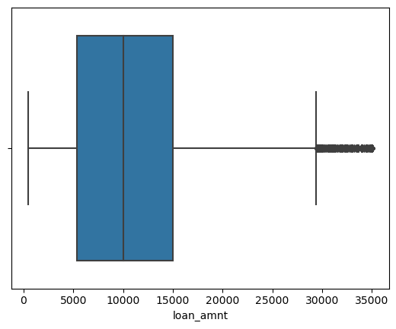
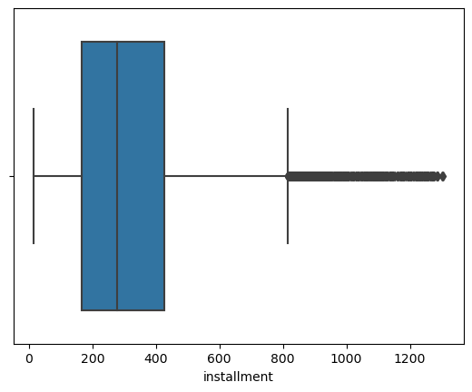
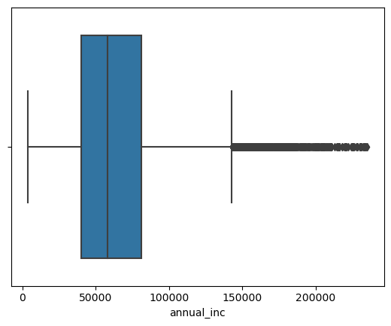
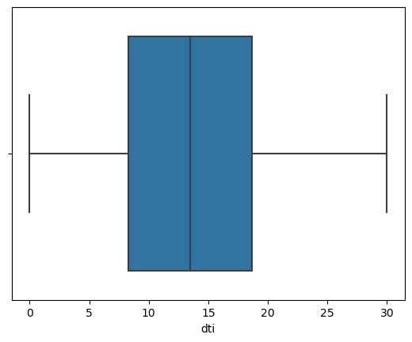
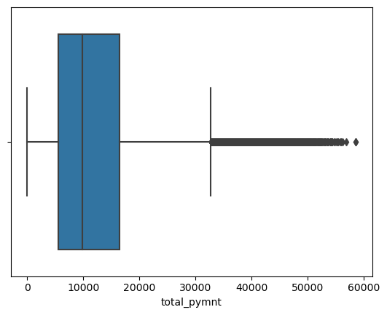
Univariate Plots

Slide 5
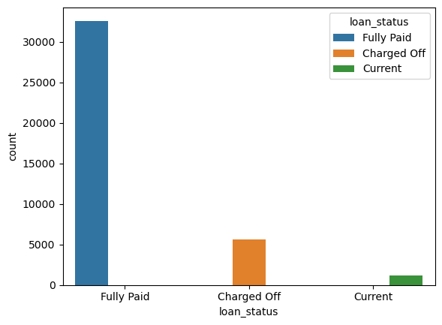
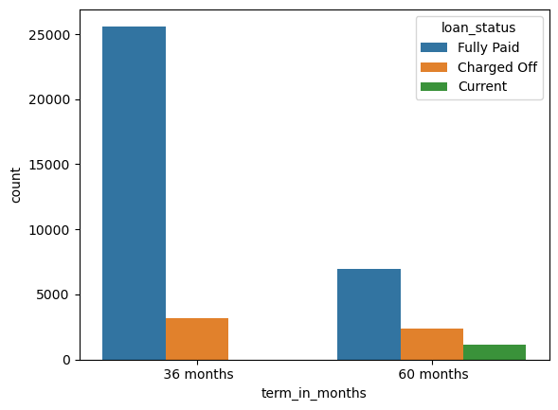
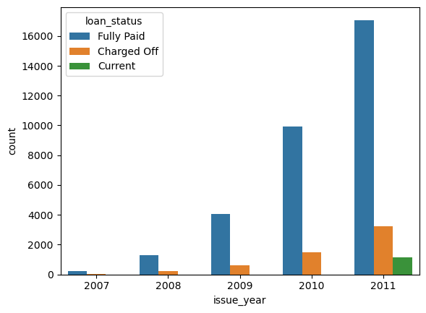
Univariate Plots

Slide 6
Bivariate Analysis
Installment and Total Payment have a very good relationship
Loan amount and Total payment have a very good relationship
Total Payment and Installment have a very good relationship
If annual income is more the charged of ratio is less
Grade F&G has very high chance of getting charged off and the ratio increase with grades moving from A to G
The Applicants who do small business has a very high chance of getting charged off.
Charged off proportion is increasing with higher interest rates
Employee whose experience is less than one year will be having a possibility to get charged off
If the derogatory public records is 1 or 2 there is a more chance of getting charged off

Slide 7
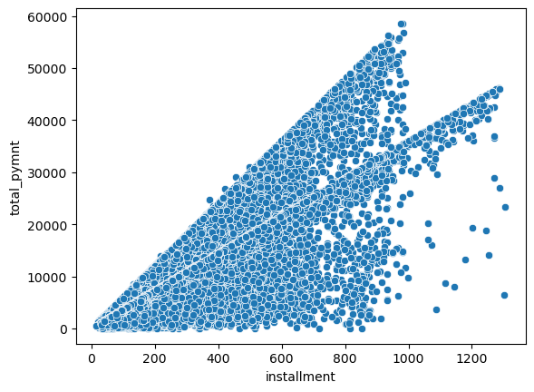
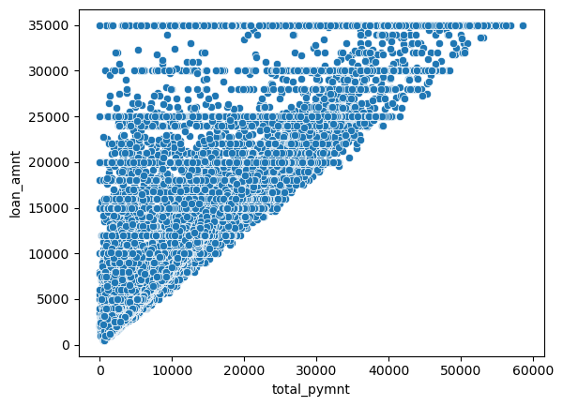
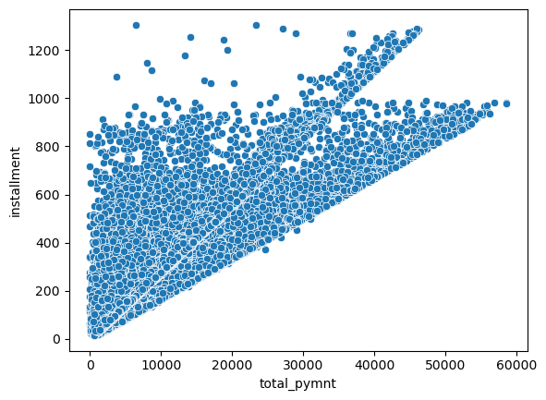
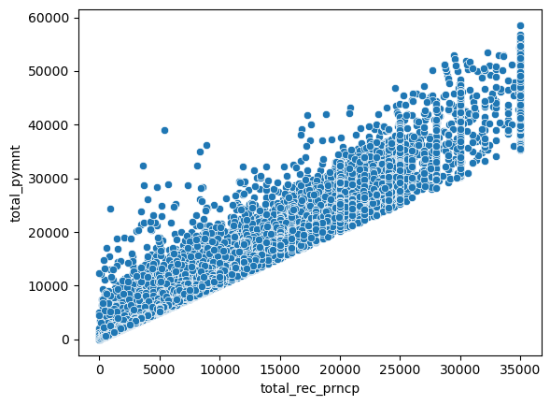
Bivariate Plots
Installment and Total Payment have a very good relationship
Loan amount and Total payment have a very good relationship
Total Payment and Installment have a very good relationship

Slide 8
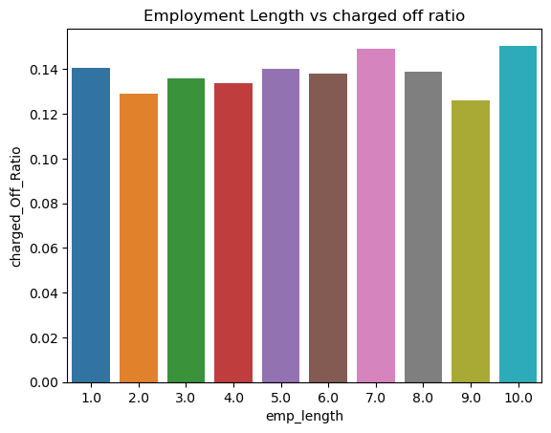
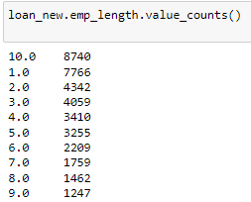
Bivariate Plots
If annual income is more the charged of ratio is less
Grade F&G has very high chance of getting charged off and the ratio increase with grades moving from A to G

Slide 9
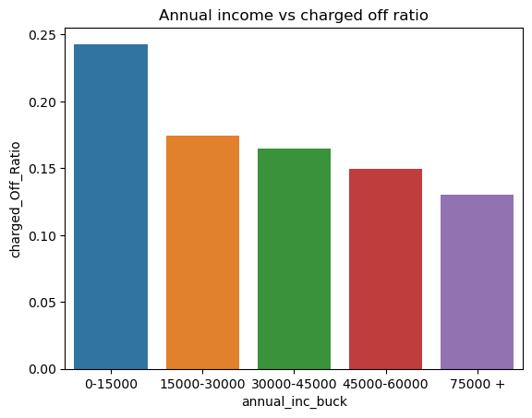
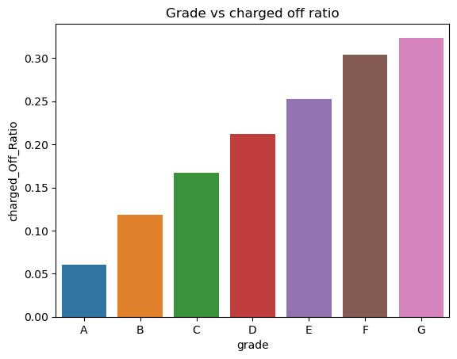
Bivariate Plots

Slide 10
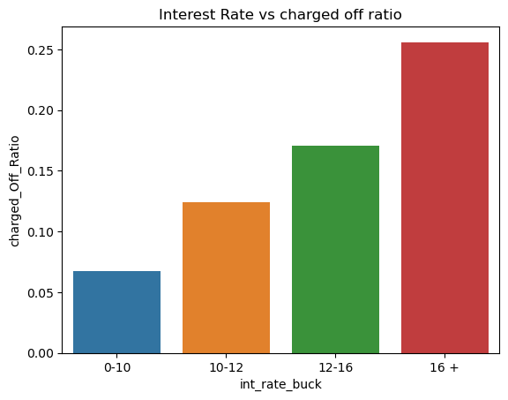
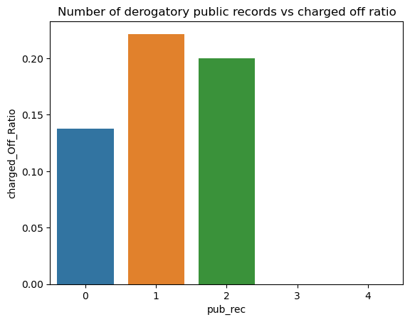
Bivariate Plots
1.Interest rates with16 and more has a greater chances of getting charged off
2. If the derogatory public records is 1 or 2 there is a more chance of getting charged off

Slide 11
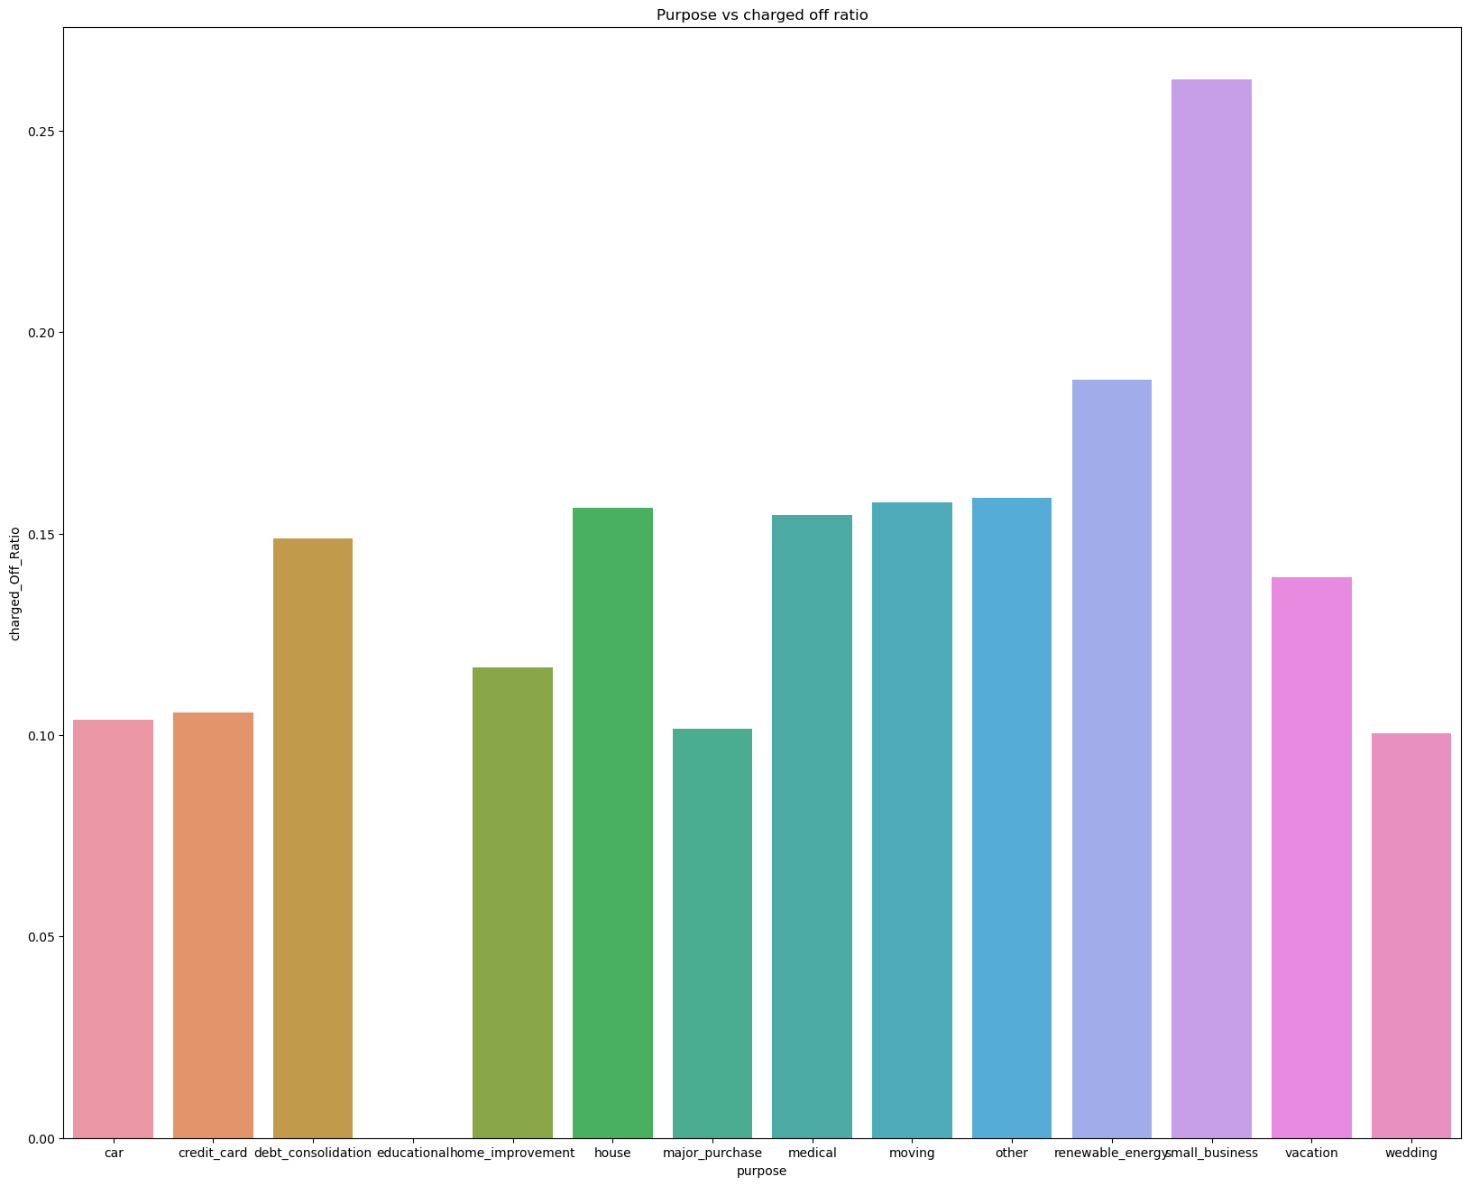
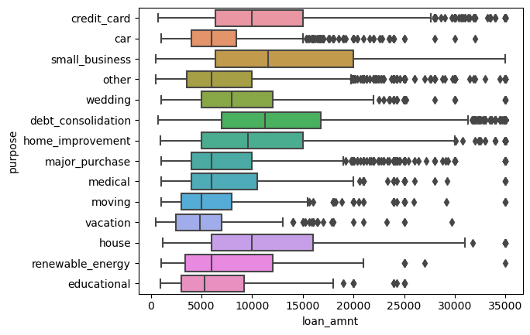
Bivariate Plots
The Applicants who do small business has a very high chance of getting charged off.

Slide 12
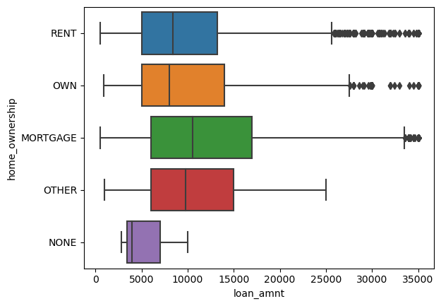
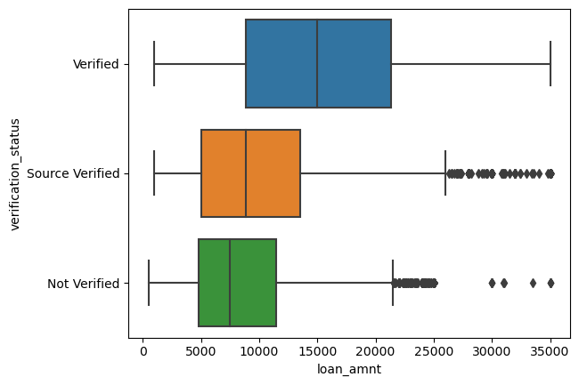
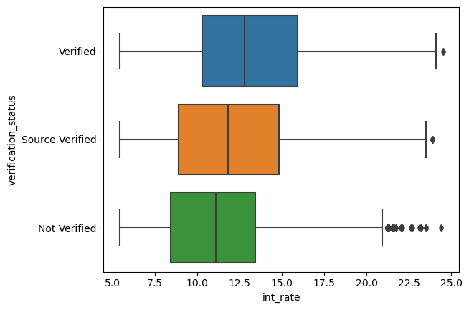
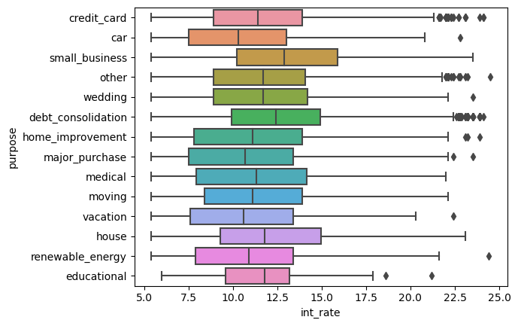
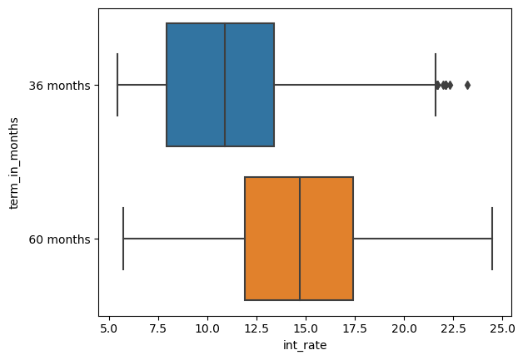
Bivariate Plots
1.Those who have Mortgage as home ownership has more loan amount
2.Those who have a verified status has more loan amount & interest rate
3.Applicant with small business & house loan has more interest rates
4.Interest rate is more for the term of 60 months.

Slide 13
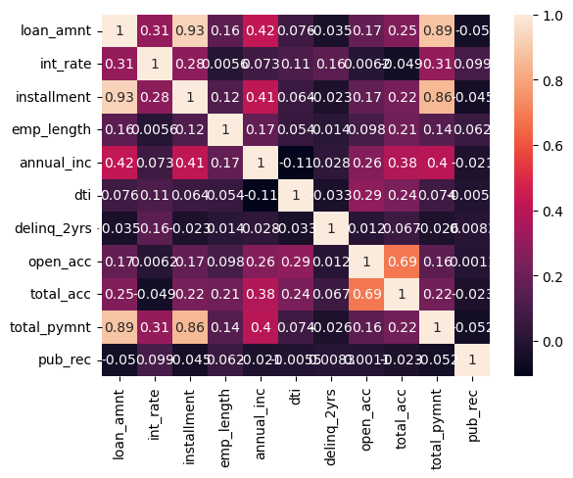
Multivariate Plots

Slide 14
Results
If annual income is more the charged of ratio is less
Grade F&G has very high chance of getting charged off and the ratio increase with grades moving from A to G
The Applicants who do small business has a very high chance of getting charged off.
Charged off proportion is increasing with higher interest rates
Employee whose experience is less than one year will be having a possibility to get charged off
If the derogatory public records is 1 or 2 there is a more chance of getting charged off

