Slide 1
Lending Club Case Study Upgrad

Slide 2
Problem Statement
Lending Club Case Study
Risk analytics in banking and financial services and understand how data is used to minimize the risk of losing money while lending various types of loans to urban customers.
Risks Involved
If the applicant is likely to repay the loan, then not approving the loan results in a loss of business to the company
If the applicant is not likely to repay the loan, i.e. he/she is likely to default, then approving the loan may lead to a financial loss for the company

Slide 3
Decisions taken by the company Based on Applicant
Loan Rejected
Loan Accepted
Fully paid: Applicant has fully paid the loan.
Current: Applicant is in the process of paying the instalments.
Charged-off: Applicant has not paid the instalments in due time for a long period of time, i.e. he/she has defaulted
Loan Rejected:
The company had rejected the loan for the candidates who does not meet the Loan Processes requirements so no data available

Slide 4
Identifying Risks of Credit loss
Using EDA To Identify the Reasons for defaulters
Identify these risky loan applicants, then such loans can be reduced thereby cutting down the amount of credit loss.
In other words, the company wants to understand the driving factors (or driver variables) behind loan default, i.e. the variables which are strong indicators of default. The company can utilize this knowledge for its portfolio and risk assessment.

Slide 5
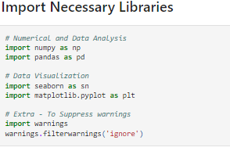
Necessary Libraries
Numerical and Data Analysis
importing numpy and pandas
Data Visualization
Importing seaborn and matplotlib.pyplot
Extra - To Suppress warnings
Warnings

Slide 6
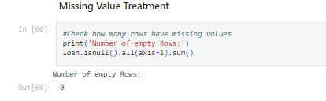
Analysis Approach
Data Handling and Cleaning
Step 1: Removing rows containing missing values
For Missing Values: Some common techniques to treat this issue are
Dropping the rows containing the missing values
Imputing the missing values
Keep the missing values if they don't affect the analysis
Step 2 :Removing rows with Incorrect Data Types
Clean certain values
Clean and convert an entire column

Slide 7
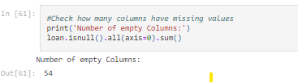
Analysis Approach
Step 3: Removing Columns with empty values(complete null)
Step 4: Checking the percentage of null values in Columns
Step 5: Dropping Columns which has more then 30% of null Values
Removing these columns will reduce impact on analysis and it will improve the accuracy of the analysis.
Analysis of columns for single valued
In this data set some columns have single value and these columns will not contribute in EDA process. So, we would need to remove those columns from the data set.
Step 1: Get All Singled Valued Columns into Array and Remove them

Slide 8
Analysis Approach
Removing the Irrelevant columns
Step1: To approve loan, we would need analyse the user details and the driving factors of the loan defaulting
Step2: We can remove these columns as these are not needed in loan analysis: "id", "member_id", "emp_title", "url","title", "zip_code", "addr_state".
Step3: Removing "funded_amnt_inv" column because it is for internal uses.
Step 4: Removing columns those are calculated after loan. So, these columns are irrelevant for analysis.

Slide 9
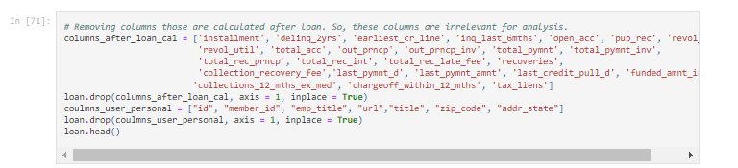
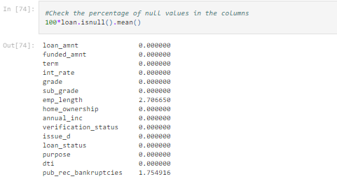
Imputing Missing Values
For numerical variables use mean and median
For categorical variables use mode

Slide 10
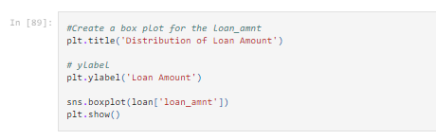
Standard Values
After Removing all null values we will get standard values for Analysis
Outliers Analysis Using Boxplot
Now we need to start identifying and removing extreme values or outliers from our dataset.
These values can tilt our analysis and often provide us with a biased perspective of the data available.
This is where we’ll start utilizing visualization to achieve our tasks. And the best visualization to use here would be the box plot. Boxplots are one of the best ways of analyzing the spread of a numeric variable.

Slide 11
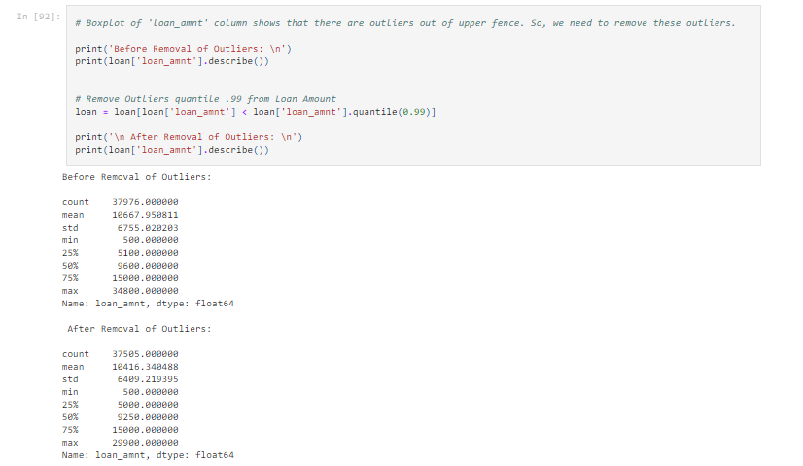
Removal of Outliner

Slide 12
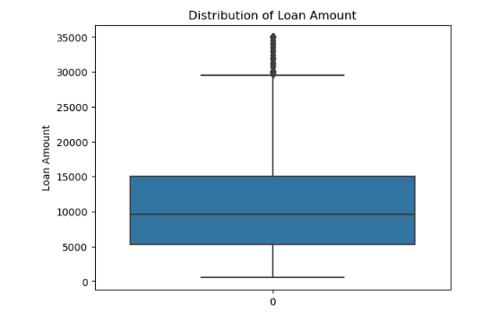
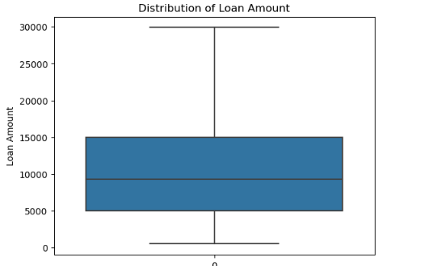
Boxplots
Boxplot of Loan-Amount with outliners
Boxplot of Loan-Amount after Removing Outliners

Slide 13
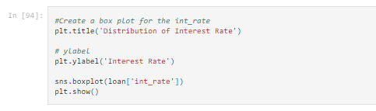
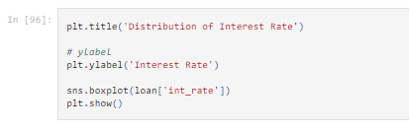
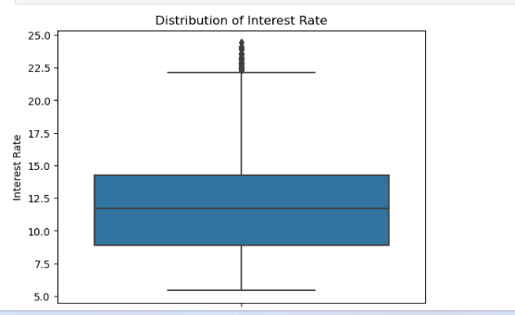
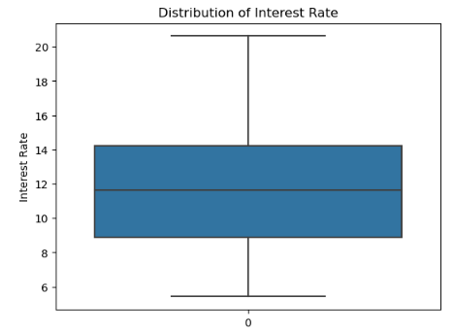
Interest Rate After Removing Outliners
Interest Rate

