Slide 1
Lending Club Case Study Upgrad

Slide 2
Problem Statement
Lending Club Case Study
Risk analytics in banking and financial services and understand how data is used to minimize the risk of losing money while lending various types of loans to urban customers.
Risks Involved
If the applicant is likely to repay the loan, then not approving the loan results in a loss of business to the company
If the applicant is not likely to repay the loan, i.e. he/she is likely to default, then approving the loan may lead to a financial loss for the company

Slide 3
Decisions taken by the company Based on Applicant
Loan Rejected
Loan Accepted
Fully paid: Applicant has fully paid the loan.
Current: Applicant is in the process of paying the instalments.
Charged-off: Applicant has not paid the instalments in due time for a long period of time, i.e. he/she has defaulted
Loan Rejected:
The company had rejected the loan for the candidates who does not meet the Loan Processes requirements so no data available

Slide 4
Identifying Risks of Credit loss
Using EDA To Identify the Reasons for defaulters
Identify these risky loan applicants, then such loans can be reduced thereby cutting down the amount of credit loss.
In other words, the company wants to understand the driving factors (or driver variables) behind loan default, i.e. the variables which are strong indicators of default. The company can utilize this knowledge for its portfolio and risk assessment.

Slide 5
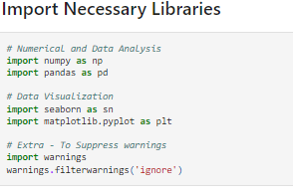
Necessary Libraries
Numerical and Data Analysis
importing numpy and pandas
Data Visualization
Importing seaborn and matplotlib.pyplot
Extra - To Suppress warnings
Warnings

Slide 6
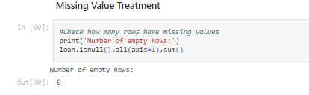
Analysis Approach
Data Handling and Cleaning
Step 1: Removing rows containing missing values
For Missing Values: Some common techniques to treat this issue are
Dropping the rows containing the missing values
Imputing the missing values
Keep the missing values if they don't affect the analysis
Step 2 :Removing rows with Incorrect Data Types
Clean certain values
Clean and convert an entire column

Slide 7
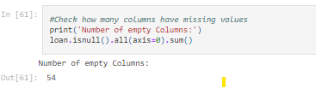
Analysis Approach
Step 3: Removing Columns with empty values(complete null)
Step 4: Checking the percentage of null values in Columns
Step 5: Dropping Columns which has more then 30% of null Values
Removing these columns will reduce impact on analysis and it will improve the accuracy of the analysis.
Analysis of columns for single valued
In this data set some columns have single value and these columns will not contribute in EDA process. So, we would need to remove those columns from the data set.
Step 1: Get All Singled Valued Columns into Array and Remove them

Slide 8
Analysis Approach
Removing the Irrelevant columns
Step1: To approve loan, we would need analyse the user details and the driving factors of the loan defaulting
Step2: We can remove these columns as these are not needed in loan analysis: "id", "member_id", "emp_title", "url","title", "zip_code", "addr_state".
Step3: Removing "funded_amnt_inv" column because it is for internal uses.
Step 4: Removing columns those are calculated after loan. So, these columns are irrelevant for analysis.

Slide 9
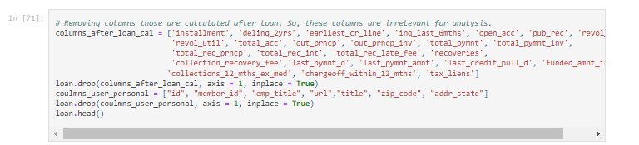
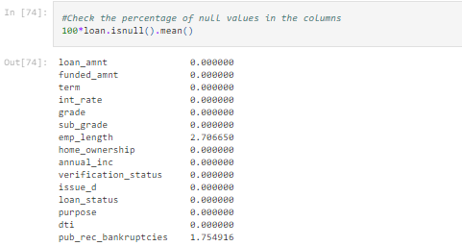
Analysis Approach
Imputing Missing Values
For numerical variables use mean and median
For categorical variables use mode

Slide 10
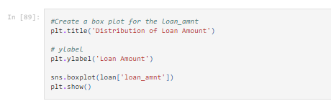
Standard Values
After Removing all null values we will get standard values for Analysis
Outliers Analysis Using Boxplot
Now we need to start identifying and removing extreme values or outliers from our dataset.
These values can tilt our analysis and often provide us with a biased perspective of the data available.
This is where we’ll start utilizing visualization to achieve our tasks. And the best visualization to use here would be the box plot. Boxplots are one of the best ways of analyzing the spread of a numeric variable.

Slide 11
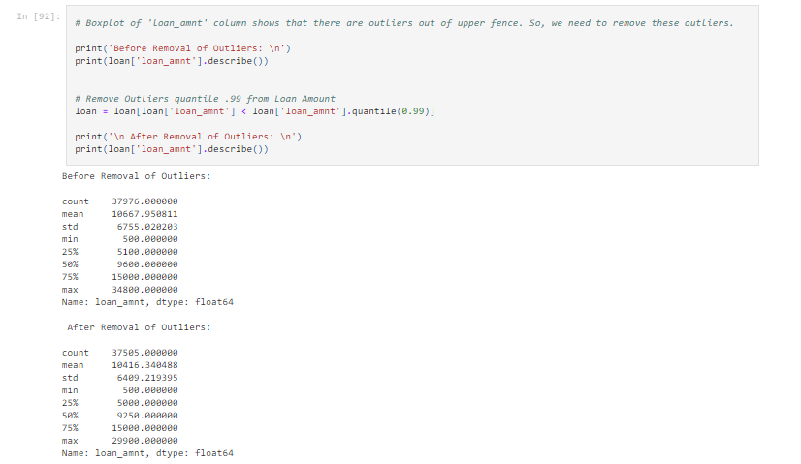
Removal of Outliner

Slide 12
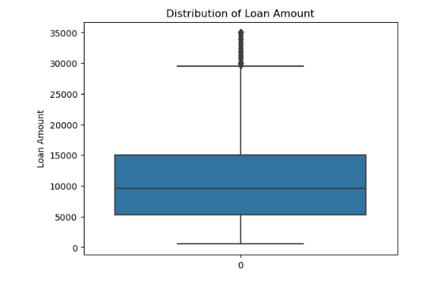
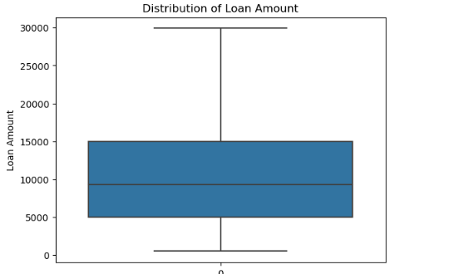
Boxplots
Boxplot of Loan-Amount with outliners
Boxplot of Loan-Amount after Removing Outliners

Slide 13
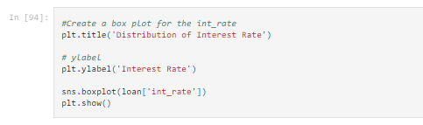
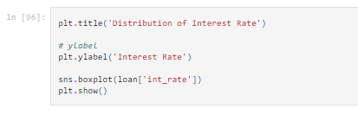
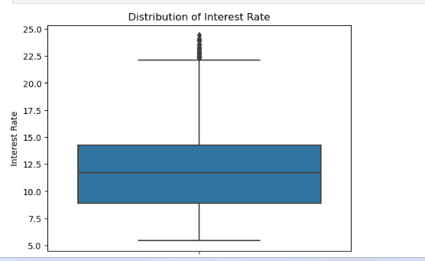
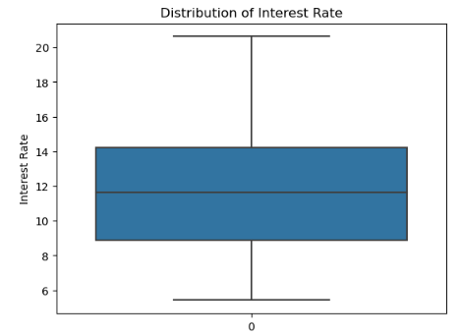
Interest Rate
Interest Rate
Interest Rate After Removing Outliners

Slide 14
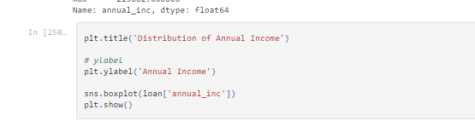
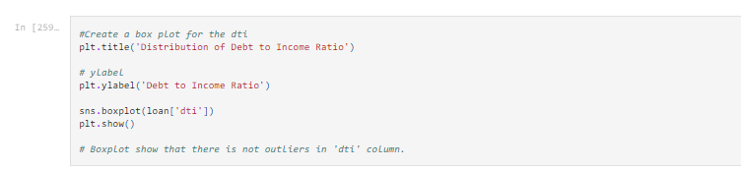
Distribution of Annual income
Distribution of Annual Income
Distribution of Debt to Income Ratio

Slide 15
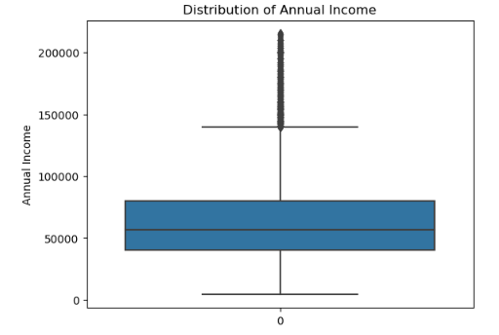
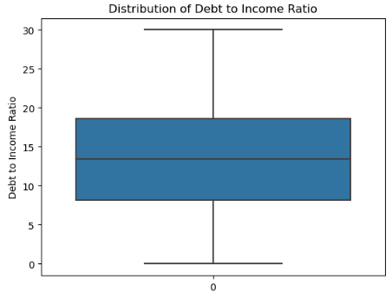
Distribution of Annual income
Distribution of Annual Income
Distribution of Debt to Income Ratio

Slide 16
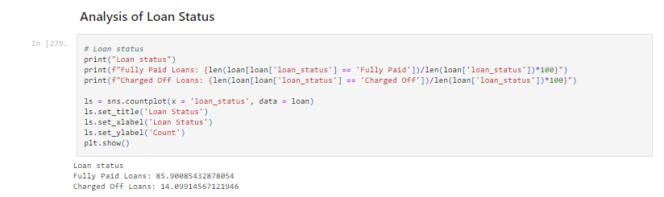
Univariate Analysis
Analysis of Loan Status shows:
Fully Paid Loans: 85.90085432878054
Charged Off Loans: 14.09914567121946

Slide 17
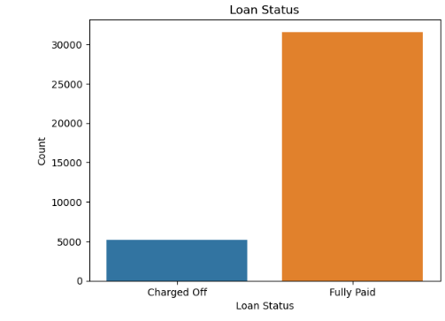
Univariate of Loan Status
Analysis shows that 85.90 % loans are fully paid and 14.09 % loans are charged off. It means defaulted loans are lower than fully paid loans

Slide 18
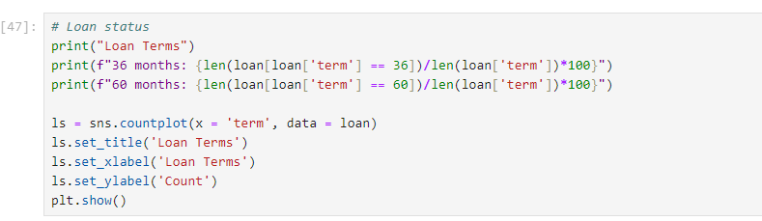
Analysis Of Loan Terms
Loan Tenure
36 month : 76.8726314940737
60 months : 23.127368505926306

Slide 19
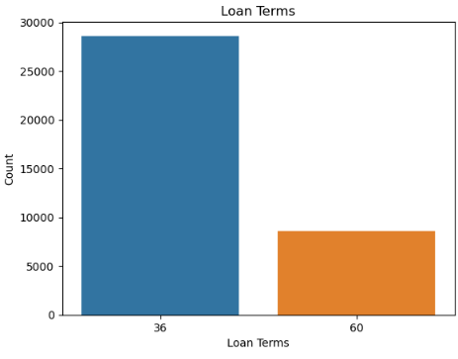
Analysis Of Loan Terms
Analysis shows that 77.45 % loan terms are 36 months and 22.54 % loan terms are 60 months. It means people taking shorter loans than long duration loans.

Slide 20
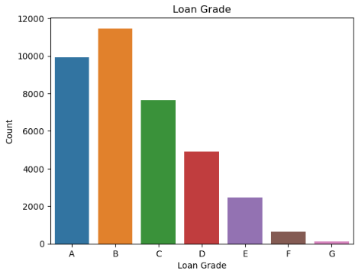
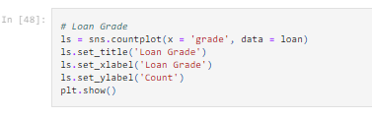
Analysis of Loan Grade

Slide 21
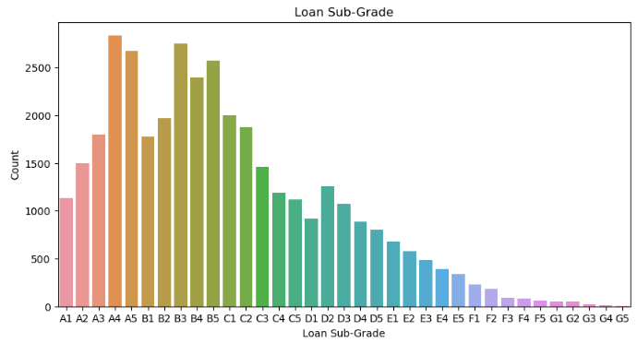
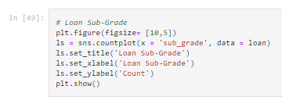
Loan Sub-Grade

Slide 22
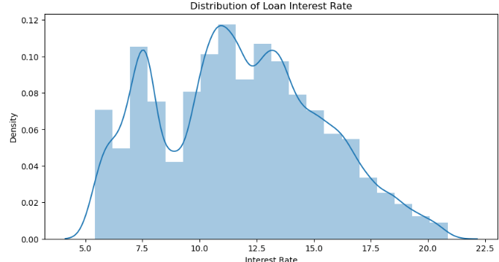
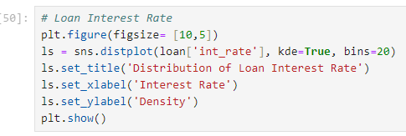
Analysis of Loan Interest Rate

Slide 23
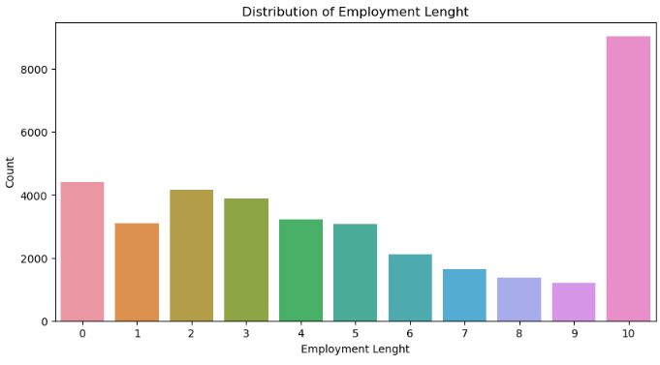
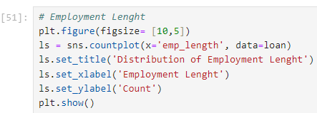
Analysis of Employment Length
Analysis of Employment Length shows that People are mostly belongs to 10 years of employment. It shows that these people are most capable to take loans.

Slide 24
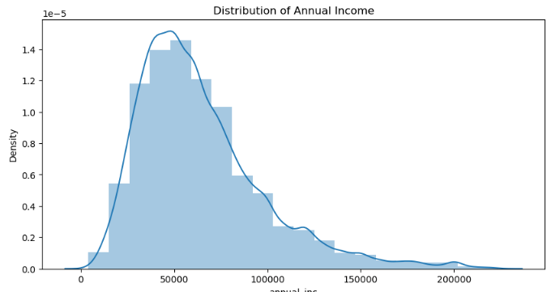
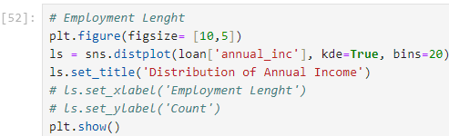
Analysis of Annual Income
Analysis of Annual Income shows that loans are taken by mostly lower income group people. It is showing left skew distribution in the graph.

Slide 25
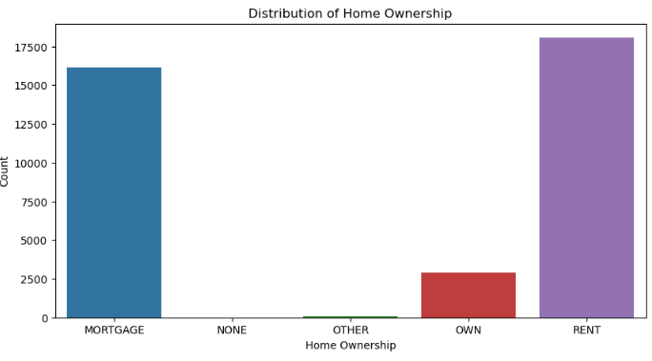
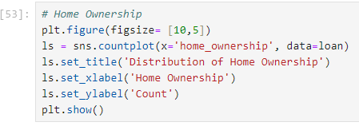
Analysis of Home Ownership
Analysis of Home Ownership: Most of the people don't own Home, They are on Mortgage or Rent.

Slide 26
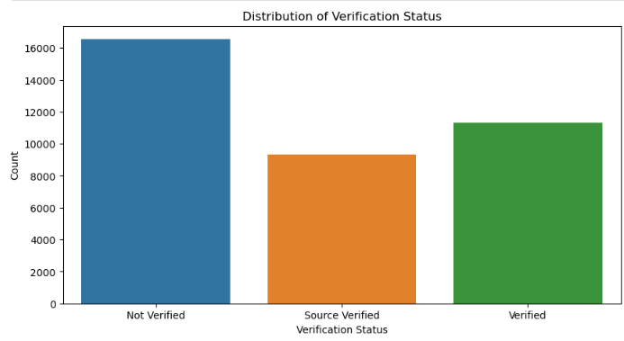
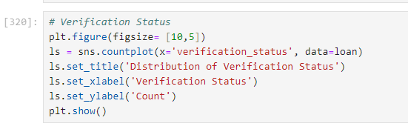
Analysis of Verification Status
Analysis of Verification Status: 50 % of people are verified by lending company or source verified.

Slide 27
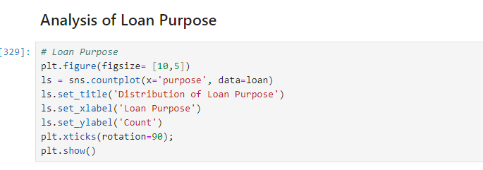
Analysis of Loan Purpose

Slide 28
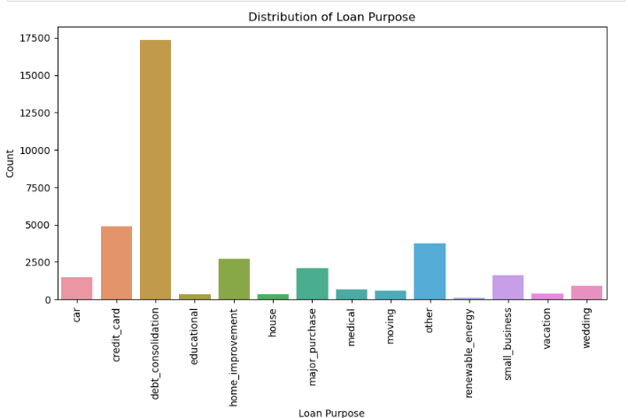
Analysis of Loan Purpose
Analysis of Loan Purpose: Most of people are taking loan for either credit card and debt consolidation.

Slide 29
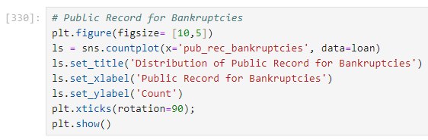
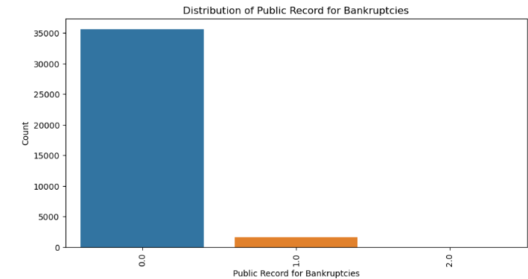
Analysis of Public Record for Bankruptcies
Analysis of Public Record for Bankruptcies: Majority of the people don't have any public record for Bankruptcy.

Slide 30
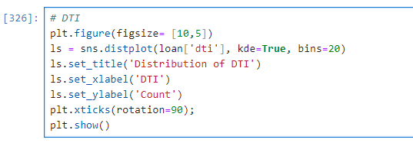
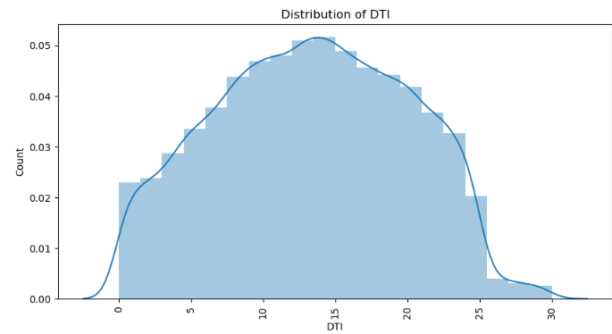
Analysis of DTI
Analysis of DTI Ratio: Majority of the people have very large debt compared to their income. Mostly having 8 to 22 DTI ratio.

Slide 31
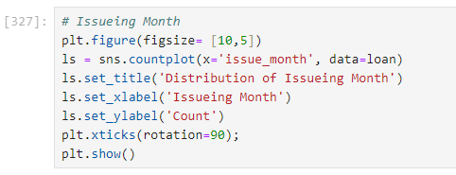
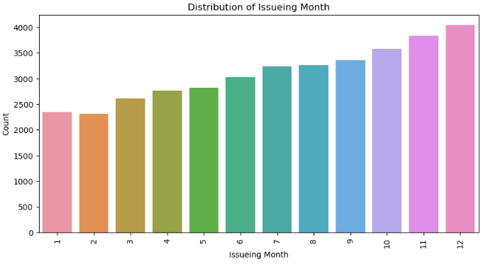
Analysis of Issuing Month
Analysis of Issuing Month: It is showing that loan count is increasing towards year ends. As year progress, loan counts increase in every month compare to last month.

Slide 32
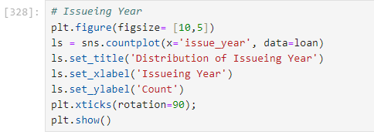
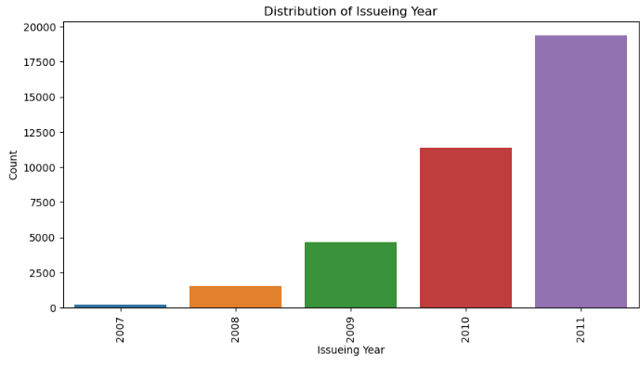
Analysis of Issuing Year
Analysis of Issuing Year: It is showing that loan approval increasing exponential rate. Increasing every year compare to previous year.

Slide 33
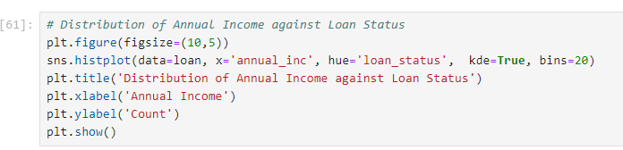
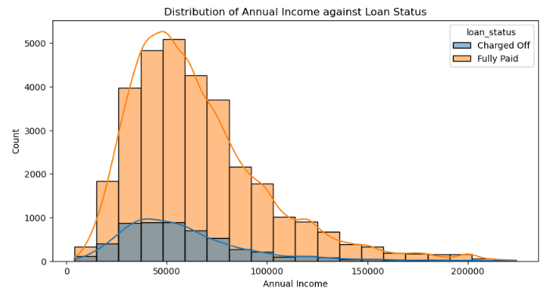
Bivariate Analysis
To find relationship between two sets of values.
Analysis of Annual Income against Loan Status: Income group having income 50000 and less are more likely to default than higher income groups.

Slide 34
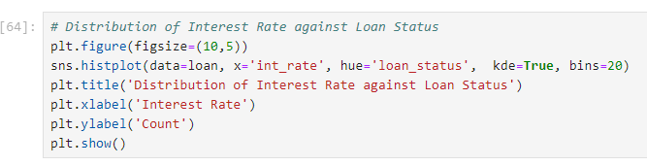
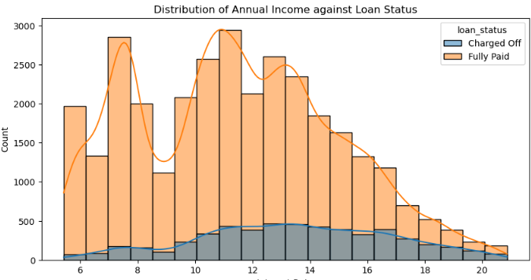
Bivariate Analysis of Interest Rate against Loan Status
Analysis of Interest Rate against Loan Status: As Interest Rate of loan increases default ratio for loans is also increasing.

Slide 35
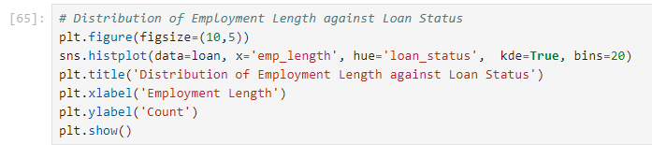

Bivariate Analysis of Employment Length against Loan Status
Analysis of Employment Length against Loan Status: The employees having 10+ years of experience are less likely to default and higher chance to fully paid the loans.

Slide 36


Bivariate Analysis of DTI against Grade on Loan Status

Slide 37


Bivariate Analysis of DTI against Grade on Loan Status

Slide 38


Bivariate Analysis of Loan Amount against Loan Status
Analysis of Loan Amount against Loan Status: Fully Paid and Charged Off are almost same for 25% but Charged Off is getting higher after 50% and above than Fully Paid. It means higher the loan amount higher chances of getting defaulted.

Slide 39


Bivariate Analysis of Home Ownership against Loan Amount on Loan Status
Analysis of Home Ownership against Loan Amount on Loan Status: People are making defaulter with Loan amount 10000 and less with None Home ownership. So, Bank should avoid giving loan these people.

Slide 40


Bivariate Analysis of Terms against Loan Amount on Loan Status
Analysis of Terms against Loan Amount on Loan Status: There is no significant difference in terms with loan amount on loan status.

Slide 41


Bivariate Analysis of Loan Purpose against Loan Amount on Loan Status

Slide 42


Heat map correlation between variables of loan dataset.

Slide 43
THANK YOU !!

