Slide 1
ONESTOP CODING DASHBOARD
BATCH-11
121810311001
121810311036
121810311044
121810311049
GUIDE : S. N. V. Jitendra M

Slide 2
CONTENTS
Abstract
Problem Statement and Objectives
Features
Mathematical Equation
System Methodology
Technologies Used
Results
Future scope
Conclusion

Slide 3
ABSTRACT
This website creates users’ coding portfolios and provides user activity which includes his/her no of problems solved in a day. By taking scores from different coding websites, we create the overall score and provide the leaderboard with global ranking and institute ranking which makes user to analyze where his/her position is. The website also shows the daily activity status. Using web scraping we are retrieving data from websites and used JSOUP API for web scraping

Slide 4
PROBLEM STATEMENT
Users can have an account on different coding platforms and each website has coding scores and contest ratings. But it became difficult to analyze the overall coding scores.
There will be various contests held on various platforms like Codechef, HackerEarth, Codeforces, etc. It’s quite difficult to navigate to each and every individual website and check which contest is being held when.

Slide 5
OBJECTIVE
Our objective is to make a single platform by integrating all five platforms (Codechef, Codeforces, HackerEarth, GFG, InterviewBit) so that
User can view all his/her scores at one place
User can have overall score and leaderboard
Can check which contest is held at which platform
Can check user activity

Slide 6
FEATURES
Overall Dashboard
Contests
Leaderboard
User Activity

Slide 7
Overall Dashboard: In this webpage we can see different scores of a user from different coding platforms and an overall calculated score will be displayed.
Contests: In this webpage we can view upcoming contest conducted by different platforms
Leaderboard: For every user, global rank will be given according to this overall score so that he/she can estimate his/her position.

Slide 8
User Activity: User can view his/her daily activity status like
How much overall score did he/she improve
How much score he/she improved in each platform

Slide 9


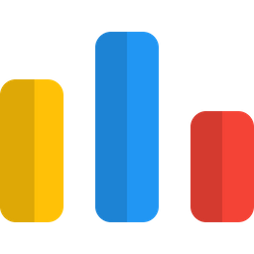

CODING PLATEFORMS
CODECHEF
CODEFORCES
INTERVIEWBIT
GEEKSFORGEEKS

Slide 10
MATHEMATICAL EQUATION
OVERALL SCORE = (CCPS*10 +(CCR-1300)^2/30) +
(CFPS*10 +(CFR-1200)^2/30) +
(IBS/3) + (GFG*10)
Where CCPS = Codechef problems solved
CCR = Codechef rating
CFPS = Codeforces problems solved
CFR = Codeforces rating
IBS = InterviewBit score
GFG = GeeksforGeeks solved problems

Slide 11
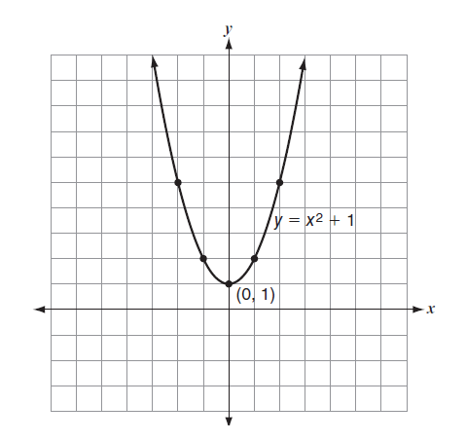
.
For example, Codechef Score = CCPS*10 +(CCR-1300) ^2/30)
That means the equation is in the form of y = x^2 + c where y stands for CodeChef score and x stands for rating and c stands for problems solved in the platform. Here the rate of increase in score mostly depended on the contest rating of a platform. The score increases drastically as the rating increases similar to a quadratic equation graph shown below

Slide 12
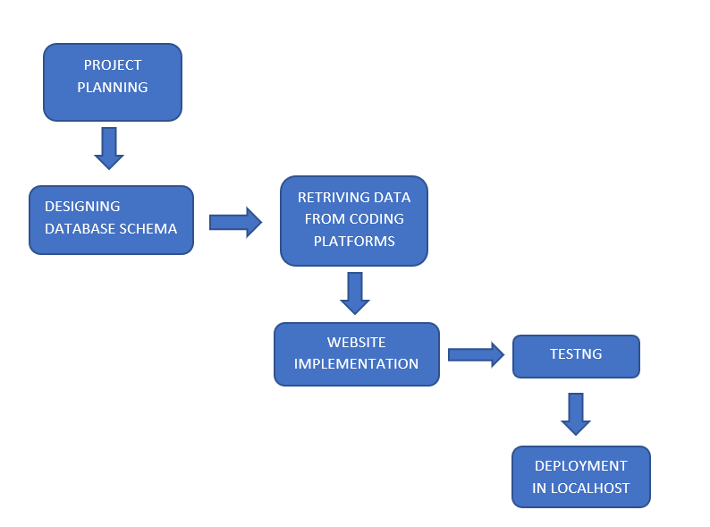
SYSTEM METHODOLOGY

Slide 13
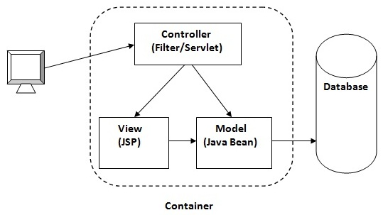
ARCHITECTURE

Slide 14
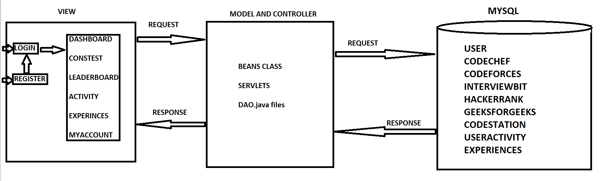
WORKFLOW

Slide 15
TECHNOLOGIES USED
FRONTEND - HTML, CSS, BOOTSTRAP 4
BACKEND – SERVLETS, JSP
DATABASE – MYSQL 8.0
API – JSOUP 1.14.3
SERVER – TOMCAT 9

Slide 16
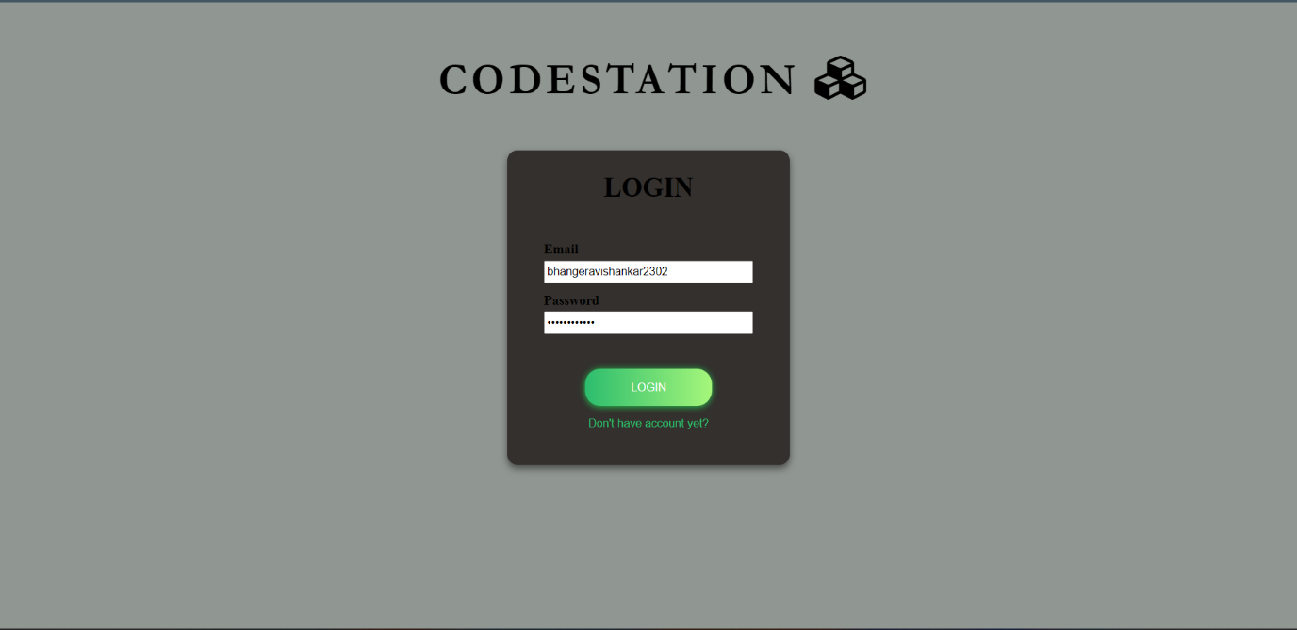
RESULTS

Slide 17
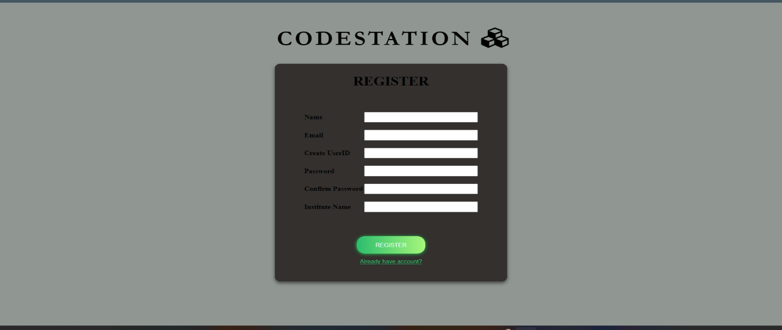
.

Slide 18
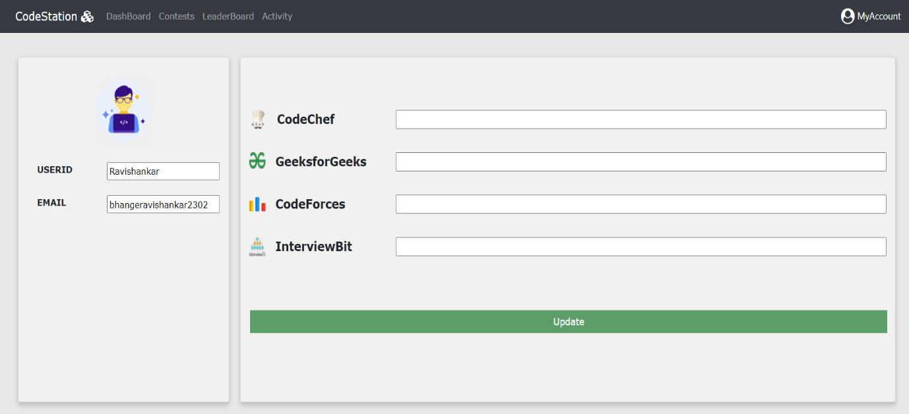

Slide 19
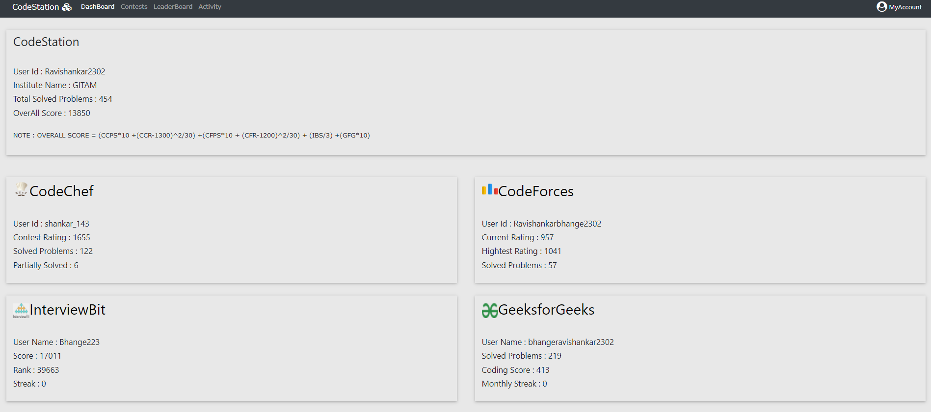

Slide 20
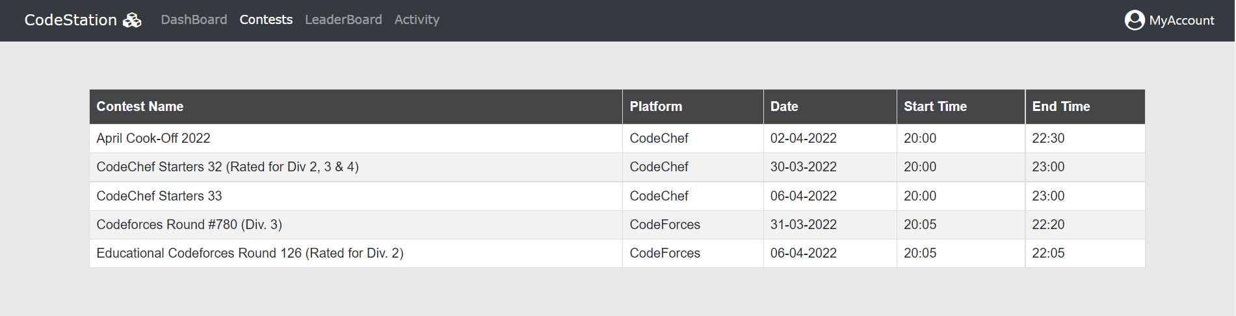

Slide 21
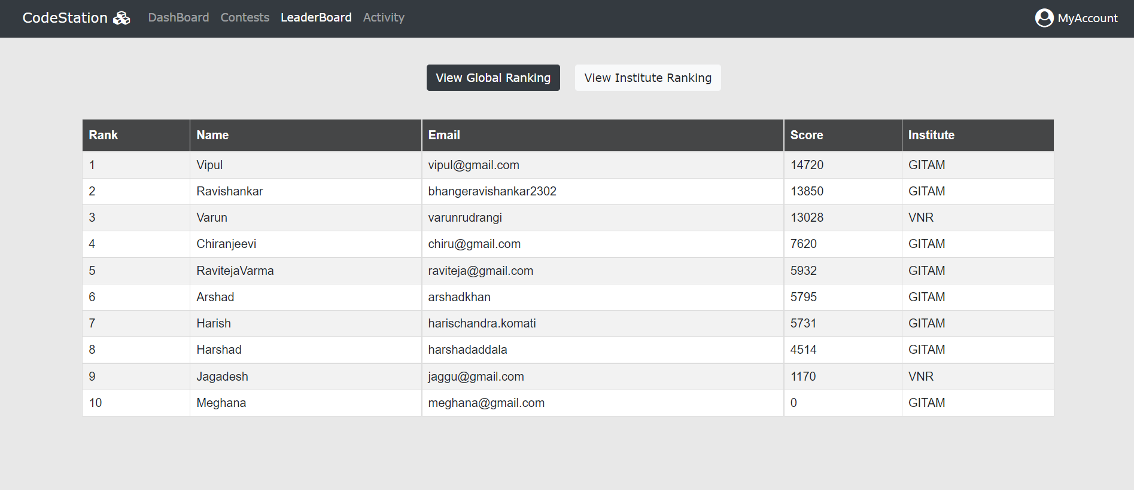

Slide 22
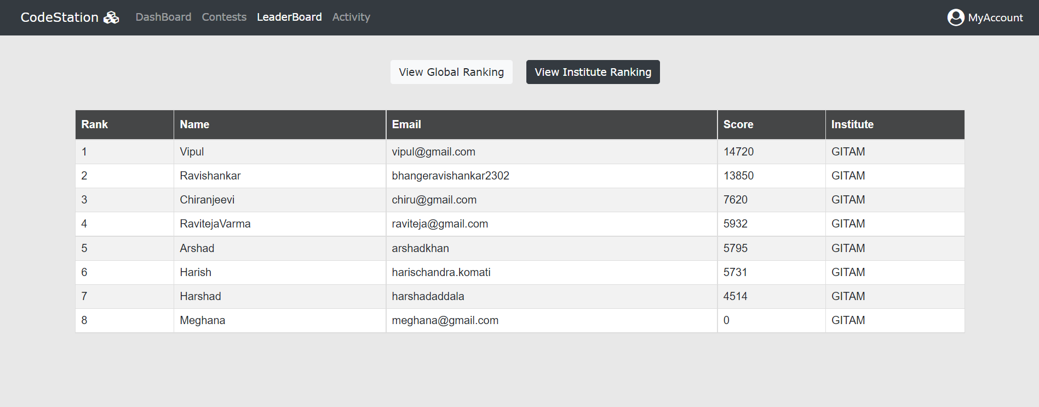

Slide 23
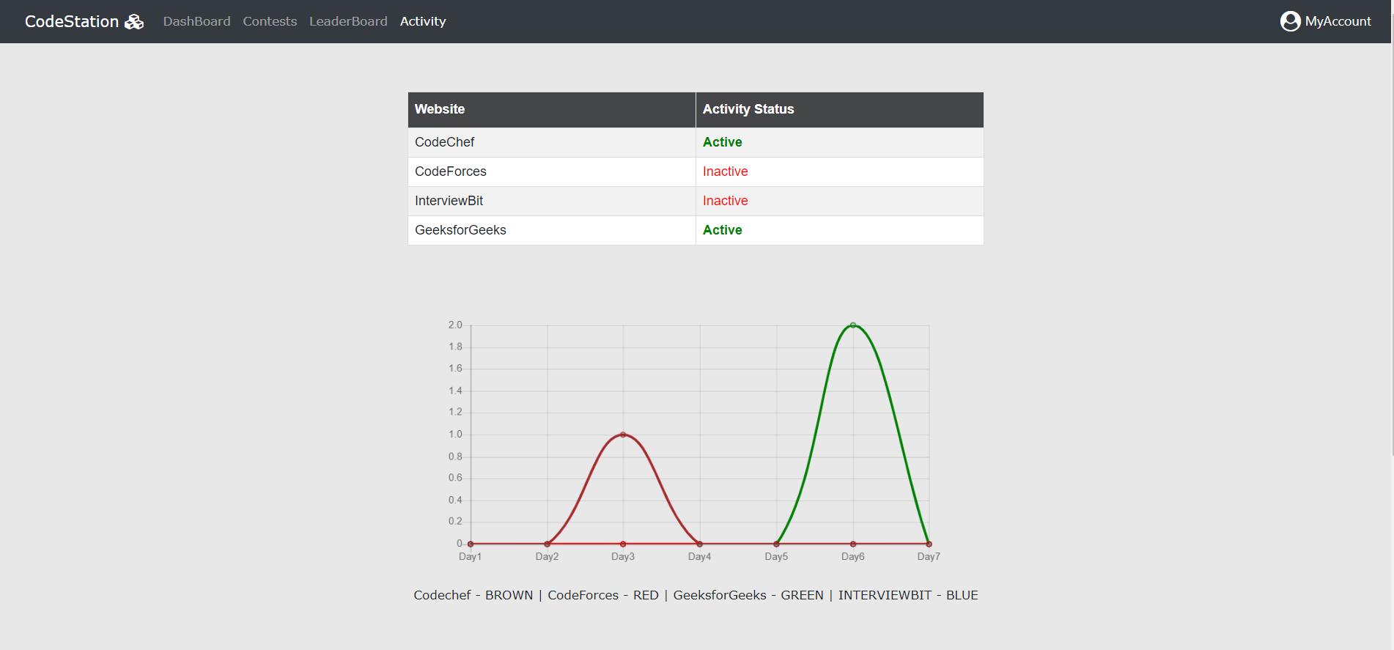

Slide 24
FUTURE SCOPE
This project can be extended by increasing the number of platforms and adding some more features like topic recommendations based on the type of problems solved in each platform. If this idea has been implemented then it will be very helpful to check on which topics they should concentrate and they can see how many problems they have solved on each topic. This can be implemented by problem tags in which each problem will be tagged with some topics. We can also add features like follow/following so that they can follow their friends to check their profiles easily. With this, we can also add one more leaderboard among friends for each user so that they can actively check their position among their friends.

Slide 25
CONCLUSION
As we have gone through different modules in the project we can say that this website will be very helpful for students who are willing to improve their skills sets in competitive programming. In this website, we have seen four platforms with ratings and scores of a user. Activity will be tracked every 24 hours. This website can be made more graphical interface by adding graphs and some other way of representation. Students are highly recommended to utilize this platform to track their performance.

Slide 26


