Slide 1
Pizza Sales Report
By using MySQL queries

Slide 2
Pizza Sales Report

Slide 3
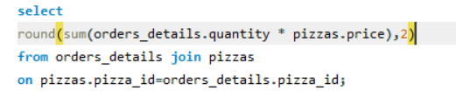
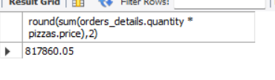
1.Retrieve the total number of orders placed.
MySQL Query:
Output:

Slide 4
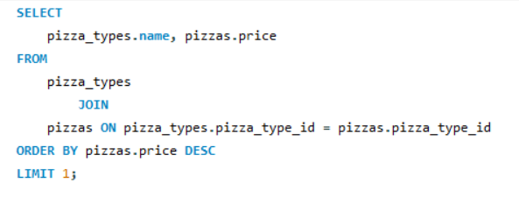

2. Identify the highest-priced pizza.
MySQL Query:
Output:

Slide 5
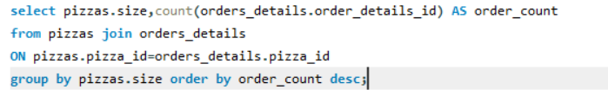
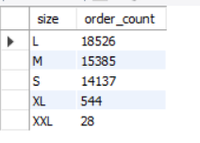
3.Identify the most common pizza size ordered.
MySQL Query:
Output:

Slide 6
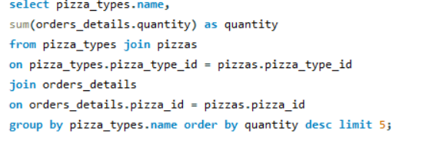
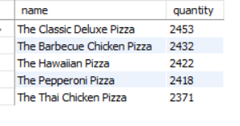
4.List the top 5 most ordered pizza types along with their quantities.
MySQL Query:
Output:

Slide 7
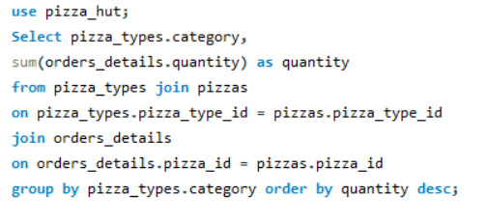
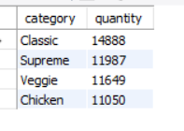
5.Join the necessary tables to find the total quantity of each pizza category ordered.
MySQL Query:
Output:

Slide 8
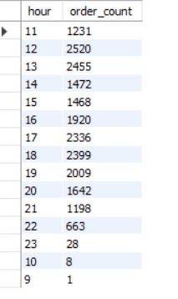
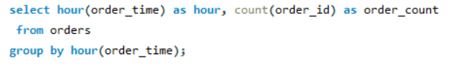
6.Determine the distribution of orders by hour of the day.
MySQL Query: Output:

Slide 9
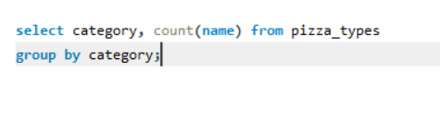
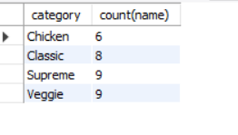
7.Join relevant tables to find the category-wise distribution of pizzas.
MySQL Query:
Output:

Slide 10
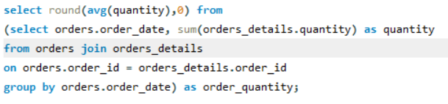
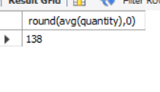
8.Group the orders by date and calculate the average number of pizzas ordered per day.
MySQL Query:
Output:

Slide 11
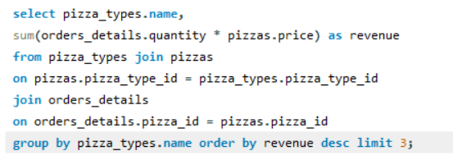
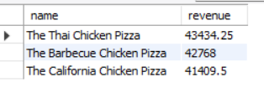
9.Determine the top 3 most ordered pizza types based on revenue.
MySQL Query:
Output:

Slide 12
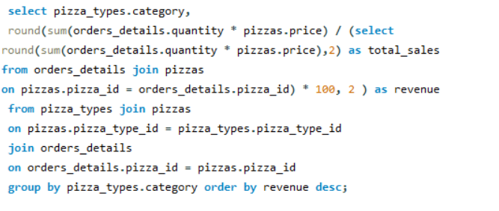
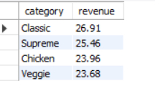
10.Calculate the percentage contribution of each pizza type to total revenue.
MySQL Query:
Output:

Slide 13
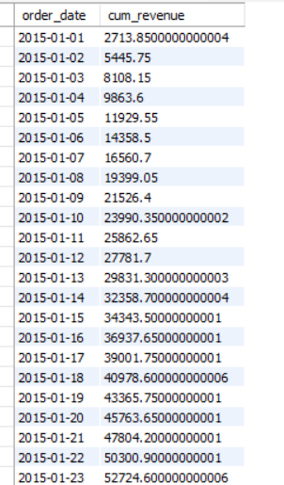
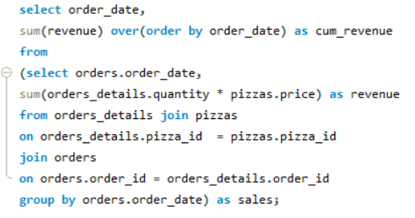
11.Analyze the cumulative revenue generated over time.
MySQL Query: Output:

Slide 14
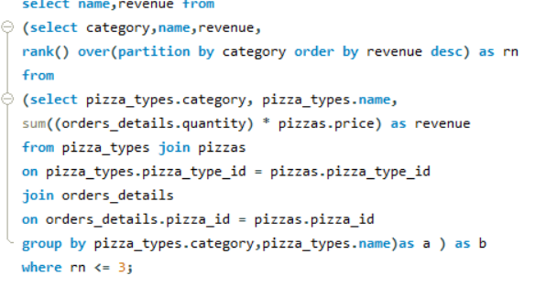
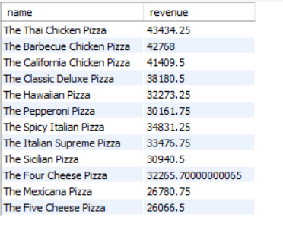
12.Determine the top 3 most ordered pizza types based on revenue for each pizza category.
MySQL Query: Output:

