Slide 1
Using Machine Cycles for Good and Bad
Ravishka Rathnasuriya Midwestern State University, Texas

Slide 2



Slide 3
Introduction
Cache Memory
Read Time Stamp Counter and Processor
How Prefetching and Machine Cycles Affects
Spectre and Meltdown

Slide 4
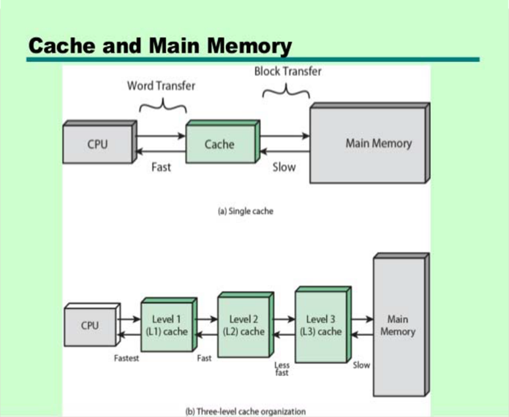
Cache Memory

Slide 5
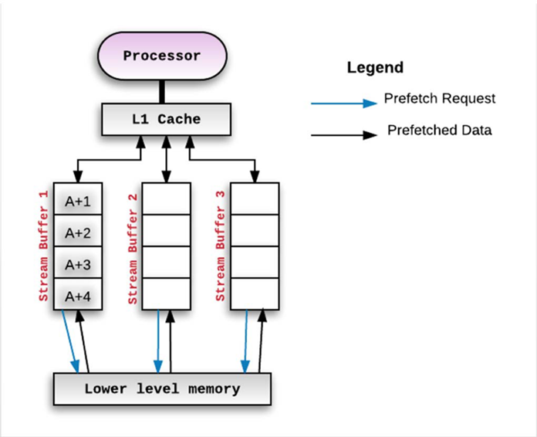
Cache Prefetching

Slide 6
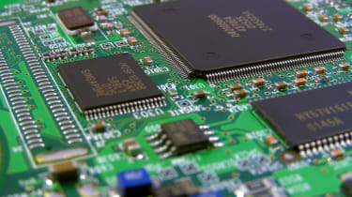
Terminology
Branch Prediction
Pipelining
Speculative Execution
Machine Cycles

Slide 7
Read Time Stamp Counter and Processor(RDTSC)
#include <intrin.h>
auto time1 = __rdtsc(); //do something auto time2 = __rdtsc(); auto interval = time2-time1;
An assembly instruction that, at the same time, reads the timestamp register and the CPU identifier.

Slide 8
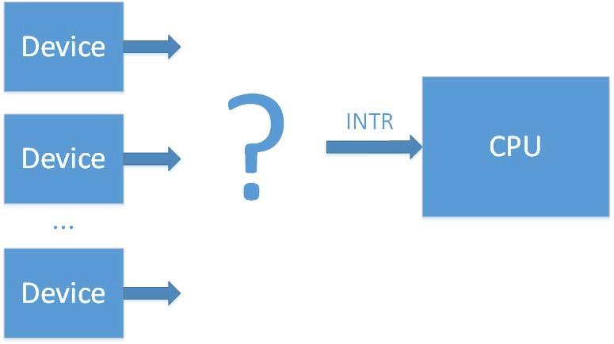
System Interrupts
CPU pauses program and gives processing time to other devices
Cause extreme delay.

Slide 9
How Prefetching Affects Storage

Slide 10
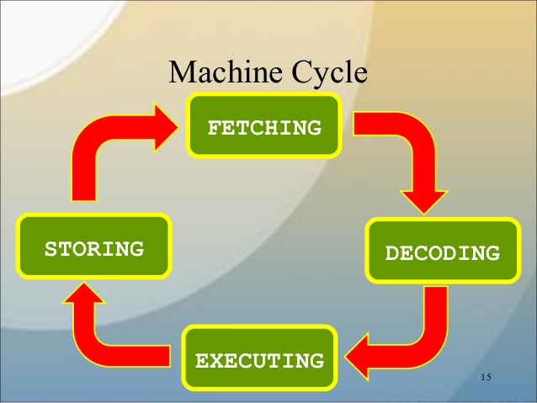
How Machine Cycles Affects the Programs
Using machine cycles for 2 purposes:
Positive ways
Negative ways

Slide 11

Spectre And Meltdown

Slide 12
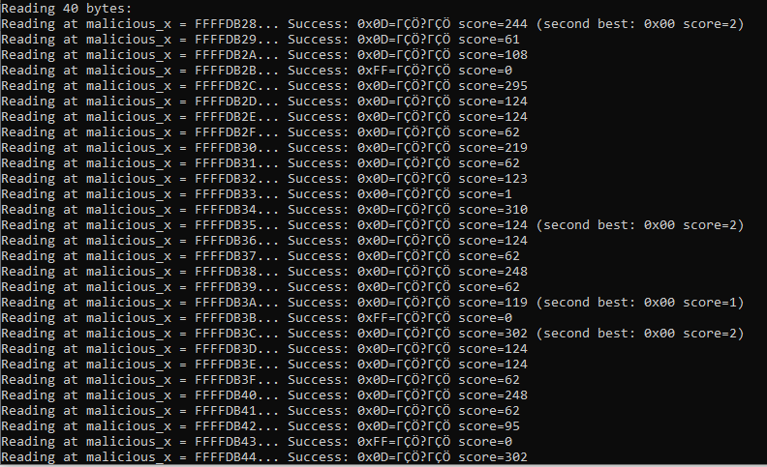
Final Results for Spectre and Meltdown

Slide 13
Final Results for Good Purposes

Slide 14
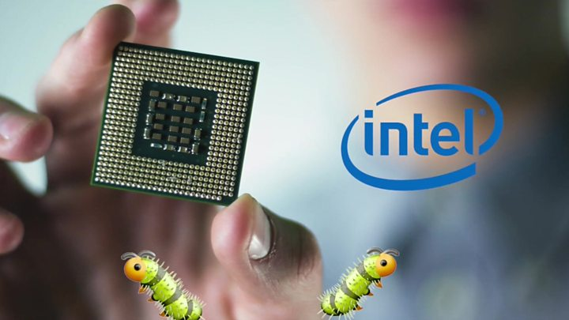
Summary
The cache memory can be used in a good way as well as it can be used to hack a computer system.

Slide 15
Acknowledgement
Dr. Nelson Passos
Dr. Ranette Halverson
Department of Computer Science
https://github.com/Ravishka123/Architecture/tree/master/Meltdown
Paoloni, Gabriele.“How to Benchmark Code Execution Times on Intel IA-32 and IA-Instruction Set Architectures.” 2010.
Kocher, Paul, Horn, Jann, et al. “Spectre Attacks: Exploiting Speculative Execution.” 2019 IEEE Symposium on Security and Privacy (SP), 2019, doi:10.1109/sp.2019.00002.
Lipp, Mortiz, Schwarz, Michael, et al. “Meltdown: Reading Kernel Memory from User Space.” 27th USENIX Security Symposium, 2018

