Slide 1
KAKATIYA UNIVERSITY
Modelling and analysis of wireless Electric Vehicle charging system with solar energy
BY:
A. Raviteja
P. Yashwanth Sai
L. Yashasri
B. Mrudhula
Md. Kaleemuddin

Slide 2
INTRODUCTION
Surge in Electric Vehicles (EVs) driven by the need for eco-friendly transportation.
Energy and environmental concerns are on the rise.
Need to develop electric vehicles (EVs) for energy savings and reduced air pollution.
Charging for EVs is a current research focus around the world.

Slide 3
Challenges with Current EV Charging
Advantages of Wireless Charging for EVs
Eliminates issues like charging cable exposure.
Offers convenience, safety, and reliability.
Overcomes challenges associated with current EV charging methods.
Existing EVs use charging cables and plugs.
Direct contact charging process requires artificial operations on outlets.
Lower flexibility in EVs charging.
Potential dangers of electric leakage, shocks, sparks, and erosion wear.

Slide 4
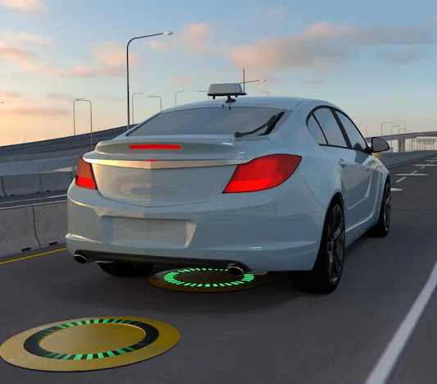
ROAD INTEGRATED WIRELESS CHARGING SYSTEM
This EV charging system benefits us with:
Wireless charging of vehicles without any wires.
No need to stop for charging as the vehicle charges while moving.
Solar power for keeping the charging system going.
No external power supply is needed.
Coils integrated with the road to avoid wear and tear.

Slide 5
In parking applications, the wireless charging system can operate continuously as your system charges, providing equivalent performance as a comparable plug-charge system.
In low-speed city applications, around 35 mph, the system provides approximately 3x as much charge as an average EV will draw, so every mile you drive on DWPT(Dynamic wireless power Transfer) will add 3 miles to your battery.
In high-speed interstate applications, around 70 mph, the system provides approximately 1.5x as much charge as your EV will draw.

Slide 6
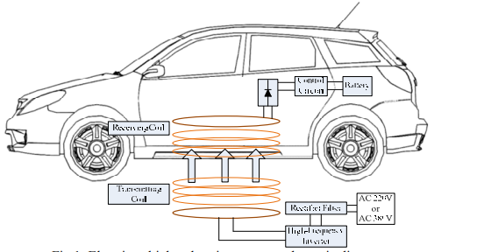
Control Circuit
Battery
Receiving Coil
Transmitting coil
Rectifier Filter
Battery
High frequency Inverter
Electric Vehicle charging system Schematic diagram

Slide 7
COMPONENTS
ATMEGA Controller
Battery
Voltage Sensor
LCD Display
Transformer
Regulator Circuitry
Transmitter and Receiver Coils

Slide 8
BLOCK DIAGRAM
LCD Display
ATMEGA Controller
Regulatory Circuit
Transformer
Transmitter Coil
Receiver Coil
AC to DC Converter
Battery
Solar Panel

Slide 9
ATMEGA CONTROLLER
8-bit AVR RISC-based microcontroller
Execute powerful instructions in a single clock cycle
High performance and low power consumption
Low power CMOS (Complementary Metal Oxide Semiconductor)

Slide 10
Battery
Two 600 volts batteries are used to store the energy which is used to supply the energy to the transmitter coils.
Voltage Sensor
A voltage sensor is integrated with the ATMEGA controller which is used to sense the voltage transmitting through the coil.
Transformer
The transformer is used to step the level of voltage.
The voltage will show up on the LCD panel which we will attach to the vehicle.
Regulator Circuitry
Matches the resonance frequency of the transmitter and receiver.
It is used to convert the power from DC to AC.

Slide 11
WORKING
The solar panel charges the battery, which stores DC power.
The DC power is then converted to AC using a regulatory circuit and regulated before being used to power copper coils for wireless energy transmission
A coil mounted underneath the electric vehicle receives the transmitted energy when driven over the coils.
The received energy, still in AC current, is converted back to DC using an AC to DC converter
The system measures input voltage using an ATMEGA microcontroller, displaying it on an LCD
This system allows electric vehicles to be charged while in motion, eliminating the need for stationary charging stops.

Slide 12
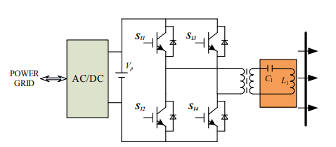
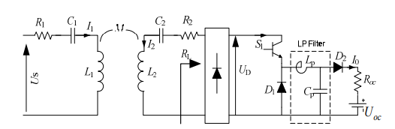
Equivalent circuit of electric vehicle wireless charging system
Battery Integrated with Solar panel

Slide 13
REFERENCES
DOI: 10.1109/WoW.2017.7959391
IEEE PELS Workshop on Emerging Technologies: Wireless Power Transfer (WoW)
DOI: 10.1109/GreenTech56823.2023.10173788
2023 IEEE Green Technologies Conference (GreenTech)

Slide 14
THE END

