Slide 1
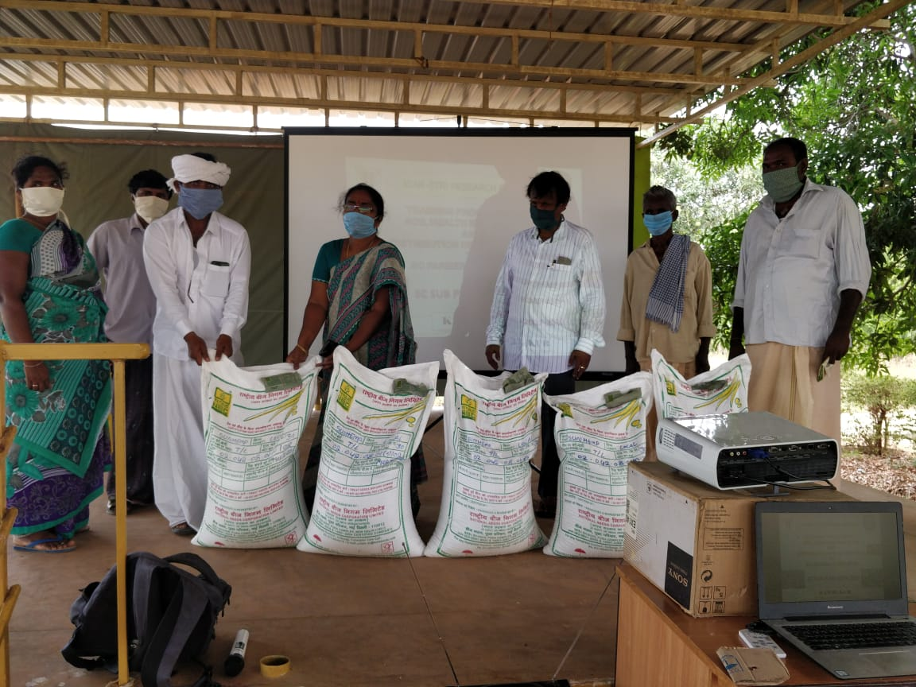
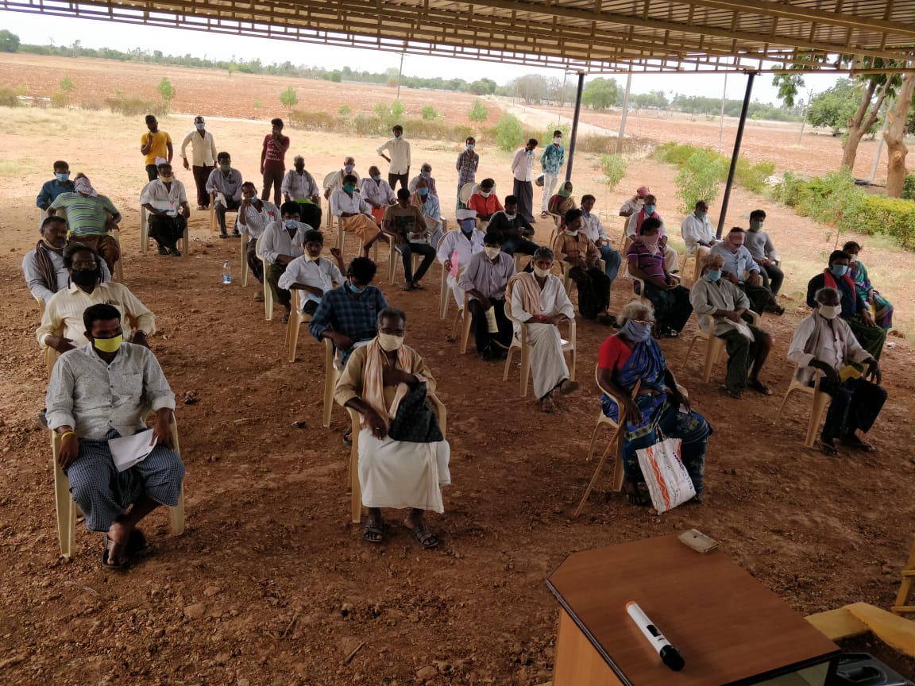
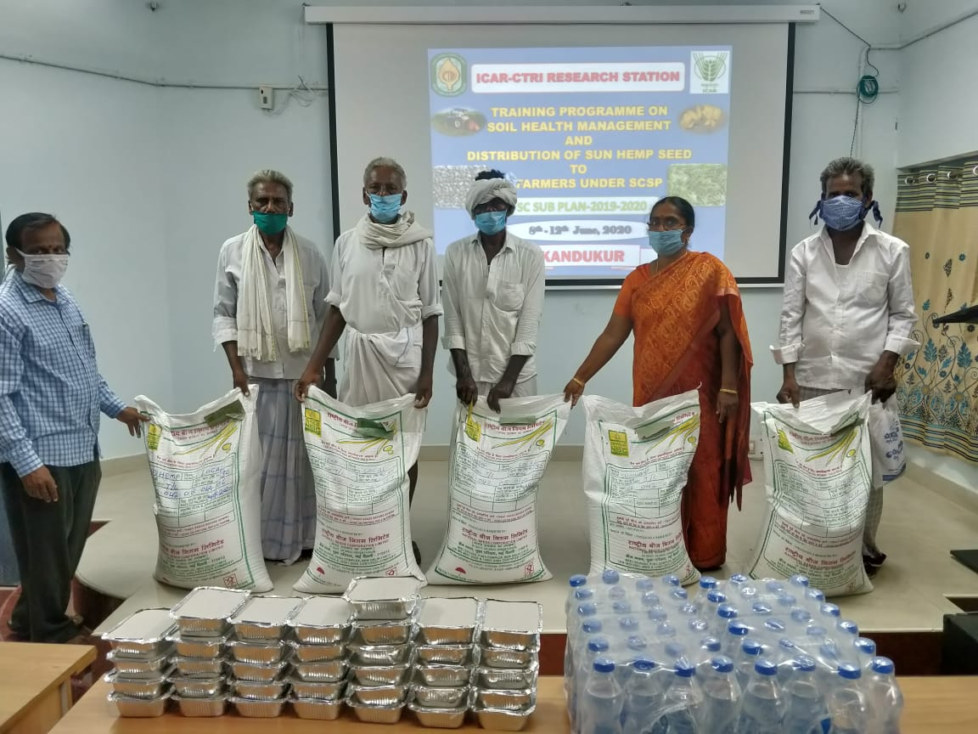
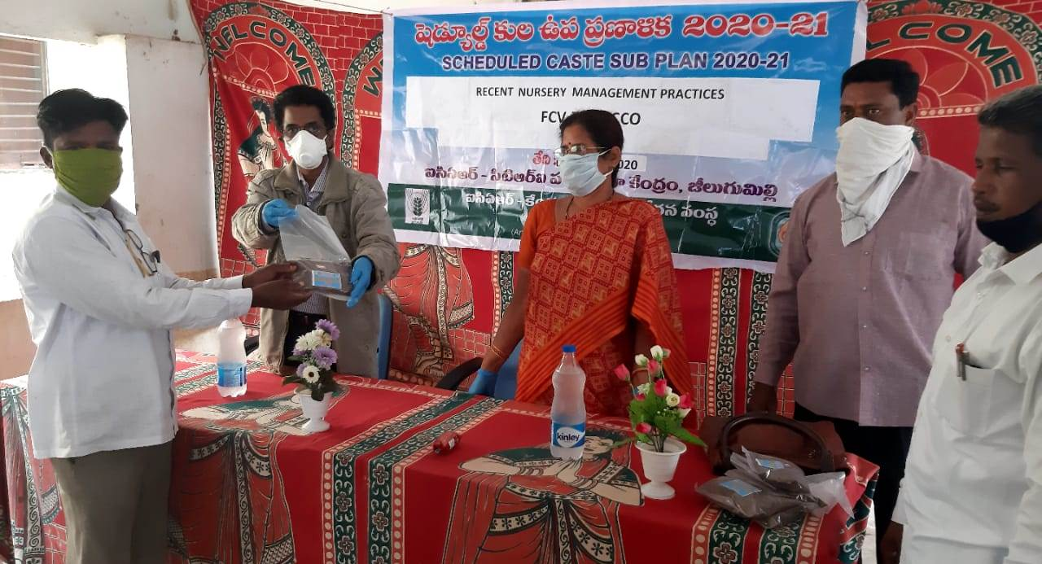
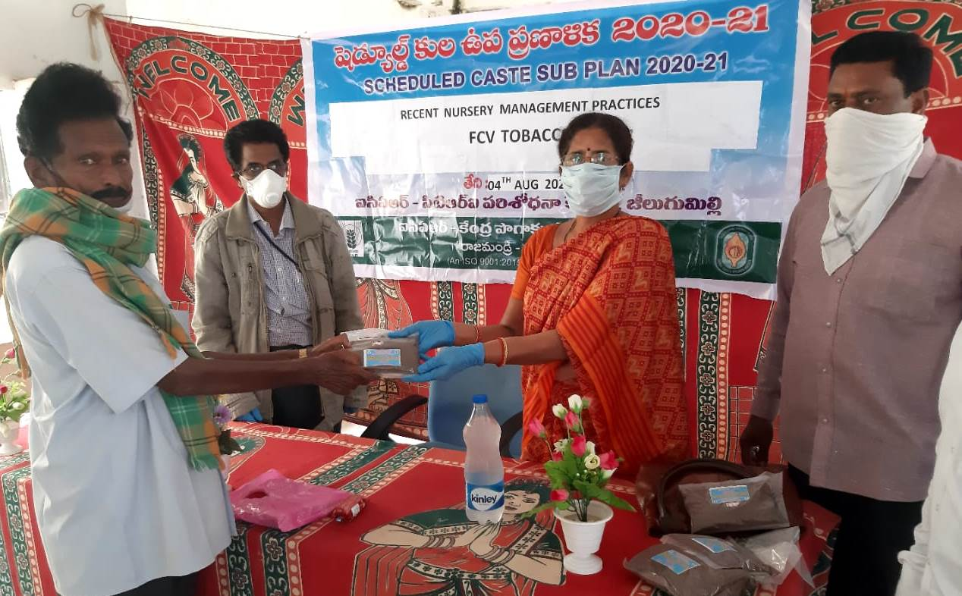
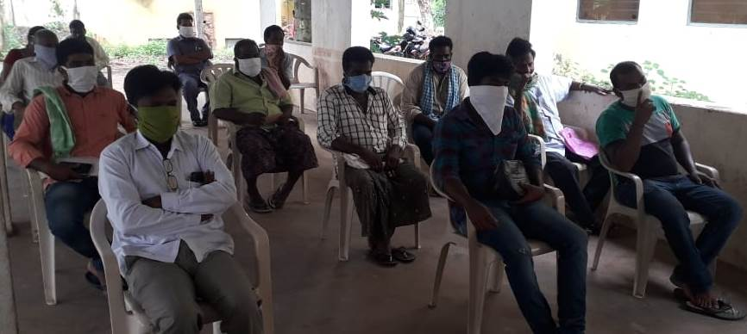
SCHEDULED CASTE SUB-PLAN, 8-12th JUNE, 2020, CTRI RS, KANDUKUR
SCHEDULED CASTE SUB-PLAN, 04.08.2020, CTRI RS, JEELUGUMILLI

