Slide 1


Student Details
NAME : GUTTA RAVITEJA
SKILL BUILD ID : g.raviteja78@gmail.com
college name : s.r.k institute of technology
college state : andhra pradesh
internship domain : cyber security with kali linux
internship start date : 03-06-2024
internship end date : 15-06-2024

Slide 2
PROJECT TITLE/Problem Statement
IMAGE STEGANOGRAPHY
Image steganography is the practice of hiding secret information within digital images. This technique exploits the redundancy in image data, such as the least significant bits (LSBs) of pixel values, to embed hidden messages without noticeably altering the image's appearance.

Slide 3
AGENDA
Whereas cryptography is the practice of protecting the contents of a message alone, steganography is concerned with concealing both the fact that a secret message is being sent and its contents. Steganography includes the concealment of information within computer files.
The agenda of this project to send a secret text to higher officials using the steganography concept and RGB technique, ensuring that criminals or others cannot identify the image or its hidden content. Thos project will involve encoding the secret text into the least significant bits of the image’s pixels, making the alterations imperceptible to the human eye.

Slide 4
PROJECT OVERVIEW
Steganography is a means of concealing secret information within (or even on top of) an otherwise mundane, non-secret document or other media to avoid detection. It comes from the Greek words steganos, which means “covered” or “hidden,” and graph, which means “to write.” Hence, “hidden writing".
A steganography technique involves hiding sensitive information within an ordinary, non-secret file or message, so that it will not be detected. The sensitive information will then be extracted from the ordinary file or message at its destination, thus avoiding detection. Steganography is an additional step that can be used in conjunction with encryption in order to conceal or protect data.

Slide 5
WHO ARE THE END USERS of this project?
Individuals: People who want to securely share private messages or information without drawing attention.
Businesses: Companies that need to protect sensitive data in images, such as trade secrets or confidential communications.
Journalists/Activists: Those in sensitive environments who require secure communication methods to protect their information.
Security Professionals: Experts focused on cybersecurity who use steganography for data protection and analysis.
Digital Artists: Artists who may incorporate hidden messages or signatures within their digital works.
Researchers: Academics studying data security, cryptography, or digital forensics.
Government Agencies: Organizations requiring secure communication channels for sensitive operations.

Slide 6
YOUR SOLUTION AND ITS VALUE PROPOSITION
The image steganography project involves embedding secret messages or data within images to ensure secure communication and data integrity without drawing attention.
Value Proposition
Security and Privacy:Enables users to share sensitive information without revealing its presence.
Data Protection: Safeguards against unauthorized access to hidden data.
Integrity of Data:Ensures that embedded messages remain intact and can be verified for authenticity.
Resilience to Attacks: Designed to withstand common image manipulations (e.g., resizing, format changes) without losing the embedded information.

Slide 7
How did you customize the project and make it your own
Choose a Programming Language
Select a Steganography Technique
Design the User Interface
Implement Image Processing
Add Functionality
Enhance Security
Support Multiple File Formats
Test and Debug
Document Your Code

Slide 8
MODELLING
ENCODING PROCESS:
Load the image.
Convert the message into binary format.
Modify the image's pixel values to encode the message.
DECODING PROCESS:
Load the encoded image.
Extract the binary data from pixel values.
Convert binary data back to the original message.

Slide 9
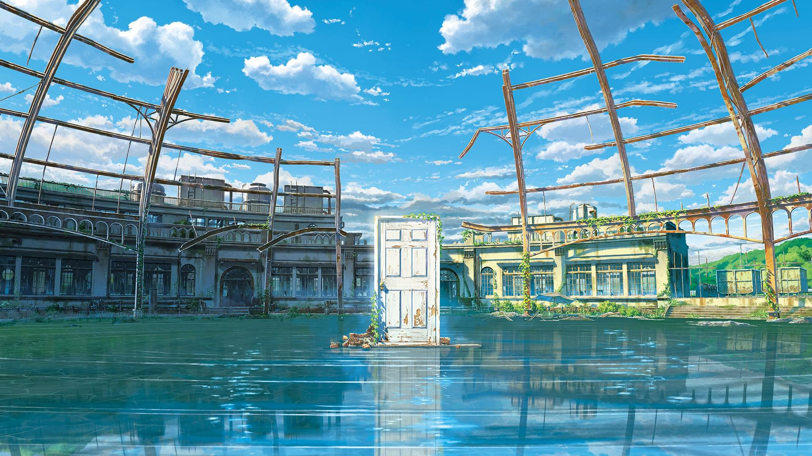
Results
ORIGINAL IMAGE
ENCODED IMAGE
HIDDEN TEXT : THIS IS TEXT

Slide 10
links
https://github.com/Raviteja78Gowtham/IMAGE-STEGONOGRAPHY

