Slide 1
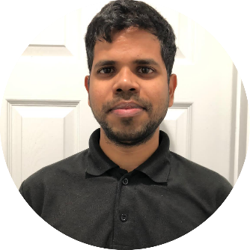


Raviteja Poosala
MS in CS
Born in Telangana, India
Project Plan
Education
Project Idea : Its a student web communication platform for Seattle university where students post their travel updates, the idea is to let other students know so that they can request travelling student for any needs from the traveler's destination place
Domain : Student Communication
Intended Users: Students
This Project is only for the SU Students
BTech from JNTUH ,India (2015)
Currently doing Masters in CS at Seattle University
Work Experience
Cloud Engineer at Mindtree (2016-20), India

