Slide 1
2D Face Recognition
Part 1
Ravitha N

Slide 2
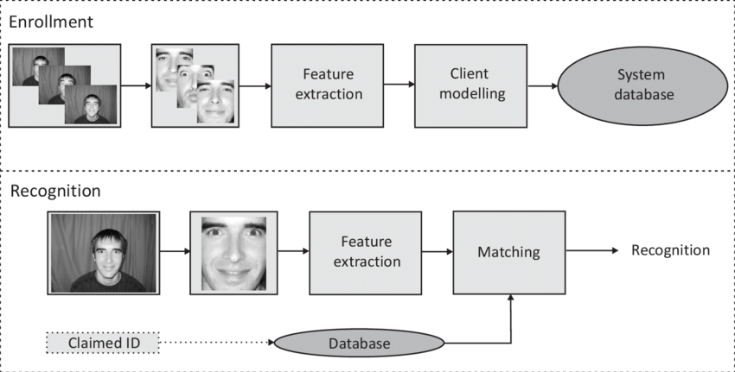
Components of a Typical Biometric System

Slide 3
What we get and What we don’t get??
Advantages
Disadvantages
Low cost
Contactless
Acceptability
Not highly secure
Face changes over time for voluntary (or) non voluntary reasons

Slide 4
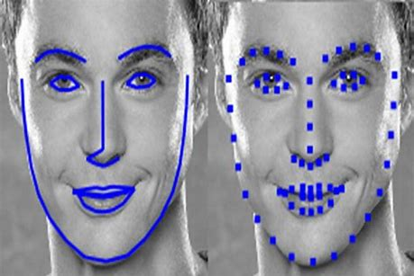
Approaches
Global Recognition
Local Recognition
PCA
LDA
Geometric techniques
Elastic graph matching techniques
Hybrid Techniques
Process the image as a whole
Divide image into patches and process them separately
to extract features

Slide 5
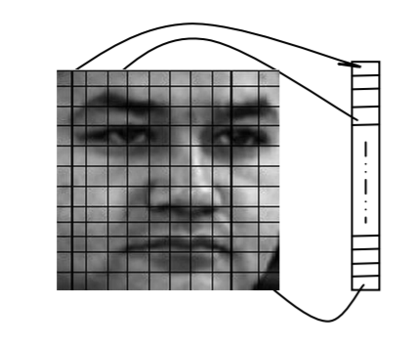
Global Recognition Approach
Use Raw Pixel Intensity Values
Convert the image into single dimensional global vector and
use the vector for recognition
PCA (Principal Component Analysis is used for dimensionality reduction
Dimension refers to the size of the vector
If an image is 4*4, size of the vector would be 16
Typical face image would be of size 256 * 256 , then global vector
would contain 65536 pixels
Why to reduce dimensions?
1. Decorrelate Data
2. Reduce the space dimensions

Slide 6
Decorrelating data
Decorrelating Features
Features that provide redundant information to be removed (or) it would affect the recognition process.

Slide 7
Dimensionality Reduction
Represent Data (images) with less number of features
Find alternate representation for Data
Original Representation {B1,B2,B3,B4}
(i.e,) Every data point represented by four features
Need for alternate representation (reduce features)
PCA finds alternate representation {D1,D2,D3,D4}with same number of features as that of original representation. Features are reduced by ignoring the feature vector which carries less variance.

Slide 8
Dimensionality Reduction
Note:
Alternate representation are linear combination of original representation
Basis of alternate representation is always orthogonal in nature
Alternate representation in PCA will be of same size as that of original representation

Slide 9
Pause Moment
Self Evaluate
If an image is of size 4*4, how many features are there in global approach?
If PCA is applied for dataset which contains 100 features , How many eigen vectors it will provide? What would be the size of the eigen vector?
Answers
16 (each pixel is considered as a feature)
It will provide 100 eigen vectors, each is a linear combination of 100 features. So, size will also be 100
Notes:
16 (each pixel is considered as a feature)
It will provide 100 eigen vectors, each is a linear combination of 100 features. So, size will also be 100

Slide 10
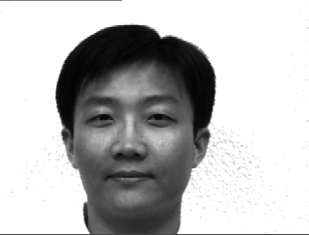
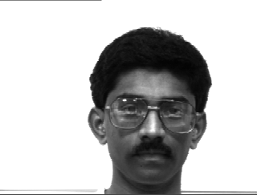
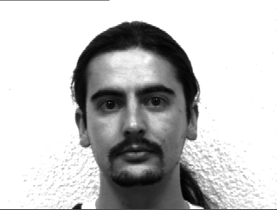














Face Recognition Using PCA – Learning Phase
Extract Principal Component from learning set (eigen faces)
Projection of face onto principal component allow extraction of features.
2
mean
$$ψ$$
$$Γ_{1}$$
$$ψ$$
$$φ_{1}$$
$$I_{1}$$
3
$$Γ_{2}$$
$$ψ$$
$$φ_{2}$$
$$I_{2}$$
Compute Eigen Value and Eigen Vector
$$A$$
1
4
5
$$Γ_{M}$$
$$ψ$$
$$I_{M}$$
$$φ_{M}$$

Slide 11

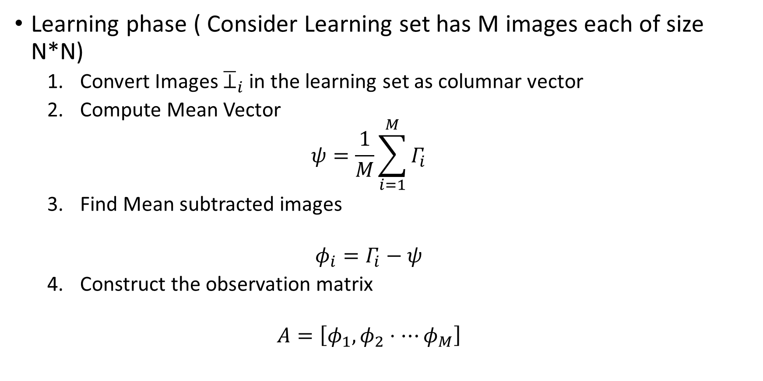

Learning phase ( Consider Learning set has M images each of size N*N)
Convert Images ${\overline{⊥}}_{i}$ in the learning set as columnar vector
Compute Mean Vector
$$ψ=\frac{1}{M}\sum_{i=1}^{M}{Γ_{i}}$$
Find Mean subtracted images
$$φ_{i}=Γ_{i}−ψ$$
Construct the observation matrix
$$A=\left[φ_{1},φ_{2}⋅⋯φ_{M}\right]$$
$$Γ_{i}$$
$$N^{2}×M$$

Slide 12
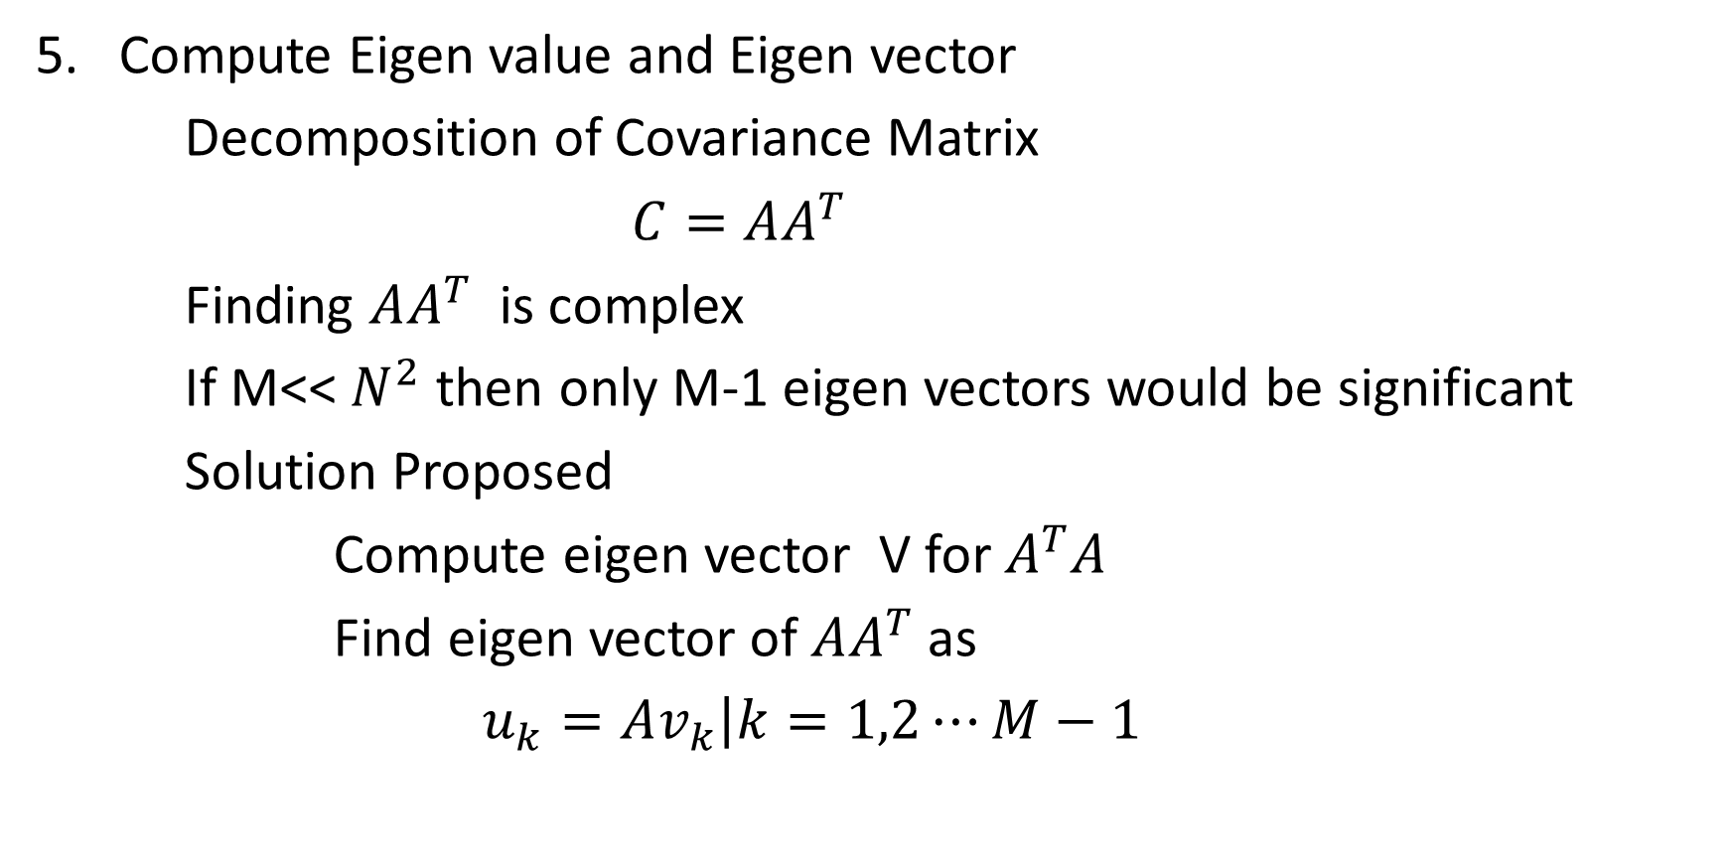
Compute Eigen value and Eigen vector
Decomposition of Covariance Matrix
$C=AA^{T}$
Finding $AA^{T}$ is complex
If M<< $N^{2}$ then only M-1 eigen vectors would be significant
Solution Proposed
Compute eigen vector V for $A^{T}A$
Find eigen vector of $AA^{T}$ as
$u_{k}=A\left.v_{k}\right|k=1,2⋯M−1$

Slide 13
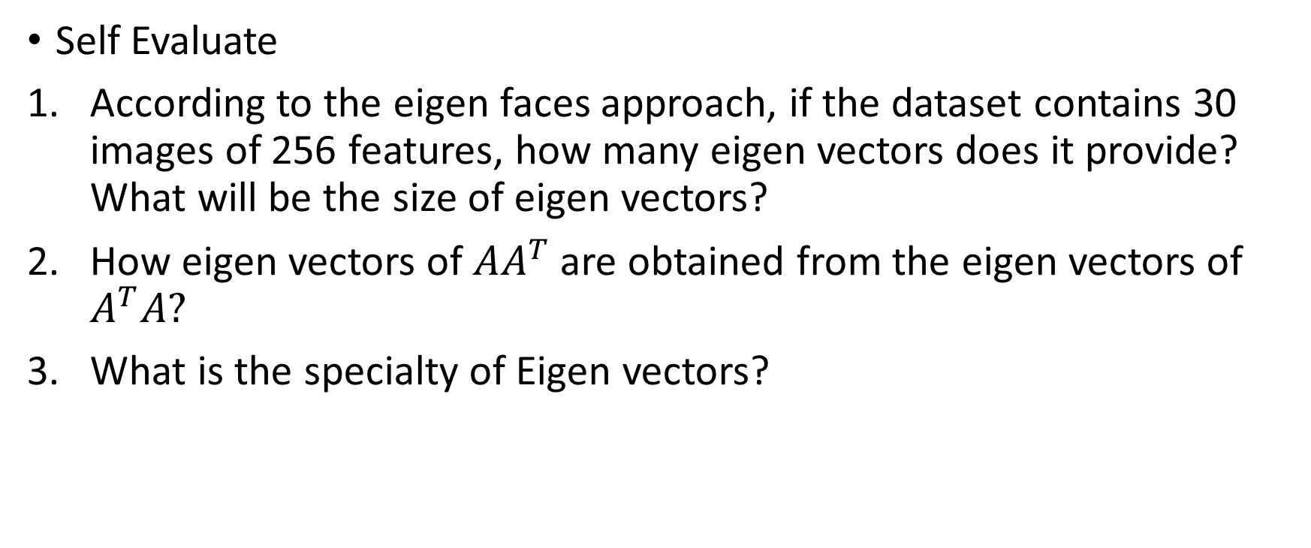
Pause Moment
Self Evaluate
According to the eigen faces approach, if the dataset contains 30 images of 256 features, how many eigen vectors does it provide? What will be the size of eigen vectors?
How eigen vectors of $AA^{T}$are obtained from the eigen vectors of $A^{T}A?$
What is the specialty of Eigen vectors?
Answers
30 vectors each of size 30
By multiplying it with the observation matrix
These vectors when multiplied with the matrix does not change its direction
Notes:
30 vectors each of size 30
By multiplying it with the observation matrix
These vectors when multiplied with the matrix does not change its direction

Slide 14

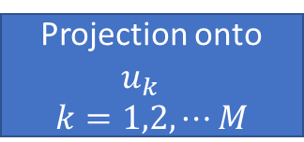

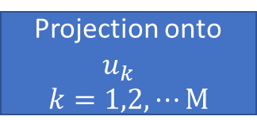





Feature Vectors
1
Reference Dataset
Projection onto
$$u_{k}$$
$$k=1,2,⋯M$$
$$φ_{1}$$
$$W_{1}=\left[w_{11},w_{12}…w_{1M}\right]$$
Projection onto
$$u_{k}$$
$$k=1,2,⋯M$$
$$φ_{2}$$
$$W_{2}=\left[w_{21},w_{22}…w_{2M}\right]$$
Projection onto
$$u_{k}$$
$$k=1,2,⋯M$$
$$φ_{M}$$
$$W_{3}=\left[w_{31},w_{32}…w_{3M}\right]$$

Slide 15
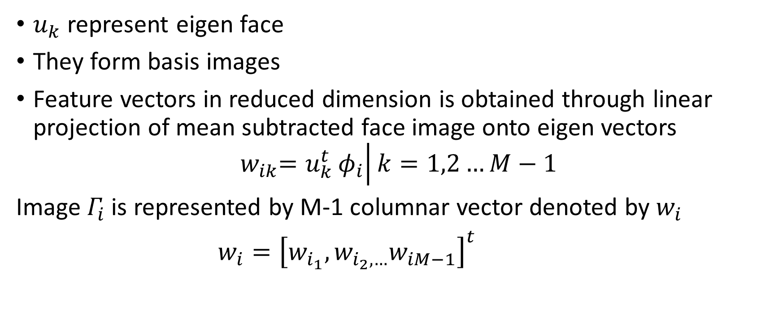
Obtaining Feature Vectors
$u_{k}$ represent eigen face
They form basis images
Feature vectors in reduced dimension is obtained through linear projection of mean subtracted face image onto eigen vectors
$${ w}_{ik}=u_{k}^{t}\left.φ_{i}\right|k=1,2…M−1$$
Image $Γ_{i}$is represented by M-1 columnar vector denoted by $w_{i}$
$w_{i}={\left[w_{i_{1}},w_{i_{2},…}w_{iM−1}\right]}^{t}$
1

Slide 16
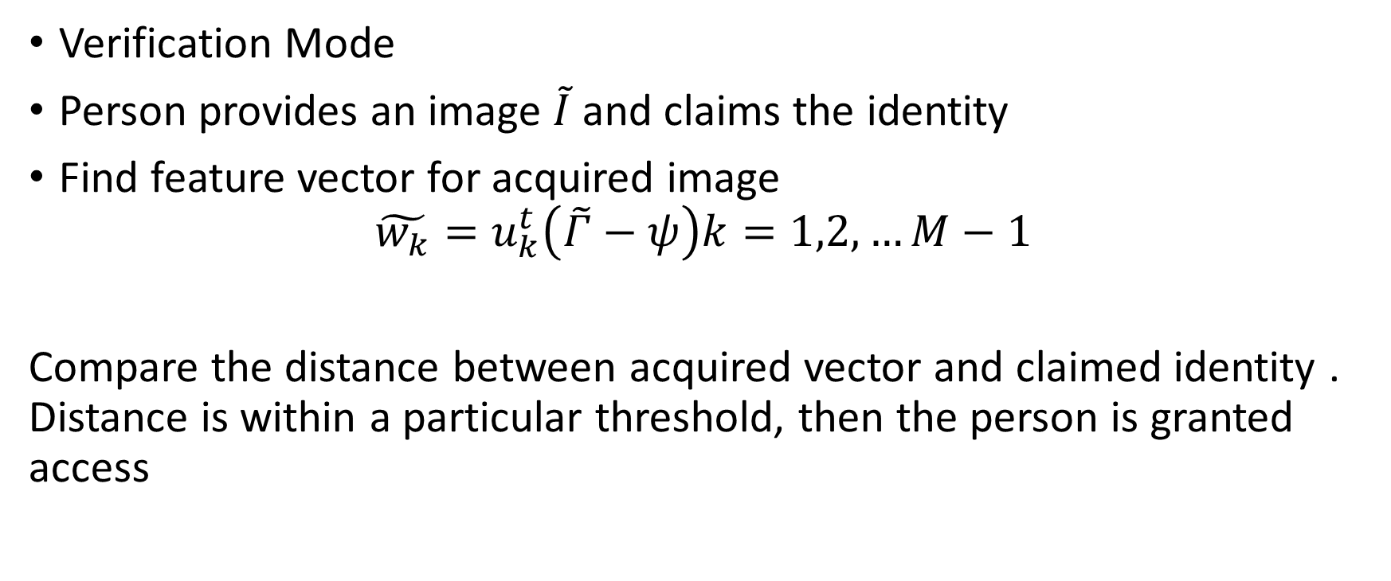
Face Recognition Using PCA – Inference Phase
Verification Mode
Person provides an image $\tilde{I}$ and claims the identity
Find feature vector for acquired image
$$\tilde{w_{k}}=u_{k}^{t}\left(\tilde{Γ}−ψ\right)k=1,2,…M−1$$
Compare the distance between acquired vector and claimed identity . Distance is within a particular threshold, then the person is granted access

Slide 17

Pause Moment
Self Evaluate
Given vector and reference vector w for the claimed identity is (1,4,2,1), Will a Manhattan distance based client model authorize the individual with a threshold of 4?
$$\tilde{w}=\left(1,2,3,4\right)$$
Answers = mod(1-1) + mod(2-4) + mod(3-2) + mod(4-1) = 0+ 2+ 1 + 3 = 6. Since it exceeds threshold,
user will not be authorized
Notes:
= mod(1-1) + mod(2-4) + mod(3-2) + mod(4-1) = 0+ 2+ 1 + 3 = 6. Since it exceeds threshold, user will not be authorized

Slide 18
Questions
Typically, 5 to 6 sample images are captured for same person. How samples are used in the recognition process?
What will you do to visualize the reduced image given a feature vector?
Does PCA really decorrelate data? How to verify that?

Slide 19
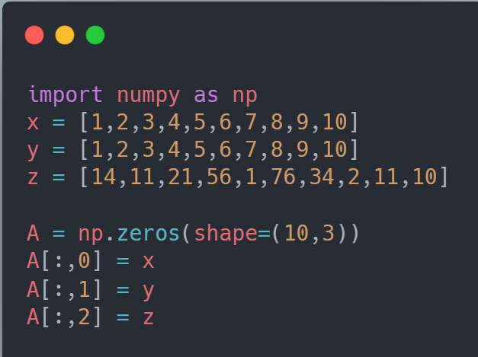
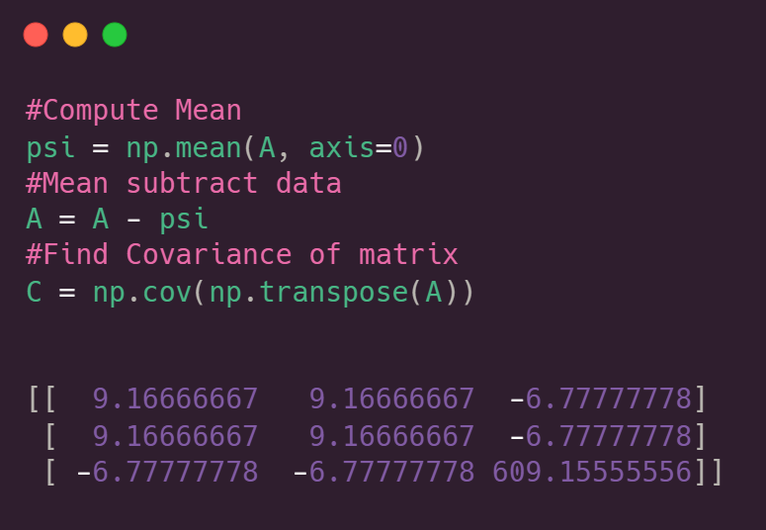
Simulation of PCA
x, y, z are features stacked together into observation matrix
A
[[ 9.16666667 9.16666667 -6.77777778]
[ 9.16666667 9.16666667 -6.77777778]
[ -6.77777778 -6.77777778 609.15555556]]

Slide 20
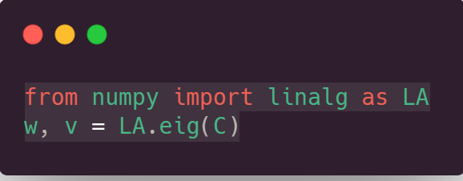
Contd..
W
(Eigen Values)
[-5.32907052e-15
1.81778680e+01
6.09311021e+02]
V (Eigen Vectors)
[[-7.07106781e-01 7.07013792e-01 -1.14672459e-02]
[ 7.07106781e-01 7.07013792e-01 -1.14672459e-02]
[-6.41847686e-17 1.62171347e-02 9.99868494e-01]]

Slide 21
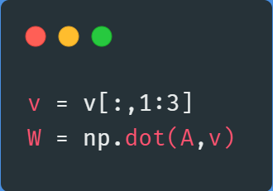

Contd..
Data points in reduced feature space
[[ -6.51880862 -9.49553233]
[ -5.15343244 -12.5180723 ]
[ -3.57723351 -2.54232185]
[ -1.59560621 32.43014093]
[ -1.07352104 -22.58556071]
[ 1.55679165 52.38164182]
[ 2.28969958 10.3642306 ]
[ 3.18477885 -21.65449569]
[ 4.74476065 -12.67861374]
[ 6.1425711 -13.70141673]]
Covariance Matrix in reduced dimension space
[[ 1.81778680e+01 -5.57676958e-14]
[-5.57676958e-14 6.09311021e+02]]

Slide 22
Pause Moment
Self Evaluate
How do you interpret the covariance matrix?
Answers
Covariance matrix is constructed between every pair of features, +ve value indicate positive correlation,
-ve value indicate negative correlation , any value close to zero indicate uncorrelated features.
In PCA , the resulting dimensions are uncorrelated.
Notes:
Covariance matrix is constructed between every pair of features, +ve value indicate positive correlation, -ve value indicate negative correlation , any value close to zero indicate uncorrelated features. In PCA , the resulting dimensions are uncorrelated.

Slide 23
References
http://vision.ucsd.edu/~iskwak/ExtYaleDatabase/Yale%20Face%20Database.htm
All the images are non – licensed images free for commercial distribution.
https://sites.cs.ucsb.edu/~mturk/Papers/mturk-CVPR91.pdf (Turk and Pentland; “Face Recognition using Eigen Faces”)
Amine Nait Ali, “Signal and Image Processing for Biometrics ”

