Slide 1
Face Recognition using Principal Component Analysis
Ravitha N

Slide 2
Face Recognition
Face recognition is the challenge of classifying whose face is in an input image.
A naïve way of accomplishing this is to take the new image, flatten it into a vector, and compute the Euclidean distance between it and all of the other flattened images in our database. Obvious Drawback is speed
Say you have a image of size 8*8 ~ 64 *1
If it needs to be compared with 200 images in the database, then the approach is unrealistic
Number of computations = 200 * 64 ~ 12,800 computations

Slide 3
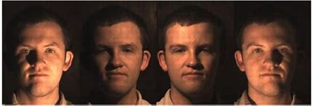
Problems with Distance classifier
It cannot capture inherent noise in image (translation, rotation, illumination variations ) in an image

Slide 4
Can we improve classifier?
Advanced Classifiers such as Neural Networks can be used. But still the network would suffer from curse of dimensionality
if the image is flattened into mn * 1 vector; then the network requires more than mn images which is not realistic for images (as it would depend on the storage space, computational complexity)

Slide 5
Principal Component Analysis
Reduce the size of the image (not blindly)
Can we have a technique which can map the face to smaller dimension but retains most of the important parts in it
Principal Component Analysis is one such technique which helps in mapping the datapoints to lower dimensions.

Slide 6
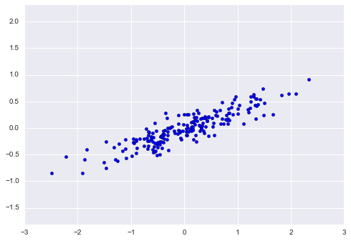
Sample Data and its Principal Components

Slide 7
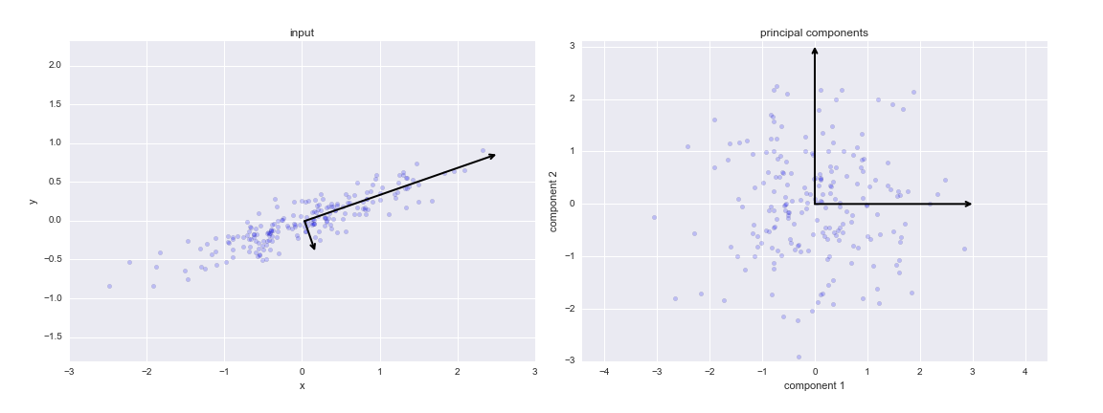
Contd..
Observation : In the First Figure, Principal Vector captures most of the variance in the data.

Slide 8
Projection of Data point to a vector
Data Point [3,2]
Vector [ 4 5]
Perpendicular Projection of data point onto the vector
Dot Product between the vectors will help in projection of point onto a vector.

Slide 9
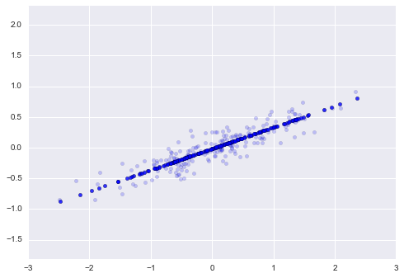
Transformation of data points onto the Principal Vector

Slide 10
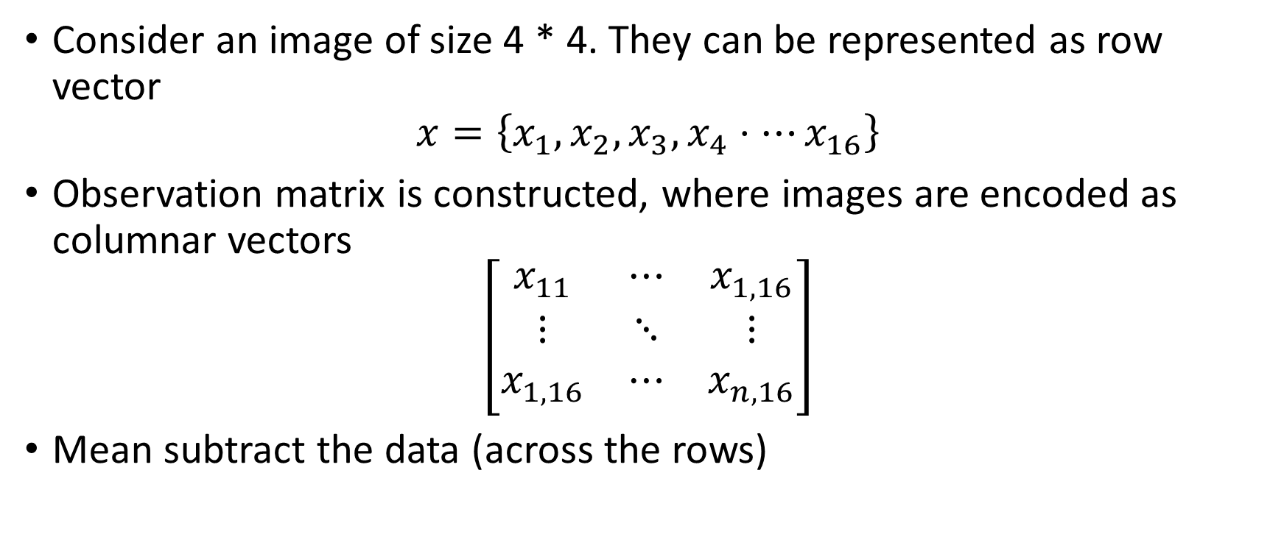
Mathematical Approach
Consider an image of size 4 * 4. They can be represented as row vector
$$x=\left\{x_{1},x_{2},x_{3},x_{4}⋅⋯x_{16}\right\}$$
Observation matrix is constructed, where images are encoded as columnar vectors
$$\left[\begin{matrix}x_{11} & ⋯ & x_{1,16} \\ ⋮ & ⋱ & ⋮ \\ x_{1,16} & ⋯ & x_{n,16}\end{matrix}\right]$$
Mean subtract the data (across the rows)

Slide 11
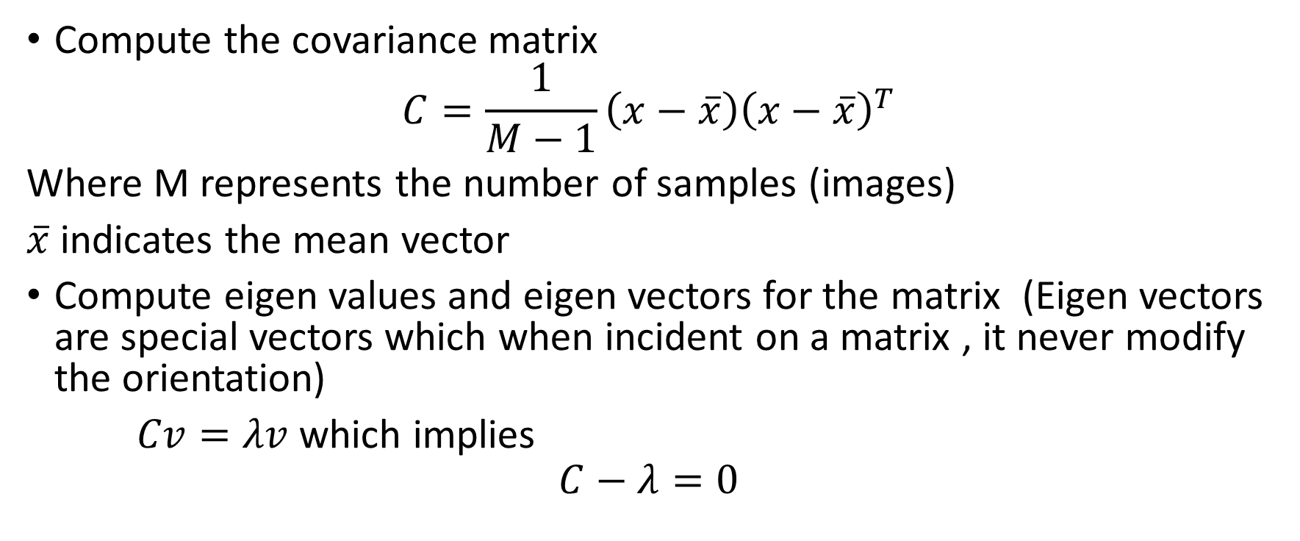
Contd..
Compute the covariance matrix
$$C=\frac{1}{M−1}\left(x−\overline{x}\right){\left(x−\overline{x}\right)}^{T}$$
Where M represents the number of samples (images)
$\overline{x}$ indicates the mean vector
Compute eigen values and eigen vectors for the matrix (Eigen vectors are special vectors which when incident on a matrix , it never modify the orientation)
$Cv=λv$ which implies
$$C−λ=0$$

Slide 12

Contd..
Solving the equation we will obtain the unknown quantity $λ$(eigen value) and v (eigen vector)

Slide 13
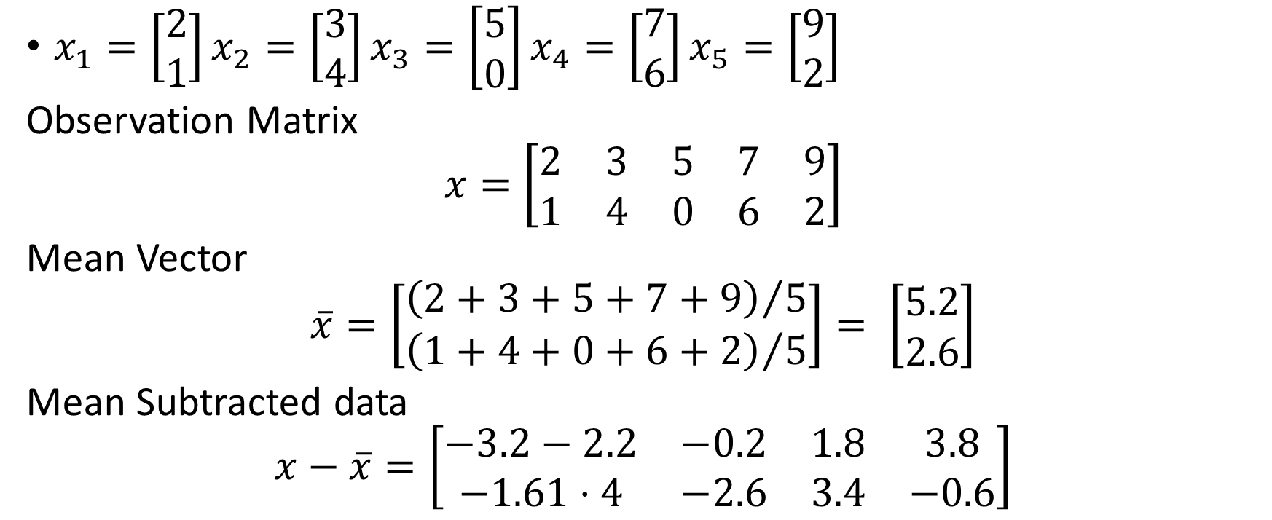
Find the principal component for the following data points
$x_{1}=\left[\begin{matrix}2 \\ 1\end{matrix}\right]x_{2}=\left[\begin{matrix}3 \\ 4\end{matrix}\right]x_{3}=\left[\begin{matrix}5 \\ 0\end{matrix}\right]x_{4}=\left[\begin{matrix}7 \\ 6\end{matrix}\right]x_{5}=\left[\begin{matrix}9 \\ 2\end{matrix}\right]$
Observation Matrix
$$x=\left[\begin{matrix}2 & 3 & 5 & 7 & 9 \\ 1 & 4 & 0 & 6 & 2\end{matrix}\right]$$
Mean Vector
$$\overline{x}=\left[\begin{matrix}{\left(2+3+5+7+9\right)}/5 \\ {\left(1+4+0+6+2\right)}/5\end{matrix}\right]= \left[\begin{aligned}5.2 \\ 2.6\end{aligned}\right]$$
Mean Subtracted data
$$x−\overline{x}=\left[\begin{matrix}−3.2−2.2 & −0.2 & 1.8 & 3.8 \\ −1.61⋅4 & −2.6 & 3.4 & −0.6\end{matrix}\right]$$

Slide 14
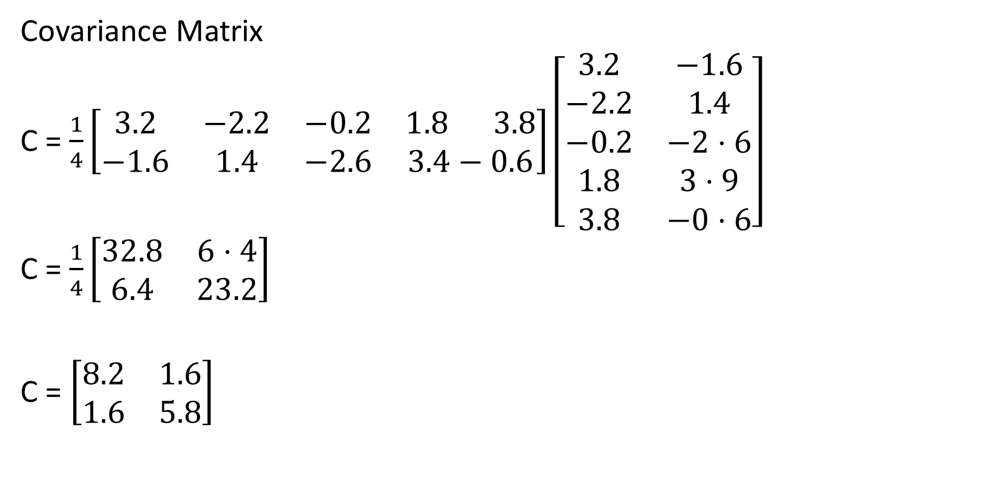
Covariance Matrix
C = $\frac{1}{4}\left[\begin{matrix}3.2 & −2.2 & −0.2 & 1.8 3.8 \\ −1.6 & 1.4 & −2.6 & 3.4−0.6\end{matrix}\right]\left[\begin{matrix}3.2 & −1.6 \\ −2.2 & 1.4 \\ −0.2 & −2⋅6 \\ 1.8 & 3⋅9 \\ 3.8 & −0⋅6\end{matrix}\right]$
C = $\frac{1}{4}\left[\begin{matrix}32.8 & 6⋅4 \\ 6.4 & 23.2\end{matrix}\right]$
C = $\left[\begin{matrix}8.2 & 1.6 \\ 1.6 & 5.8\end{matrix}\right]$

Slide 15

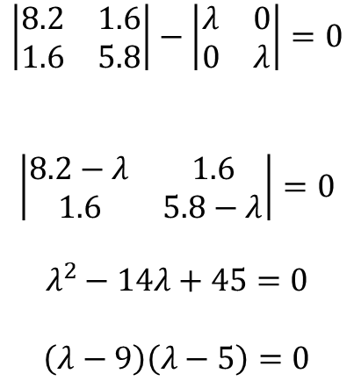

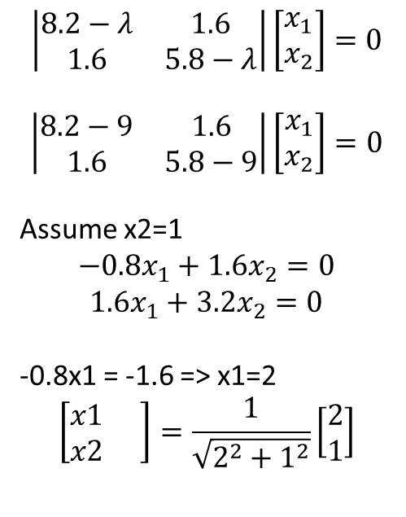
Finding Eigen Vectors
Eigen vector for lambda 9
Substitute it in
$$\left|\begin{matrix}8.2 & 1.6 \\ 1.6 & 5.8\end{matrix}\right|−\left|\begin{matrix}λ & 0 \\ 0 & λ\end{matrix}\right|=0$$
$$\left|\begin{matrix}8.2−λ & 1.6 \\ 1.6 & 5.8−λ\end{matrix}\right|=0$$
$$λ^{2}−14λ+45=0$$
$$\left(λ−9\right)\left(λ−5\right)=0$$
$$\left|\begin{matrix}8.2−λ & 1.6 \\ 1.6 & 5.8−λ\end{matrix}\right|\left[\begin{matrix}x_{1} \\ x_{2}\end{matrix}\right]=0$$
$$\left|\begin{matrix}8.2−9 & 1.6 \\ 1.6 & 5.8−9\end{matrix}\right|\left[\begin{matrix}x_{1} \\ x_{2}\end{matrix}\right]=0$$
Assume x2=1
$$−0.8x_{1}+1.6x_{2}=0$$
$$1.6x_{1}+3.2x_{2}=0$$
-0.8x1 = -1.6 => x1=2
$$\left[\begin{matrix}x1 & \\ x2 & \end{matrix}\right]=\frac{1}{\sqrt{2^{2}+1^{2}}}\left[\begin{matrix}2 \\ 1\end{matrix}\right]$$
$$λ=9, λ=5$$
$$\left(\begin{matrix}0.89 \\ 0.45\end{matrix}\right)$$

Slide 16


Eigen vector for lambda 5
Substitute it in
$$\left|\begin{matrix}8.2−λ & 1.6 \\ 1.6 & 5.8−λ\end{matrix}\right|\left[\begin{matrix}x_{1} \\ x_{2}\end{matrix}\right]=0$$
$$\left|\begin{matrix}8.2−5 & 1.6 \\ 1.6 & 5.8−5\end{matrix}\right|\left[\begin{matrix}x_{1} \\ x_{2}\end{matrix}\right]=0$$
Assume x2=1
$$3.2x_{1}+1.6x_{2}=0$$
$$1.6x_{1}+0.8x_{2}=0$$
3.2x1 = -1.6 => x1=-0.5
$$\left[\begin{matrix}x1 & \\ x2 & \end{matrix}\right]=\frac{1}{\sqrt{{−0.5}^{2}+1^{2}}}\left[\begin{matrix}−0.5 \\ 1\end{matrix}\right]$$
$$\left[\begin{matrix}−0.45 \\ 0.89\end{matrix}\right]$$

Slide 17




Projecting Data points onto Principal Components
Eigen Vectors v1 =
V2 =
Convert data point (2 1) its mean centered value (-3.2 -1.6)
Project (-3.2 -1.6) = -3.568
Onto v1
Project (-3.2 -1.6) = 0.016
Onto v2
$\left(\begin{matrix}0.89 \\ 0.45\end{matrix}\right)$
$$\left[\begin{matrix}−0.45 \\ 0.89\end{matrix}\right]$$
$\left(\begin{matrix}0.89 \\ 0.45\end{matrix}\right)$
$$\left[\begin{matrix}−0.45 \\ 0.89\end{matrix}\right]$$

Slide 18
https://pythonmachinelearning.pro/face-recognition-with-eigenfaces/

