Slide 1
TCSS 143, Autumn 2004 Lecture Notes
Graphical User Interfaces
Koffman/Wolfgang Appendix C,
pp. 747-786

Slide 2
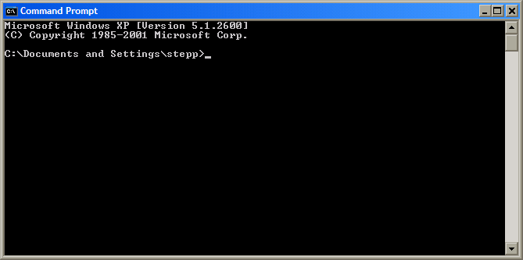
Motivation
learn how to create a graphical user interface (GUI) using Java and Swing
understand Java graphical component hierarchy
learn Java's event-driven model
banish the evil black box to the fiery depths from which it came

Slide 3
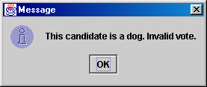
Simplest GUI programming:
JOptionPane
An option pane is a simple dialog box for graphical input/output
advantages:
  simple
  flexible (in some ways)
  looks better than the black box of doom
disadvantages:
  created with static methods;
  not very object-oriented
  not very powerful (just simple dialog boxes)

Slide 4
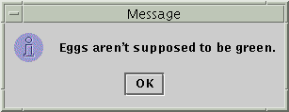

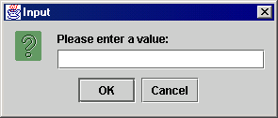
Types of JOptionPanes
public static void showMessageDialog(
Component parent, Object message)
Displays a message on a dialog
with an OK button.
public static int showConfirmDialog(
Component parent, Object message)
Displays a message and list of
choices Yes, No, Cancel
public static String showInputDialog(
Component parent, Object message)
Displays a message and text
field for input, and returns the
value entered as a String.

Slide 5
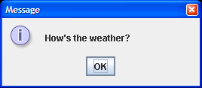
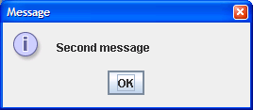
JOptionPane examples 1
showMessageDialog analogous to System.out.println for displaying a simple message
import javax.swing.*;
class MessageDialogExample {
public static void main(String[] args) {
JOptionPane.showMessageDialog(null,
"How's the weather?");
JOptionPane.showMessageDialog(null,
"Second message");
}
}

Slide 6
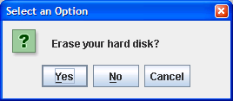
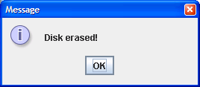
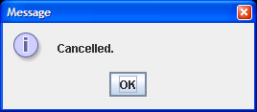
JOptionPane examples 2
showConfirmDialog analogous to a System.out.print that prints a question, then reading an input value from the user (can only be one of the provided choices)
import javax.swing.*;
class ConfirmDialogExample {
public static void main(String[] args) {
int choice = JOptionPane.showConfirmDialog(null,
"Erase your hard disk?");
if (choice == JOptionPane.YES_OPTION) {
JOptionPane.showMessageDialog(null, "Disk erased!");
} else {
JOptionPane.showMessageDialog(null, "Cancelled.");
}
}
}

Slide 7
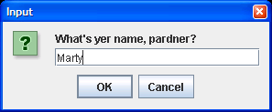
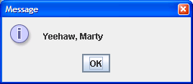
JOptionPane examples 3
showInputDialog analogous to a System.out.print that prints a question, then reading an input value from the user (can be any value)
import javax.swing.*;
class InputDialogExample {
public static void main(String[] args) {
String name = JOptionPane.showInputDialog(null,
"What's yer name, pardner?");
JOptionPane.showMessageDialog(null, "Yeehaw, " + name);
}
}

Slide 8

Onscreen GUI elements
windows: actual first-class citizens of desktop; also called top-level containers
examples: frame, dialog box
components: GUI widgets
examples: button, text box, label
containers: logical grouping for components
example: panel

Slide 9
Java GUI: AWT and Swing
Sun’s initial idea: create a set of classes/methods that can be used to write a multi-platform GUI (Abstract Windowing Toolkit, or AWT)
  problem: not powerful enough; limited; a bit clunky to use
Second edition (JDK v1.2): Swing
  a newer library written from the ground up that allows much more powerful graphics and GUI construction
Drawback: Both exist in Java now; easy to get them mixed up; still have to use both sometimes!

Slide 10
Swing component hierarchy
java.lang.Object
+--java.awt.Component
+--java.awt.Container
|
+--javax.swing.JComponent
| +--javax.swing.JButton
| +--javax.swing.JLabel
| +--javax.swing.JMenuBar
| +--javax.swing.JOptionPane
| +--javax.swing.JPanel
| +--javax.swing.JTextArea
| +--javax.swing.JTextField
|
+--java.awt.Window
+--java.awt.Frame
+--javax.swing.JFrame
import java.awt.*;
import javax.swing.*;

Slide 11
Methods of all Swing components
public int getWidth()
public int getHeight()
Allow access to the component's current width and height in pixels.
public boolean isEnabled()
Returns whether the component is enabled (can be interacted with).
public boolean isVisible()
Returns whether the component is visible (can be seen on the screen).

Slide 12
More JComponent methods
public void setBackground(Color c)
Sets the background color of the component to be the given color.
public void setFont(Font f)
Sets the font of the text on the given component to be the given font.
public void setEnabled(boolean b)
Sets whether the component is enabled (can be interacted with).
public void setVisible(boolean b)
Sets whether the component is visible (can be seen on the screen). Set to true to show the component, or set to false to hide the component.

Slide 13
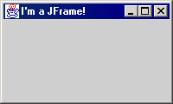
JFrame
A frame is a graphical window that can
be used to hold other components
public JFrame() or public JFrame(String title)
Creates a frame with an optional title.
public void setTitle(String text)
Puts the given text in the frame’s title bar.
public void setDefaultCloseOperation(int op)
Makes the frame perform the given action when it closes. Common value: JFrame.EXIT_ON_CLOSE
public void add(Component comp)
Places the given component or container inside the frame.
  How would we add more than one component to the frame?
public void pack()
Resizes the frame to fit the components inside it.
NOTE: Call setVisible(true) to make a frame appear on the screen after creating it.

Slide 14
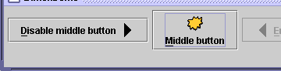
JButton, JLabel
The most common component—
a button is a clickable onscreen
region that the user interacts with
to perform a single command
A text label is simply a string of text
displayed on screen in a graphical
program. Labels often give infor-
mation or describe other components
public JButton(String text)
public JLabel(String text)
Creates a new button / label with the given string as its text.
public String getText()
Returns the text showing on the button / label.
public void setText(String text)
Sets button / label's text to be the given string.

Slide 15
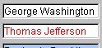

JTextField, JTextArea
A text field is like a label, except that the text
in it can be edited and modified by the user.
Text fields are commonly used for user input,
where the user types information in the field
and the program reads it
A text area is a multi-line text field
public JTextField(int columns)
public JTextArea(int lines, int columns)
Creates a new text field that is the given number of columns (letters) wide.
public String getText()
Returns the text currently in the field.
public void setText(String text)
Sets field's text to be the given string.

Slide 16
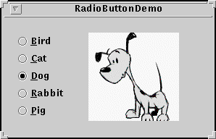
JCheckBox, JRadioButton
A check box is a toggleable button with two states:
checked and unchecked
A radio button is a button that can be selected; usually part of a group of mutually-exclusive radio buttons (1 selectable at a time)
public JCheckBox / JRadioButton(String text)
public JCheckBox(String text, boolean isChecked)
Creates checked/unchecked check box with given text.
public boolean isSelected()
Returns true if check box is checked.
public void setSelected(boolean selected)
Sets box to be checked/unchecked.

Slide 17
ButtonGroup
A logical group of radio buttons that ensures
that only one is selected at a time
public ButtonGroup()
public void add(JRadioButton button)
The ButtonGroup is not a graphical component, just a logical group; the RadioButtons themselves are added to the container, not the ButtonGroup

Slide 18
Problem: positioning, resizing
How does the programmer specify where each component sits in the window, how big each component should be, and what the component should do if the window is resized/moved/maximized/etc?
Absolute positioning (C++, C#, others):
Specify exact pixel coordinates for every component
Layout managers (Java):
Have special objects that decide where to position each component based on some criteria
  What are benefits or drawbacks to each approach?

Slide 19
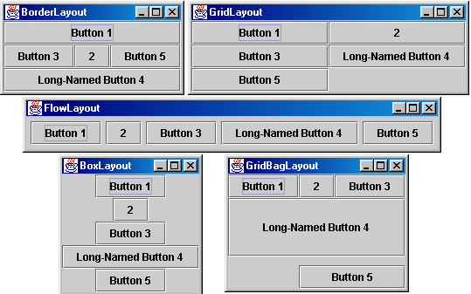
Containers with layout
The idea: Place many components into a container(s), then add the container(s) to the JFrame

Slide 20
Container
A container is an object that holds components; it also governs their positions, sizes, and resize behavior
public void add(Component comp)
public void add(Component comp, Object info)
Adds a component to the container, possibly giving extra information about where to place it.
public void remove(Component comp)
Removes the given component from the container.
public void setLayout(LayoutManager mgr)
Uses the given layout manager to position the components in the container.
public void validate()
You should call this if you change the contents of a container that is already on the screen, to make it re-do its layout.

Slide 21
JPanel
A panel is our container of choice; it inherits the methods from the previous slide and defines these additional methods (among others):
public JPanel()
Constructs a panel with a default flow layout.
public JPanel(LayoutManager mgr)
Constructs a panel that uses the given
layout manager.

Slide 22

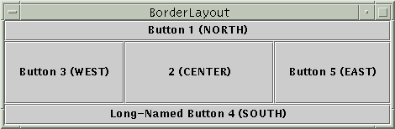
Preferred size of components
Swing component objects each have a certain size they would "like" to be--just large enough to fit their contents (text, icons, etc.)
This is called the preferred size of the component
Some types of layout managers (e.g. FlowLayout) choose to size the components inside them to the preferred size; others (e.g. BorderLayout, GridLayout) disregard the preferred size and use some other scheme
Buttons at preferred size: Not preferred size:

Slide 23
BorderLayout
public BorderLayout()
divides container into five regions: NORTH, SOUTH, WEST, EAST, CENTER
NORTH and SOUTH regions expand to fill region horizontally, and use preferred size vertically
WEST and EAST regions expand to fill region vertically, and use preferred size horizontally
CENTER uses all space not occupied by others
Container panel = new JPanel(new BorderLayout());
panel.add(new JButton("Button 1 (NORTH)", BorderLayout.NORTH);

Slide 24
FlowLayout
public FlowLayout()
treats container as a left-to-right, top-to-bottom "page" or "paragraph"
components are given their preferred size both horizontally and vertically
components are positioned in order added
if too long, components wrap around to next line
Container panel = new JPanel(new FlowLayout());
panel.add(new JButton("Button 1"));

Slide 25
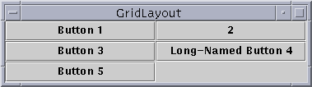
GridLayout
public GridLayout(int rows, int columns)
treats container as a grid of equally-sized rows and columns
components are given equal horizontal / vertical size, disregarding preferred size
can specify 0 rows or columns to indicate expansion in that direction as needed

Slide 26
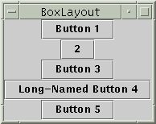
BoxLayout
Box.createHorizontalBox()
Box.createVerticalBox()
aligns components in container in a single row or column
components use preferred sizes and align based on their preferred alignment
preferred way to construct a container with box layout:
Box.createHorizontalBox(); or Box.createVerticalBox();

Slide 27

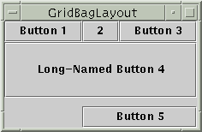
Other layouts
CardLayout
layers of "cards" stacked
on top of each other;
one visible at a time
GridBagLayout
very complicated;
my recommendation:
never ever use it
custom / null layout
allows you to define absolute positions using setX/Y and setWidth/Height

Slide 28
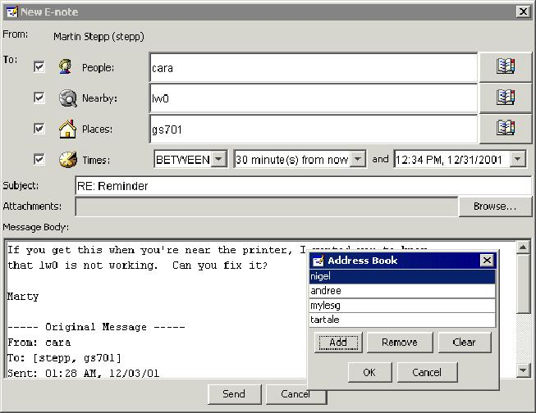
Problem with layout managers
How would you create a complex window like this, using the layout managers shown?

Slide 29
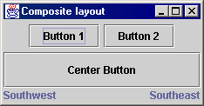
Solution: composite layout
create panels within panels
each panel has a different layout, and by combining the layouts, more complex / powerful layout can be achieved
example:
  how many panels?
  what layout in each?

Slide 30
For next time...
What is missing?
  Why don't the buttons do anything when we click them?
  How can we fix this problem?
Next lecture: events
  (making the GUI responsive to user interaction)
  allows our own GUIs to be interactive like JOptionPane

Slide 31
Event-driven Programming
program’s execution is indeterminate
on-screen components cause events to occur when they are clicked / interacted with
events can be handled, causing the program to respond, driving the execution thru events (an "event-driven" program)

Slide 32
Java Event Hierarchy
java.lang.Object
+--java.util.EventObject
+--java.awt.AWTEvent
+--java.awt.event.ActionEvent
+--java.awt.event.TextEvent
+--java.awt.event.ComponentEvent
+--java.awt.event.FocusEvent
+--java.awt.event.WindowEvent
+--java.awt.event.InputEvent
+--java.awt.event.KeyEvent
+--java.awt.event.MouseEvent
import java.awt.event.*;

Slide 33
Action events (ActionEvent)
most common / simple event type in Swing
represent an action occurring on a GUI component
created by:
  button clicks
  check box checking / unchecking
  menu clicks
  pressing Enter in a text field
  etc.

Slide 34

Listening for events
attach listener to component
listener’s appropriate method will be called when event occurs (e.g. when the button is clicked)
for Action events, use ActionListener

Slide 35
Writing an ActionListener
// part of Java; you don’t write this
public interface ActionListener {
void actionPerformed(ActionEvent event);
}
// Prints a message when the button is clicked.
public class MyActionListener
implements ActionListener {
public void actionPerformed(ActionEvent event){
System.out.println("Event occurred!");
}
}

Slide 36
Attaching an ActionListener
JButton button = new JButton("button 1");
ActionListener listener = new MyActionListener();
button.addActionListener(listener);
now button will print "Event occurred!" when clicked
addActionListener method exists in many Swing components

Slide 37
ActionEvent objects
public Object getSource()
Returns object that caused this event to occur.
public String getActionCommand()
Returns a string that represents this event.
(for example, text on button that was clicked)
Question: Where to put the listener class?

Slide 38
Inner class listener
public class Outer {
private class Inner implements ActionListener {
public void actionPerformed(
ActionEvent event) {
...
}
}
public Outer() {
JButton myButton = new JButton();
myButton.addActionListener(new Inner());
}
}

Slide 39
Anonymous inner listener
public class Outer {
public Outer() {
JButton myButton = new JButton();
myButton.addActionListener(
new ActionListener() {
public void actionPerformed(ActionEvent e) {
...
}
}
);
}
}

Slide 40
ActionListener in JFrame
public class Outer extends JFrame
implements ActionListener {
public Outer() {
JButton myButton = new JButton();
myButton.addActionListener(this);
}
public void actionPerformed(ActionEvent event) {
...
}
}

Slide 41
References
The Java Tutorial: Visual Index to the Swing Components.
http://java.sun.com/docs/books/tutorial/
uiswing/components/components.html
The Java Tutorial: Laying Out Components Within a Container.
http://java.sun.com/docs/books/tutorial/uiswing/
layout/index.html
The Java Tutorial: How to Write Action Listeners.
http://java.sun.com/docs/books/tutorial/
uiswing/events/actionlistener.html

