Slide 1
JDBC

Slide 2
JDBC stands for Java Database Connectivity.
JDBC is a Java API to connect and execute the query with the database.
It is a part of JavaSE (Java Standard Edition).
JDBC API uses JDBC drivers to connect with the database.

Slide 3
Definition of JDBC
JDBC is an API(Application programming interface) which is used in java programming to interact with databases.
The classes and interfaces of JDBC allows application to send request made by users to the specified database.

Slide 4
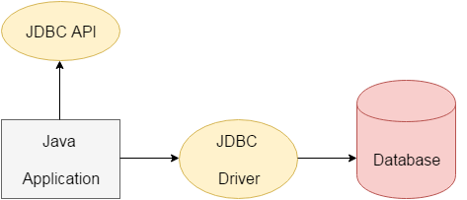

Slide 5
Why Should We Use JDBC
We can use JDBC API to handle database using Java program and can perform the following activities:
Connect to the database
Execute queries and update statements to the database
Retrieve the result received from the database.

Slide 6
Components of JDBC
There are generally four main components of JDBC through which it can interact with a database.
JDBC API
JDBC DRIVE MANAGER
JDBC Test suite
JDBC-ODBC Bridge Drivers

Slide 7
Architecture of JDBC

Slide 8
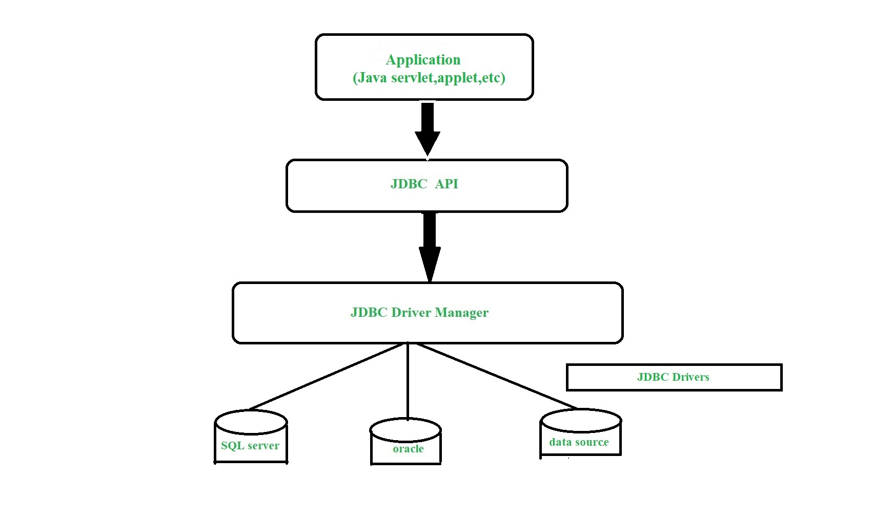

Slide 9
Application: It is a java applet or a servlet which communicates with a data source.
2.The JDBC API: The JDBC API allows Java programs to execute SQL statements and retrieve results

Slide 10
Some of the important classes and interfaces defined in JDBC API are as follows:
1.DriverManager 2.Driver 3.Connection 4.Statement 5.PreparedStatement 6.CallableStatement 7.ResultSet 8.SQL data

Slide 11
3.DriverManager: It plays an important role in the JDBC architecture.It uses some database-specific drivers to effectively connect enterprise applications to databases.
4.JDBC drivers: To communicate with a data source through JDBC, you need a JDBC driver that intelligently communicates with the respective data source.

Slide 12
JDBC CLASSES AND INTERFACES

Slide 13
Driver Manager
.
The DriverManager class (java.sql.DriverManager) is one of main components of JDBC.
DriverManager manages database drivers, load database specific drivers and select the most appropriate database.

Slide 14
Connection
Connection interface provides access the session established with a database server.
Connection con = DriverManager.getConnection(url, username, password);

Slide 15
Statement
The Statement interface provides a standard abstraction to execute SQL statements and return the results using the ResultSet objects.
Statement st = con.createStatement();

Slide 16
PreparedStatement
PreparedStatement is a sub interface of the Statement interface.
PreparedStatements are pre-compiled and hence their execution is much faster than that of Statements.

Slide 17
PreparedStatement ps1 = con.prepareStatement("insert into employeeList
values ('Heartin',2)");
CallableStatement
CallableStatement extends the capabilities of a PreparedStatement to include methods
CallableStatement
CallableStatement extends the capabilities of a PreparedStatement to include methods

Slide 18
JDBC Drivers

Slide 19
There are 4 types of JDBC drivers:
JDBC-ODBC bridge driver
2.Native-API driver (partially java driver)
3.Network Protocol driver (fully java driver)
4.Thin driver (fully java driver)

Slide 20
1.JDBC-ODBC bridge driver
The JDBC-ODBC bridge driver uses ODBC driver to connect to the database.
The JDBC-ODBC bridge driver converts JDBC method calls into the ODBC function calls.
This is now discouraged because of thin driver.

Slide 21
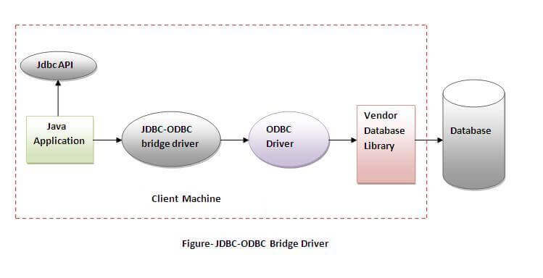

Slide 22
2.Native-API driver
The Native API driver uses the client-side libraries of the database.
The driver converts JDBC method calls into native calls of the database API.

Slide 23
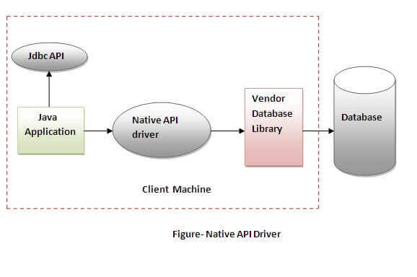

Slide 24
3.Network Protocol driver
The Network Protocol driver uses middleware (application server) that converts JDBC calls directly or indirectly into the vendor-specific database protocol.

Slide 25
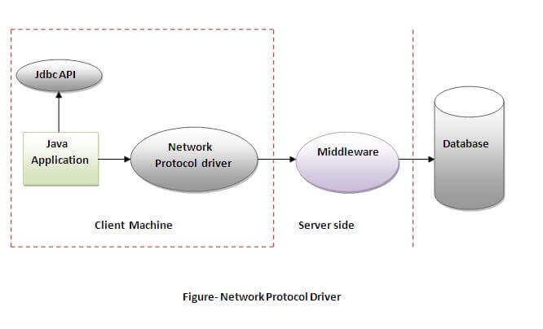

Slide 26
4.Thin driver
The thin driver converts JDBC calls directly into the vendor-specific database protocol.
That is why it is known as thin driver.

Slide 27
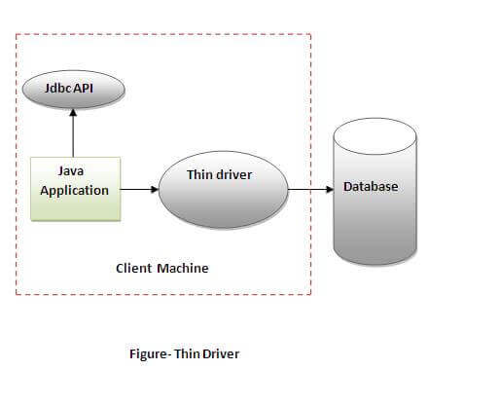

Slide 28
Java Database Connectivity

Slide 29
Java Database Connectivity
There are 5 steps to connect any java application with the database using JDBC.
These steps are as follows:Register the Driver class
Create connection
Create statement
Execute queries
Close connection

Slide 30
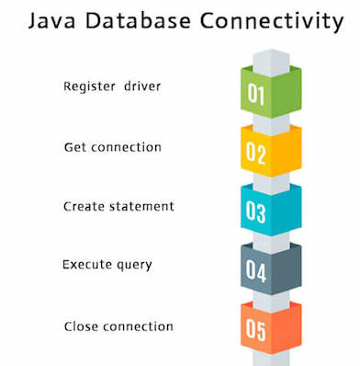

Slide 31
1.Register the driver class
The forName() method of Class class is used to register the driver class.
Syntax
public static void forName(String className)
throws ClassNotFoundException

Slide 32
2.Create the connection object
The getConnection() method of DriverManager class is used to establish connection with the database.
Syntax
public static Connection getConnection(String url)throws SQLExce
ption

Slide 33
3.Create the Statement object
The createStatement() method of Connection interface is used to create statement.
The object of statement is responsible to execute queries with the database.
Syntax
public Statement createStatement()throws SQLE
xception

Slide 34
4.Execute the query
The executeQuery() method of Statement interface is used to execute queries to the database.
Syntax
public ResultSet executeQuery(String sql)throws
SQLException

Slide 35
Close the connection object
By closing connection object statement and ResultSet will be closed automatically.
Syntax
public void close()throws SQLException

