Slide 1
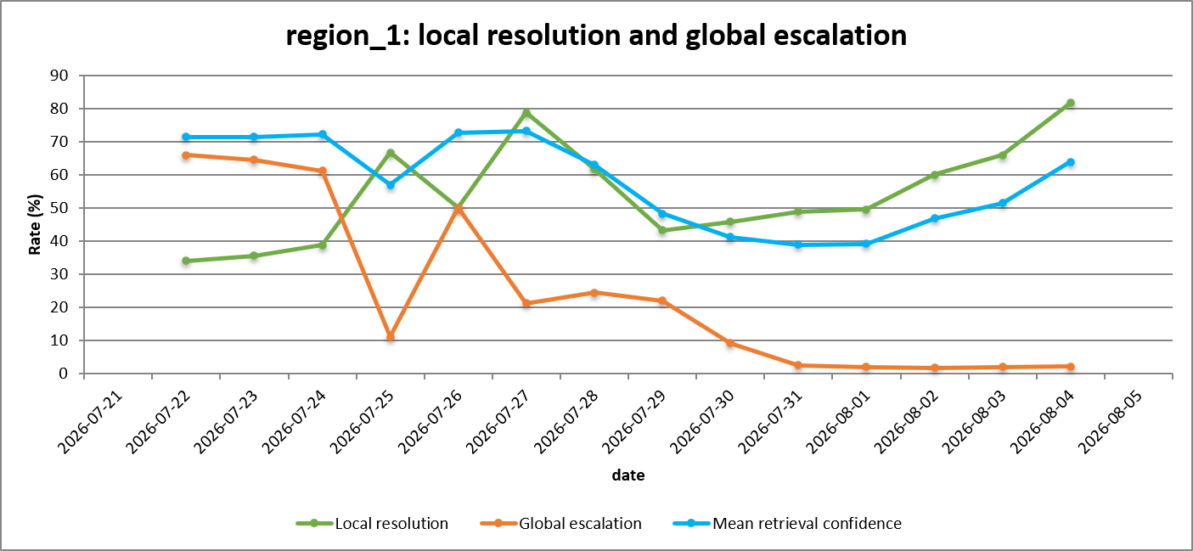
Regional learning: escalation falls as the region learns
Escalation 66% → 2%;
local resolution 34% → 82%
Global answers are canonicalized back into the region, so repeat threats resolve at the edge
Local answers resolve in < 50 ms at zero cloud LLM cost
Confidence dips as the KB widens to harder events, recovers to 64%
19
Notes:
This is the regional learning effect in one picture. Region 1 starts by escalating about two thirds of its threats to the Global RAG. By the end it resolves over eighty percent locally and escalates almost nothing. Nothing about the routing threshold changed: eligible global answers were canonicalised back into the region, so events that once needed the central agent are now answered at the edge in under fifty milliseconds at zero cloud cost. Volunteer the dip before you are asked: mean retrieval confidence falls from about seventy-three percent to thirty-nine while local resolution rises. That is not a contradiction. As the knowledge base grows the region starts answering a broader and harder set of events, so the mean is taken over more marginal matches. It recovers to sixty-four percent as that knowledge consolidates, and confidence per accepted answer never drops below the routing gate. Note the window: this chart spans the full evaluation period, not just the five-day campaign.

Slide 2
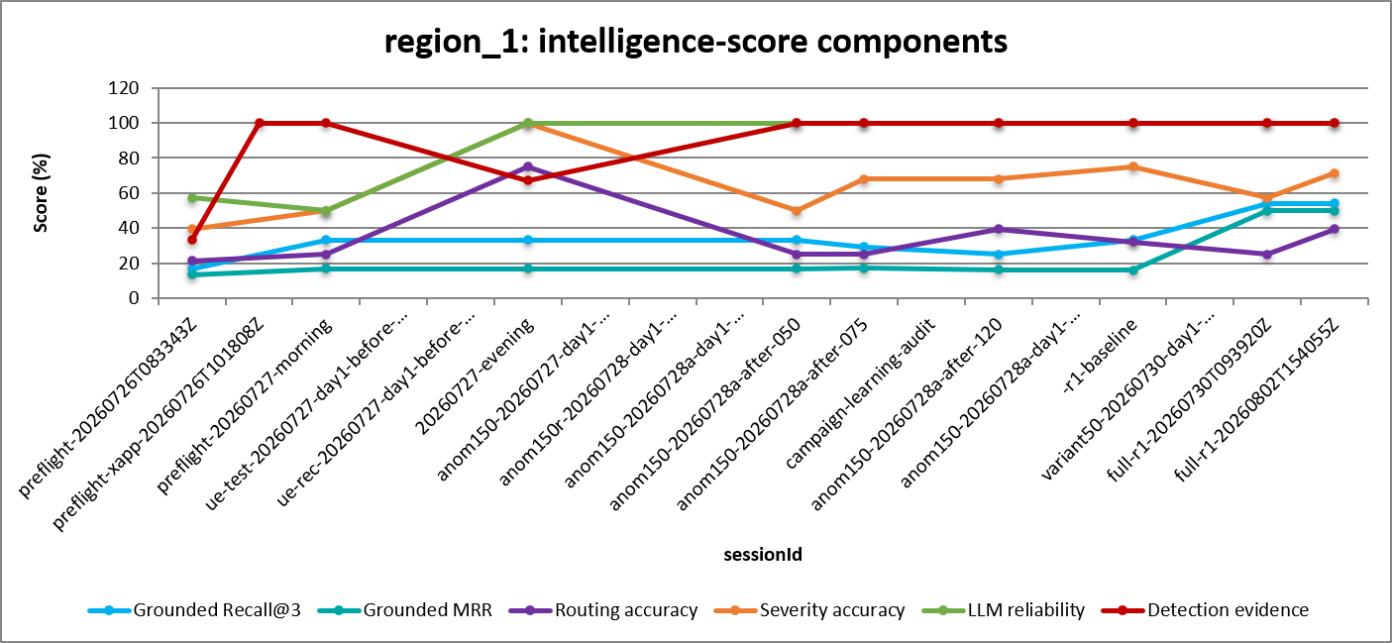
Why the composite moved
LLM reliability and detection evidence saturate at 100%
Retrieval steps up late: Recall@3 54.2%, MRR 50.0%
Every one of the six components improved on its starting value
Severity accuracy climbed ≈40% → 71.4% across the campaign
20
Notes:
This slide is the honesty check on the previous one. The composite rose to 75.6 percent, and this shows exactly which components earned it. Two components saturate early and hold: generation reliability and detection evidence are both at one hundred percent, so neither is a source of remaining headroom. Retrieval is the late mover — grounded Recall-at-3 and MRR sit flat for most of the campaign and only step up in the final session, because retrieval can only improve once enough learned knowledge has accumulated to be retrievable. Routing accuracy at thirty-nine percent is our weakest component and the most volatile, and we say so rather than burying it in the total. Severity ends at seventy-one percent, which matters because a complete, well-formed response can still carry an incorrect security judgement — that is why severity is scored separately from generation reliability. The point of the slide is decomposability: every movement in the headline number traces to a named component, and below that to a specific benchmark case.

