Slide 1



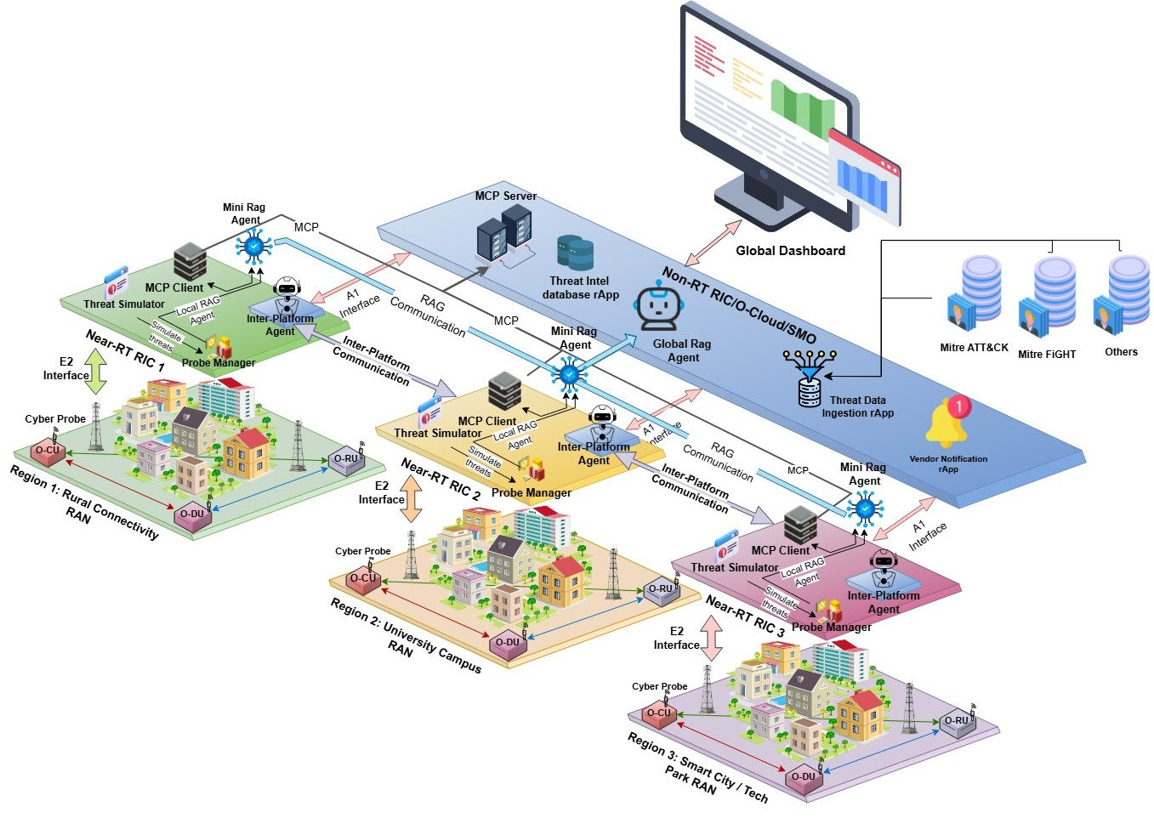






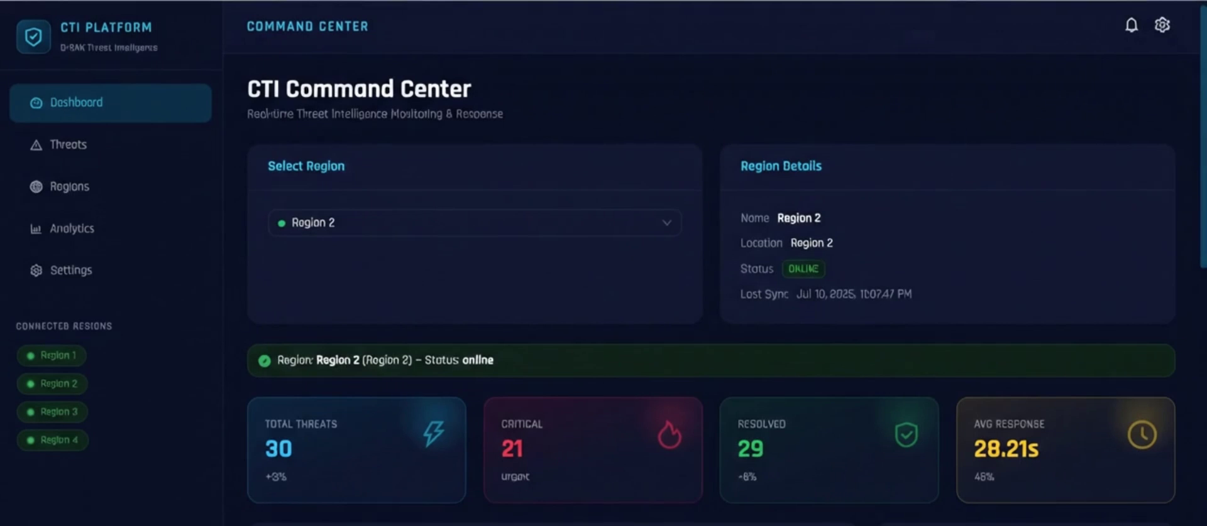








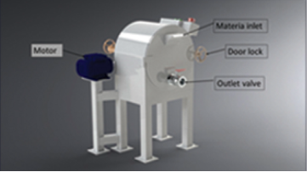
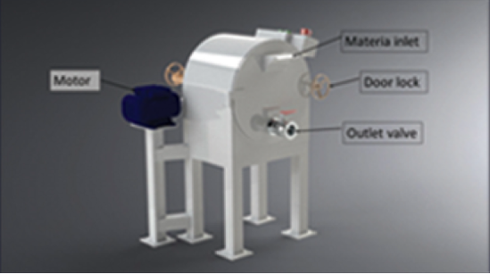





CYBER THREAT INTELLIGENCE (CTI) PLATFORM FOR OPEN RAN
Madakaladeniya I.U., Wijesinghe S.A., Rathnaweera P.A.G.N., Achintha H.G.R.
Supervised by Dr. (Eng.) W.N.B.A. Geeth Priyankara and Asst. Prof. Pasika Ranaweera
Abstract
System Architecture
Open RAN disaggregates the radio access network across multi-vendor components connected by open interfaces. That openness enables innovation but widens the attack surface, while general-purpose CTI platforms describe enterprise IT assets and cannot express which O-RAN component or interface a threat actually affects. This project delivers an O-RAN-native Cyber Threat Intelligence platform deployed across four regions on a Netslab K3s testbed with active O-RAN SC Near-RT RIC services, srsRAN radio workloads and an Open5GS 5G core. Regional Mini-RAG agents contextualise threats against their own knowledge base and escalate to a central Global-RAG over the Model Context Protocol only when local evidence is insufficient, while an Inter-Platform Agent distributes sanitised intelligence to peer regions that do not already hold it. A guarded controller executes bounded mitigations with verification and rollback.
Introduction
O-RAN replaces closed, single-vendor base stations with disaggregated O-RU, O-DU and O-CU functions coordinated by RAN Intelligent Controllers over the open E2, A1, O1 and Open Fronthaul interfaces.
The resulting attack surface spans the radio units, the RIC and its xApps and rApps, and the O-Cloud platform beneath them. Security evidence is therefore produced in different administrative, geographic and timing domains rather than at one central observation point, which makes a conventional centralised CTI workflow a poor fit for the architecture.
Four Near-RT RIC regions with their own RAN, xApps, Mini-RAG and Inter-Platform Agent, under one Non-RT RIC / SMO platform.
Results & Evaluation
Problem Statement
Closed-loop intelligence score rose from 30.6% to 75.6% across nine complete measurement sessions (mean 64.4%, SD 12.6 pp) on the frozen benchmark.
100% LLM generation reliability and 100% end-to-end detector capture in the latest session; severity accuracy 71.4% and grounded Recall@3 54.2%.
750 bounded security events emulated over a five-day campaign across eight threat families in two evaluated regions.
85-90% reduction in CTI data footprint after semantic pruning and graph reduction.
Cross-region pre-arming let a peer region respond without repeating the full analysis loop (N = 10 bounded quarantine trials).
A security event affecting an O-DU, an E2 interface or an xApp is not simply a generic software vulnerability. Its significance depends on the component's role, its relationships with other O-RAN functions, the affected control or user-plane path and the current operational state.
Existing CTI platforms offer mature enterprise workflows but no native O-RAN semantics. Technically valid intelligence therefore cannot be connected to the exposed radio component, interface or RIC application, which leads to irrelevant retrieval, delayed decisions and inappropriate mitigation.
Aims & Objectives
Benchmark against OpenCTI 6.0+
Aim
To design, implement and validate an evidence-grounded, O-RAN-specific CTI knowledge framework that converts heterogeneous observations into component-aware and actionable intelligence, enriched through controlled cross-region learning.
Objectives
Build a disaggregated multi-region O-RAN CTI platform that collects explainable evidence from E2SM-KPM, Prometheus, Loki and Falco into dynamic, O-RAN-aware CTI registries.
Integrate agentic AI so regional RAG agents contextualise threats, escalate to Global-RAG over MCP when evidence is insufficient, and learn eligible knowledge back into their region.
Distribute confirmed intelligence between regions with sanitisation, semantic de-duplication and preserved provenance, never by writing into another region's data.
Keep response under deterministic policy gates, with operator approval where required, effect verification and rollback.
Validate the platform with a frozen intelligence benchmark, controlled detector and mitigation experiments, and a comparison against an isolated OpenCTI baseline.
Six ground-truth 5G security scenarios executed concurrently against both platforms.
Evaluation metric
Our platform
OpenCTI 6.0+
STIX precision (Recall@3)
100.0%
0.0%
STIX taxonomy alignment
100.0%
33.3%
End-to-end detection
100.0%
100.0%
Platform stability
100.0%
100.0%
STIX confidence validation
90.0%
100.0%
Operational CTI latency
3755 ms
37.7 ms
Live Platform
Methodology
1. CTI Ingestion
2. Semantic Pruning
3. Detection Gateway
Scan for the interactive project walkthrough
MITRE ATT&CK and FiGHT normalised to STIX 2.1, then pruned
Max-Sim relevance and 2-hop BFS reduce the footprint 85-90%
Prometheus, Loki, Falco and KPM into one transparent schema
4. Regional Mini-RAG
5. Global Escalation
6. Guarded Mitigation
Conclusion & Future Work
Local vector retrieval, severity and routing decision
global_rag.analyze_threat over MCP/SSE, then regional learning
Safety gates, actuation, PromQL verification and rollback
The platform shows that an O-RAN-native, local-first CTI architecture can contextualise threats with the component and interface awareness that generic CTI tools lack, while keeping detection authority in deterministic detectors and execution authority behind policy gates.
Future work: Physical and multi-vendor validation on separate infrastructure with realistic delay. A larger, independently reviewed O-RAN CTI benchmark with repeated trials. Telecom-specific embeddings and locally hosted language models.
DEPARTMENT OF ELECTRICAL AND INFORMATION ENGINEERING
FACULTY OF ENGINEERING, UNIVERSITY OF RUHUNA

