Slide 1

Cyber Threat Intelligence
(CTI) Platform for
Open-RAN
H.G.R. Achintha
EG/2021/4384
I.U. Madakaladeniya
EG/2021/4651
P.A.G.N. Rathnaweera
EG/2021/4751
S.A. Wijesinghe
EG/2021/4877
Supervisor : Dr. Geeth Priyankara
Co-Supervisor : Assistant Prof. Pasika Ranaweera
1
Notes:
Good morning. We are presenting our final year project: a Cyber Threat Intelligence platform built specifically for Open RAN. Over the next fifteen minutes I will cover why O-RAN needs its own CTI, what we built across a four-region testbed, and the measured results including a head-to-head against OpenCTI.

Slide 2
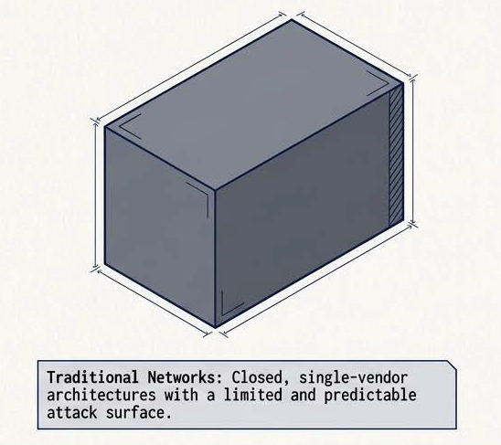
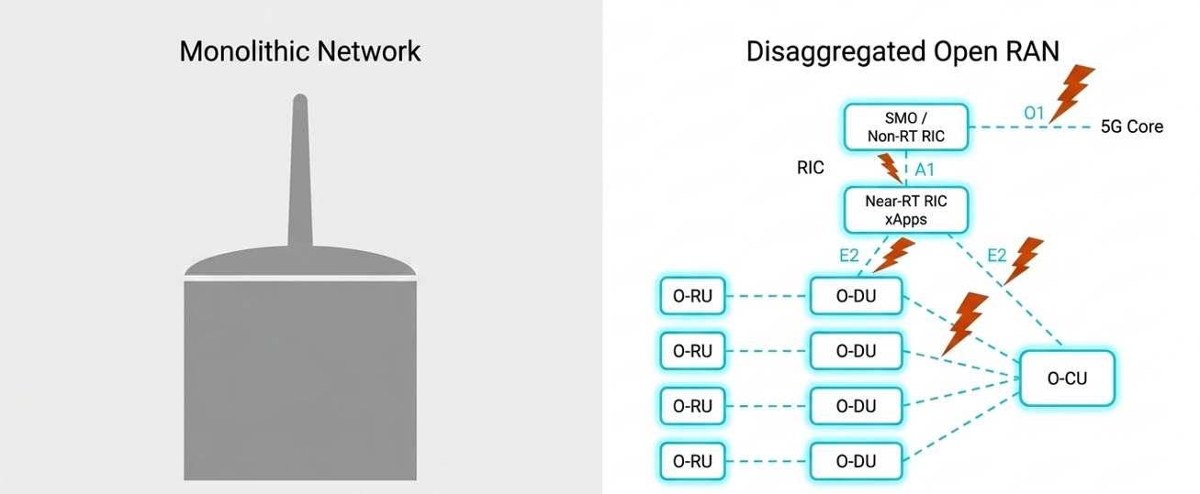
The O-RAN Paradigm - Flexibility vs. Vulnerability
Traditional networks: closed, single-vendor architectures with a limited and predictable attack surface.
O-RAN: unprecedented flexibility through interoperable components, completely redefining the security perimeter.
O-RAN Specific CTI Absence
Lack of RIC Integration
Insufficient Threat Sharing
E2E Detection & Mitigation
Existing enterprise CTI tools are blind to specific O-RAN components (O-RU, O-DU, O-CU).
Security fails to natively use the RAN Intelligent Controller for programmable defence.
No standardised, privacy-preserving protocol, creating reactive silos not collaborative defence.
No end-to-end threat detection and mitigation with CTI in the context of O-RAN.
2
Notes:
O-RAN disaggregates the base station into multi-vendor components joined by open interfaces. That is the innovation, and it is also the vulnerability: the attack surface now spans the radio units, the RIC and its apps, and the cloud platform underneath. Our literature review found four concrete gaps, and these four gaps are what the project set out to close.

Slide 3
Solution
A disaggregated CTI platform on a native O-RAN with autonomous threat dissemination
O-RAN Domain-Native CTI & STIX 2.1 Graph
Dual-Tier RIC Integration (xApps + rApps)
Synthesises telecom-specific threat intelligence across all 10 O-RAN components, open interfaces (E2, A1, O1) and multi-vendor radio attack paths.
Natively integrates detection, vector retrieval and tactical defence directly into Near-RT and Non-RT RIC control loops with locality-first sub-second edge resolution.
Max-Sim semantic tensor pruning of MITRE ATT&CK and FiGHT, ArangoDB STIX 2.1 graph store (:8529), OASIS TAXII 2.1 REST server (:5001)
xApp2 telemetry ingestion, all-MiniLM-L6-v2 ChromaDB vector store with strict threshold gate (t_L = 0.69) for <50 ms local response, Gemini 1.5 Pro with OpenRouter fallback.
Inter-Platform Agent & FastMCP Exchange
Deterministic Gateway & Guarded Mitigation
Enables collaborative cross-region threat defence by securely synchronising intelligence and dynamic edge learning without exposing operational privacy or creating broadcast loops.
Provides end-to-end protection by grounding multi-modal anomalies in verifiable mathematical metrics and executing safety-gated, reversible network responses.
FastMCP tool escalation (:8000/mcp), automated PII and IP scrubbing, source-exclusion loop prevention, local ChromaDB PVC upsert.
Multi-modal E2SM-KPM, Falco and Loki V% scoring, xApp1 E2SM-RC throttle and CNI pod quarantine, PromQL closed-loop effect verification with automated safe rollback.
3
Notes:
Our solution has four pillars. First, a CTI knowledge base that is native to O-RAN rather than enterprise IT. Second, integration into both RIC tiers so intelligence actually reaches the control loop. Third, an Inter-Platform Agent that shares intelligence between regions without leaking operational data. Fourth, a deterministic detection gateway with guarded, reversible mitigation. Everything after this slide is the detail behind these four boxes.

Slide 4
Initial Project Objectives
01
O1: Design and Implement a Disaggregated, O-RAN-specific CTI Platform
02
O2: Integrate Agentic AI for O-RAN Threat Contextualisation & Response
Build multi-region testbed with Near-RT RIC, srsRAN/Open5GS, xApps and regional intelligence.
Collect security evidence from O-RAN and cloud sources (E2SM-KPM, Prometheus, Loki, Falco).
Ingest ATT&CK, FiGHT and vulnerabilities into O-RAN-aware CTI registries.
Enable prioritised, privacy-aware dissemination with provenance and dashboard.
Develop regional RAG agents for CTI retrieval and severity classification.
Coordinate escalation to Global-RAG via MCP when regional evidence is insufficient.
Return global knowledge to the region, control growth via canonicalisation and de-duplication.
Generate contextual recommendations with policy gates, approval, verification and rollback.
03
O3: Validate and Evaluate the O-RAN CTI Platform & Agentic AI Workflow
Measure retrieval, contextualisation and knowledge growth against an OpenCTI baseline.
Validate detector capture and evidence transparency with controlled scenarios.
Evaluate bounded mitigation: execution, verification, timing and rollback.
Observe operational health via the security score and component metrics.
4
Notes:
These are the three objectives we declared at the proposal stage. O1 build the platform, O2 integrate agentic AI, O3 validate it properly. I will come back at the end and show you exactly which of these we met and where we fell short.

Slide 5
Extended Project Objectives
Two major capabilities were added as the project evolved from the progress-report proposal into the final multi-region platform.
Implement the Anomaly Detection Gateway for O-RAN Telemetry
Set Up Automated Mitigation Pipeline for Closed-Loop O-RAN Defence
Ingest and correlate multi-modal telemetry across O-RAN radio, container runtime syscalls and control-plane logs.
Execute deterministic anomaly scoring and baseline evaluation using rolling 3-sigma statistical thresholds.
Record immutable, normalised ThreatEvent ledgers in rApp2, preserving affected component, interface and structured rule_evaluations.
Validate detector transparency and evidence contracts across controlled synthetic scenarios.
Enforce safety policy gates and allow-listed actuators (xApp1 E2SM-RC throttle, A1 policy, pod quarantine) with explicit critical-infrastructure protection.
Implement closed-loop PromQL telemetry verification across a 5-stage state machine to confirm security outcomes.
Execute automated safe rollback upon verification failure or timeout, restoring baseline radio policies and network connectivity.
5
Notes:
Two capabilities were added after the progress report, and they are the largest engineering additions in the project. The Anomaly Detection Gateway gave us deterministic, explainable detection instead of relying on the language model. The automated mitigation pipeline closed the loop, so the platform does not just describe a threat, it responds to it and verifies the response.

Slide 6
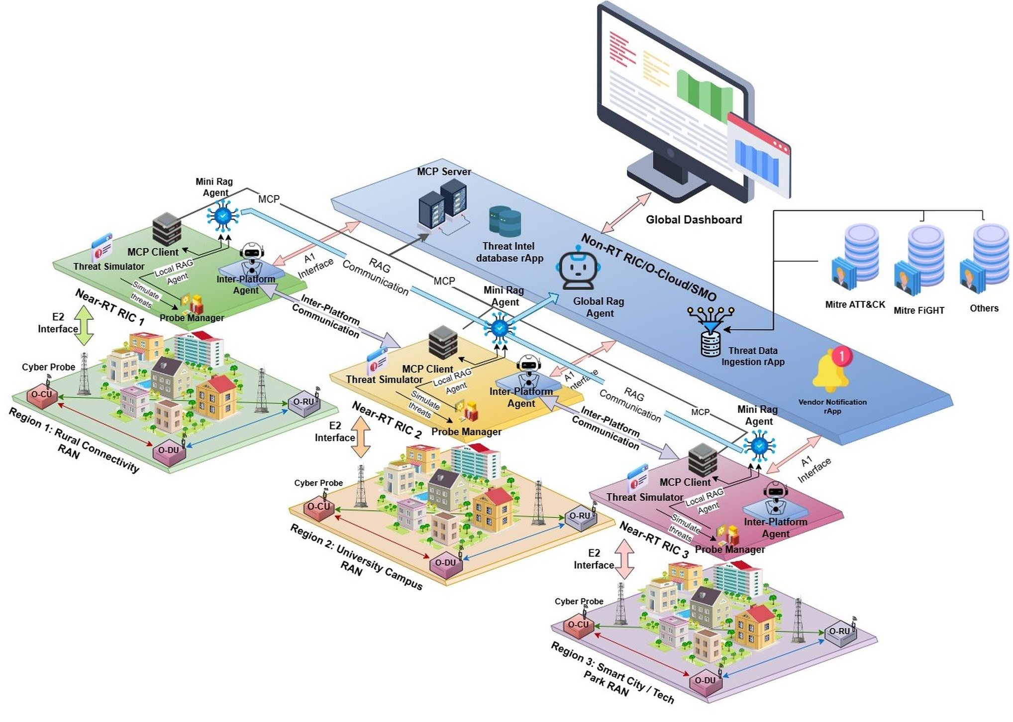
System Architecture
1
Threat intelligence sources
MITRE ATT&CK, MITRE FiGHT and vulnerability feeds enter through the Threat Data Ingestion rApp.
2
Non-RT RIC / O-Cloud / SMO
Global RAG agent, MCP server, threat-intel database rApp, vendor notification rApp and the global dashboard.
3
Near-RT RIC regions
Each region runs a Threat Simulator, Probe Manager, MCP client, Mini RAG agent and Inter-Platform Agent.
4
RAN and radio layer
srsRAN O-CU, O-DU and O-RU with cyber probes, observed by the region over the E2 interface.
6
Notes:
This is the whole platform on one canvas. Working right to left: number one, public threat intelligence enters through the ingestion rApp. Number two is the central Non-RT RIC and SMO layer holding the Global RAG agent, the MCP server and the dashboard. Number three, four independent Near-RT RIC regions, each with its own Mini RAG and its own Inter-Platform Agent. Number four, each region has a real RAN underneath it observed over E2. The key design principle is local-first: a region answers from its own knowledge if it can, and only escalates when it cannot.

Slide 7
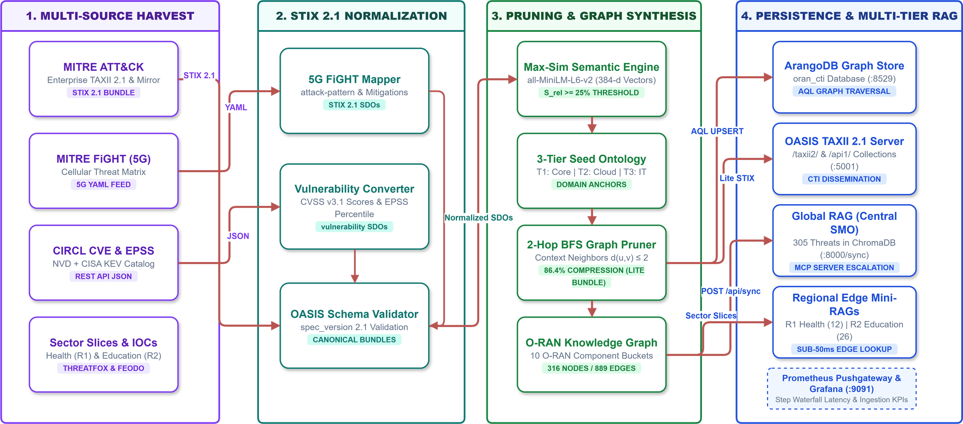
Threat Ingestion & Normalization Pipeline
Semantic Tensor Pruning - dual-stage Max-Sim filtering prunes 85 to 90% of irrelevant enterprise IT noise from MITRE ATT&CK and FiGHT, retaining only O-RAN-specific threat vectors.
Domain-Native TAXII server & STIX 2.1 Graph - combined threats across all 10 O-RAN architectural components into an ArangoDB graph database (:8529), exposed via an OASIS TAXII 2.1 server (:5001).
7
Notes:
The knowledge layer. We harvest four sources: MITRE ATT&CK, MITRE FiGHT for 5G, CVE and EPSS vulnerability data, and sector-specific IOC feeds. Everything is normalised to STIX 2.1, then a Max-Sim semantic engine scores each record against the O-RAN domain and a two-hop breadth-first search extracts the connected subgraph. The headline number is the compression: 86.4 percent, leaving 316 nodes and 889 edges. That is what makes this deployable at the edge instead of needing a data centre.

Slide 8
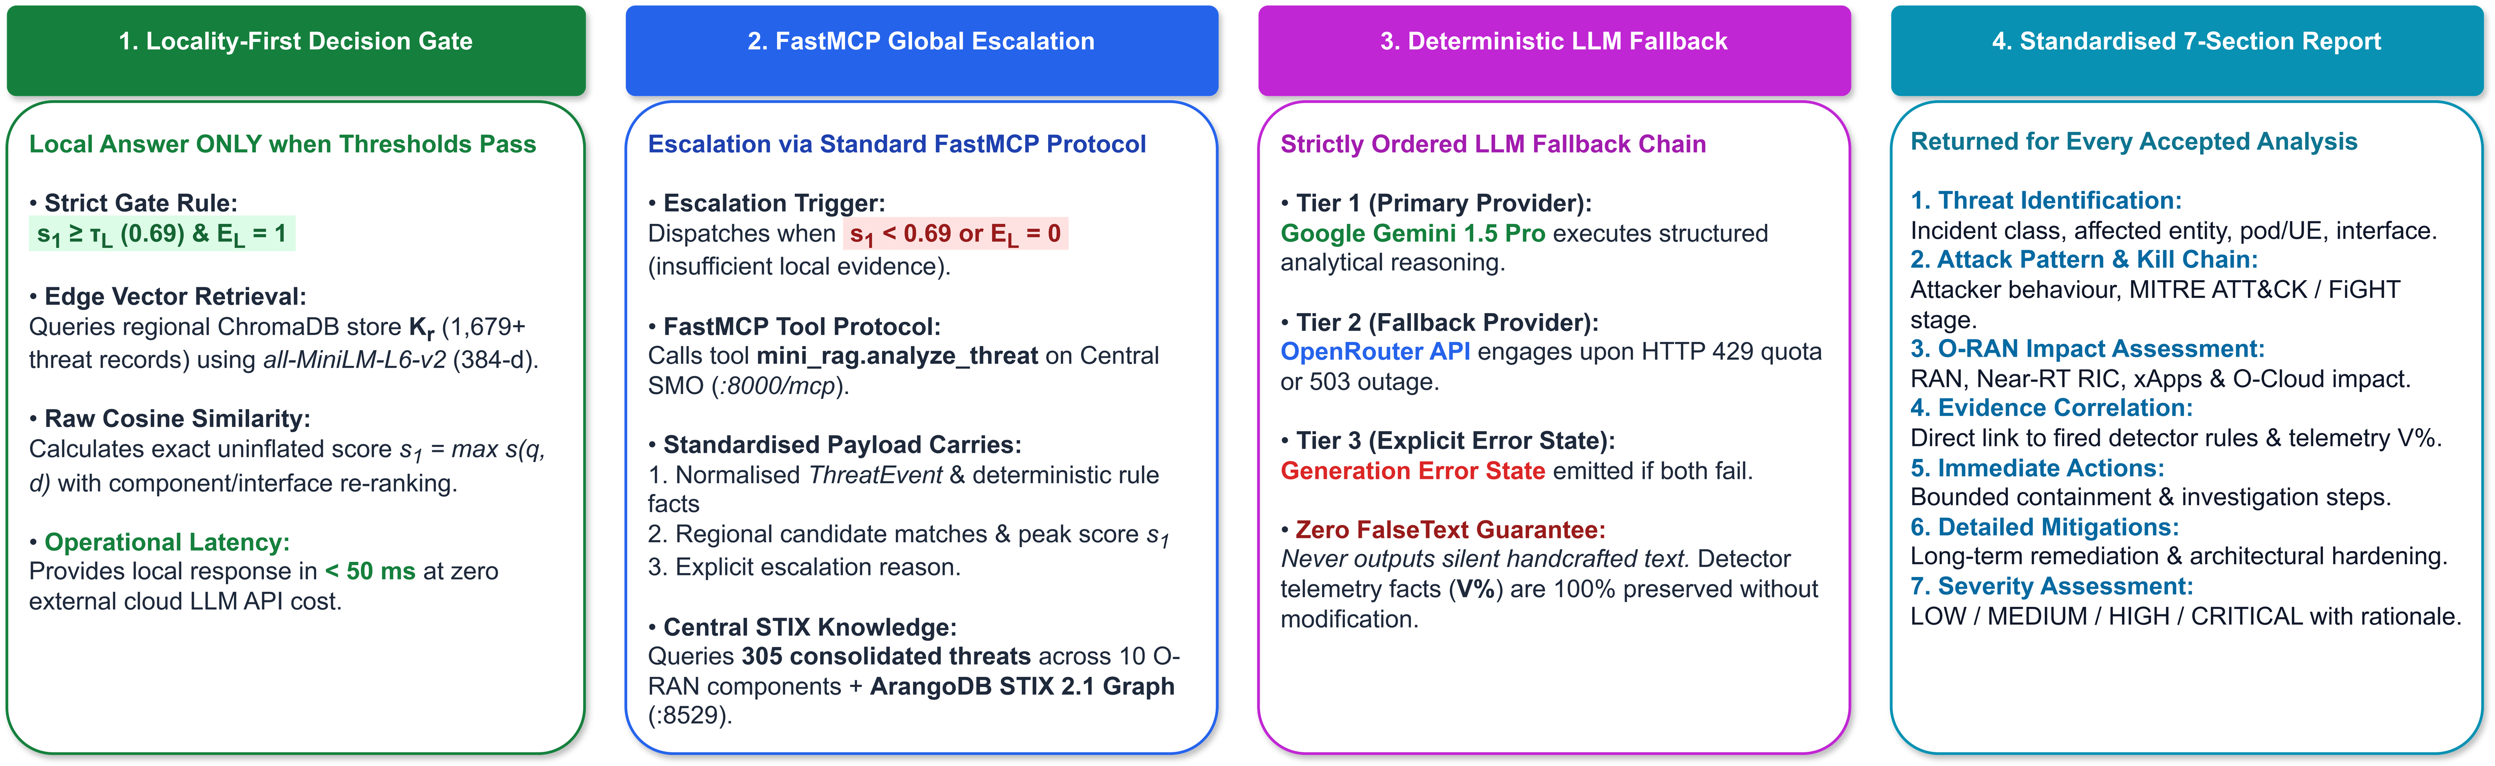
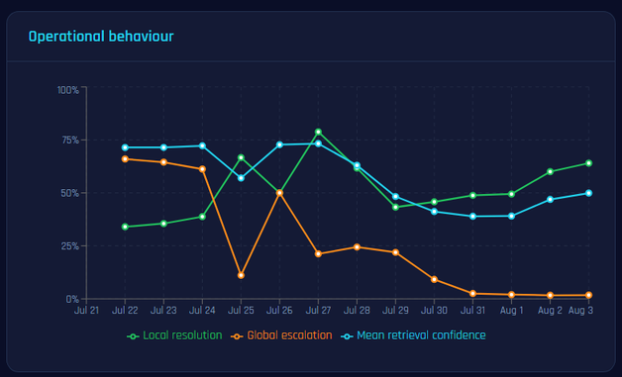
Regional Mini-RAG and Global-RAG Workflow
Escalation trigger - Global-RAG is engaged only when local similarity drops below the threshold.
Learning criteria - integration is limited to valid, usable and novel records; existing families are ignored.
The RL metric - growth efficiency is learned records over eligible escalations, not raw threat volume.
Decision separation - escalation and learning are deliberately decoupled.
8
Notes:
This is the intelligence decision. A region answers locally only when the similarity score clears 0.69 and the evidence flag is set, which gives a sub-fifty-millisecond answer at zero cloud cost. If it cannot, it escalates over FastMCP to the Global RAG. There is a strict three-tier LLM fallback, and critically a zero false-text guarantee: if every provider fails we emit an explicit error state rather than inventing an answer. Every accepted analysis comes back as the same seven-section report.

Slide 9
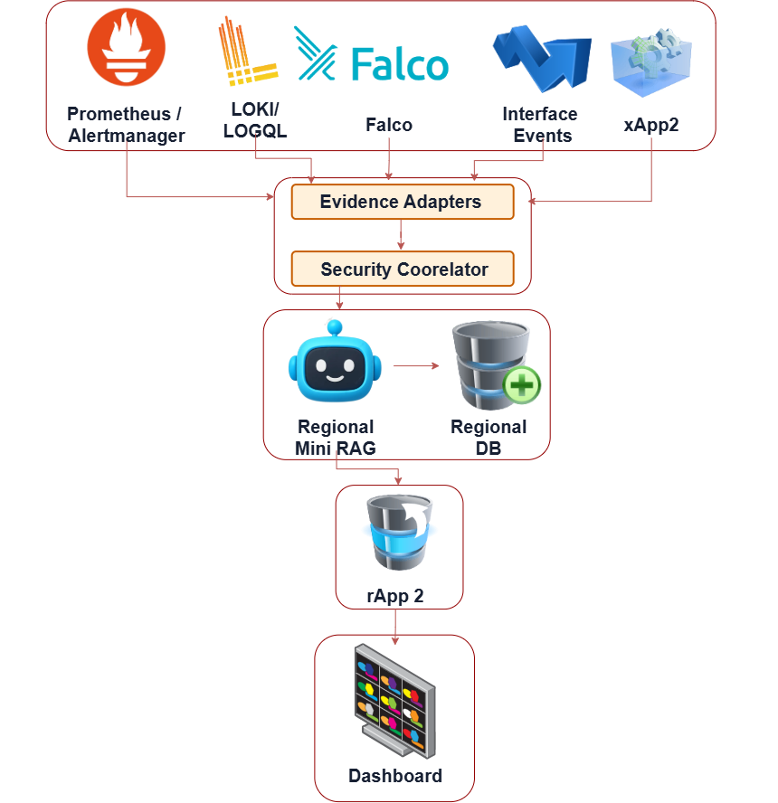
Anomaly Detection Gateway
Multi-Modal Telemetry Streams
Radio metrics (E2SM-KPM / xApp2)
Container runtime (Falco)
Control-plane logs (Loki)
Interface events and Prometheus alerts
Deterministic Scoring Engine
Direct threshold and 3-sigma baseline evaluation
Correlation over a 300 s window
Zero AI involvement in the detection decision
Normalized ThreatEvent Recording
Standardised JSON contract
Rule, criterion, measured value and threshold retained
Immutable persistence in rApp2
9
Notes:
This is our first extended objective delivered. Four very different evidence sources are normalised into one schema by the security correlator. The most important design decision is on the middle right: the scoring is deterministic. The rule that fired, the measured value and the threshold are stored separately from any AI explanation. So if every language model provider is unavailable, an operator can still see exactly why an event exists. The AI explains; it never decides detection.

Slide 10
Anomaly Families - Emulation and Detection
Family
Mechanism (bounded / labelled simulation)
Expected detector family
UE DoS / KPM
Bounded iperf load + KPM throughput evidence
KPM threshold / baseline
UE runtime shell
Bounded shell execution with experiment marker
Falco container shell rule
A1 anomaly (simulated)
Structured invalid / unauthorised policy burst
A1 policy validation failure
F1 anomaly (simulated)
Structured F1 interface anomaly contract
F1 interface anomaly family
E2 signalling (simulated)
Structured E2 signalling anomaly contract
E2 signalling / subscription family
xApp invalid API
Bounded invalid threat-event API requests
OranXappInvalidApiBurst
Pod runtime shell
Short-lived Alpine pod shell marker
Falco shell-spawn family
Memory pressure
Resource-limited workload, sustained pressure
Memory limit pressure family
Auth log burst
Controlled authentication failure log messages
Region auth failure burst
10
Notes:
These are the nine anomaly families we emulate. I want to be explicit about honesty here: the middle column says bounded or labelled simulation. The UE DoS runs real iperf traffic through a real UE path and the shell tests are observed by Falco. But A1, F1 and E2 anomalies are detector-contract simulations, permanently flagged simulation-equals-true in the database. We never present a simulated contract as a live radio exploit.

Slide 11
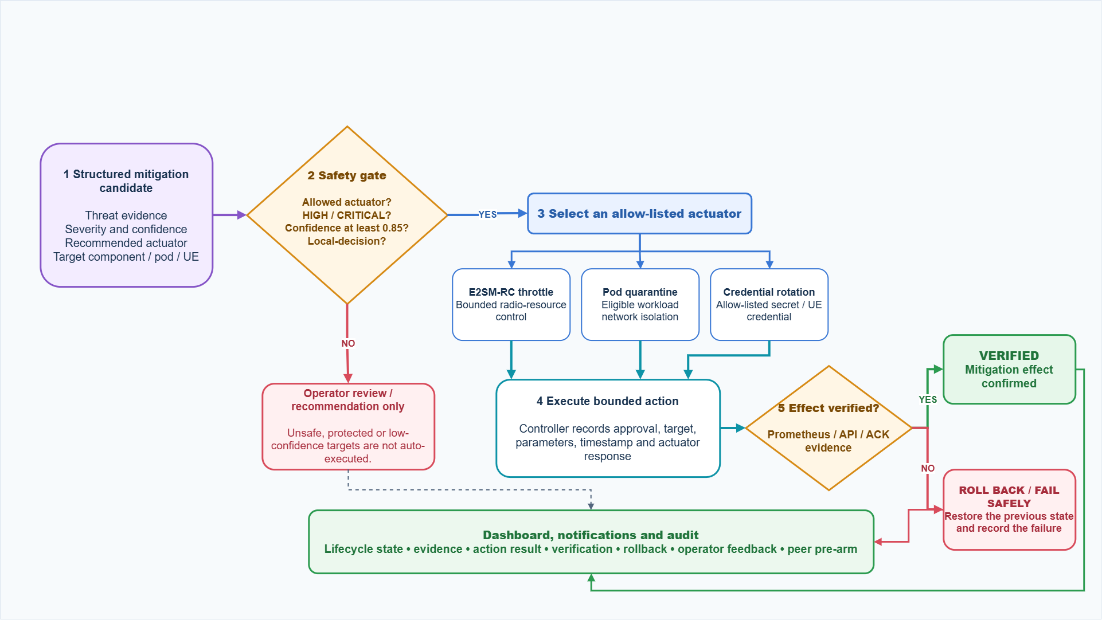
Guarded Closed-Loop Mitigation & Actuation
11
Notes:
Our second extended objective. A structured mitigation candidate arrives with its evidence, severity and confidence. It then hits a safety gate: is the actuator allow-listed, is the severity high or critical, is confidence at least 0.85, and was this a local decision. If any answer is no, it becomes a recommendation for an operator and is never auto-executed. If yes, the controller picks an allow-listed actuator, executes a bounded action, then verifies the effect against Prometheus. If verification fails it rolls back automatically and records the failure. An issued command is never reported as a security outcome on its own.

Slide 12
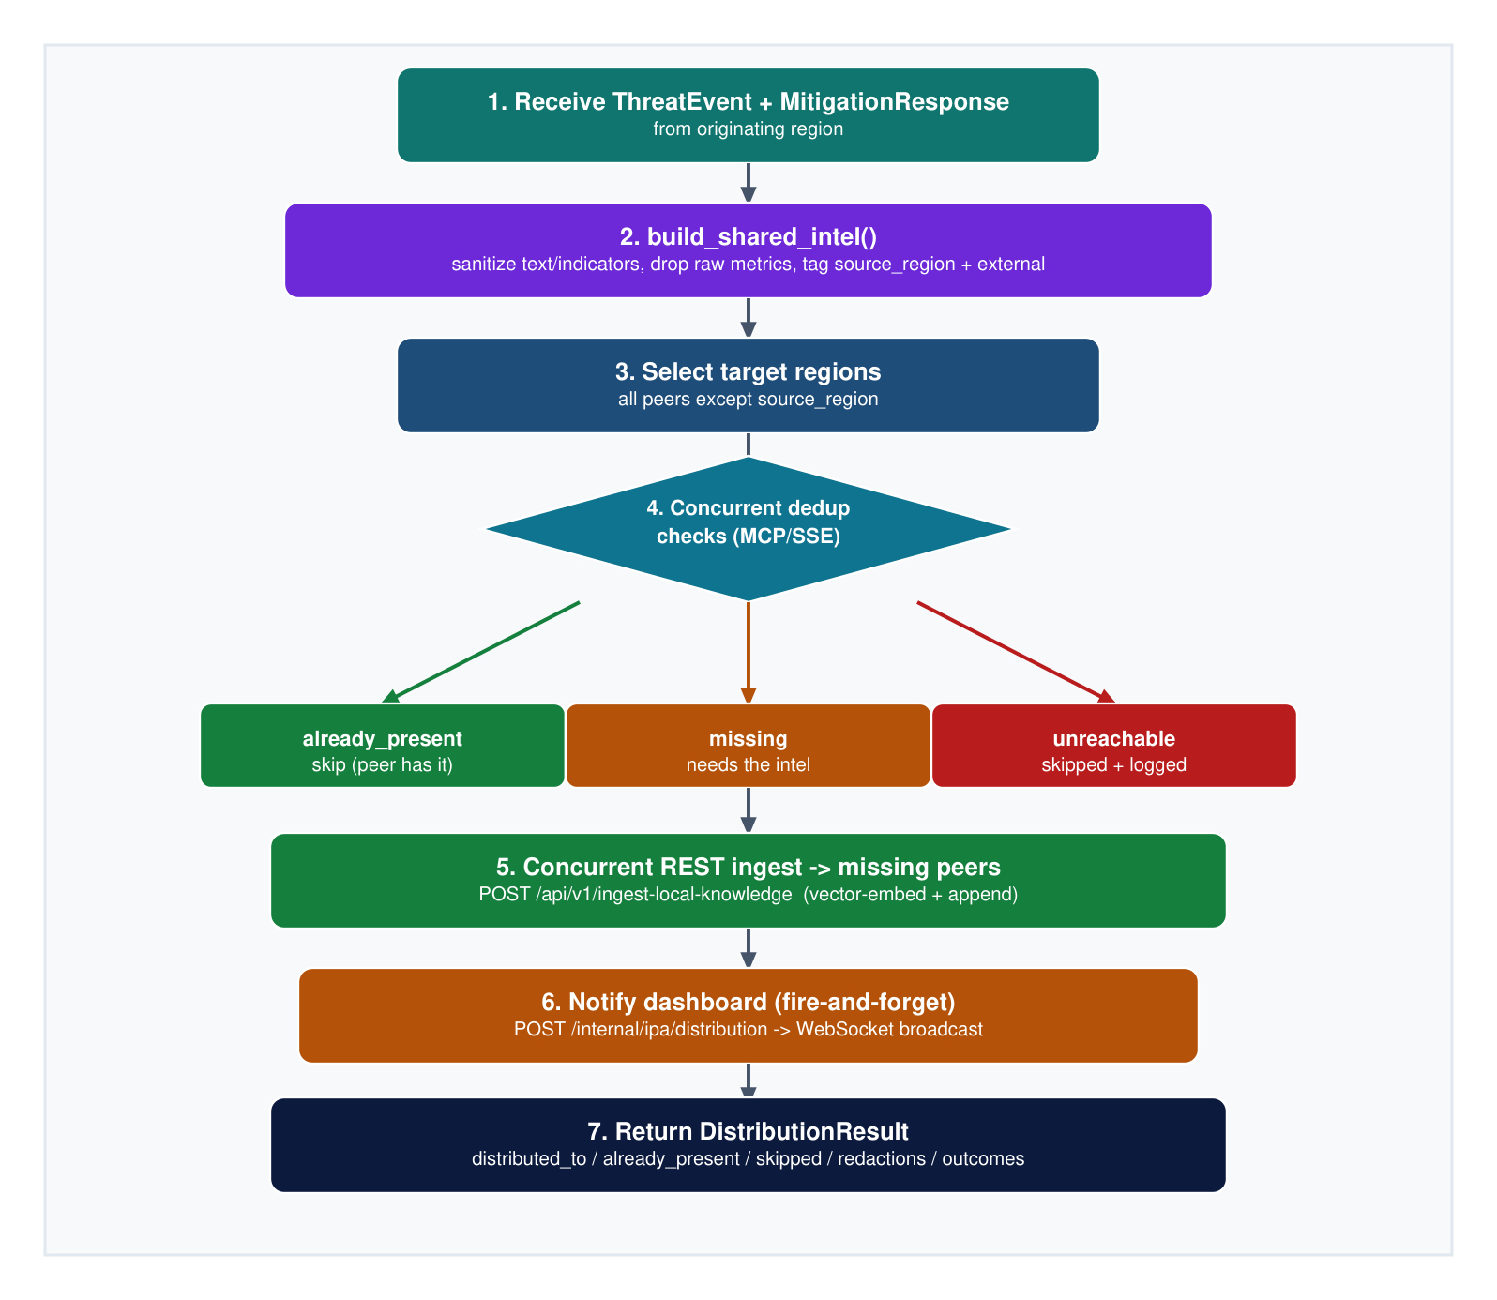
Inter-Platform Agent - Privacy-Preserving Sharing
Sanitise before it leaves
build_shared_intel() scrubs indicators and raw metrics, drops operational identifiers and tags the source region as external intel.
Source exclusion prevents loops
The originating region is removed from the target set, so shared intelligence can never be reflected back to its author.
Concurrent dedup, not broadcast
Every remaining peer is asked over MCP/SSE whether it already holds the intel. Peers answer already_present, missing or unreachable.
Selective REST ingest
Only peers that lack it receive a POST to /api/v1/ingest-local-knowledge, which vector-embeds and appends into that region alone.
Auditable outcome
DistributionResult records distributed_to, already_present, skipped and the redaction counts for every attempt.
12
Notes:
This is the Inter-Platform Agent, and it is a core contribution that deserves its own slide. When a region confirms a serious threat, the agent first sanitises it, stripping indicators and raw metrics and tagging the source. It then excludes the originating region, which is how we prevent broadcast loops, and asks every remaining peer concurrently whether they already have it. Only the peers that are missing it get the intelligence. The result is that a threat learned in one region defends the others before it ever reaches them, without any region leaking its operational data.

Slide 13
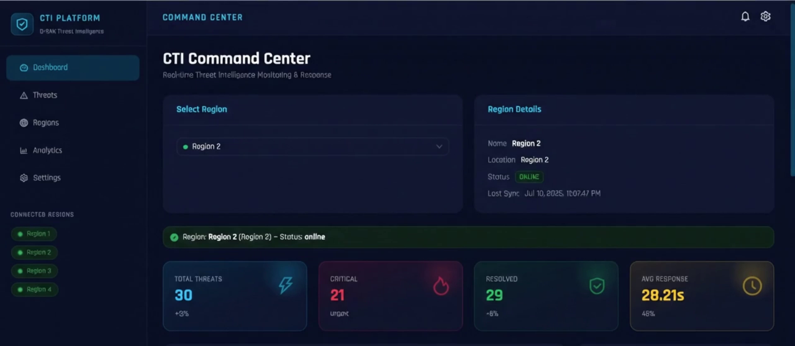
Operator Command Dashboard
Region-scoped single pane
One view over all four regions with a selector; each region streams its own live updates over WebSocket.
Evidence transparency
Every threat card exposes the detector rule, measured value and threshold, plus the matched knowledge-base records and their similarity.
Mitigation history
Full candidate lifecycle with verification and rollback state, persisted rather than live-only.
Command centre: region selector, live status and per-region threat counters
Live deployment: http://193.1.132.238/
Intelligence growth tab
Session scores, metric composition and weight-sensitivity, served from /cti/intelligence/growth.
13
Notes:
This is the operator-facing surface, and it is what we will demonstrate live. The command centre gives one pane over all four regions with a region selector, and each region streams its own updates over a WebSocket, so there is no polling anywhere in the pipeline. The point I want to stress is evidence transparency: every threat card shows the rule that fired, the measured value and the threshold, and the matched knowledge records with their similarity scores. An examiner can audit any decision the platform made without trusting the language model.

Slide 14
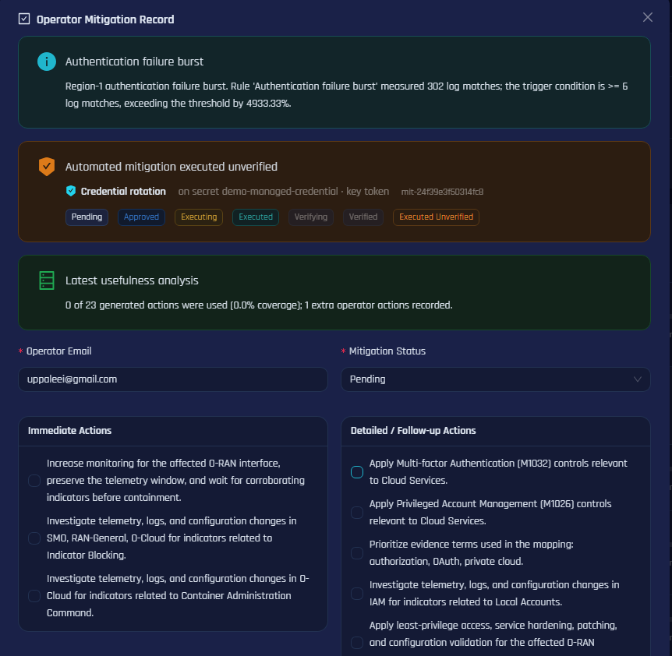
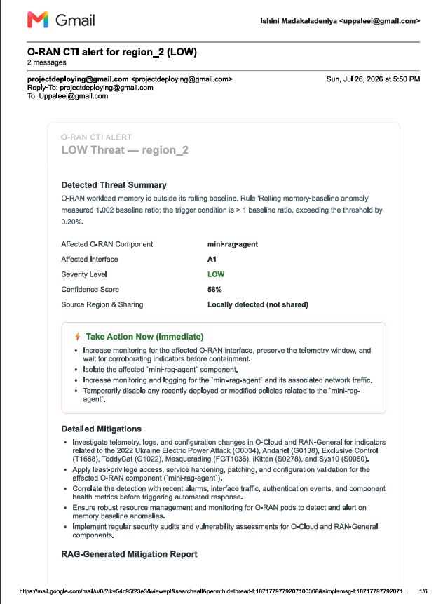
Subscriber Notifications & Operator Feedback
Subscription model
Vendors, operators and security teams subscribe per region; an alert is sent when a threat is detected, analysed, mitigated or shared.
Emailed once, never twice
A notification log keyed per threat guards idempotency, so a re-broadcast or a restart cannot spam a subscriber.
Immediate actions first
The message leads with the take-action-now tier, then detailed mitigations, evidence correlation and severity rationale.
Operator action and knowledge-feedback capture
Feedback closes the loop
Applied actions, extra actions and a usefulness rating are persisted with the threat and can become reviewed regional knowledge.
Delivered Region 2 alert
14
Notes:
Two things here that were originally scoped as future work and are now built. On the left, a real delivered alert email: it carries the affected component, the interface, severity, confidence, the immediate actions and the detailed mitigations. This means an operator can act from their inbox without watching the dashboard. On the right, the feedback path: the operator records which recommended actions they actually applied and how useful they were. That feedback is persisted with the threat, which is the beginning of a supervised learning signal for the RAG agents.

Slide 15
Testbed Deployment & Experimental Evaluation
64 Physical Cores
250 GB Host
K3s v1.36.2
4 Regions
(128 Logical)
RAM
Single Node Control Plane
One Node, 4 Namespaces
AMD Ryzen Threadripper PRO 7985WX host with Ubuntu 24.04.4 LTS, containerd 2.3.2-k3s2
Region
1
Region
2
Region
3
Region
4
2 gNB groups
6 UEs
O-RAN SC RIC
xApps
Mini RAG agent
Sharing peers
Receive distributed intel
Pre-armed for cross-region response
8-point readiness checklist run before every campaign
namespace health, correlator to Mini-RAG reachability, rApp2 routes, Gemini key fingerprinting, pre-campaign knowledge snapshot.
15
Notes:
The testbed. Four regions on a single K3s node, on a Threadripper host with 128 logical CPUs and 250 gigabytes of RAM. Regions 1 and 2 are fully instrumented with two gNB groups, six UEs each and a real Open5GS core; regions 3 and 4 act as sharing peers. Before every campaign we run an eight-point readiness checklist, because an experiment that starts from an unhealthy namespace produces evidence you cannot trust. I will flag the limitation now: this is logically distributed, not physically distributed.

Slide 16
Evaluation Design
The 750-event campaign
Frozen intelligence benchmark
A deterministic 150-slot schedule run over five days across two evaluated regions, spanning eight threat families: UE DoS and KPM anomalies, runtime shell, A1, F1 and E2 interface anomalies, xApp API abuse, pod shell and memory pressure.
A fixed, checksummed ground-truth case set evaluated read-only, so scores are comparable across sessions. It measures grounded retrieval recall, ranking, local-versus-global routing, severity accuracy and generation reliability.
The declared composite score
54%
RAG intelligence
36%
End-to-end detection
10%
Mitigation response
retrieval, ranking, routing, severity, generation
persisted event capture and expected-rule accuracy
execution, verification, timeliness, cross-region gain
Weights are pre-declared, never learned. A component that was not measured is omitted and the remainder renormalised, never scored as zero and never assumed successful.
16
Notes:
How we evaluated. Two instruments. First the 750-event campaign, a deterministic schedule across eight threat families run over five days. Second, a frozen benchmark: a checksummed ground-truth case set evaluated read-only so sessions are genuinely comparable. The composite score is 54 percent RAG, 36 percent detection, 10 percent mitigation. Those weights were declared in advance, not tuned to flatter the result. And if something was not measured we omit it rather than scoring it zero, which would have made the number look worse, or scoring it as success, which would have been dishonest.

Slide 17
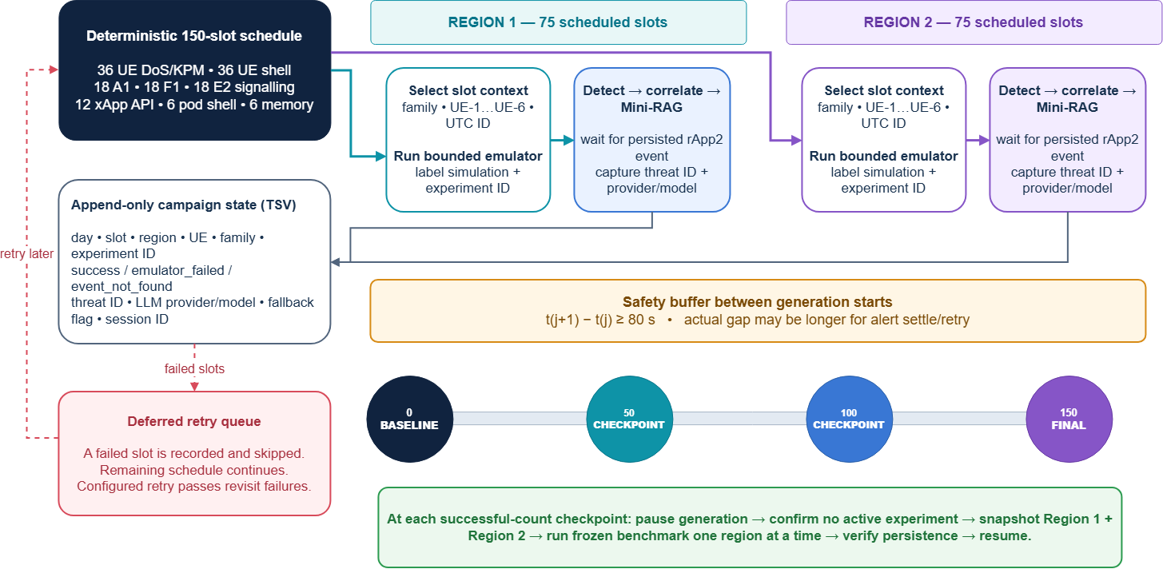
Evaluation - 150-Event Anomaly Campaign
Declared 150-slot composition
(75 slots per region)
UE DoS / KPM
36
24%
UE runtime shell
36
24%
A1 / F1 / E2 anomaly
54
36%
xApp invalid API
12
8%
Pod shell / memory
12
8%
Run for 5 days -> 750 events; a new campaign ID and knowledge snapshot per day.
Minimum 80 s safety buffer between slot start times.
Checkpoints at baseline, 50, 100 and 150 successful persisted events.
17
Notes:
The campaign is deterministic, which matters for reproducibility. 150 slots per day split 75 and 75 between the two evaluated regions, with a declared family composition. There is a minimum 80 second buffer between slots so alerts have time to settle, and a failed slot is recorded and retried rather than silently dropped. At each checkpoint we pause generation, snapshot both regions and run the frozen benchmark one region at a time. That is what makes the growth curve on the next slide trustworthy.

Slide 18
Measured Intelligence Growth
30.6% -> 75.6%
overall closed-loop intelligence score
100%
LLM generation reliability
100%
End-to-end detector capture
71.4%
Severity accuracy
54.2%
Grounded Recall@3
Mean 64.4% · SD 12.6 pp · n = 9
Nine complete measurement sessions, Region 1 (S1 = earliest)
Retrieval grounding and routing remain the main improvement areas.
18
Notes:
This is our headline result. Across nine complete sessions the closed-loop score rose from 30.6 to 75.6 percent. Look at the two lines: detection saturated early at 100 percent, so the continued improvement is coming from the RAG subscore as the regions learn. I want to be honest about the weak points rather than let you find them. Severity accuracy is 71 percent and grounded retrieval is 54 percent. Those are our main improvement areas. We also do not claim this is pure learning: some movement comes from corrected ground truth and evaluator versions, and we only claim growth where the knowledge and escalation evidence agree.

Slide 19
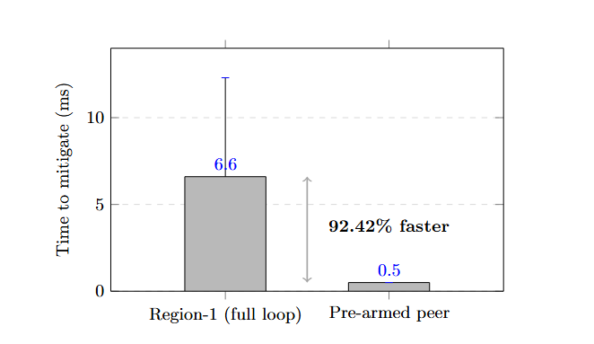
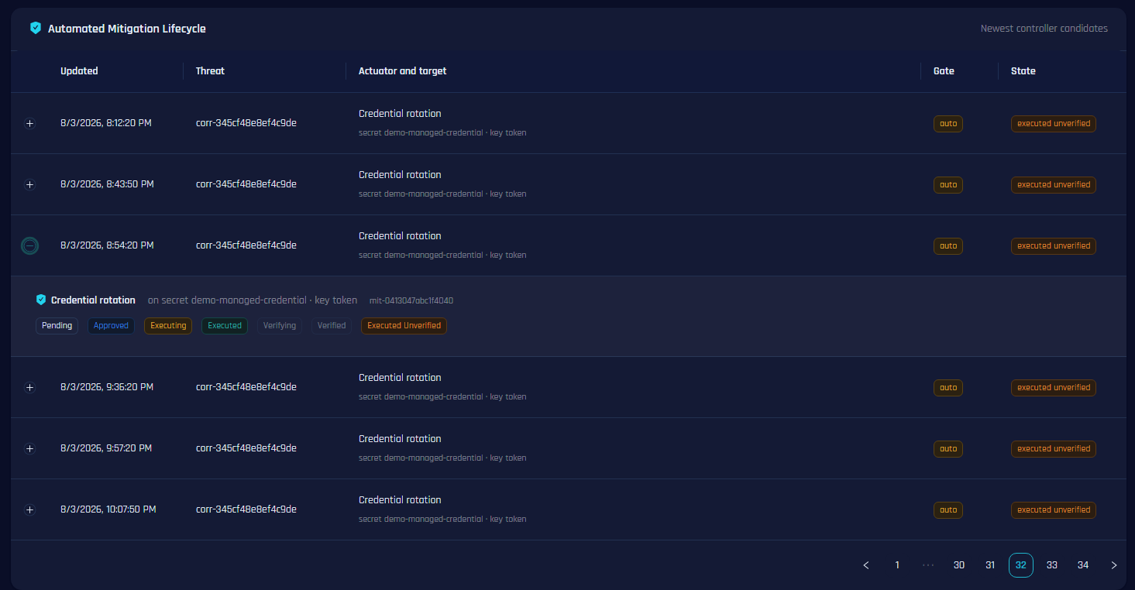
Automated Mitigation Results
92.42%
faster on a pre-armed peer
6.6 ms full regional loop vs 0.5 ms when the peer already holds the intelligence.
5
allow-listed actuators
E2SM-RC throttle, UE access revocation, pod quarantine, credential rotation and A1 policy.
Mean time-to-mitigate over N = 10 bounded quarantine runs
0.85
minimum confidence gate
Below it, or on a protected target, the candidate becomes an operator recommendation only.
Rollback
on verification failure
executed_unverified is recorded distinctly and never counts towards mitigation success.
Persisted candidate lifecycle in the operator view
19
Notes:
These are the mitigation results. The chart top left is the cross-region advantage: a full regional loop takes 6.6 milliseconds, but a peer that was pre-armed by the Inter-Platform Agent responds in 0.5, which is 92 percent faster. One caveat I will state before you ask: this is N equals ten bounded quarantine runs, so we treat it as a measured indication, not a universal performance claim. Bottom left is the persisted lifecycle: every state transition is stored, and executed-unverified is deliberately distinguishable from verified so an issued command is never counted as a security success.

Slide 20
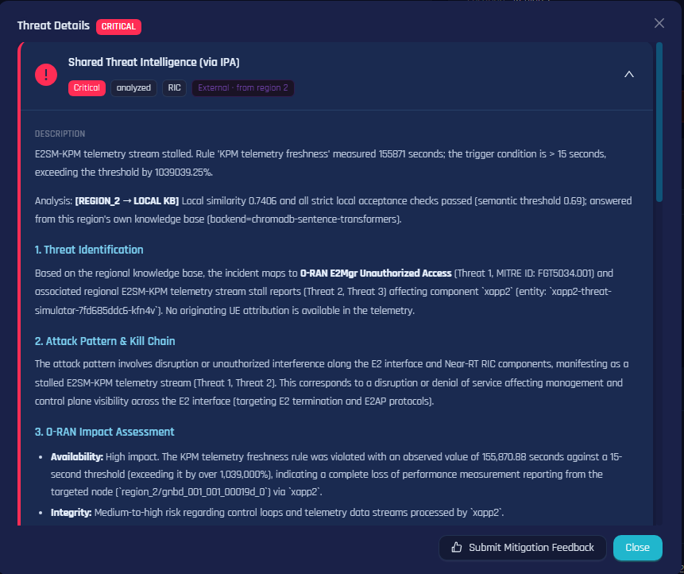
Inter-Platform Sharing Results
Source exclusion verified
The originating region is absent from every distribution target set, so intelligence is never reflected back to its author.
Peers correctly deduplicated
Peers that already held an equivalent record returned already_present with a similarity score and were skipped rather than re-ingested.
Provenance preserved
Destination records carry external and source-region metadata, so an operator can always distinguish shared intel from a local detection.
Failure isolated, not fatal
An unreachable peer is skipped and logged; the remaining regions still receive the intelligence.
Threshold is a trade-off
Too low suppresses useful contextual variants, too high admits duplicates, so every decision retains its similarity score and reasoning for audit.
Threat intelligence received through the Inter-Platform Agent, marked external with its source region
20
Notes:
The sharing results. On the left is operator-visible proof: a threat card in one region marked external and identifying the region it came from. On the right are the five findings. The two that matter most for a security audit are source exclusion, which we verified is enforced in every distribution, and provenance, which means an operator can always tell shared intelligence from a local detection. I will also be straight about the trade-off at the bottom: the deduplication threshold is a tuning decision, so we keep the similarity score and the reasoning for every skip so the decision can be audited later.

Slide 21
Benchmark Comparison
Six ground-truth 5G security scenarios executed concurrently against our Global-RAG platform and an isolated OpenCTI baseline, the leading open-source enterprise CTI platform.
Evaluation metric
Our platform
OpenCTI 6.0+
Observation
STIX precision (Recall@3)
100.0%
0.0%
Complete 5G retrieval superiority
STIX taxonomy alignment
100.0%
33.3%
Native MITRE FiGHT 5G encoding
End-to-end detection
100.0%
100.0%
Equal event capture
Platform stability
100.0%
100.0%
Equal high availability
STIX confidence validation
90.0%
100.0%
Dynamic RAG vs. static schema
Operational CTI latency
3755 ms
37.7 ms
Deep reasoning vs. keyword lookup
Why OpenCTI scores 0% on precision
The honest trade-off
It runs static keyword lookups over enterprise IT feeds that contain no 5G RAN context to retrieve.
We are roughly 100x slower per query. That is the cost of vector embedding, MCP escalation and generative synthesis, and it buys domain precision a keyword index cannot reach.
21
Notes:
This is the slide that answers why the project needed to exist. Six ground-truth 5G scenarios against both platforms concurrently. On STIX precision we retrieve the correct threat every time; OpenCTI, never. On taxonomy alignment, 100 versus 33 percent, because OpenCTI simply has no schema for a UE traffic surge or xApp API abuse. We are equal on detection capture and stability. And I want to volunteer the one place we lose: latency. We are about a hundred times slower, because we run embedding, escalation and synthesis instead of a keyword lookup. For analysis at the Non-RT tier that is the right trade, and we say so rather than hiding the number.

Slide 22
Objectives Met & Declared Limitations
Objective completion
Declared limitations
O1
Disaggregated O-RAN CTI platform implemented across four regions, with O-RAN and cloud-native evidence, dynamic registries and operator visibility.
Single-node K3s cluster: the platform is logically, not physically, distributed. No real inter-region latency or partitions.
Implemented
O2
A1, F1 and selected E2 anomalies are detector-contract simulations, permanently flagged simulation=true.
Agentic AI integrated through regional RAG, Global-RAG and MCP for hierarchical contextualisation, controlled learning and safety-gated response.
Implemented
No multi-vendor or commercial hardware validation; srsRAN and Open5GS only.
O3
Validated with a frozen benchmark, controlled detector and mitigation experiments, an OpenCTI comparison and regional security-score observation.
Evaluated
Score weights are pre-declared, not empirically calibrated against an external ground truth.
E1
Anomaly Detection Gateway delivered: four evidence sources, deterministic scoring, immutable ThreatEvent ledger.
Implemented
Per-UE containment is realised in the 5G core, because srsRAN answers an E2SM-RC control request with RIC Control Failure.
E2
Automated mitigation pipeline delivered: five actuators, safety gates, PromQL verification and rollback.
Implemented
Cross-region mitigation advantage measured over N = 10 runs, treated as indicative rather than a universal claim.
22
Notes:
Left side: all three original objectives and both extended objectives are implemented, and O3 is evaluated within our declared scope. Right side, and I want to present this myself rather than have it drawn out of me: the cluster is single-node, so this is logically distributed, not physically. Three of our interface anomalies are detector-contract simulations and are flagged as such in the database. We have not validated against commercial multi-vendor hardware. And the per-UE containment happens in the core rather than the RAN, because srsRAN rejects the E2SM-RC control action. Every one of these is stated in the report.

Slide 23
Future Work
Deploy across physical nodes
Use local / paid resilient models
Measure real inter-region latency, partitions and independent failure domains.
Reduce quota dependence, migrate deprecated SDKs and evaluate provider diversity.
Expand frozen ground truth
Improve retrieval quality
Add reviewed O-RAN cases, adversarial paraphrases and external assessors.
Hybrid retrieval, reranking, metadata filters and validation of learned knowledge.
Strengthen control verification
Longitudinal evaluation
Broader E2SM-RC profiles, causal effect checks and richer rollback policies.
Run multi-week campaigns and test whether local resolution rises without quality drift.
23
Notes:
Future work follows directly from the limitations I just showed. The single most valuable next step is deploying across physical nodes, because that is what turns a logically distributed prototype into a genuinely federated system. After that, a larger independently reviewed benchmark, better retrieval, and longer campaigns to test whether local resolution keeps rising without quality drift.

Slide 24
Thank you
Questions and discussion
4
750
75.6%
100%
O-RAN regions
emulated events
closed-loop score
vs 0% STIX precision
Cyber Threat Intelligence (CTI) Platform for Open-RAN · Department of Electrical and Information Engineering, University of Ruhuna
24
Notes:
To summarise: four O-RAN regions, 750 emulated security events, a closed-loop intelligence score that rose to 75.6 percent, and 100 percent STIX precision against zero for the leading enterprise CTI platform on 5G scenarios. Thank you. We are happy to take questions, and the live dashboard is running if you would like a demonstration.

