Slide 1
UNIVERSITY OF RUHUNA · FINAL YEAR RESEARCH PROJECT
Cyber Threat Intelligence
Platform for Open RAN
Agentic AI for multi-region O-RAN threat detection, hierarchical intelligence sharing and guarded automated mitigation
I.U. Madakaladeniya
S.A. Wijesinghe
P.A.G.N. Rathnaweera
H.G.R. Achintha
Supervisor
Dr. Geeth Priyankara
External Supervisor
Asst. Prof. Pasika Ranaweera
Department of Electrical and Information Engineering · Faculty of Engineering
Notes:
Good morning. We built a Cyber Threat Intelligence platform designed specifically for Open RAN. Over the next ten minutes I will show you why generic CTI tools fail in a telecom network, what we built across a four-region O-RAN testbed, and the measured results — including a head-to-head against OpenCTI, the leading open-source CTI platform.

Slide 2
THE PROBLEM
O-RAN opened the network — and the attack surface
O-RAN replaced closed, single-vendor base stations with disaggregated multi-vendor components talking over open interfaces. That openness is the innovation — and the vulnerability.
1
Expanded attack surface
2
Open interface exposure
O-RU, O-DU, O-CU, RIC and O-Cloud each add entry points that monolithic RAN never exposed.
E2, A1, O1 and Open Fronthaul carry strict latency budgets that resist heavy security.
3
Malicious xApps / rApps
4
Multi-vendor supply chain
A rogue app can alter radio parameters, track users or poison the ML models behind control.
Mixed vendors and open-source components make trust and incident attribution far harder.
A security event on an O-DU or an E2 interface is not a generic software bug — its meaning depends on the component's role, the affected control path and the live network state.
Notes:
O-RAN disaggregates the base station into components from different vendors, connected by open interfaces. That gives operators flexibility and lower cost — but it multiplies the attack surface: the radio units, the distributed and central units, the RIC, and the cloud platform underneath. The key point is at the bottom: in O-RAN, a threat only means something in the context of which component and which interface it touches.

Slide 3
THE GAP
Generic CTI platforms cannot speak O-RAN
Enterprise CTI tools — Recorded Future, ThreatConnect, Anomali, OpenCTI — are mature, but their data models describe IT assets, not radio components. A feed may correctly describe a technique and still fail to say which O-RAN element is exposed.
Four gaps identified in the literature
What generic CTI cannot answer
Which O-RAN component or interface is actually exposed?
How would this threat propagate through a disaggregated RAN?
Which radio or cloud observation supports the assessment?
What response is safe for this specific deployment?
G1
No O-RAN-specific CTI platform
G2
No automated telecom threat contextualisation
G3
No intelligent inter-platform coordination
G4
No RIC integration for threat intelligence
Measured later in this deck: on six ground-truth 5G scenarios, OpenCTI retrieved the correct threat 0% of the time. Our platform: 100%.
Notes:
Existing CTI platforms are excellent at what they were built for — enterprise IT. But they have no native representation of radio components, open interfaces, RIC applications or RAN measurements. Our literature review identified four concrete gaps. And this is not theoretical: we measured it. On six ground-truth 5G security scenarios, OpenCTI retrieved the correct threat zero percent of the time. I will show that evidence at the end.

Slide 4
OBJECTIVES
Three objectives, all implemented and evaluated
O1
Build the platform
O2
Integrate agentic AI
O3
Validate and evaluate
Repeatable multi-region O-RAN testbed
Explainable evidence from E2SM-KPM, Prometheus, Loki, Falco
ATT&CK / FiGHT ingested into O-RAN-aware CTI registries
Privacy-aware dissemination with provenance
Regional RAG agents for component-aware retrieval
MCP escalation to Global-RAG when local evidence is weak
Controlled regional learning with de-duplication
Recommendations behind deterministic policy gates
Frozen ground-truth intelligence benchmark
Controlled detector and mitigation experiments
Head-to-head comparison against OpenCTI
Operational security score per region
All three objectives were implemented; O3 is evaluated within the declared prototype scope.
Notes:
We organised the work around three objectives. O1 — build a disaggregated, O-RAN-specific CTI platform. O2 — integrate agentic AI so the platform reasons about threats rather than just storing them. O3 — validate it properly, with a frozen benchmark and a baseline comparison. All three are implemented. We are careful to say O3 is evaluated within our declared prototype scope — I will be explicit about the limits at the end.

Slide 5
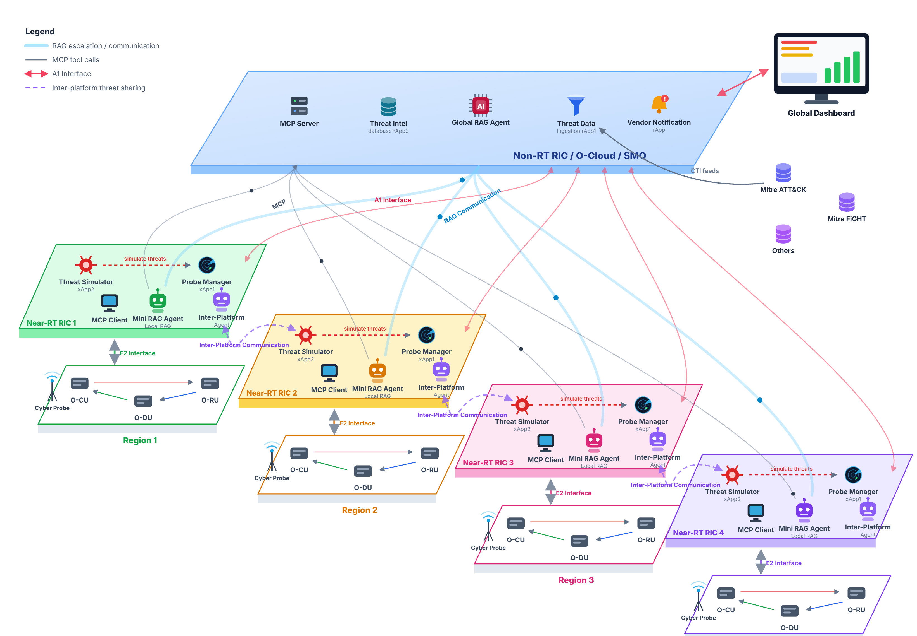
SYSTEM ARCHITECTURE
Local-first intelligence, globally coordinated
Two tiers, four regions
1
Non-RT RIC / SMO
Global-RAG, MCP server, CTI ingestion rApp, threat-intel store and the operator dashboard.
2
Near-RT RIC ×4
Each region runs its own xApps, Mini-RAG agent, MCP client and Inter-Platform Agent.
3
RAN + core per region
srsRAN gNBs, Open5GS core and UEs observed over E2 with KPM telemetry.
4
Isolation by design
No region reads or writes another region's data — sharing only via the agent.
Notes:
This is the full platform. The blue slab at the top is the Non-RT RIC and SMO layer — it holds the Global RAG agent, the MCP server, the CTI ingestion rApp and the dashboard. Below it sit four independent Near-RT RIC regions, each with its own radio access network, its own xApps, and critically its own Mini-RAG agent with its own knowledge base. The design principle is local-first: a region answers from its own knowledge if it can, and only escalates when it cannot.

Slide 6
THE TESTBED
A real four-region O-RAN deployment, not a simulation
The final artefact runs on the Netslab K3s cluster with active O-RAN SC Near-RT RIC services, srsRAN radio workloads and an Open5GS 5G core — real traffic flows through the emulated radio path.
4
12
128
250 GiB
750
O-RAN regions
UE namespaces
logical CPUs
host RAM
emulated events
Radio & core
srsRAN gNBs · Open5GS AMF/UPF/SMF · srsUE with ZMQ RF simulation
O-RAN control
O-RAN SC Near-RT RIC · E2 termination · A1 mediator · xApp1 probe manager · xApp2 KPM detector
Evidence & telemetry
Prometheus · Alertmanager · Loki / LogQL · Falco runtime security · E2SM-KPM
Intelligence
Mini-RAG per region · Global-RAG · FastMCP over SSE · ChromaDB vector stores · ArangoDB graph
Persistence & UI
rApp2 PostgreSQL registries · React operator dashboard · email notification service
Notes:
This matters for credibility: it is not a paper design. Four regions run on a single Netslab K3s cluster with a Threadripper host — 128 logical CPUs, 250 gigabytes of RAM. Regions 1 and 2 each run two gNB groups and six UEs against a real Open5GS core. We drove 750 emulated security events through it across a five-day campaign. Everything from the radio layer up to the dashboard is deployed and wired through explicit Kubernetes services.

Slide 7
CONTRIBUTION 1 · KNOWLEDGE CONSTRUCTION
Turning global CTI into O-RAN-specific intelligence
1
Harvest
2
Prune
3
Reduce
4
Serve
MITRE ATT&CK, MITRE FiGHT and vulnerability feeds normalised to a STIX 2.1 schema.
›
Dual-stage Max-Sim semantic relevance scoring keeps only O-RAN-relevant knowledge.
›
Bounded 2-hop BFS subgraph extraction with CVSS v3.1 and EPSS risk adjustment.
›
ArangoDB graph, OASIS TAXII 2.1 gateway and ChromaDB vector stores for retrieval.
85 – 90%
Why pruning matters
Edge regions cannot host a full enterprise CTI corpus
Irrelevant intelligence degrades retrieval precision
Smaller payloads keep regional vector search sub-second
reduction in data footprint after semantic pruning and graph reduction — the knowledge base keeps only what an O-RAN deployment can act on.
Notes:
Our first contribution is the knowledge layer. We harvest MITRE ATT&CK and FiGHT, normalise everything to STIX 2.1, then apply a two-stage semantic pruning model — Max-Sim relevance scoring — to keep only what is relevant to O-RAN. A bounded two-hop breadth-first search extracts the connected subgraph and we adjust risk using CVSS and EPSS. The result is an 85 to 90 percent reduction in data footprint. That is what makes it deployable at the edge and what keeps retrieval precise.

Slide 8
CONTRIBUTION 2 · ANOMALY DETECTION GATEWAY
Four evidence sources, one transparent schema
Heterogeneous telemetry is normalised into a single event schema that records the rule that fired, the criterion, the measured value, the threshold and the correlation decision — stored independently of any AI explanation.
Prometheus
Loki / LogQL
Falco
E2SM-KPM
metric thresholds
& Alertmanager
log pattern and
authorisation evidence
container runtime
and shell detection
RAN performance
measurements
Normalised threat event · de-duplication · correlation score · UE attribution
Explainable without AI
Evidence-first design
An operator can inspect exactly why an event exists — rule, threshold, measured value — even when every LLM provider is unavailable. Detection authority never depends on a model.
Deterministic detectors remain the source of detection truth; the language model only explains and recommends. This separation is what makes the platform auditable and safe to trust.
Notes:
Our second contribution is the Anomaly Detection Gateway. We take four very different evidence sources — Prometheus metrics, Loki logs, Falco runtime security and RAN KPM telemetry — and normalise them into one transparent event schema. The critical design decision is on the bottom left: the rule that fired, the threshold and the measured value are stored separately from the AI explanation. So if every LLM provider is down, an operator can still see exactly why an event exists. The AI explains; it never decides detection.

Slide 9
CONTRIBUTION 3 · HIERARCHICAL RAG OVER MCP
Answer locally when you can, escalate when you cannot
1
Local retrieval first
2
Escalate over MCP
3
Learn regionally
The regional Mini-RAG searches only its own vector knowledge base and accepts the answer when local similarity clears the configured routing threshold (0.69) and usability checks.
If evidence is insufficient — or severity is high — the agent calls global_rag.analyze_threat as a typed MCP tool over an SSE stream, carrying evidence and provider provenance.
Eligible global knowledge is canonicalised, de-duplicated and re-vectorised into that region only — so the region answers the next similar event locally.
Three FastMCP servers, four typed tools
Mini-RAG Agent (×4, edge)
mini_rag.check_threat_intel
Global RAG Agent (central)
global_rag.analyze_threat · global_rag.report_local_intel
Inter-Platform Agent (central)
inter_platform.distribute_threat
All three are FastMCP servers mounted at /mcp, serving SSE at /mcp/sse — agents call each other as typed tools, not ad-hoc REST.
Notes:
Third contribution: hierarchical retrieval. Each region tries to answer from its own knowledge base first. Only if local confidence falls below the routing threshold — or the severity is high — does it escalate to the central Global RAG. That escalation happens over MCP, the Model Context Protocol, as a typed tool call on a streaming connection. And crucially, when the global answer comes back, the region learns it — so next time it answers locally. That is how each region gets smarter over time.

Slide 10
CONTRIBUTION 4 · INTER-PLATFORM SHARING
One region learns, every region benefits — safely
1
Confirm
Privacy by construction
A region confirms a high or critical threat with its mitigation report.
No region ever writes into another region's database. Data minimisation strips operational identifiers before anything leaves a region, and every shared record keeps its provenance and an audit trail.
2
Sanitise
The agent redacts IPs, MACs, FQDNs and subscriber identities, then tags the source region.
3
Check peers
Concurrent MCP dedup calls ask every other region: do you already know this?
Inter-region pre-arming
Because peers receive the intelligence before the threat reaches them, a pre-armed region can respond without repeating the full analysis loop — measured as a large reduction in preparation time over N = 10 bounded quarantine trials.
4
Selective ingest
Only regions that lack it receive and vector-embed the intel; the source is excluded.
Notes:
Fourth contribution: controlled sharing. When a region confirms a serious threat, the Inter-Platform Agent sanitises it — stripping IP addresses, MAC addresses, subscriber identities — tags the source, then concurrently asks every other region whether they already know it. Only regions that lack the intelligence receive it. The source region is always excluded, which prevents loops. The operational payoff is pre-arming: a peer region is defended before the threat ever arrives.

Slide 11
CONTRIBUTION 5 · GUARDED AUTOMATED MITIGATION
A recommendation is not execution authority
Generated advice never actuates the network directly. Every candidate passes deterministic gates before execution, and the controller verifies the effect and rolls back when verification fails.
pending
›
approved
›
executing
›
executed
›
verified
Safety gates
Protected targets
Actuator type, severity, confidence, decision class, target eligibility and experiment context are all checked before anything runs.
Critical components are explicitly denied — added after an early broad policy accidentally quarantined an intelligence pod.
Verification & rollback
Operator authority
PromQL telemetry confirms the effect after a settle interval; failed checks trigger reversal. executed_unverified never counts as success.
A1 policy actions always remain operator-approved. Feedback and usefulness ratings feed back into regional knowledge.
Actuators: Kubernetes quarantine · credential rotation · A1 policy · guarded E2SM-RC candidate path
Notes:
Fifth contribution, and the one we are proudest of from a safety standpoint: guarded mitigation. The AI produces a recommendation, but it has no authority to act. Every candidate goes through a state machine with deterministic gates — actuator type, severity, confidence, and whether the target is even eligible. We learned this the hard way: an early broad policy accidentally quarantined one of our own Mini-RAG pods. That incident is in the report, and it is why protected-target checks are now explicit. After execution we verify the effect with PromQL and roll back if it did not work.

Slide 12
EVALUATION DESIGN
Measured against a frozen benchmark, not anecdotes
The 750-event campaign
Frozen intelligence benchmark
A deterministic 150-slot schedule run over five days across two evaluated regions, spanning eight threat families — UE DoS and KPM anomalies, runtime shell, A1, F1 and E2 interface anomalies, xApp API abuse, pod shell and memory pressure.
A fixed, checksummed ground-truth case set evaluated read-only, so scores are comparable across sessions. It measures grounded retrieval recall, ranking, local-versus-global routing, severity accuracy and generation reliability.
The declared composite score
54%
RAG intelligence
36%
End-to-end detection
10%
Mitigation response
retrieval, ranking, routing, severity, generation
persisted event capture and expected-rule accuracy
execution, verification, timeliness, cross-region gain
Weights are pre-declared, never learned. Unmeasured components are omitted and the remainder renormalised — never scored as zero, and never imputed as success.
Notes:
How we evaluated. Two instruments. First, a 750-event emulation campaign — a deterministic schedule across eight threat families, run over five days. Second, a frozen benchmark: a fixed, checksummed ground-truth case set, evaluated read-only so that sessions are actually comparable. The composite score is 54 percent RAG intelligence, 36 percent detection, 10 percent mitigation. Those weights were declared in advance, not tuned to flatter the result — and if something was not measured, we omit it rather than scoring it as zero or as success.

Slide 13
RESULTS
Measured intelligence growth across nine sessions
30.6% → 75.6%
overall closed-loop intelligence score
100%
LLM generation reliability
100%
End-to-end detector capture
71.4%
Severity accuracy
54.2%
Grounded Recall@3
Nine complete measurement sessions, Region 1 (S1 = earliest)
Mean 64.4% · SD 12.6 pp · n = 9 sessions
Retrieval grounding and routing remain the main improvement areas.
Notes:
This is our headline result. Across nine complete measurement sessions the closed-loop intelligence score rose from 30.6 percent to 75.6 percent. Notice the two lines: detection saturated early at 100 percent — every emulated event reached persisted evidence — while the RAG subscore is what drove continued improvement as the regions learned. We are deliberately honest here: severity accuracy is 71 percent and grounded retrieval is 54 percent. Those are our weak points and we say so. We also do not claim this is pure learning — some movement comes from corrected ground truth and evaluator versions.

Slide 14
BENCHMARK COMPARISON
Head-to-head against OpenCTI 6.0+
Six ground-truth 5G security scenarios executed concurrently against our Global-RAG platform and an isolated OpenCTI baseline — the leading open-source enterprise CTI platform.
Evaluation metric
Our platform
OpenCTI 6.0+
Observation
STIX precision (Recall@3)
100.0%
0.0%
Complete 5G retrieval superiority
STIX taxonomy alignment
100.0%
33.3%
Native MITRE FiGHT 5G encoding
End-to-end detection
100.0%
100.0%
Equal event capture
Platform stability
100.0%
100.0%
Equal high availability
STIX confidence validation
90.0%
100.0%
Dynamic RAG vs. static schema
Operational CTI latency
3755 ms
37.7 ms
Deep reasoning vs. keyword lookup
Why OpenCTI scores 0% on precision
The honest trade-off
It runs static keyword lookups over enterprise IT feeds that contain no 5G RAN context to retrieve.
We are ~100× slower per query. That is the cost of vector embedding, MCP escalation and generative synthesis — and it buys domain precision a keyword index cannot reach.
Notes:
This is the slide that answers "why does this need to exist?". We ran six ground-truth 5G scenarios against both platforms concurrently. On STIX precision, we retrieve the correct threat 100 percent of the time; OpenCTI, zero. On taxonomy alignment, 100 versus 33 percent — OpenCTI simply has no schema for a UE traffic surge or xApp API abuse. We are equal on detection capture and stability. And I want to be straight about the one place we lose: latency. We are about a hundred times slower, because we run vector embedding, MCP escalation and generative synthesis instead of a keyword lookup. That is a deliberate trade, and for threat analysis at the Non-RT tier it is the right one.

Slide 15
CONCLUSION
What we delivered, and what comes next
Contributions
Declared limitations
An O-RAN-native CTI platform running across four regions
An Anomaly Detection Gateway unifying four evidence sources into one transparent, AI-independent schema
Hierarchical Mini-RAG / Global-RAG retrieval over MCP with controlled regional learning
Privacy-preserving inter-platform sharing with semantic de-duplication and pre-arming
Guarded automated mitigation with verification, rollback and operator authority
Single-node K3s cluster — logically, not physically, distributed
A1, F1 and selected E2 anomalies are labelled detector-contract simulations
No multi-vendor or commercial hardware validation
Score weights are pre-declared, not empirically calibrated
Per-UE containment realised in the 5G core, since srsRAN rejects E2SM-RC control
Next
Physical & multi-vendor validation
Larger independent benchmark
Telecom-specific embeddings
Signed provenance & mTLS federation
Shadow-mode mitigation testing
Notes:
To close. We delivered five contributions — the platform itself, the detection gateway, hierarchical RAG over MCP, privacy-preserving sharing, and guarded mitigation. And we are explicit about the limits: this is a single-node cluster, three of our interface anomalies are detector-contract simulations, and we have not validated against commercial multi-vendor hardware. The next steps follow directly from those limits. Thank you — I am happy to take questions.

