Slide 1

Healthcare Management System
“Patient, Doctor, Appointment, Billing & Insurance Management”

Slide 2

Agenda
Introduction
Project Objectives
Database Design
ER Diagram
Tables & Sample Data
Queries & Reports
Future Enhancements
Conclusion

Slide 3

Introduction
Hospitals handle patients, doctors, billing, and insurance.
Manual management → errors & inefficiency.
SQL database ensures accuracy, speed, and security.

Slide 4

Project Objectives
Store and manage patient records.
Manage doctor schedules and specializations.
Handle appointments and billing.
Link insurance policies for patients.
Generate reports for analysis.

Slide 5
Database Design
Entities: Patient, Doctor, Hospital, Appointment, Medical Record, Billing, Insurance
Relationships:
Patient ↔ Appointment ↔ Doctor
Patient ↔ Medical Record
Patient ↔ Billing ↔ Appointment
Patient ↔ Insurance

Slide 6
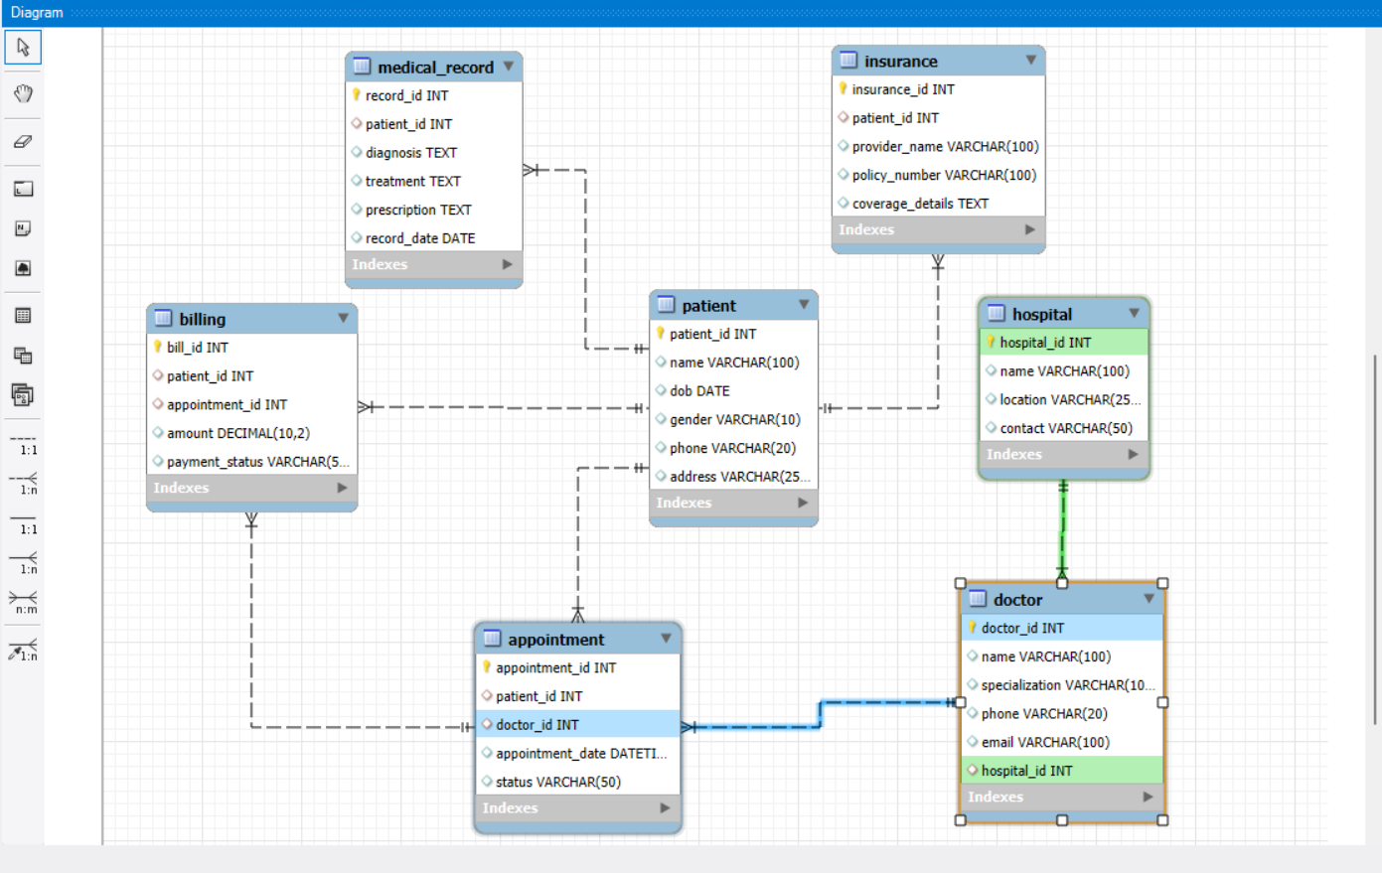
Entity–Relationship Diagram

Slide 7
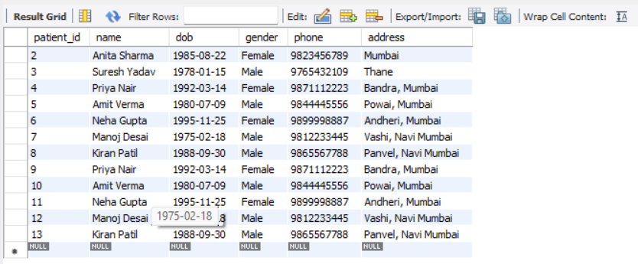
Patient Table
Columns: patient_id, name, dob, gender, phone, address
Stores patient personal details.
SELECT * FROM Patient;

Slide 8
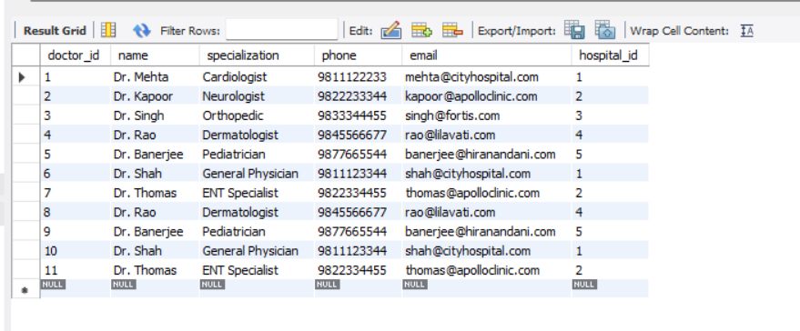
Doctor Table
Columns: doctor_id, name, specialization, phone, email, hospital_id
Stores doctor info & linked hospital.
Example: Dr. Mehta, Cardiologist, City Hospital.
SELECT * FROM Doctor;

Slide 9
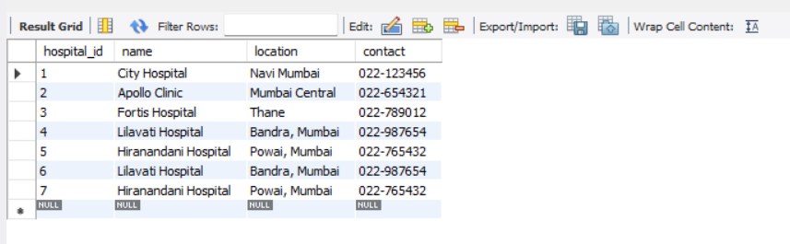
Hospital Table
Columns: hospital_id, name, location, contact
Stores hospital info.
Example: Apollo Clinic, Mumbai Central.
SELECT * FROM Hospital;

Slide 10
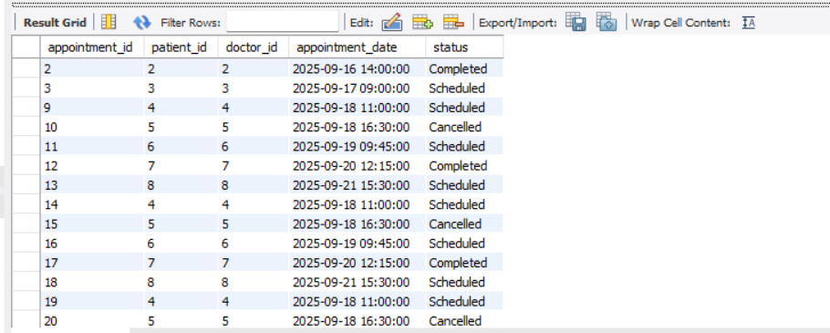
Appointment Table
Columns: record_id, patient_id, diagnosis, treatment, prescription, record_date
Stores diagnosis, treatment, prescription.
Example: High BP → Amlodipine 5mg.
SELECT * FROM Appointment;

Slide 11
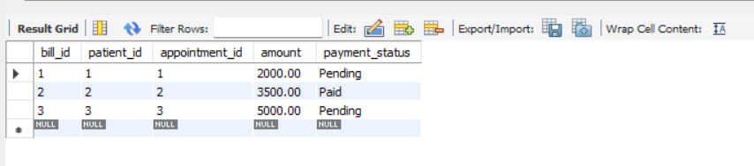
Billing Table
Columns: bill_id, patient_id, appointment_id, amount, payment_status
Stores billing info linked with appointment.
Example: Bill = ₹2000, Status = Pending.
SELECT * FROM Billing;

Slide 12
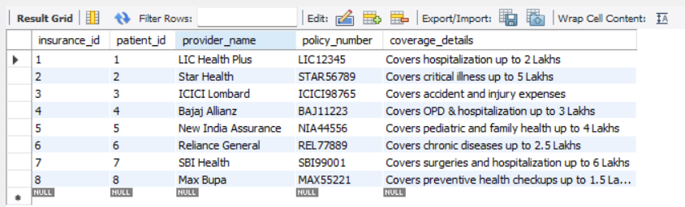
Insurance Table
Columns: insurance_id, patient_id, provider_name, policy_number, coverage_details
Stores patient’s insurance coverage.
Example: LIC Health Plus, 2 Lakhs cover.
SELECT * FROM Insurance;

Slide 13
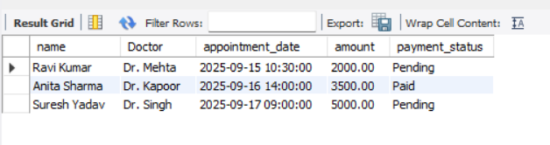
Sample Query – Join
Finds patient appointments with doctor name and bill details.
SELECT P.name, D.name AS Doctor, A.appointment_date, B.amount, B.payment_status
FROM Patient P
JOIN Appointment A ON P.patient_id = A.patient_id
JOIN Doctor D ON A.doctor_id = D.doctor_id
JOIN Billing B ON A.appointment_id = B.appointment_id;

Slide 14
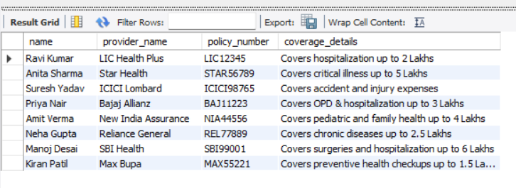
Patients with Insurance Coverage
USE HealthcareDB;
SELECT P.name, I.provider_name, I.policy_number, I.coverage_details
FROM Patient P
JOIN Insurance I ON P.patient_id = I.patient_id;

Slide 15
Data Relationships
One patient can have many appointments.
One doctor can attend many patients.
One bill belongs to one appointment.
One patient can have multiple insurance policies.

Slide 16
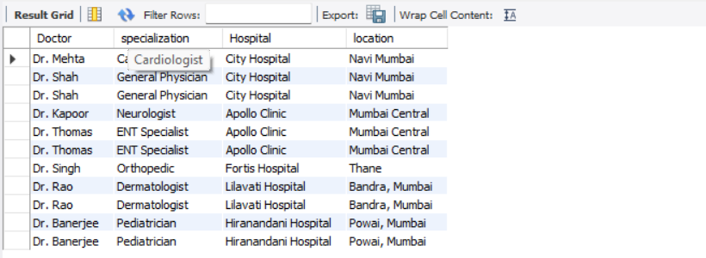
Doctors and Their Hospitals
USE HealthcareDB;
SELECT D.name AS Doctor, D.specialization, H.name AS Hospital, H.location
FROM Doctor D
JOIN Hospital H ON D.hospital_id = H.hospital_id;

Slide 17
Medical Records of Patients
USE HealthcareDB;
SELECT P.name, M.diagnosis, M.treatment, M.prescription, M.record_date
FROM Patient P
JOIN Medical_Record M ON P.patient_id = M.patient_id;

Slide 18
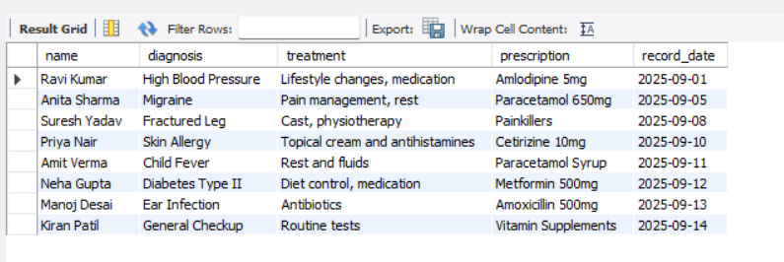
.

Slide 19
Reports & Analytics
Total patients per hospital.
Pending vs Paid bills.
Doctor-wise appointments.
Insurance coverage analysis.

Slide 20
Use Cases
Receptionist can book appointments.
Doctors can view patient medical history.
Finance team can track billing & payments.
Patients can check insurance coverage.

Slide 21
Future Enhancements
Pharmacy management.
Staff management.
Integration with Power BI dashboards.
Online appointment booking.

Slide 22

Conclusion
Centralized healthcare management.
Better data accuracy & efficiency.
Useful for hospital administration, patients, and insurance companies.

