Slide 1

Spot the Glitch: Anomaly Detection in IoT Networks
Ashmit Pareek, Ravjot Singh, Sheik Mohammed Azaruddin, Srushtee Upashi, Srushti Doshi
Department of Applied Data Science, San Jose State University
DATA 245 - Machine Learning Tec
Dr. Shih Yu. Chang
05/13/2024

Slide 2

Introduction :
IoT networks are widely used in various industries, including healthcare, manufacturing, and smart cities, to monitor and control devices remotely.
Anomaly detection in IoT networks is crucial for ensuring the security and integrity of these systems.

Slide 3

Problem Understanding :
Security threats in IoT networks can lead to data breaches, financial losses, and disruptions in critical services.
Anomaly detection helps in early detection and mitigation of security threats, reducing the risk of damage and loss.
Ensuring the security of IoT networks is essential for maintaining trust and reliability in connected systems.

Slide 4

Objective :
Develop
Develop an anomaly detection system using machine learning for IoT networks.
Utilize
Utilize machine learning algorithms to detect anomalies in IoT network data.
Enhance
Enhance the security and reliability of IoT networks by identifying and mitigating potential threats.

Slide 5

Dataset Details
The IoT-23 dataset consists various captures, called scenarios, of different IoT network traffic.
Every scenario contains the following basic information, among other content that will be described later:
README.md: this file has the capture and malware information such as the probable malware name, md5, sha1 and sha256 of the malware binary; the duration of the capture in seconds, the link to the VirusTotal malware file and some short description of the files inside the folder.
.pcap: this is the original packet capture file from the network traffic capture.
conn.log.labeled: this is the netflows generated by Zeek/Bro IDS with labels.

Slide 6
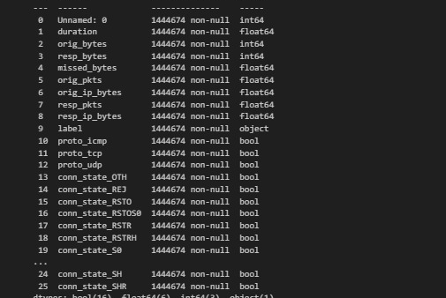
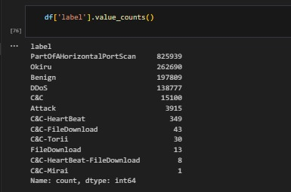
Data Information

Slide 7

Data Preparation :
Steps followed while preparing the data from available IoT -23 dataset -
Read Data: Load network traffic data from various log files into separate DataFrames.
Concatenate DataFrames : Combine the data from different captures into a single DataFrame for a comprehensive analysis.
Feature Engineering : Apply One-Hot Encoding to categorical columns to convert them into a format suitable for machine learning algorithms.
Drop Unnecessary Columns: Remove columns that do not contribute to the analysis.

Slide 8

Data Preprocessing
Removing Duplicates
Handling Missing Values
Data Type Conversion
Target Variable Class Labeling
Balancing data in classes using SMOTE
Label encoding

Slide 9

Data Understanding and Exploration :
Publicly available dataset of malicious and benign network traffic of real IoT devices.
Data is stored in log files, capturing different network interactions.
Includes data from normal and various types of anomalous activities.
Allows simulation of real-world IoT environments with multiple device types.
Dataset includes anomalies like scanning attacks, botnet traffic, and data exfiltration attempts.

Slide 10
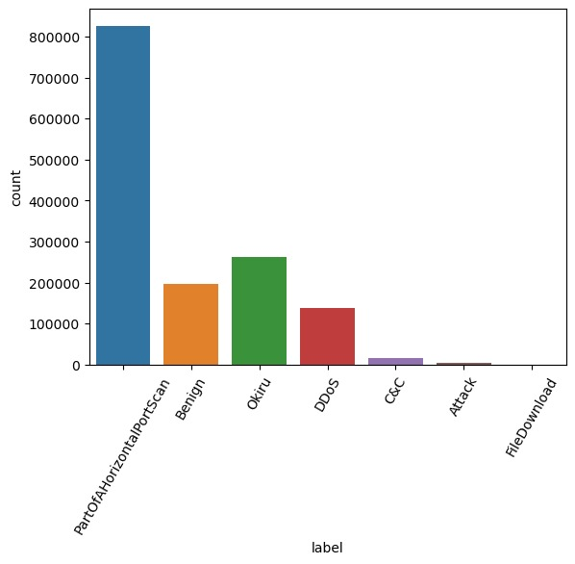
Distribution across different classes

Slide 11
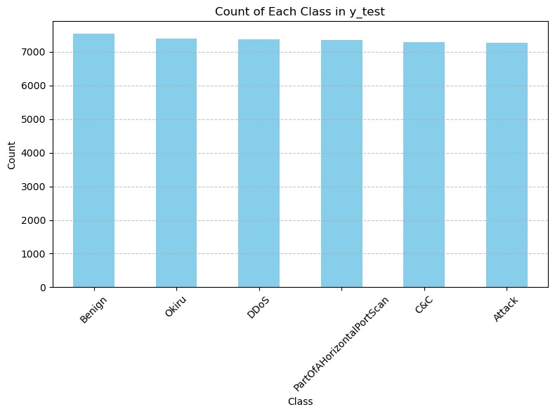
SMOTE for class imbalance handling
SMOTE (Synthetic Minority Over-sampling Technique) is a statistical technique used to increase the number of cases in your dataset in a balanced way. It was developed to address the imbalance issue in classification problems where some classes are significantly under-represented. SMOTE works by creating synthetic samples from the minor class instead of creating copies.

Slide 12
Evaluation :
Precision: The proportion of correctly identified anomalies among all detected anomalies. High precision indicates few false positives.
Recall: The proportion of correctly identified anomalies among all actual anomalies. High recall indicates few false negatives.
F1-score: The harmonic mean of precision and recall. It provides a balance between precision and recall.
Computational Complexity: Evaluate the model's efficiency in terms of time and resource requirements, especially for large datasets.

Slide 13
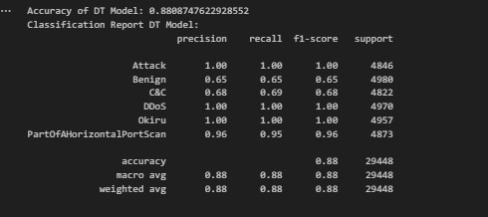
Modeling : Decision Trees
Working Principle: Decision Trees recursively split the dataset into subsets based on the most significant attribute, creating a tree-like structure. Each internal node represents a "decision" based on a feature, and each leaf node represents the outcome.
Suitability for Anomaly Detection: Decision Trees are easy to interpret and can capture complex relationships in the data. They are suitable for anomaly detection in IoT networks where interpretability is important and can handle both numerical and categorical data.

Slide 14
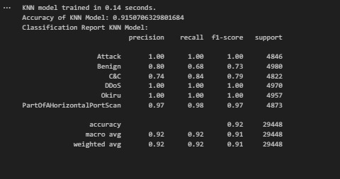
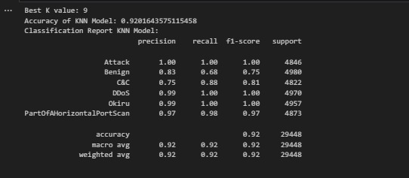
Modeling : K-NN
Working Principle: KNN operates by identifying the nearest data points to a new instance, based on a predefined number of 'k' closest neighbors. It classifies the new instance based on the majority vote of its neighbors.
Suitability for Anomaly Detection: KNN is effective for anomaly detection in IoT networks as it quickly adapts to new data without retraining. Its ability to measure similarity makes it ideal for environments where data patterns frequently change.

Slide 15
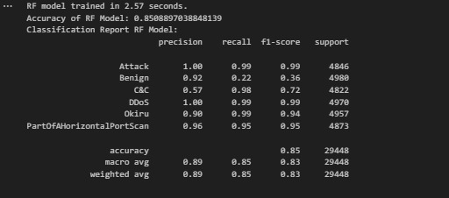
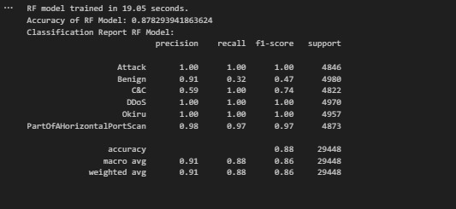
Modeling : Random Forest
Working Principle: Random Forest is an ensemble learning method that builds multiple decision trees during training. It aggregates the predictions of individual trees to make a final prediction.
Suitability for Anomaly Detection: Random Forest is robust against overfitting and can handle large datasets with high dimensionality. It is suitable for anomaly detection in IoT networks where the data may exhibit complex and non-linear relationships.

Slide 16
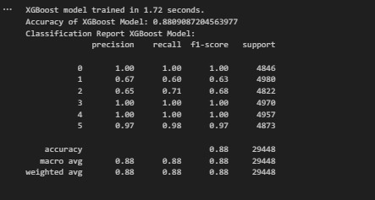
Modeling : XGBoost
Working Principle: XGBoost is an optimized gradient boosting algorithm that uses an ensemble of weak learners (decision trees) to make predictions. It sequentially builds trees to correct errors made by previous models.
Suitability for Anomaly Detection: XGBoost is highly scalable and can handle large datasets with high dimensionality. It is suitable for anomaly detection in IoT networks where high accuracy and efficiency are required.

Slide 17
Model Performance Evaluation
Overview of Model Performance:
Models Evaluated: Decision Tree, Random Forest, KNN, XGBoost.
Key metrics: Precision, Recall, F1-Score, and Model Accuracy.
K-Nearest Neighbors (KNN):
Best K value: 9
Accuracy: 0.92016
High F1-scores across classes, especially for 'Okiru' and 'DDoS'.
Excellent performance in classifying 'PartOfAHorizontalPortScan'.
Random Forest:
Performance across different runs shows consistency.
Strong in detecting 'Okiru' and 'PartOfAHorizontalPortScan'.
Lower performance on 'Benign' and 'C&C' classifications.
Detailed Insights:
KNN demonstrates high accuracy and is very effective for certain anomaly types.
Random Forest exhibits robustness but varies slightly in precision and recall across classes.

Slide 18
Conclusion :
Our project has successfully demonstrated the application of machine learning models for anomaly detection in IoT networks using the IoT-23 dataset. We evaluated multiple models, including Decision Trees, K-Nearest Neighbors, Random Forest, and XGBoost, finding that each has strengths and weaknesses depending on the specific anomaly types and network conditions. This research underscores the importance of choosing the right model based on precision, recall, and efficiency, tailored to the particular challenges of IoT security.
Future work will focus on enhancing model accuracy and exploring real-time anomaly detection capabilities, aiming to strengthen the resilience and reliability of IoT systems against emerging threats.

Slide 19
Thank You !

