Slide 1
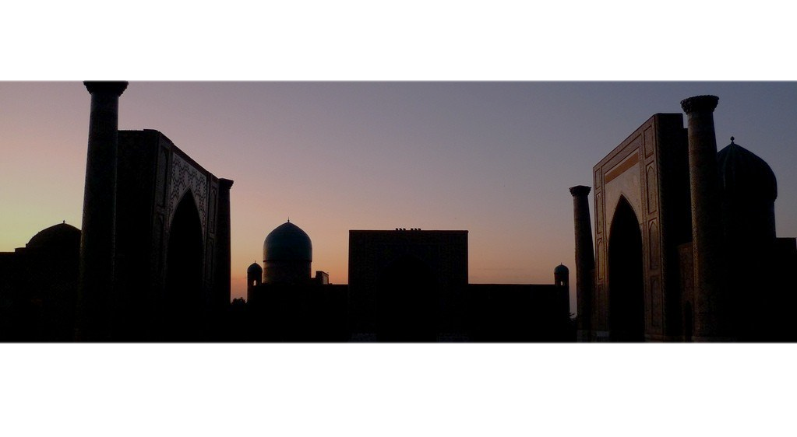
Final project for IBM Data Science Course
Uzbek Restaurant in Charlotte, North Carolina
By Ravshan Rasuli

Slide 2
Charlotte and Uzbek Restaurant
Introduction
Data
Methodology
Results and discussion
Conclusion

Slide 3
Introduction
Probably you never heard about Uzbekistan and it’s food. I am from Uzbekistan and you can trust me, our food is delicious with influences from all over Asia and the Middle East!
Now I live in Charlotte.
Charlotte is the second-largest banking center in the United States, after New York City.
The nation's second largest financial institution by total assets, Bank of America, calls the city home.
Charlotte is the major center of the U.S. motorsports industry, housing the US's only Formula One team, Haas F1, multiple teams and offices of NASCAR.

Slide 4
Data
In this project I will try to show and explain:
Why Charlotte is a good place to do business. I will download some tables from Wikipedia.
Why Uzbek restaurant is a good choice. I am going to do little presentation by downloading photos of our most famous dishes (unfortunately I cannot give you to try, you’d definitely love it).

Slide 5
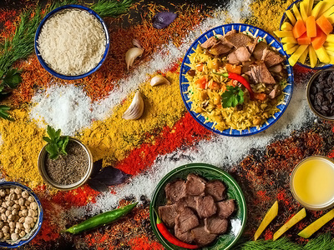
Colors of Uzbek food

Slide 6
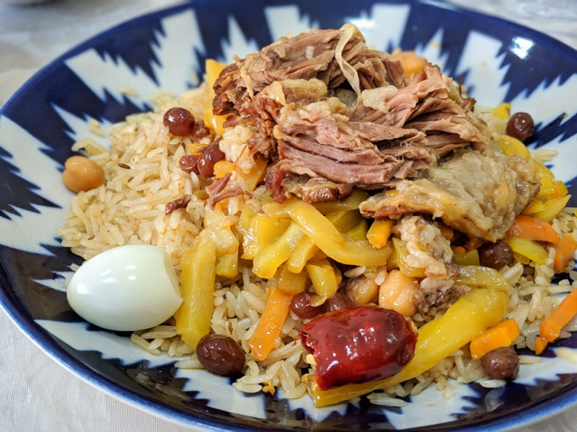
Plov
You can expect a heaping portion of rice that has been cooked together with lamb or beef, onions. garlic, raisins, carrots, and apricots.

Slide 7
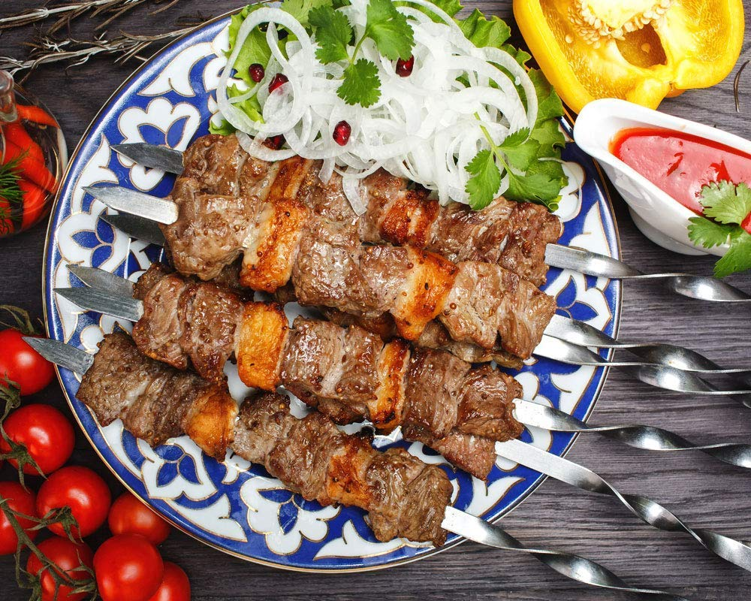
Shashlik (Kebabs)
The classic Uzbek shashlik is a dish of shallow meat, usually lamb with a minimum of spices, plus salt, pepper, spices and sliced onions.

Slide 8
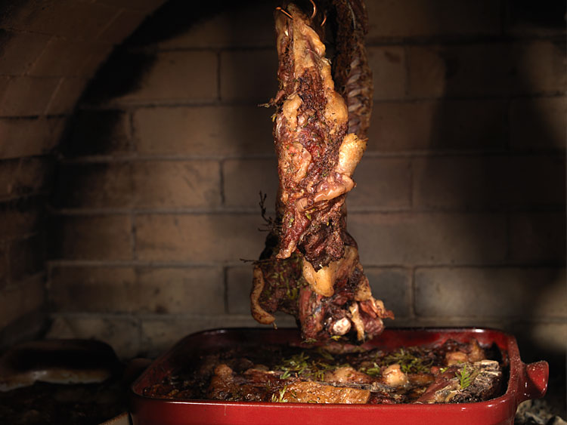
Tandoor Kabob
Whole lamb cooked in tandoor (an underground brick oven).

Slide 9
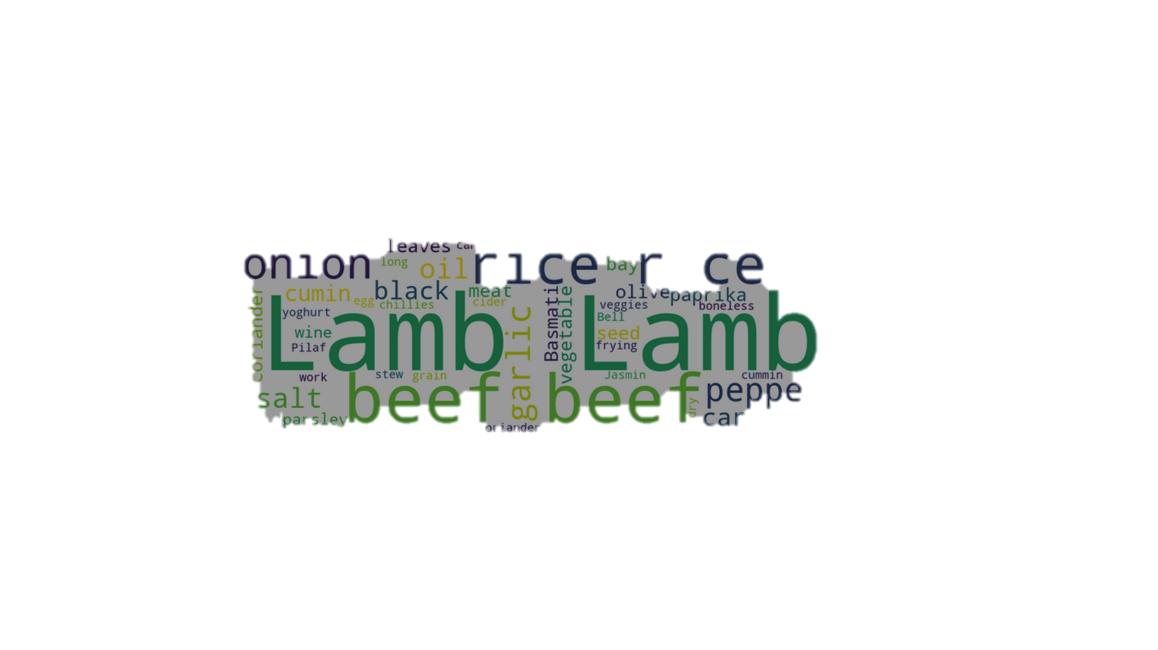
Products we use to cook our delicious meals
Yes, we love the meat

Slide 10
Methodology
In this project we will try to find the best location to open an Uzbek restaurant in Charlotte.
First we will find the location of Turkish and Mediterranean restaurants in Charlotte using Foursquare.
Then we put Turkish and Mediterranean restaurants location together to the Charlotte map using Folium.
To make decision what area would be the best to place out new Uzbek restaurant, we need to make a research of Charlotte neighborhoods.

Slide 11
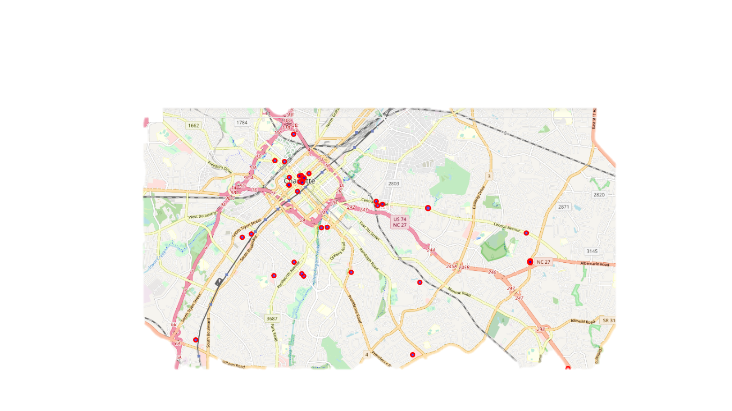
Charlotte map marked with Turkish and Mediterranean restaurants.

Slide 12
Results and discussion
As we can see most of the restaurants are spreaded around the city. Most of the restaurants placed in the city center of Charlotte, we call this place Uptown, it is also a business center of Charlotte. Uptown is a not good choice to open a Uzbek restaurant, because it's already has many places and most of them making business during lunch time.
We are looking for place where people going after work or on weekend to have fun and proper meal. My choice would be area around Central Avenue. This area is growing and it has future prospects. Also we can see some places with Turkish and Mediterranean restaurants in that area.
As Uzbek food needs time. You have to be relaxed to enjoy your meal.

Slide 13
Conclusion
In this project I tried to introduce you to Uzbek food. I hope by this time you have little idea what is it. I think one day you will try. I am sure if you try Uzbek food once, you will want to come back.
To make decision about your preferences you have to try and I am ready to make your first Uzbek Feast!

