Slide 1

DE-FREELANCER Decentralized middleman

Slide 2
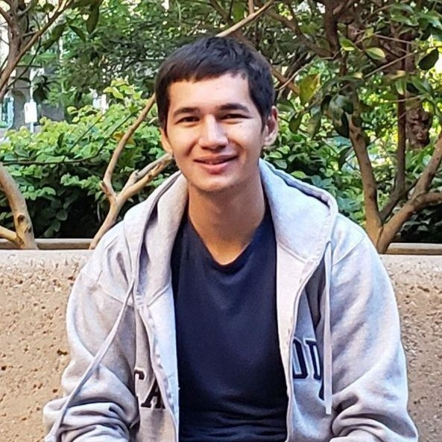
Ravshan
Makhmadaliev
Software Engineer
Science Enthusiast

Slide 3
PROBLEMS WITH FREELANCING PLATFORMS
Scams
Slow
Expensive

Slide 4
DE-FREELANCER – a middleman without a middleman
A new way of doing business!

Slide 5
BENEFITS OF DE-FREELANCER
Fast
Cheap
Predictable

Slide 6
MAIN FEATURES
Open-source
Ethereum based smart-contract
Modern solution

Slide 7
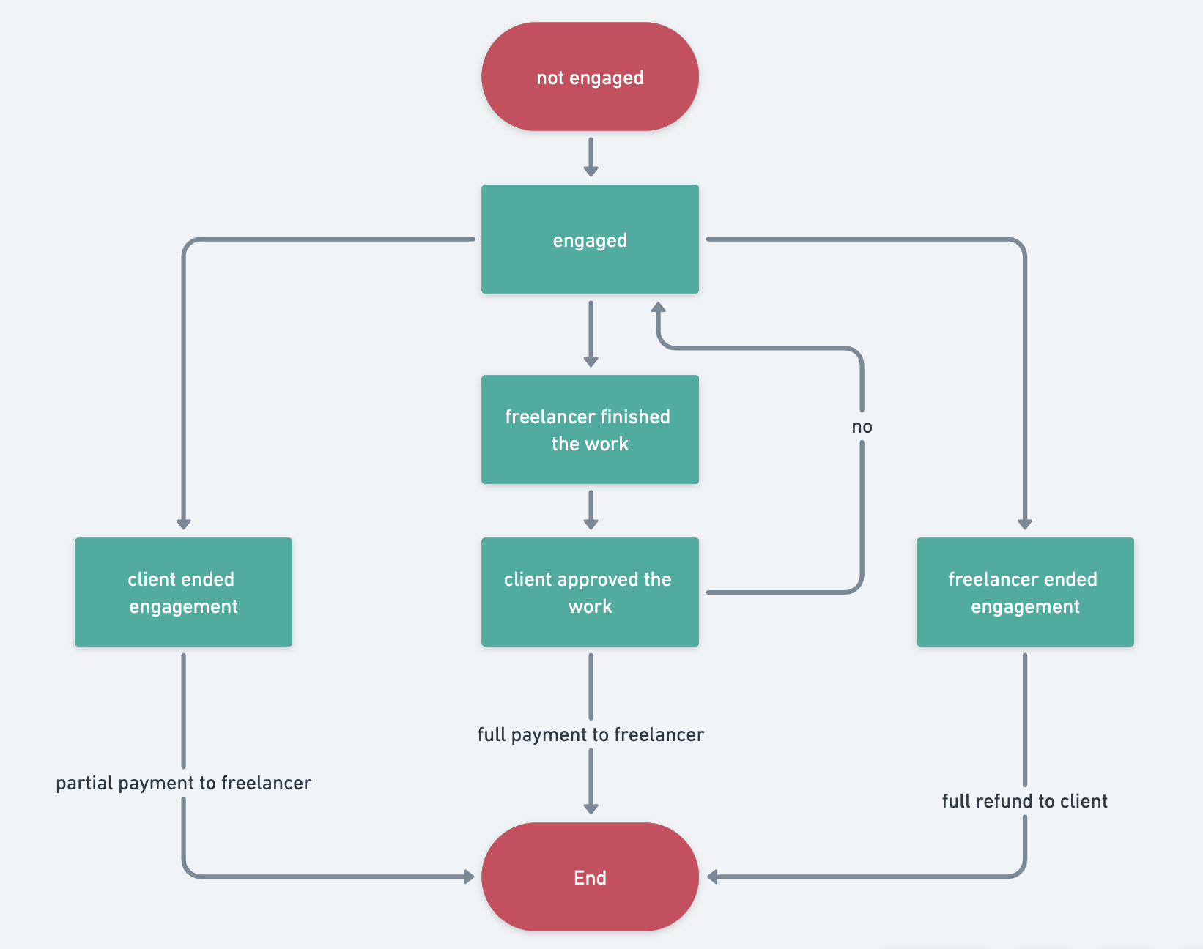
HOW IT WORKS

Slide 8
SWOT Analysis
STRENGTHS
Fast
Cheap
Predictable
WEAKNESSES
High transaction cost
S
W
Low transaction cost
Multiple crypto access
Not only freelancing
OPPORTUNITIES
Money laundering
Competitors
THREATS
O
T

Slide 9
<1 minute
500M+ crypto users
~$900M USD
Multiple business days ==> some seconds
Total number of crypto users by the end of 2022
Estimated freelancing market size in 2027

Slide 10
A middleman without a middleman
Learn more, donate and contribute:
https://github.com/Ravshann/de-freelancer

