Slide 1
A Project Presentation
On
Electricity management System
Submitted to:
SHIVA KRISHNA REDDY
Department of
Data Structures and Algorithms
Submitted by:
R.Jayanth Reddy
2103A51489
CSE-A

Slide 2

agenda
1. Introduction
2. Objectives
3. Software
4. Hardware
5. Modules
6.References
7. Sample Output
8. Conclusion

Slide 3
Introduction
The electrical officers in India especially in rural areas they need to visit each and every house in order to collect electricity bills, to check any issues regarding electric connection to a house and etc.
But with the help of this application we can save the time of the officers and decrease their efforts . The people will also get benefited by using this application.
By using this application the user can be able to get a new account/connection or can remove his/her previous existing connection and can pay the electricity bills.
This application is user efficient and the user can be used simply.

Slide 4
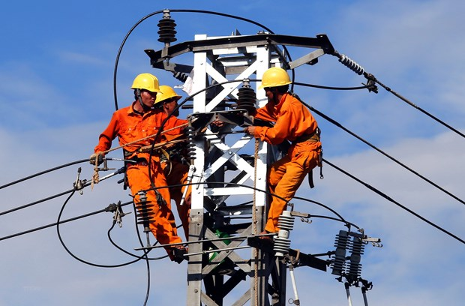
Objectives
The application aims to fulfil the following objectives:
The user can be able to save his time by using this application.
The maintenance of electricity bills to electrical officers will become easier.
Helps the user to pay the electricity bills .

Slide 5

software : dev c ++
Dev-C++ is a fully featured graphical IDE (Integrated Development Environment) that uses the MinGw compiler system to create Windows as well as Console based C/C++ applications. It can also be used with any other GCC-based compiler like Cygwin. Dev-C++ is free software and is distributed under the GNU General Public License.
Embarcadero Dev-C++ is a new and improved fork (sponsored by Embarcadero) of Bloodshed Dev-C++ and Orwell Dev-C++.

Slide 6

hardware : personal Laptop

Slide 7
modules:
Create() :
This function is used to create a new node
Bill() :
This function is used to show the total bill to user on his service number
Newenrol() :
This function is used to enrol a new account to user .
Terminate() :
This function is used to remove already existing connection on his service number.
Feedback() :
This function allows the user to give any feedbacks on this application .
Viewfeedback():
This function allows the user to view his feedback given on this application .

Slide 8
References:
BOOKS:-
C : The Complete reference
Let Us C++
VIDEOS:-
https://youtu.be/aTVSEEQXs-Y
https://youtu.be/mCTSzm1YcfM
https://youtu.be/y9UJn4fqqWk
https://www.youtube.com/watch?v=eGnlKPCkAFY

Slide 9
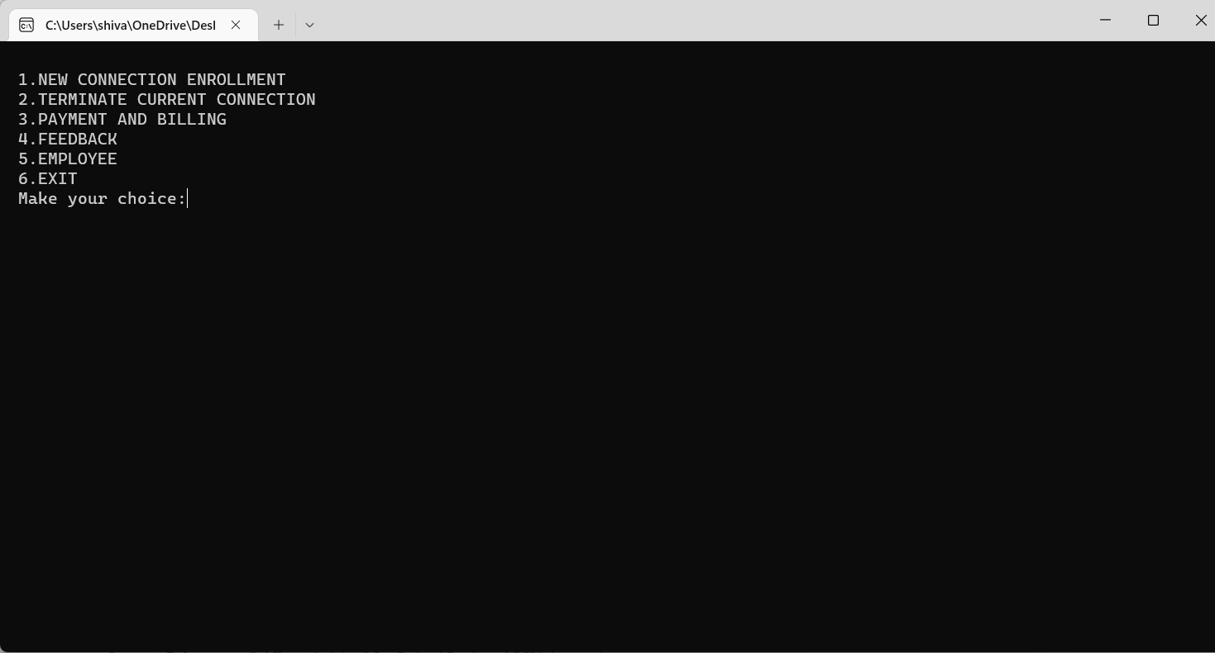
SAMPLE OUTPUT
Main Menu

Slide 10
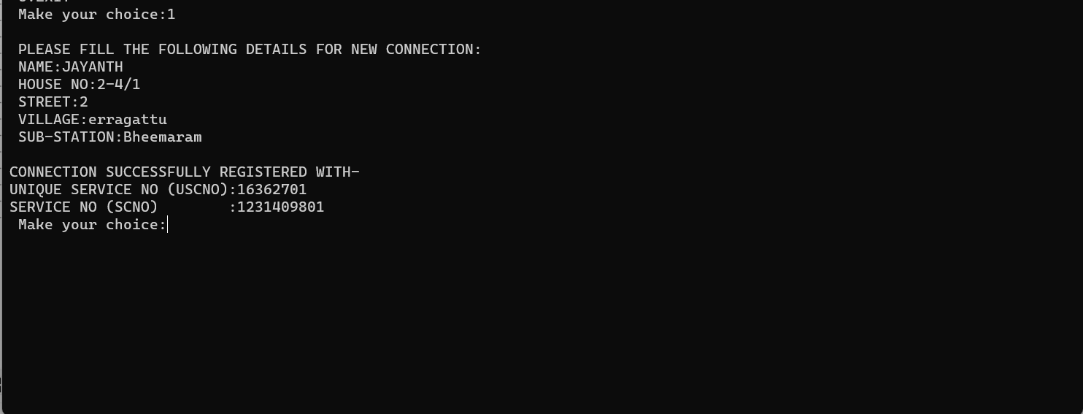
New Connection Enrolment

Slide 11
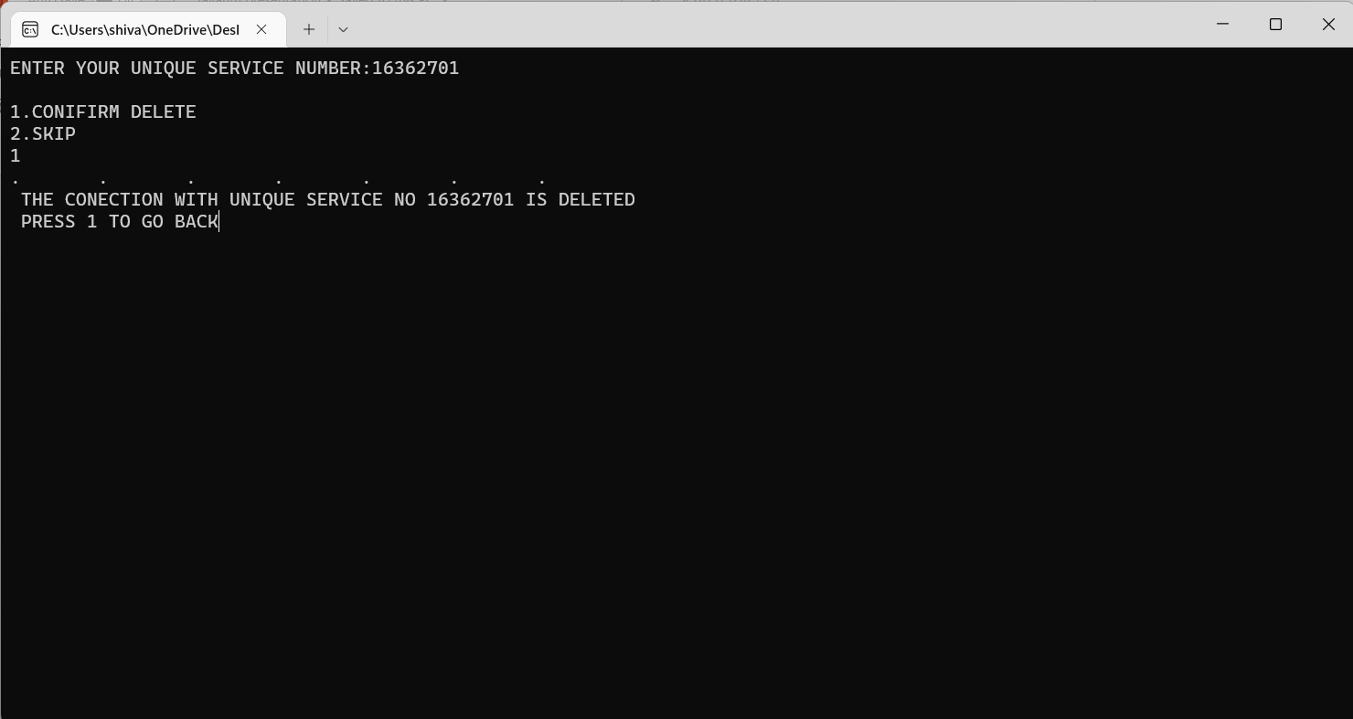
Terminating Current Connection

Slide 12

Payment and Billing

Slide 13
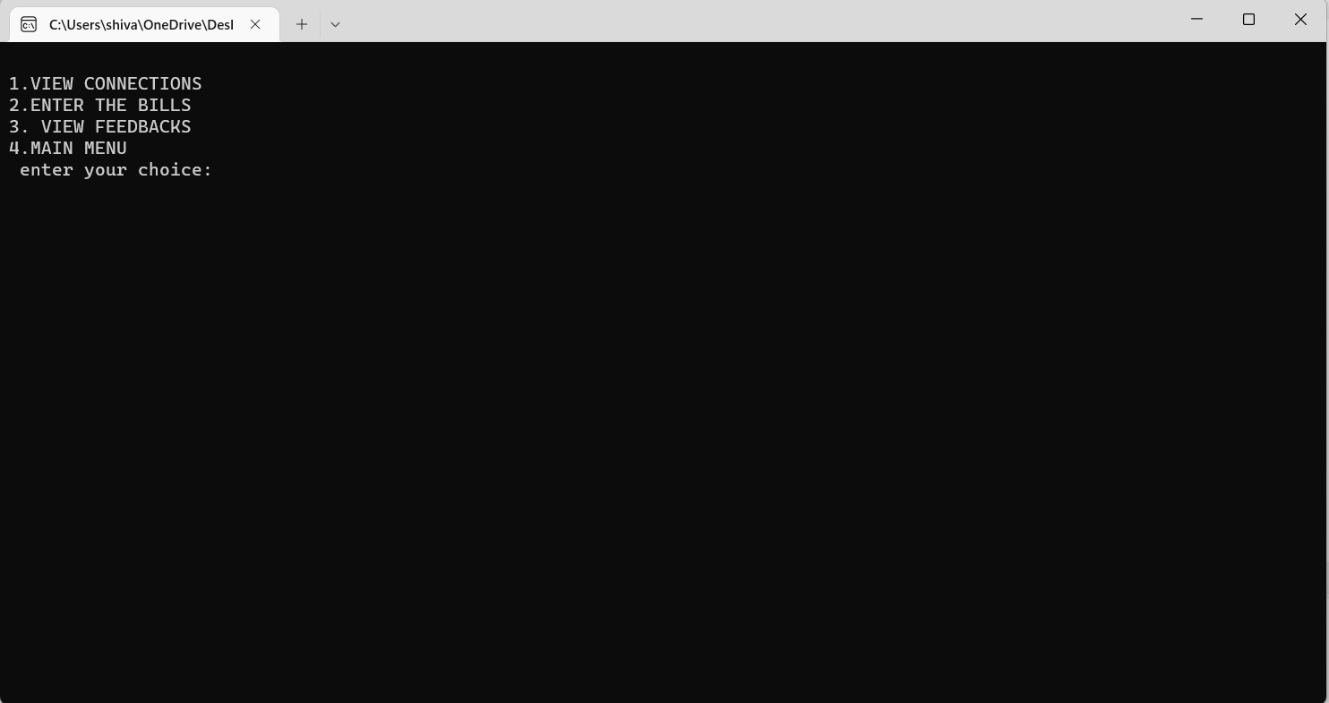
Employee

Slide 14
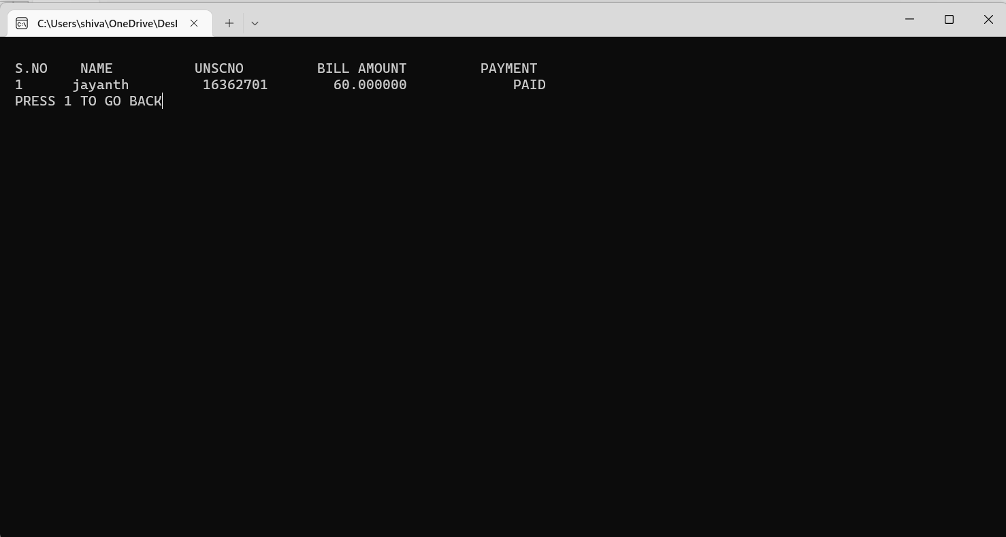

Slide 15
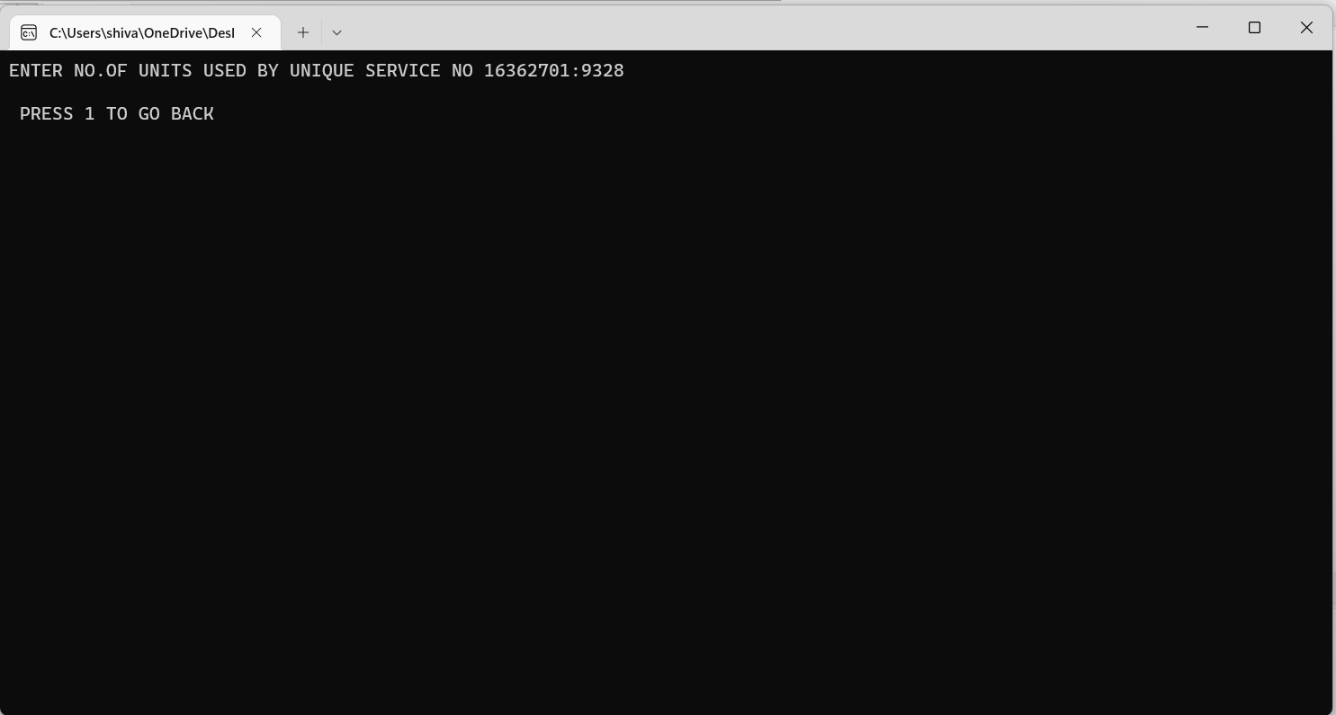

Slide 16
Conclusion:
This application is efficient in maintaining customer details and can easily performs operations on customer’s records and also works to handles the information of the electrical connection/electricity supply available.
This application also reduces the work load the electric officers and helps them to reduce the efforts.
The project explores various features of C-programming language mainly like functions, loops, structures, linked lists and Arrays.

Slide 17
Thank you

