Slide 1
THROAT CANCER DETECTION
Done by
2103a51290
2103A51489
2103a51519
Under the esteemed guidance of-
Mr. S Naresh kumar

Slide 2
overview
This project aims to use artificial intelligence and machine learning techniques to detect the THROAT CANCER by using text data input .
The project will detect the throat cancer by analyzing Collected data on the medications and health related information collected from diagnosis tests and basic information such as health condition.

Slide 3
Problem Statement
Develop a machine learning model that can accurately detect the presence of throat cancer in patients based on the analysis of their medical records and symptoms. The model should be able to analyze a set of input variables, including age, sex and other relevant medical history, and provide a binary output indicating the likelihood of throat cancer The ultimate goal of this project is to provide a tool that can aid doctors in making more informed diagnoses and treatment decisions for patients with throat cancer.

Slide 4
Existing Systems
There are several existing systems for detecting throat cancer that use artificial intelligence and machine learning techniques. Here are a few examples:
Image-based systems: these systems use images of the throat, taken using an endoscope or other imaging tools, to detect signs of cancer. The images are analyzed using machine learning algorithms that can identify abnormal cells and tissues.
Voice analysis systems: these systems analyze the patient's voice to detect signs of cancer. They use machine learning algorithms to analyze changes in pitch, tone, and other vocal characteristics that may indicate the presence of cancer.

Slide 5
Proposed System
The proposed system will focus on analyzing and detecting the number of confirmed throat cancer cases based on input data. The system will detect the throat cancer by analyzing several quantities such as thyroxine levels and other information collected from diagnosis and will be used to accurately detect the throat cancer.

Slide 6
Objectives
The objective of our AIML project for throat cancer detection is to develop an algorithm or system that can accurately identify the presence of throat cancer in patients using text data.
The system would need to be able to analyze the values and detect any signs of throat cancer. The goal would be to create a tool that could assist medical professionals in making faster and more accurate diagnoses of throat cancer, potentially leading to earlier treatment and better patient outcomes.

Slide 7
Dataset Description
We have selected the our world in data (OWID) dataset which is a non profit organization that provides research and data to make progress.
The data in this dataset is sourced from a variety of sources including the world health organization (who), national health ministries, and other public sources. The data is updated regularly, and the dataset covers the period from early 2020 to the present day.

Slide 8
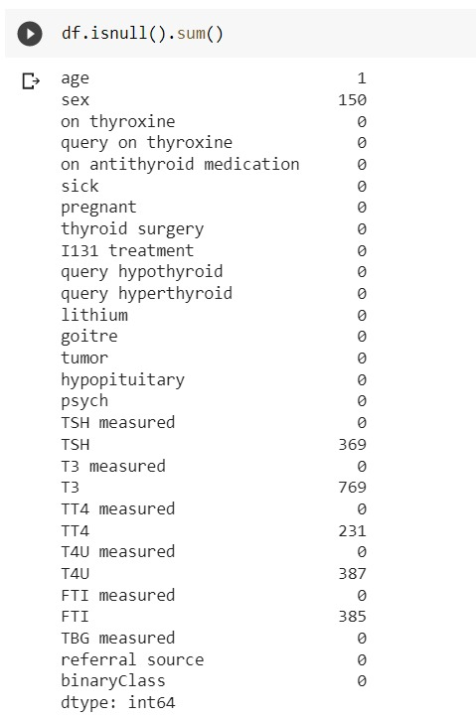
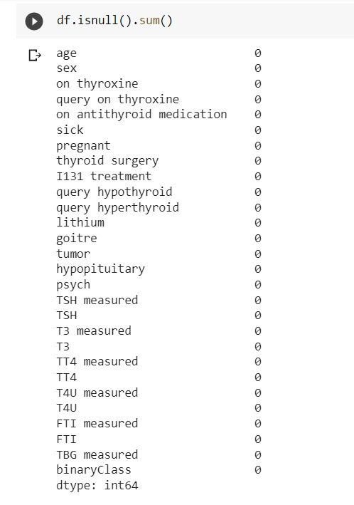
Data Cleaning
After removing duplicate values
Checking for duplicate values

Slide 9
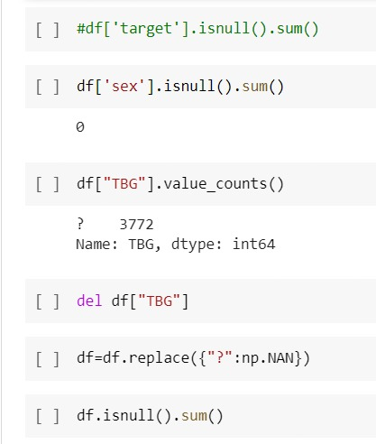
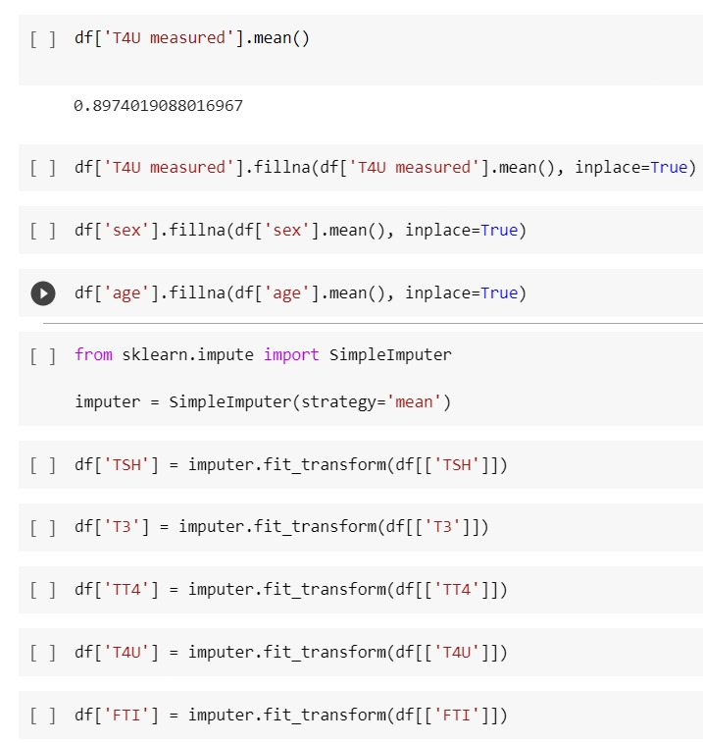
Data cleaning

Slide 10
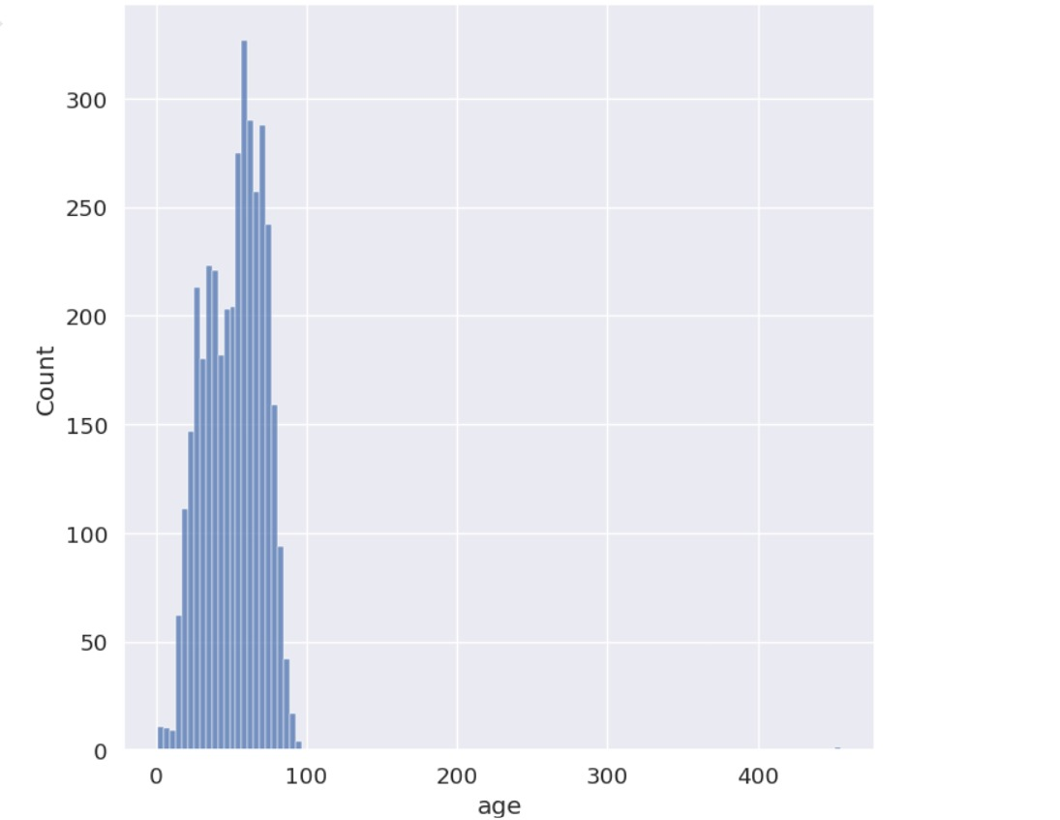
Data Visualization
DATA VISUALISATION Bar Graph
By analyzing the above bar graph, we can gain insights into which features are most relevant for throat cancer detection and potentially improve the accuracy of the language detection model.

Slide 11
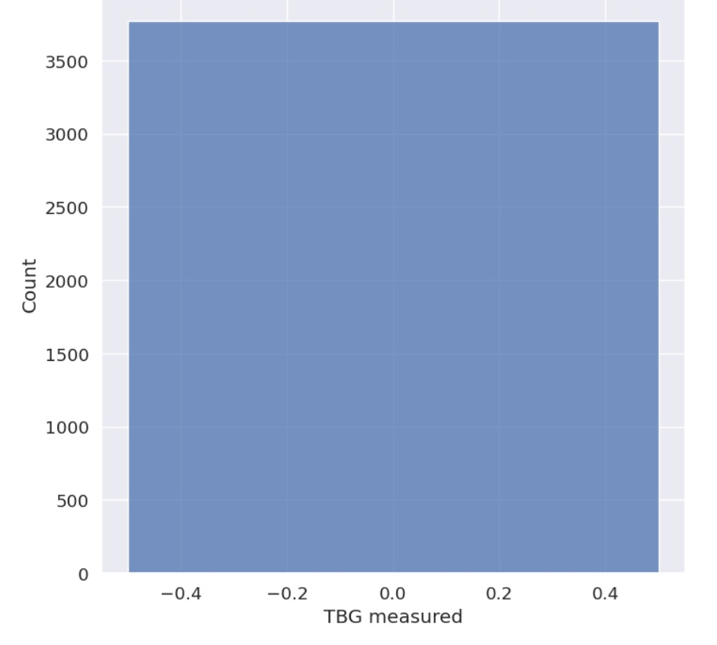
DATA Visualization
DATA VISUALISATION Bar Graph
A Bar Graph is drawn by taking two quantities TBG measured and count

Slide 12
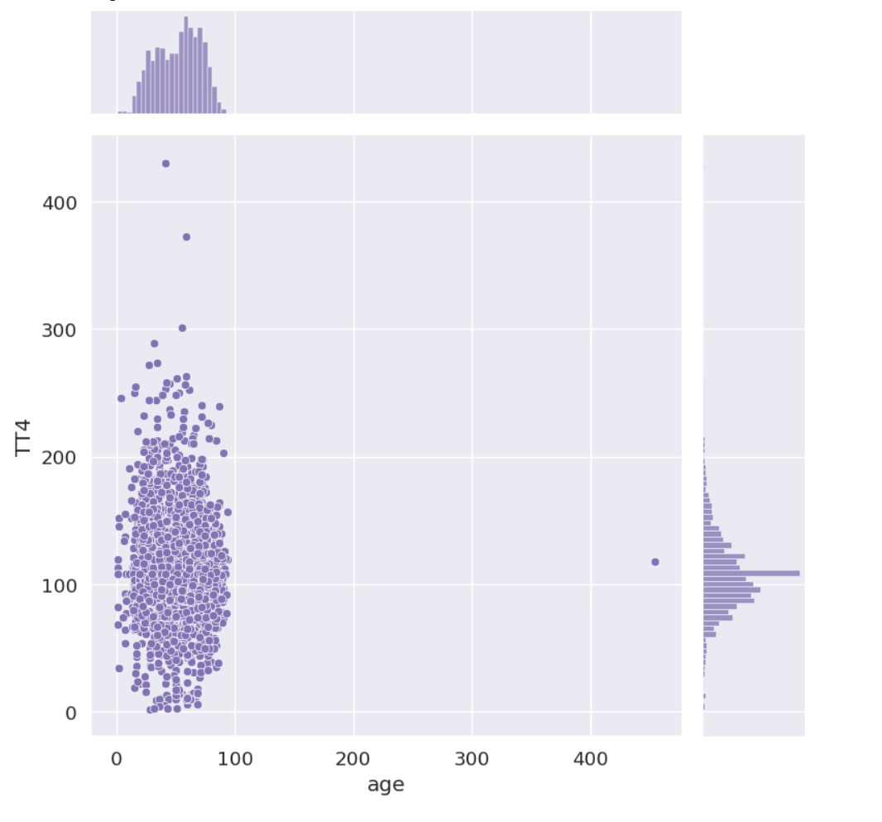
Data Visualization

Slide 13
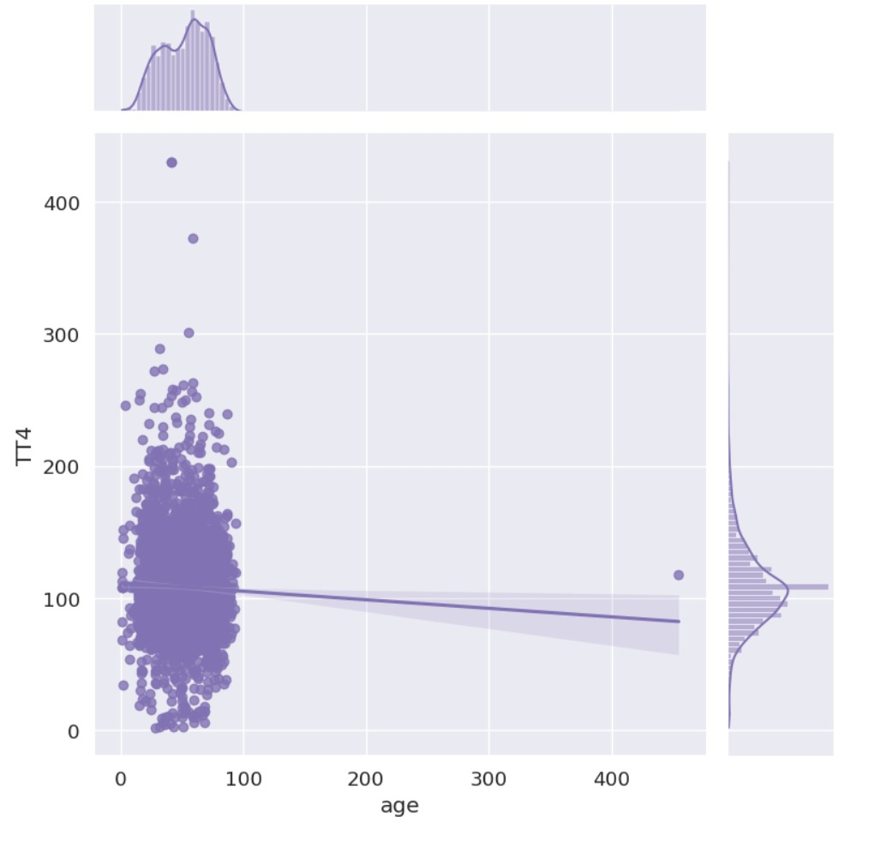
Data Visualization

Slide 14
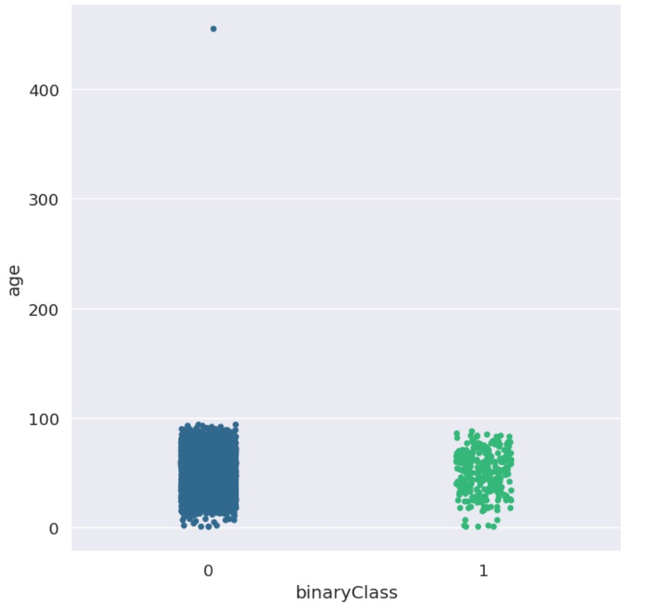
Data visualisation

Slide 15
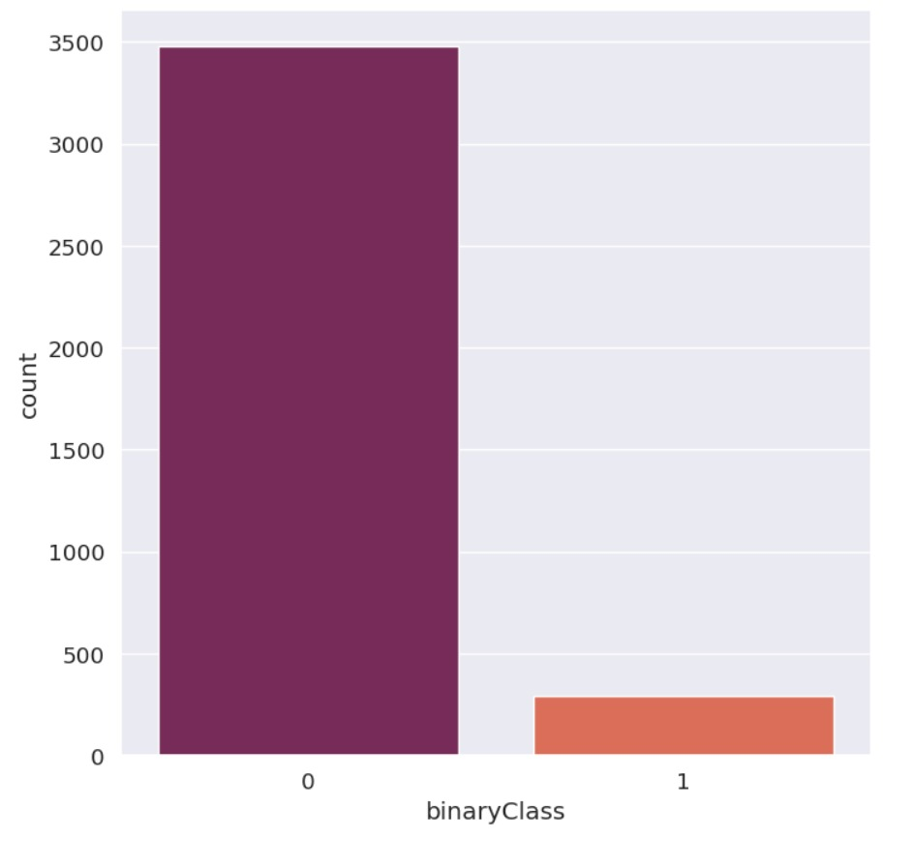
Data Visualization

Slide 16
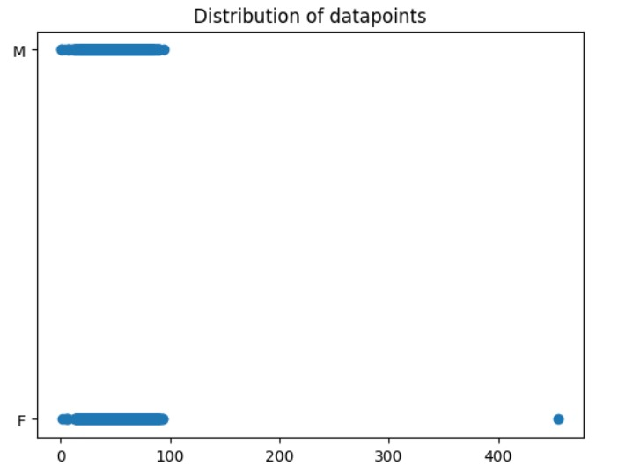
DATA VISUALISATION scatter plot

Slide 17
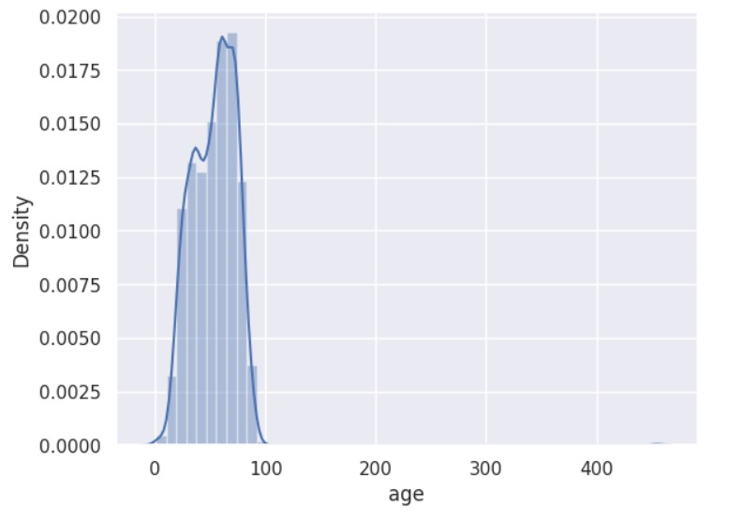

Slide 18
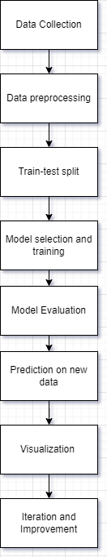
Model Architecture

Slide 19
Software Description
Python
Pandas
Numpy
Scikit-Learn
Matplotlib
Seaborn

Slide 20
Conclusion and Future Scope
In conclusion, the use of artificial intelligence and machine learning techniques for the detection of throat cancer shows great promise. By analyzing large amounts of data, such as medical images and patient histories, these tools can help identify potential cases of throat cancer at an earlier stage, when treatment is more likely to be effective.
Throat cancer is a serious and life-threatening condition that affects millions of people worldwide. Early detection of throat cancer is essential to improving patient outcomes and survival rates. One promising approach to improving throat cancer detection is through the use of artificial intelligence and machine learning (AIML) techniques.

Slide 21
Results and Discussion
The results of the throat cancer detection project show that the model achieved an accuracy of 96% on the testing set using Logistic Regression and Support Vector System

Slide 22
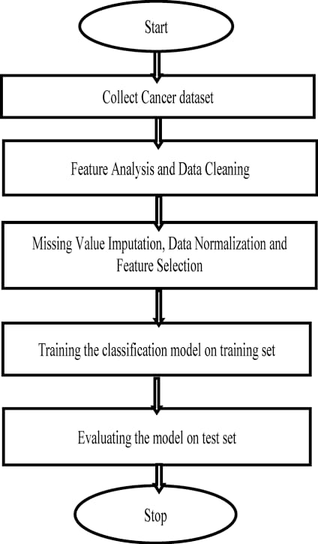
Procedure to solve the given problem

Slide 23
REFERENCES
https://www.cancerresearchuk.org/about-cancer/throat-cancer
https://www.cancer.org/cancer/throat-cancer.html
.https://www.cancer.gov/types/head-and-neck/patient/adult/oropharyngeal-treatment-pdq

Slide 24
THANK YOU

