Slide 1

VAAGDEVI COLLEGE OF ENGINEERING
Department of computer Science and Engineering
Project: Real Time Human Detection
TEAM:
RAVULA DEERAJ REDDY (19641A0502)
GAJA SAI CHANDU (19641A0503)
BASANI MANOJ KUMAR (19641A0526)
MOHAMMED MUZAKKIR BIN RAHMAN (19641A0504)
Under guidence of :
A. SWETHA

Slide 2
CONTENTS
Absract
Introduction
Existing
Proposed
System Design
Software Requirement
Hardware Requirement
Reference
Conclusion

Slide 3
Abstract
In this python project, we are going to build the HumanDetection and Counting System through Webcam or you can give your own video or images.This is an intermediate level deep learning project on computervision, which helped us to grab the very basics of AI, ML and DL.
The system will tell how many people are present in the screenat any given time that is it can give real timeanalysis.
Our project will be using basics of DL (majorly), through which will be defining differentsort of functions to capture the humanbody in real time and then following the capture we will be counting the number of humans detected.
We will be dividing the given image, video or live webcam image to the model as an input which will then pass through some custom made functions which created through librarieslike OpenCV, NumPy. The functions will be dividing the input into different frames to analyze and show the output.

Slide 4
Introduction
Over the recent years, detecting human beings in a video sceneof a surveillance system is attracting more attention due to its wide range of applications in abnormal event detection, humangait characterization, person counting in a dense crowd, personidentification, gender classification, fall detection for elderly people, etc.
The scenes obtained from a surveillance video are usually with low resolution.
Most of the scenes captured by a static camera are with minimal change of background.
Objects in the outdoorsurveillance are often detected in far field. Most existing digital video surveillance systems rely on human observers for detecting specific activities in a real-time video scene.
However,there are limitations in the human capability to monitor simultaneous events in surveillance displays.
Hence, human motion analysis in automated video surveillance has become one of the most active and attractive research topics in the area of computer vision and pattern recognition.

Slide 5
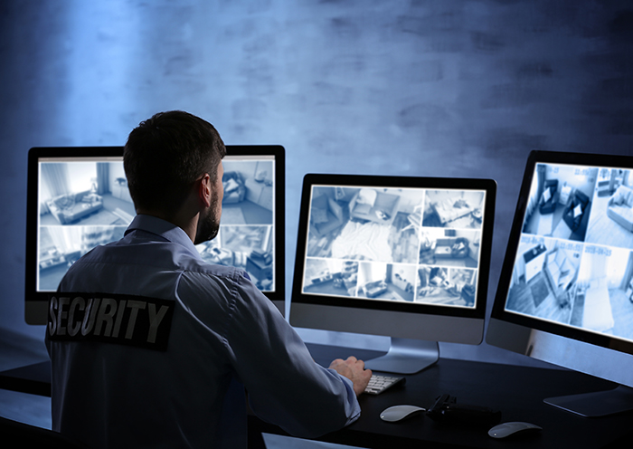
Existing
Most existing digital video surveillance systems rely on human observers for detecting specific activities in a real-time video scene.
However,there are limitations in the human capability to monitor simultaneous events in surveillance displays.

Slide 6
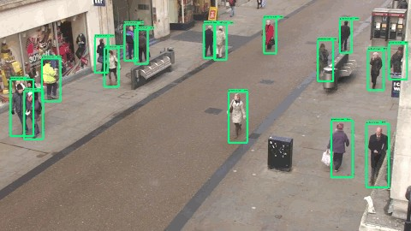
Proposed
An intelligent system detects and captures motion information of moving targets for accurate object classification. The classified object is being tracked for high-level analysis. In this study, we focus on detecting humans and do not consider recognition of their complex activities.

Slide 7
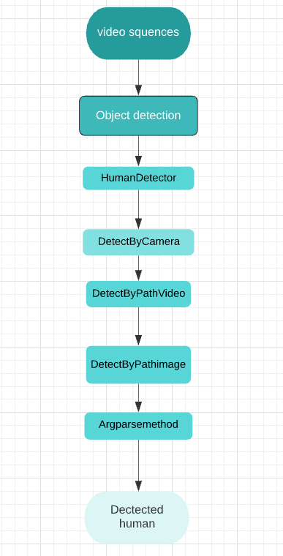
System Design

Slide 8
Software and Hardware Requirement
Software Requirements:
Windows or Linux or Macos
Visual Studio Code or Anaconda
Python
Opencv
Hardware Requirements:
Processor(intel i3,i5,i7, apple silicon m1,etc..)
Ram of 4GB
A hard disk of 100GB

Slide 9
Reference
[1] Face Detection and Recognition Using OpenCV
https://ieeexplore.ieee.org/document/8974493
Authors: Maliha Khan; Sudeshna Chakraborty; Rani Astya; Shaveta Khepra Publication year: 2019
[2] Face Recognition Implementation on Raspberrypi Using Opencv and Python
https://papers.ssrn.com/sol3/papers.cfm? abstract_id=3557027
Author: Manav Bansal Publication year: 2020
[3] Facial Detection & Recognition Using Open CV library
https://www.researchgate.net/
publication/305703476_Facial_Detection_Recognition_Using_Op en_CV_library
Author: Manav Bansal, Sohan Garg

Slide 10
Conclusion
We expect to build the Human Detection and Counting System through Webcam or we can give your own video or images.
This is an intermediate level deep learning project on computer vision, which will help us to master the concepts.
The system will tell how many people are present in the screen at any given time that is it can give real time analysis.
We expect the system to be used in fields like proximity alert systems, intrusion alarm system, etc.

Slide 11
THANK YOU！

