Slide 1

Blinkit Analysis
BUSINESS REQUIREMENT
To conduct a comprehensive analysis of Blinkit's sales performance, customer satisfaction, and inventory distribution to identify key insights and opportunities for optimization using various KPIs and visualizations in Power BI.
KPI's Requirements
Total Sales: The overall revenue generated from all items sold.
Average Sales: The average revenue per sale.
Number of Items: The total count of different items sold.
Average Rating: The average customer rating for items sold.
by Tharun Ravula

Slide 2
Granular Requirements
1. Total Sales by Fat Content
2. Total Sales by Item Type
Objective: Analyze the impact of fat content on total sales.
Objective: Identify the performance of different item types in terms of total sales.
Additional KPI Metrics: Assess how other KPIs (Average Sales, Number of Items, Average Rating) vary with fat content.
Additional KPI Metrics: Assess how other KPIs (Average Sales, Number of Items, Average Rating) vary with fat content.
3. Fat Content by Outlet for Total Sales
4. Total Sales by Outlet Establishment
Objective: Compare total sales across different outlets segmented by fat content.
Objective: Evaluate how the age or type of outlet establishment influences total sales.
Additional KPI Metrics: Assess how other KPIs (Average Sales, Number of Items, Average Rating) vary with fat content.

Slide 3
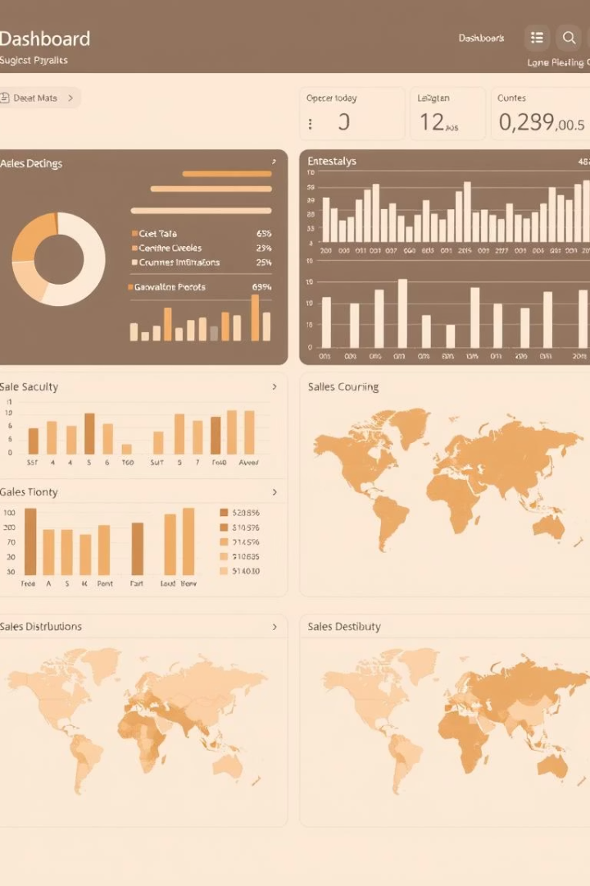



Percentage of Sales by Outlet Size
Objective: Analyze the correlation between outlet size and total sales.
Sales by Outlet Location
Objective: Assess the geographic distribution of sales across different locations.
All Metrics by Outlet Type
Objective: Provide a comprehensive view of all key metrics (Total Sales, Average Sales, Number of Items, Average Rating) broken down by different outlet types.

