Slide 1


ReScene: A Hybrid Semantic and Structural Framework for Revisit-Based Video Forgery Detection
Team Members
B. MANVITH REDDY
R.JEETENDRA
(23211A6618) (24215A6605)
Supervisor :
Co-Supervisor : Mrs. B. Priyanka

Slide 2
Outline
Motivation
Introduction to Topic
Introduction to domain
Datasets
Literature Review
Methodology
Applications
Overview of the project
References

Slide 3
Motivation
Why Video Forgery Detection?
  AI-based editing tools can create highly convincing manipulated videos.
  Manipulations include object insertion, deletion, replacement, movement, and face modification.
  Forged videos threaten the reliability of digital visual evidence.
Limitations of Existing Methods
  Most forensic techniques focus primarily on pixel-level artifacts.
  CNN and transformer methods can detect visual abnormalities but often lack reasoning about the semantic consistency of objects and their relationships over time.
Need for Revisit-Based Verification
  Applications such as surveillance and security auditing require determining whether a previously observed environment has been modified.
  A system should detect both semantic changes and structural/visual changes.

Slide 4
Introduction To Topic
Project Objective: Develop a hybrid video forgery detection framework capable of identifying modifications between a reference video and a revisited/query video.
Core Concepts:
  Semantic Scene Analysis:
    Detect objects using YOLOv8.
    Represent objects as nodes in a Scene Graph.
    Represent spatial relationships such as: Left-of, Right-of, Above, Below, Near.
  Scene Memory:
    Stores frequently observed objects.
    Maintains object relationships and co-occurrence information across the reference video.
  Structural Verification
    Uses SSIM and ORB feature matching to identify visual or structural differences.
  Adaptive Fusion
    Combines semantic and structural evidence to produce the final tampering confidence score.

Slide 5
Introduction to domain
Digital Video Forensics: Digital video forensics focuses on determining whether video content is authentic or manipulated without relying on embedded signatures or watermarks.
Computer Vision: Computer vision enables ReScene to analyze the contents of video frames, including:
  Object detection
  Spatial relationships
  Visual similarity
  Feature matching
Graph Neural Networks: Scene information is represented as a graph:
G = (V, E)
where:
    V = detected objects
    E = relationships between objects
Key Technologies for the Project
  YOLO v8 : A real – time object detection model that can be adapted for face detection and spoof detection.
  OpenCV : A real - time image processing and motion analysis and face detection.

Slide 6
Datasets
Dataset and Benchmark Construction
A major challenge is the lack of publicly available datasets specifically designed for semantic video manipulation detection.
Semantic Training Dataset:
Authentic video frames are converted into scene graphs.
Forgery samples are generated using a Semantic Graph Perturbation Module with five corruption techniques:
  Object Replacement
  Relation Corruption
  Random Object Addition
  Edge Removal
  Spatial Perturbation
Revisit Video Evaluation
  The complete ReScene framework is evaluated using pairs containing:
  Reference Video → Authentic/Forged Revisit Video
  Manipulations include object:
  Addition | Deletion | Replacement | Movement

Slide 7
Literature Review
Real-Time Face Liveness Detection and Face Anti-spoofing Using Deep Learning.
Authors:Ruchi Zawar and Vrishali Chakkarwar
Year:2023
Methodology:Our system uses two steps to verify if a face is real: first, a liveness detector checks if the person is alive, then a CNN classifier determines if the face is real or fake. Both must confirm the face is real for a positive result. This ensures accurate face authentication.
Data preprocessing,
model training
model evaluation
testing.

Slide 8
Methodology
FACE DETECTION WITH BOUNDING BOXES
Utilizing bounding boxes is essential for accurately identifying faces in images. This method allows for the clear delineation of facial regions, which is crucial for further processing and analysis.
AUTOMATIC ANNOTATION USING A FACE DETECTION MODEL
By leveraging advanced face detection models, we can automate the annotation process. This reduces the need for manual labeling, thereby increasing efficiency and consistency across datasets.
FILTERING BASED ON
CONFIDENCE SCORES
Confidence scores play a vital role in ensuring the reliability of detected faces. By filtering out detections that fall below a certain threshold, we can enhance the quality of the dataset and minimize false positives.
BLURRINESS CHECKS
FOR IMAGE QUALITY
Incorporating blurriness checks helps to ensure that only clear images are used in the dataset. This step is crucial as blurry images can lead to inaccurate annotations and affect model training outcomes.
NORMALIZATION OF BOUNDING BOX COORDINATES FOR YOLO FORMAT
Normalizing bounding box coordinates is necessary for integrating with models like YOLO. This ensures that the data is formatted correctly, facilitating seamless training and inference processes.

Slide 9
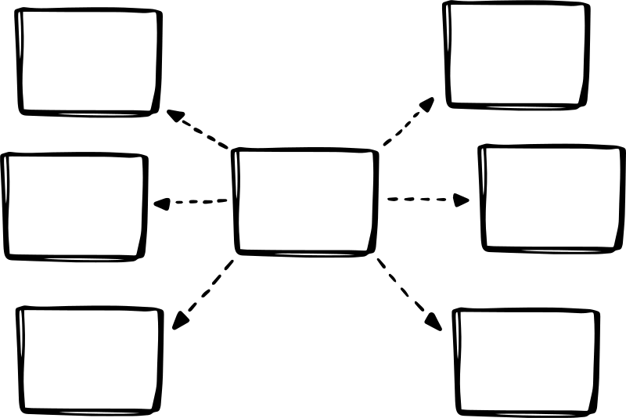
Applications
Travel and Transportation
Financial Services
Identity Verification
Healthcare
Applications
Government and Public Services
  Online Education

Slide 10
Overview
Objective: Develop a real-time face liveness detection system for detection of deepfake and Fake images.
Core Features: Tracks the face movements and pupil movement to detect the real and fake images and videos.
Technologies used: YOLO v8, MediaPipe, OpenCV, CVZone.
Datasets Used: Created our own dataset with 3000+ images.
Applications: Ranges from financial Authentication and Face Id recognition.
Goal: Improve the security while using the face recognition.

Slide 11

THANK YOU

