Slide 1


ReScene: A Hybrid Semantic and Structural Framework for Revisit-Based Video Forgery Detection
B. V. Raju Institute of Technology
Vishnupur, Narsapur, Medak Dist - 502313 (UGC-Autonomous)
Department of CSE (Artificial Intelligence and Machine Learning)
Presenter:
B. Manvith Reddy (23211A6618)
R. Jeetendra (24215A6605)
Under the Guidance Of
Supervisor: Dr. B VeeraSekharReddy
Co-Supervisor: Ms. B Priyanka
Research Domain: Deep Learning and Computer Vision

Slide 2
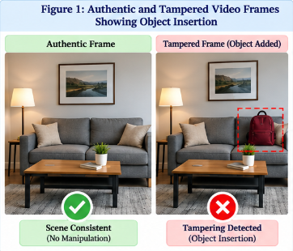
Table of Contents
Motivation
Introduction to Topic
Introduction to domain
Datasets
Literature Review
Methodology
Applications
Overview of the project
References

Slide 3
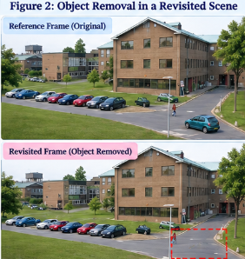
Motivation
Why Video Forgery Detection?
• AI-enabled editing tools can create convincing manipulated videos.
• Manipulations include object insertion, deletion, replacement, movement.
• Existing forensic methods mainly focus on pixel-level artifacts and often miss semantic inconsistencies.
• Revisit scenarios require checking whether objects or relationships changed between observations.
Goal: Combine semantic scene understanding with structural verification for interpretable forgery detection.

Slide 4
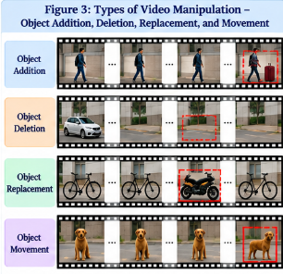
Introduction To Topic
Project Objective: Detect modifications between a reference video and a revisited/query video using a hybrid semantic + structural framework.
Core Concepts:
• Semantic Scene Analysis: YOLOv8 detects objects and builds scene graphs.
• Scene Memory: stores object appearances, relationships and co-occurrence statistics.
• Structural Verification: SSIM and ORB detect visual/structural differences.
• Adaptive Fusion: combines semantic and structural confidence scores.
Output: Authentic or Tampered video with supporting evidence.

Slide 5
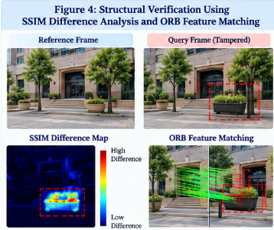
Introduction to Domain
Digital Video Forensics
Determines whether video content is authentic or manipulated without relying on embedded signatures or watermarks.
Computer Vision
Provides object detection, spatial reasoning, visual similarity and local feature matching.
Graph Neural Networks
A scene is represented as G = (V, E), where V denotes detected objects and E denotes spatial relationships. A GCN reasons over these relationships to identify contextual inconsistencies.
Key Technologies: YOLOv8 • Scene Graphs • MemoryGCN • SSIM • ORB • OpenCV • PyTorch Geometric

Slide 6
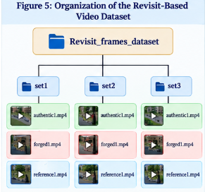
Dataset
Dataset and Benchmark Construction
• Authentic video frames are converted into scene graphs.
• Forged semantic samples are generated using a Semantic Graph Perturbation Module.
Five corruption techniques:
Object replacement
Relation corruption
Random object addition
Edge removal
Spatial perturbation
Dataset Preparation:
Balanced authentic and forged samples
Stratified 80:20 train-test split
Revisit evaluation includes object addition, deletion, replacement and movement.

Slide 7
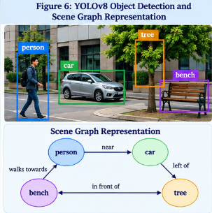
Literature Review
Noise Residue / PRNU:
Detects sensor/statistical traces; sensitive to compression and post-processing.
CNN-based Detection:
Learns appearance artifacts; mainly appearance-focused.
Transformer-based Detection:
Models visual and temporal patterns; often requires large training datasets.
Scene Graph Learning:
Provides semantic/contextual reasoning but depends on object detector performance.
Research Gap:
Existing approaches usually emphasize either structural evidence or semantic understanding. ReScene combines both.

Slide 8
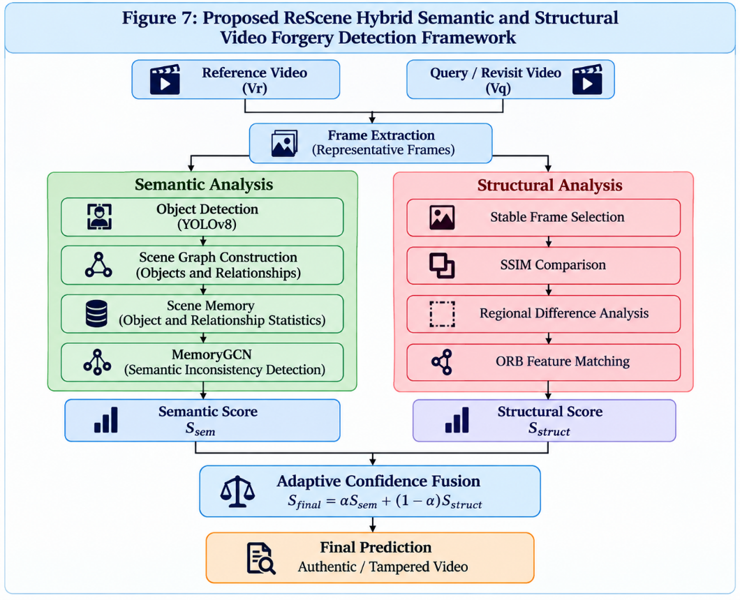
Proposed Methodology
VIDEO INPUT & FRAMES
Reference video Vr and query video Vq are sampled at fixed intervals to obtain representative frames.
SEMANTIC PATH
YOLOv8 detects objects. Objects become graph nodes and spatial relations become graph edges.
SCENE MEMORY + GCN
Scene Memory stores object frequency, relations and co-occurrence. MemoryGCN detects semantic inconsistencies.
STRUCTURAL PATH
Stable frame pairs are compared using SSIM, regional differences and ORB feature matching.
ADAPTIVE FUSION
Combine Ssem and Sstruct: Sfinal = αSsem + (1−α)Sstruct. Final output: Authentic / Tampered.

Slide 9
Applications
Surveillance Systems: Detect unauthorized changes in monitored environments.
Security Auditing: Verify whether previously inspected areas were modified.
Digital Forensics: Analyze suspicious or manipulated video evidence.
Criminal & Insurance Investigation: Support authenticity checks for submitted visual evidence.
Social Media Verification: Identify manipulated or misleading video content.
Inventory / Asset Monitoring: Detect object addition, removal, movement or replacement.

Slide 10
Overview & Results
Objective: Develop an interpretable revisit-based video forgery detector using semantic and structural consistency.
Semantic Branch: YOLOv8 → Scene Graph → Scene Memory → MemoryGCN
Structural Branch: Stable Frames → SSIM → ORB Feature Matching
Fusion: Adaptive combination of semantic and structural confidence scores
Technologies: Python, PyTorch, PyTorch Geometric, YOLOv8n, OpenCV, GCN, SSIM, ORB
Training: Adam optimizer, learning rate 1×10⁻³, batch size 32, dropout and early stopping
Reported Performance on Custom Revisited-Scene Dataset
Accuracy: 77% Precision: 78% Recall: 75% F1 Score: 76%
Key Finding: Semantic and structural branches provide complementary evidence for object-level manipulation detection.

Slide 11
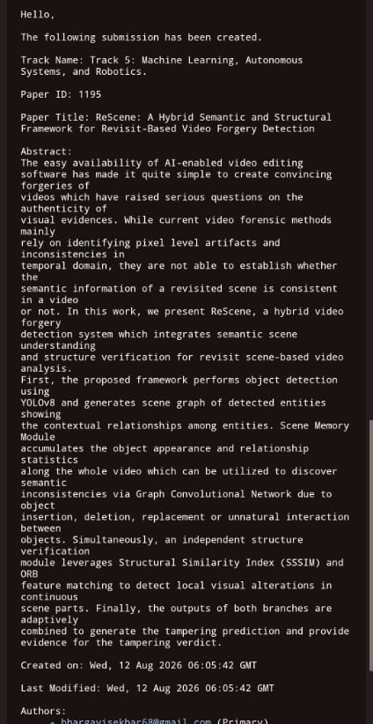
International Conference on Electrical, Electronics and Computer Science with Advance Power Technologies – A Future trends (ICE2CPT)
Conference
PAPER ID - 1195
Acceptance notification – 30th September

Slide 12
THANK YOU

