Slide 1

Songs analysis

Slide 2
Project statement:
This internship project aims to conduct a comprehensive analysis of YouTube songs data using Power BI.
2. The dataset contains key attributes such as video ID, channel title, title, description, tags, published date,
view count, like count, favorite count, comment count, video duration, video definition, and caption
details.
3. The goal is to utilize Power BI to create insightful visualizations and reports that provide a deeper
understanding of YouTube songs' performance, popularity, and user engagement.
4. The analysis aims to uncover trends, preferences, and patterns in the data to aid content creators and stakeholders in
optimizing their YouTube song content.

Slide 3
Dataset description :
1. video_id: Unique identifier for each YouTube video.
2. channelTitle: Title of the YouTube channel publishing the song.
3. title: Title of the YouTube song video.
4. description: Description provided for the YouTube song video.
5. tags: Tags associated with the YouTube song video.
6. publishedAt: Date and time when the YouTube song video was published.
7. viewCount: Number of views received by the YouTube song video.
8. likeCount: Number of likes received by the YouTube song video.
9. favoriteCount: Number of times the YouTube song video has been marked as a favorite.
10. commentCount: Number of comments posted on the YouTube song video.
11. duration: Duration of the YouTube song video.
12. definition: Video definition or quality (e.g., HD, SD).
13. caption: Availability of captions for the YouTube song video.

Slide 4
Data cleaning and preparation: Clean and preprocess the dataset, handling missing values or outliers and removing the duplicates, Convert relevant columns to appropriate data types.
Exploratory Data Analysis (EDA): Explore patterns and distributions in view counts, like counts, and comments, Identify trends in the popularity and engagement of YouTube song videos.
Content and Channel Analysis: Analyze the distribution of videos across different channels, Identify popular tags and their correlation with view counts.
Temporal Trends: Explore how YouTube song video metrics vary over time, Identify peak publishing times and their impact on engagement.
User Engagement Insights: Investigate relationships between likes, comments, and views, Identify factors influencing user engagement with YouTube song videos.

Slide 5

Deliverables:

Slide 6
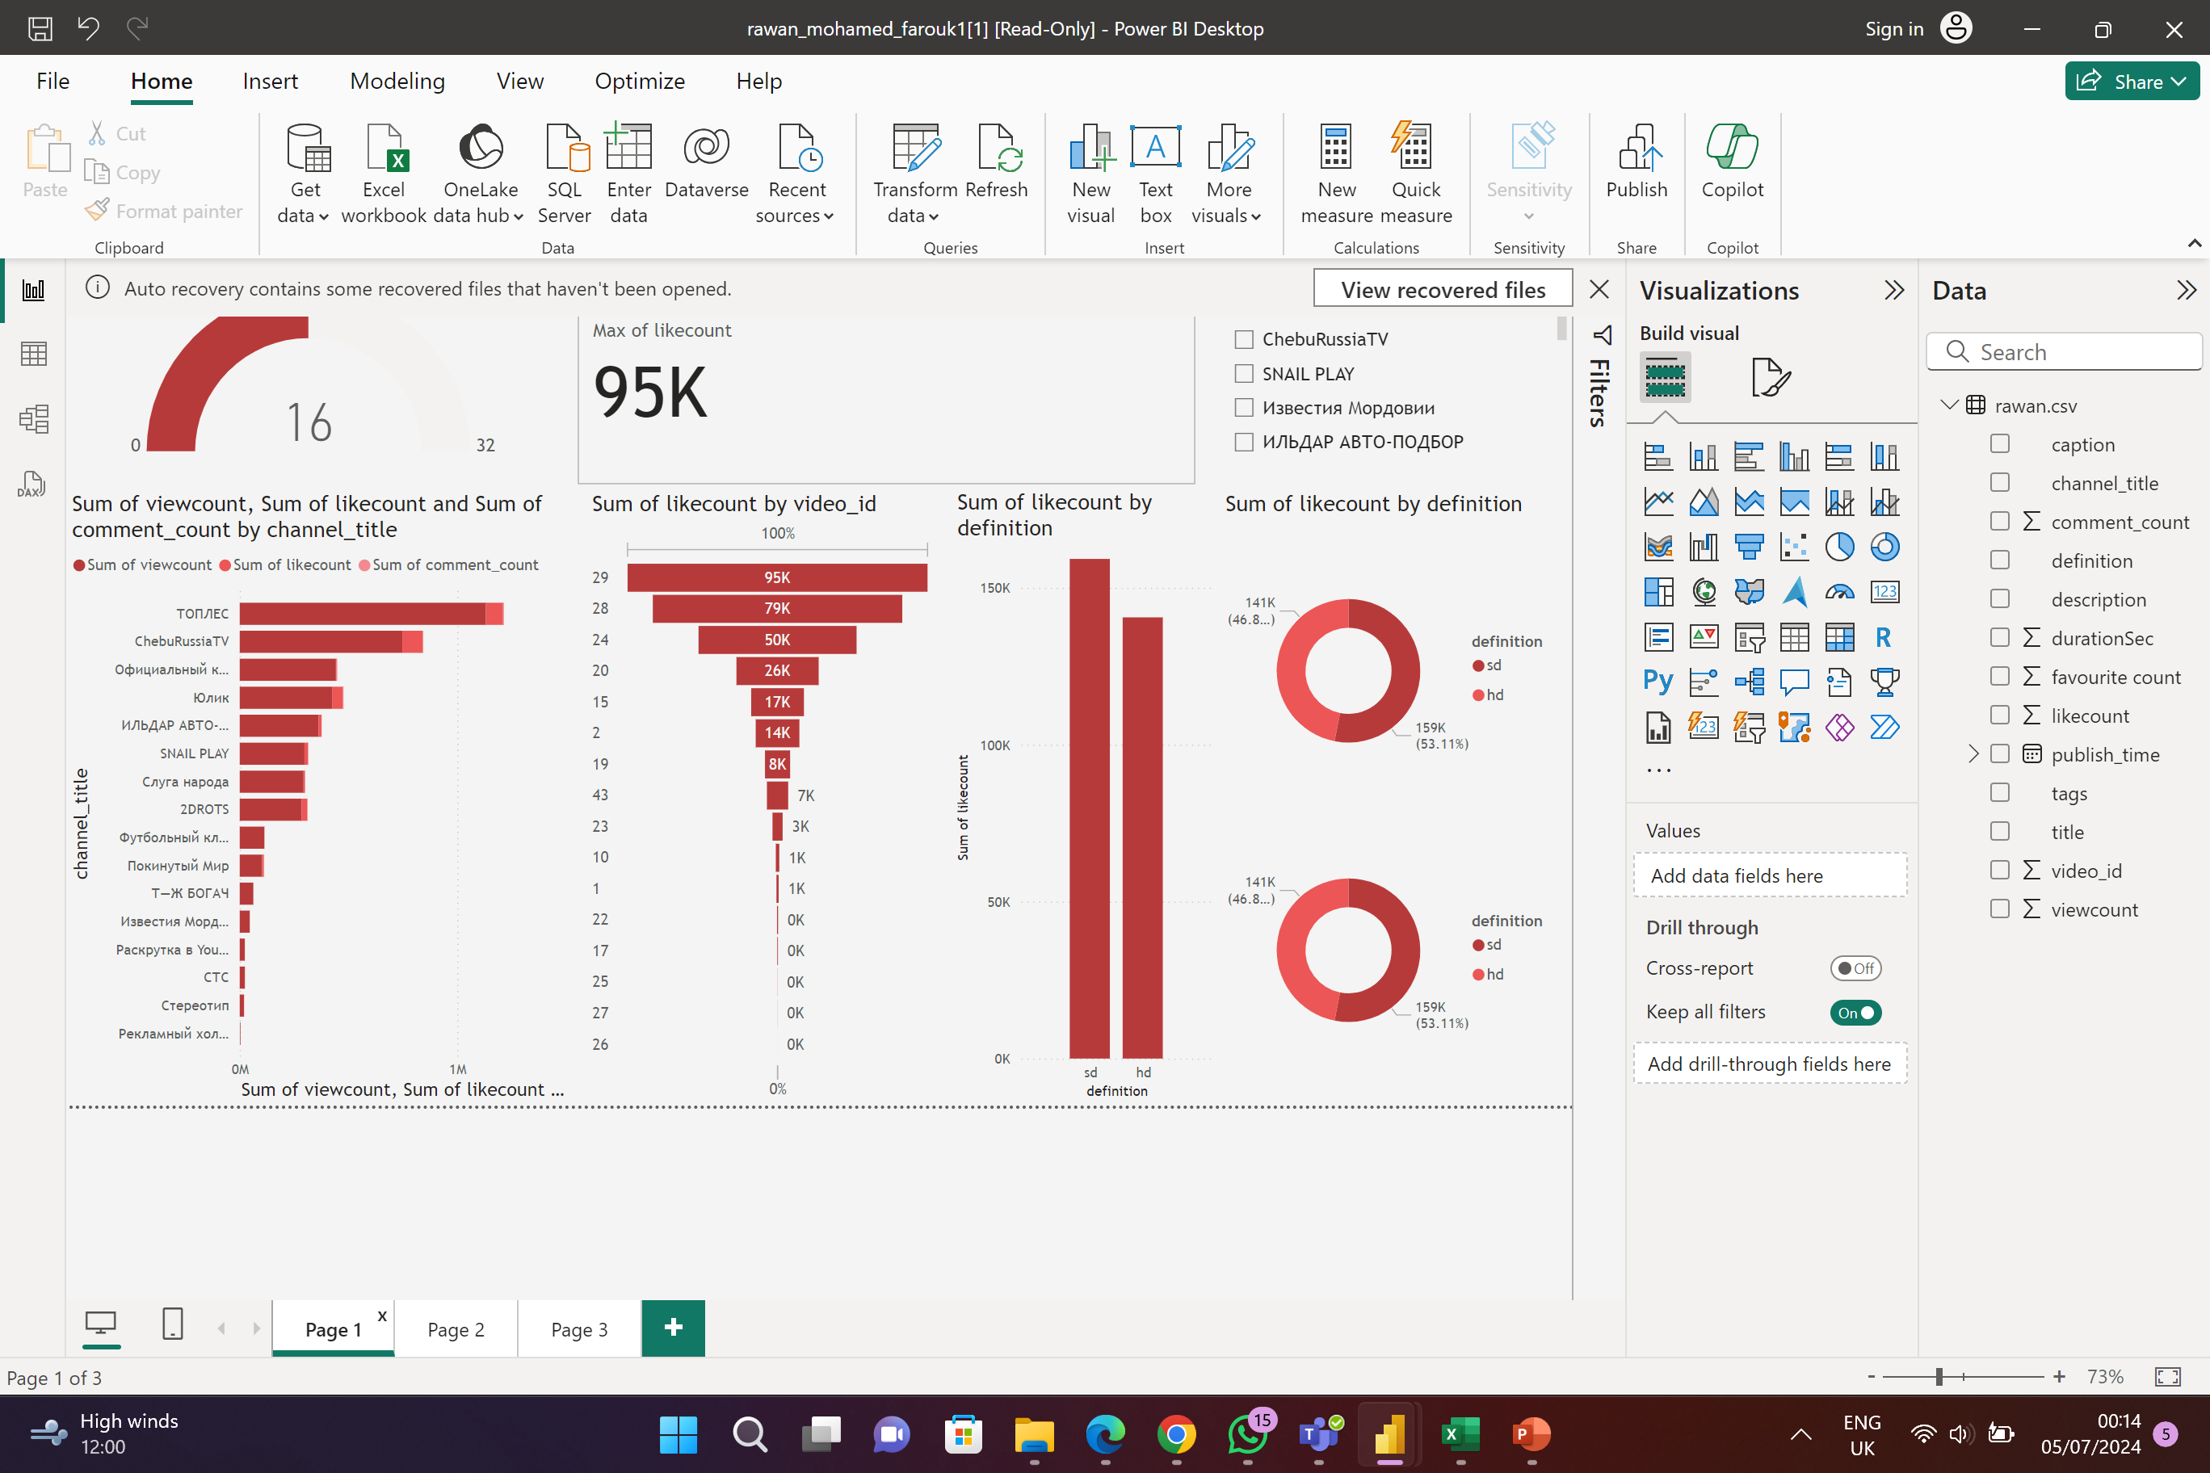
1. Interactive Power BI dashboards showcasing visualizations of YouTube song data trends:

Slide 7

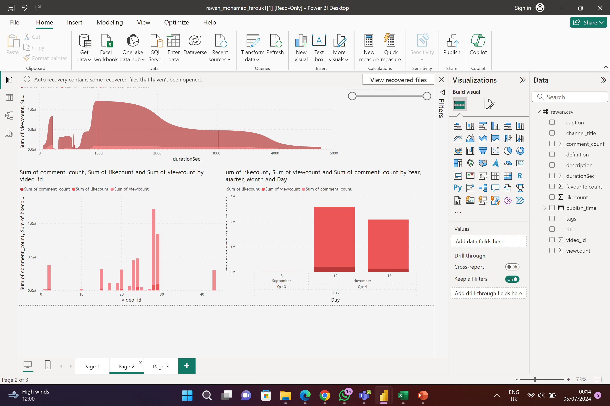

Slide 8

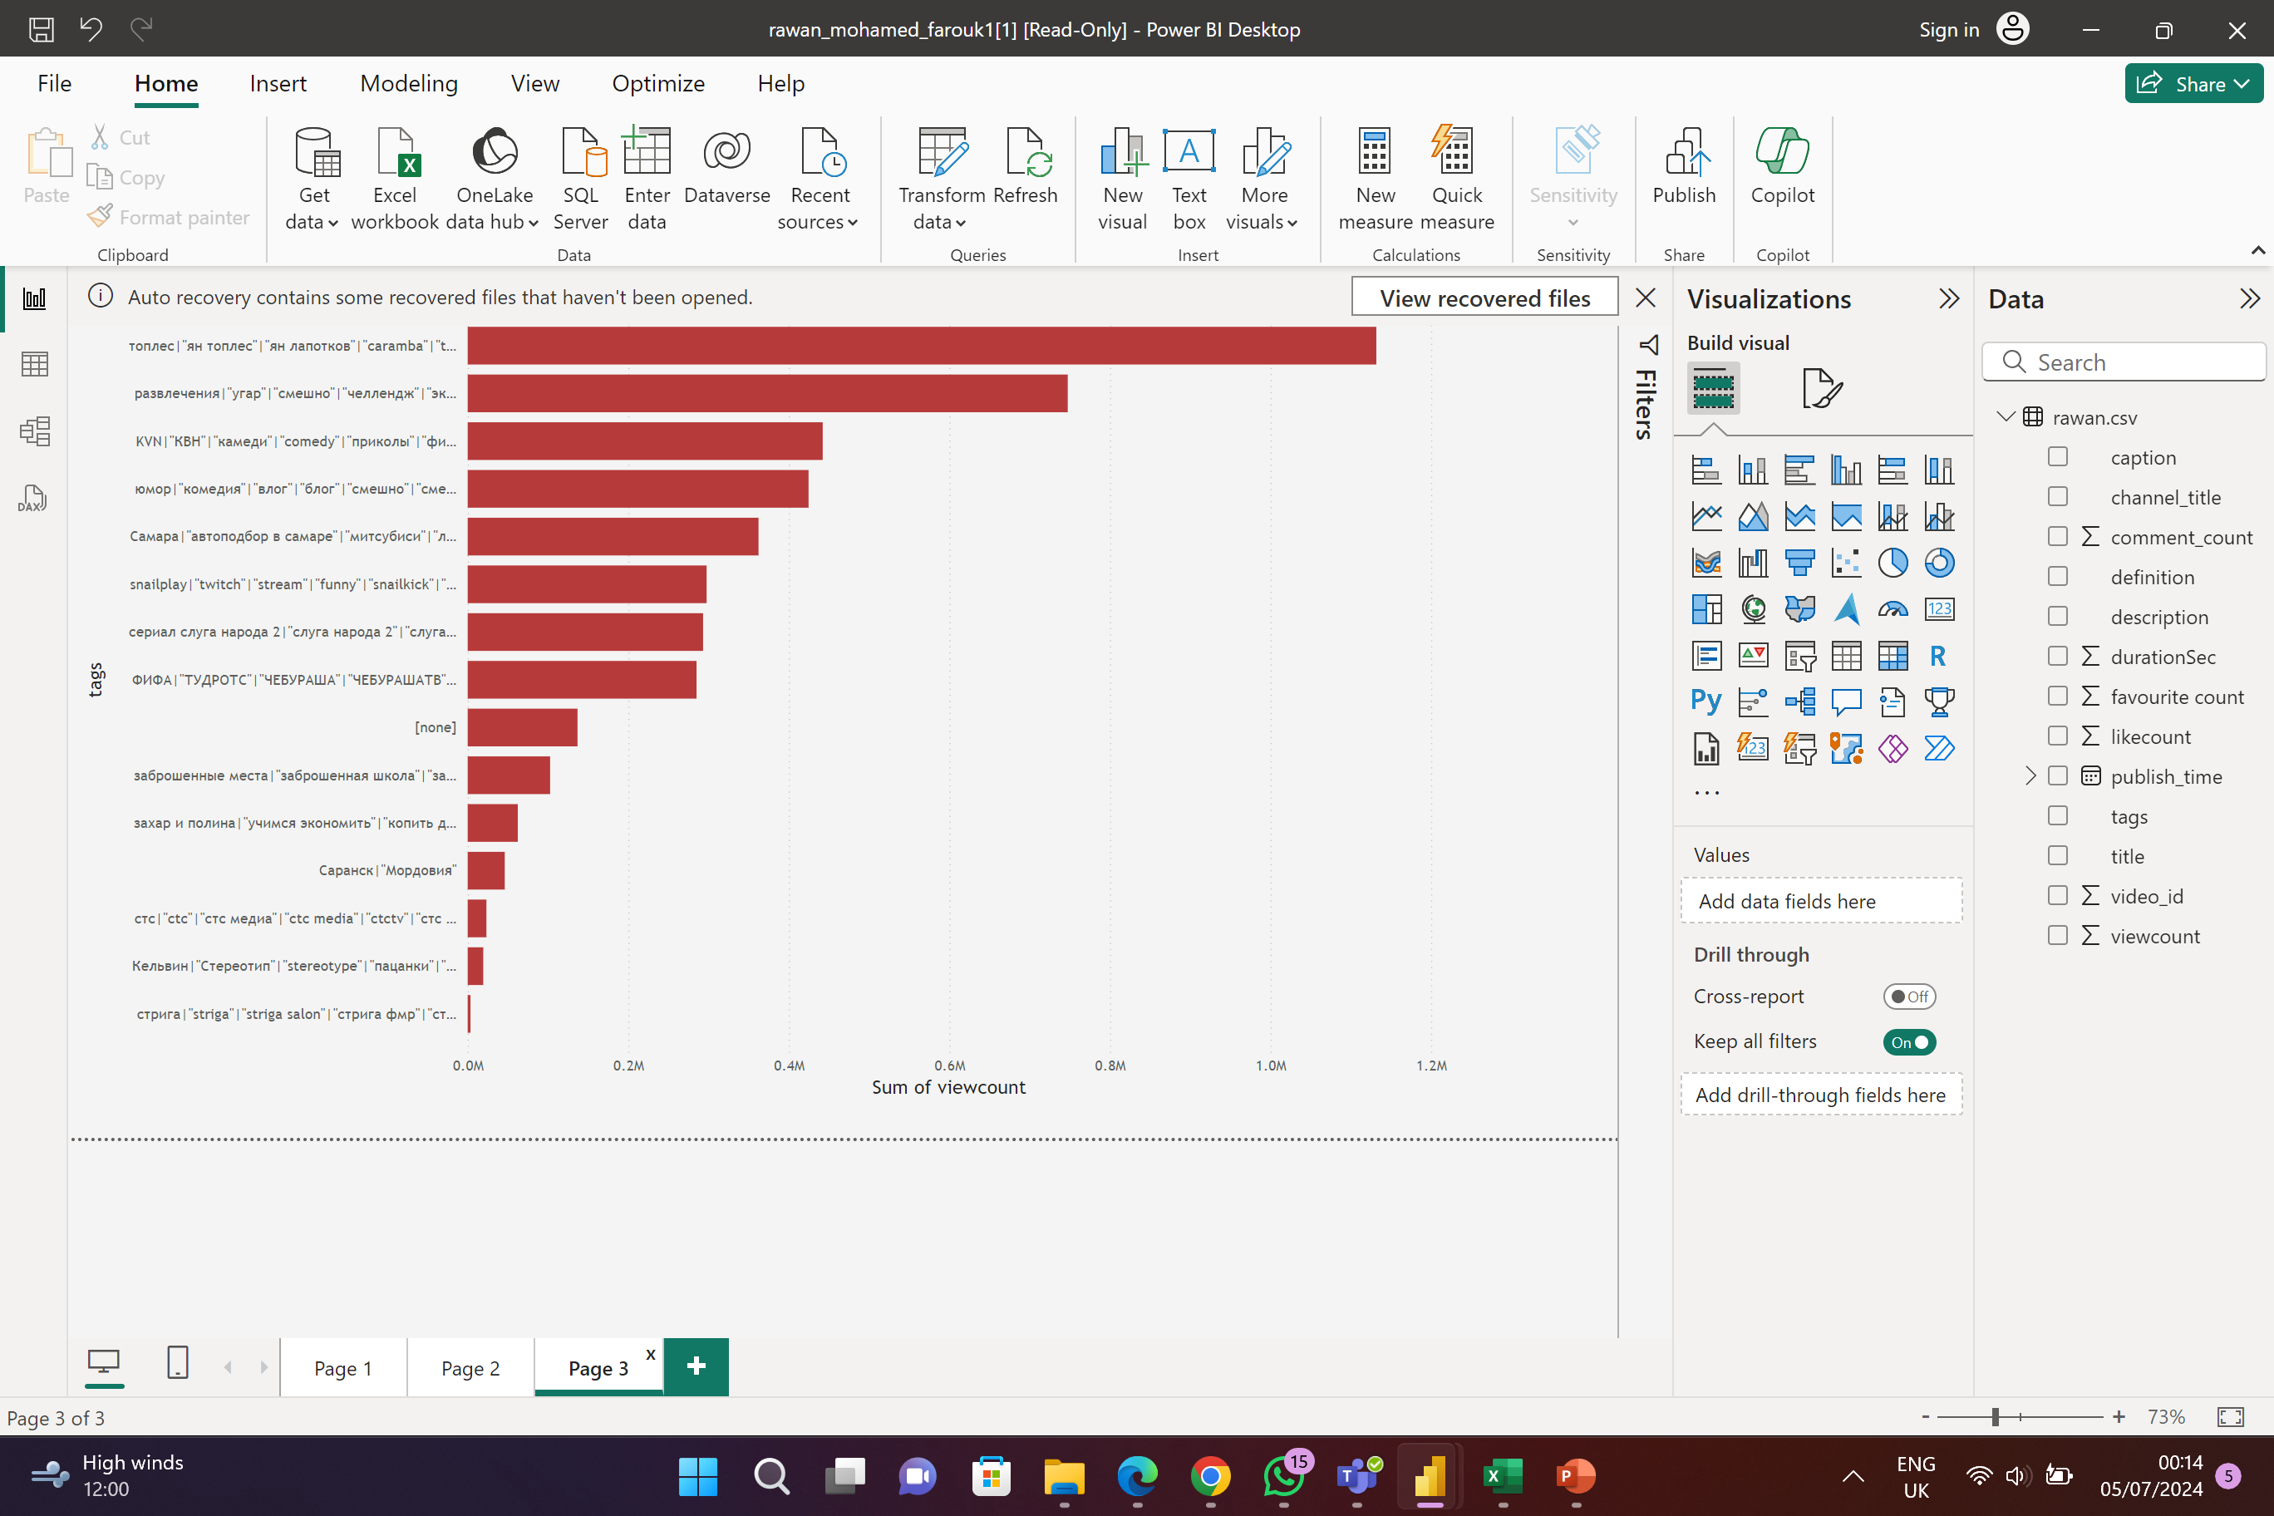

Slide 9
2. Reports detailing channel and content analysis, temporal trends, and user engagement insights:
channel and content analysis:
Engagement insights
Temporal trends

Slide 10
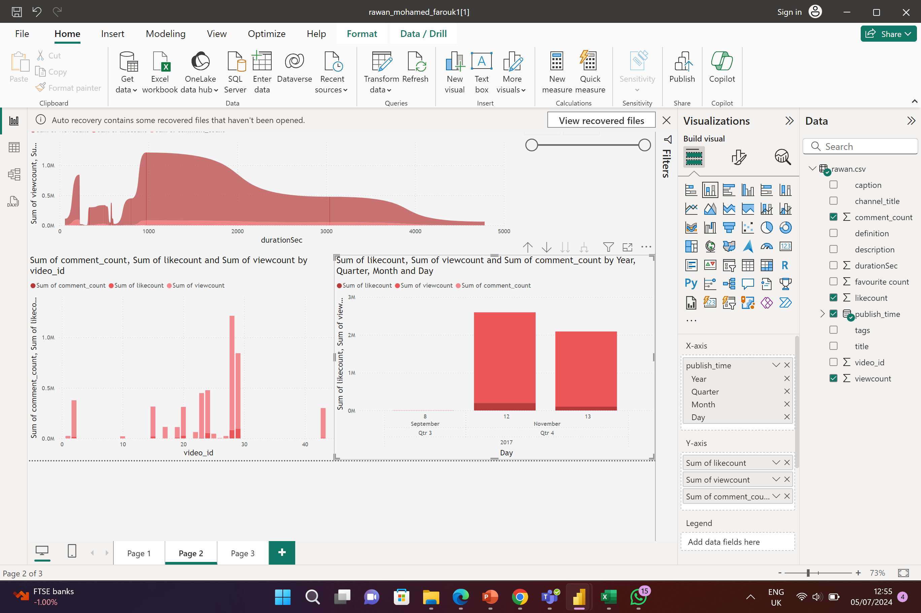
3. Recommendations for content creators and stakeholders to enhance YouTube song video performance:
Optimal Publishing Times:
Finding: Videos published during certain hours of the day or specific days of the week show higher engagement.
Recommendation:
Schedule Releases During Peak Times: Analyze the data to identify peak times for publishing, such as late afternoons, evenings, and weekends, when viewers are most active.
Consistency: Maintain a consistent publishing schedule to build a loyal audience base

Slide 11
THANKS
Was represented to you by
Rawan Mohamed Farouk

