Slide 1

Translated from Turkish to English - www.onlinedoctranslator.com
Products Management Project

Slide 2
Basic Information and Purpose of the Application
The "Product Management System – Desktop Application" project was developed using the C# programming language and SQL Server database. The primary goal of this project was to create an effective system for managing products. Using C#'s powerful features, users can add, organize, delete, and manage products in the database. Additionally, features such as product categorization, arrangement, and retrieval were implemented.
Throughout this project, I gained valuable experience in desktop application development, problem-solving, and project management. The successful completion of the project strengthened my skills in these areas. In the future, I plan to apply the knowledge and experiences gained from this project to improve the effectiveness of my software projects.

Slide 3
Basic Information and Purpose of the Application
The "Product Management System – Desktop Application" project was developed using the C# programming language and SQL Server database. This software operates on users' local devices and is designed to manage work processes, database transactions, and provide user interface interactions. In this example, the project includes product management functionality, allowing companies to manage their products efficiently.

Slide 4
Basic Information and Purpose of the Application
Project Purpose: The main aim of the project is to create an effective system for managing products, making it easier for users to manage and organize their products.
Project Results:
Created Platform: The platform allows users to add, organize, and delete products while managing these operations within the database.
Features: The system integrates interactive features, such as product categorization, arrangement, and retrieval.

Slide 5


Basic Information and Purpose of the Application

Slide 6
Basic Information and Purpose of the Application
Software Development Details:
Used Software Architecture: The software was developed using the strong features of the C# programming language, leveraging its capabilities to create a customized architecture.
Data Storage Environment: Data is securely stored using the SQL Server database, ensuring reliability and trustworthiness.
Interactive Features: Interactive features such as product categorization, arrangement, and retrieval were successfully integrated into the system.

Slide 7
Basic Information and Purpose of the Application
Tasks:
Determination of Basic Product Management Functions and Software Integration: Defined the core product management functionalities and integrated them into the software.
User Interface Design and Experience Optimization: Focused on designing the user interface and optimizing the user experience for improvements.
Database Data Modeling and Relationship Setup in SQL Server: Performed data modeling and established relationships within the SQL Server database.
Project Process Management and Problem Solving: Actively contributed to effective project process management and played a key role in solving any issues that arose during the project.

Slide 8
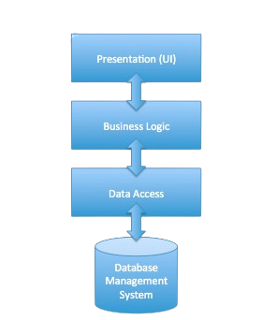
Architecture and Technical Specifications of the Application

Slide 9
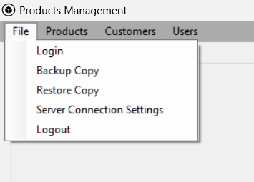
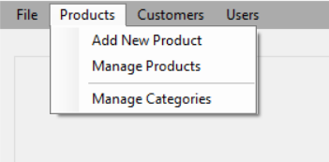
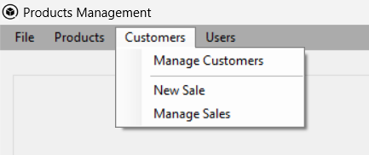
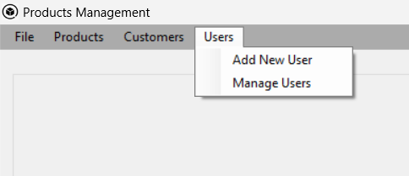
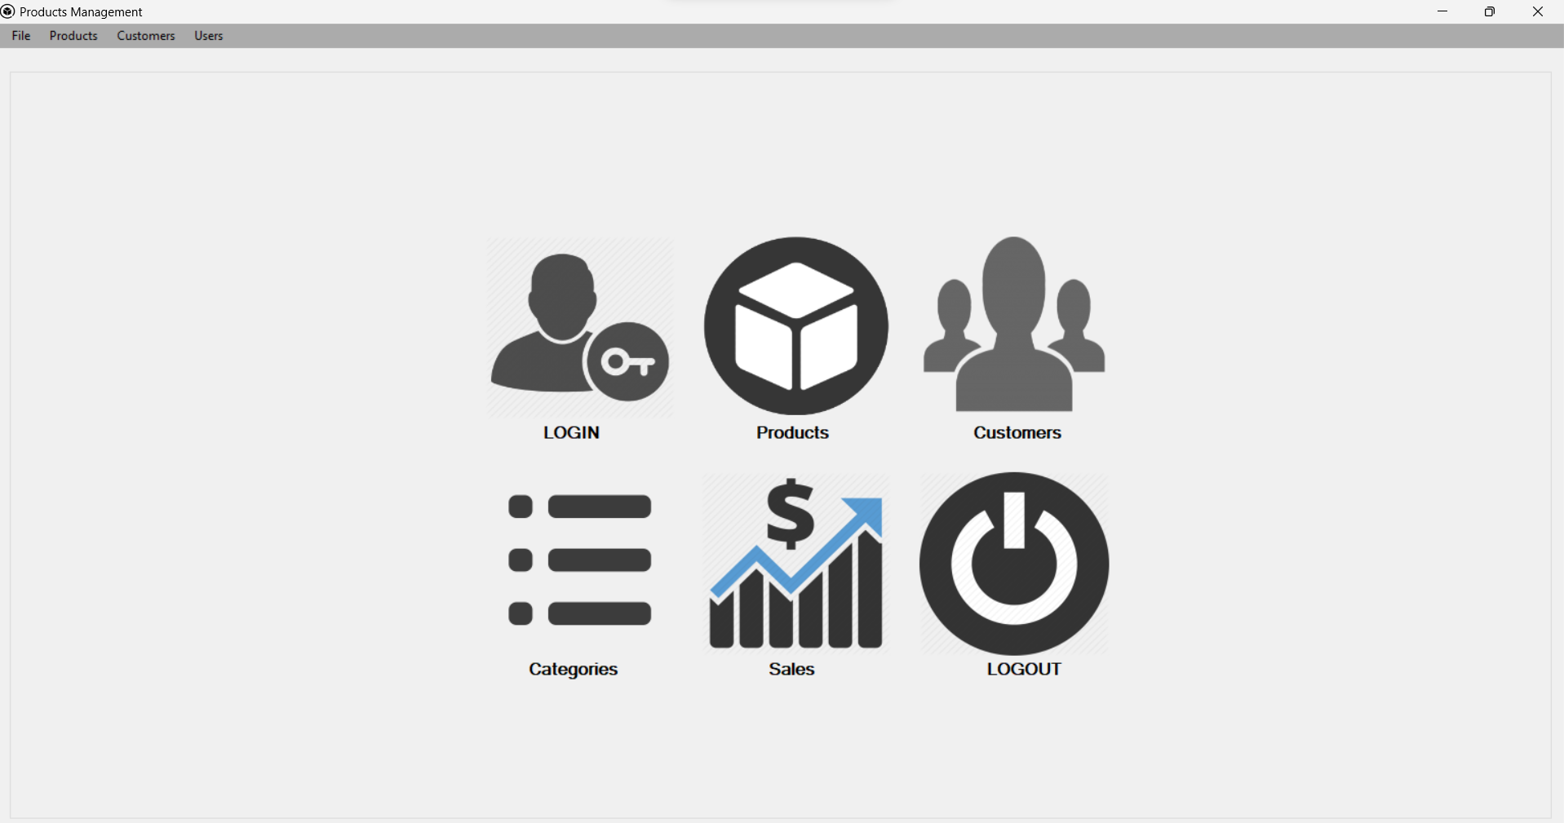
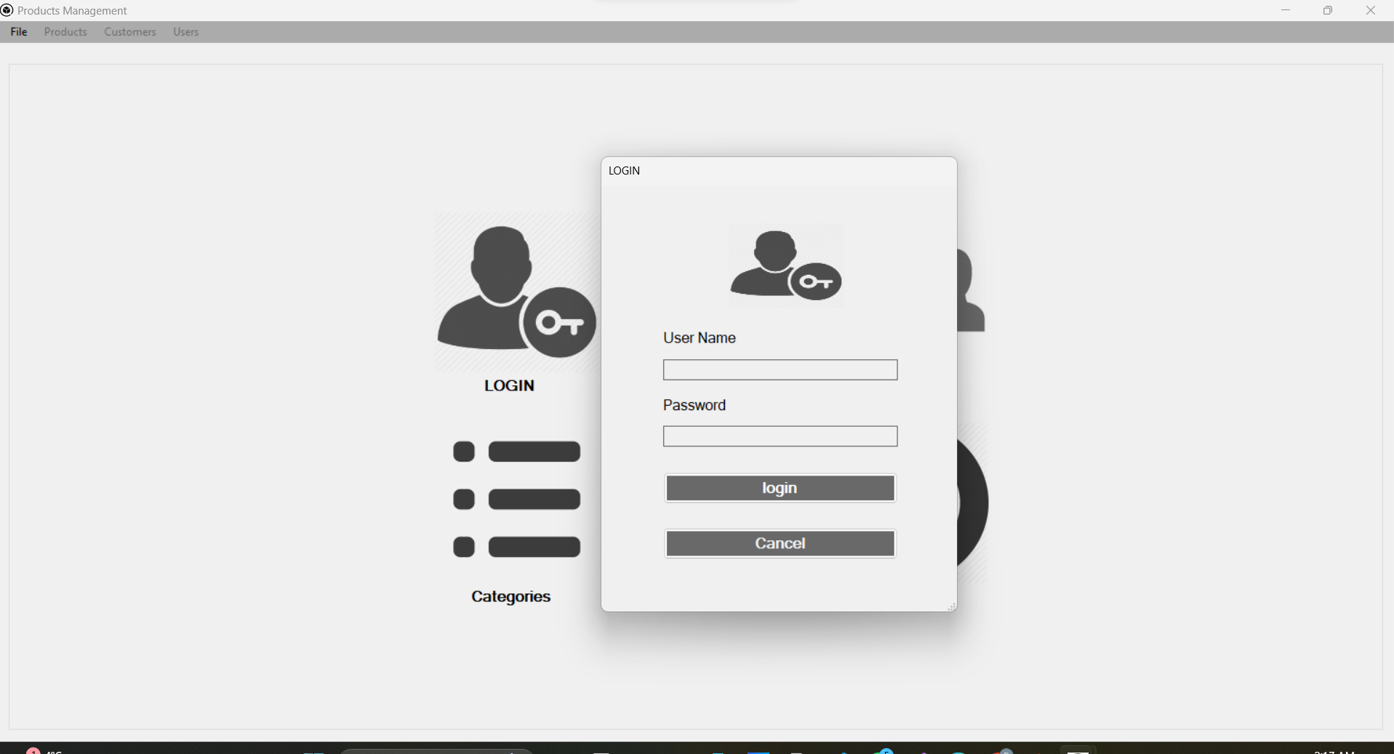
Information on the Operation and Use of the Application

Slide 10
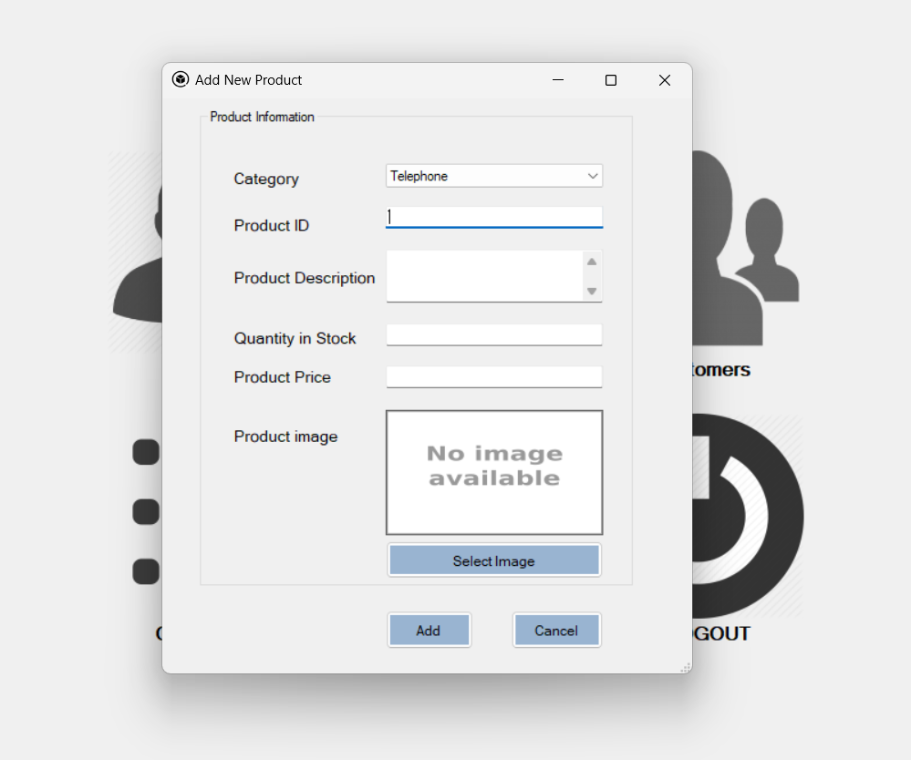
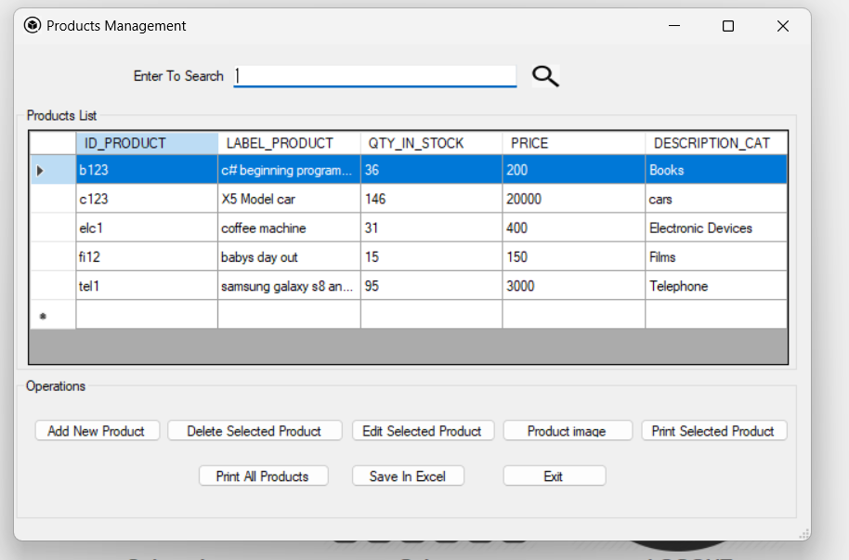
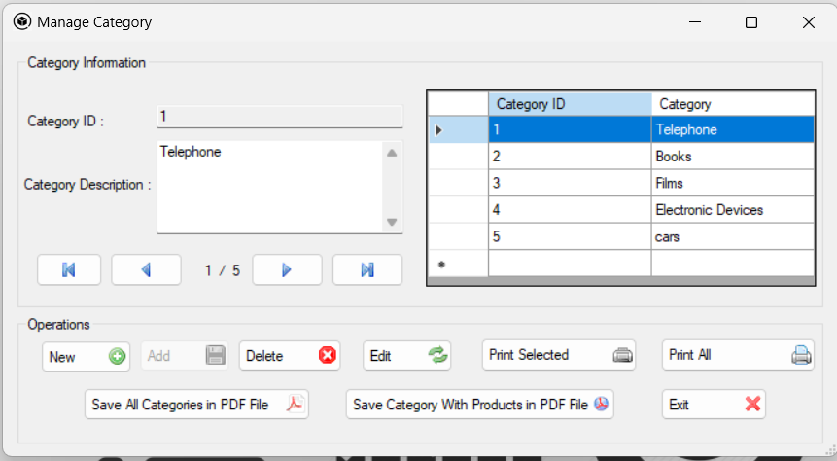
Information on the Operation and Use of the Application

Slide 11
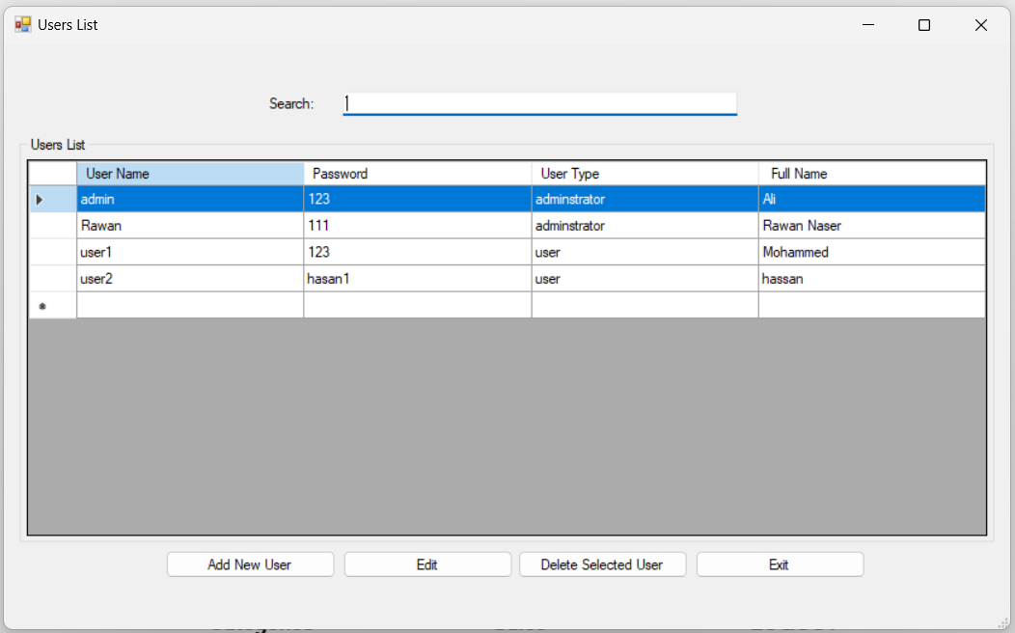
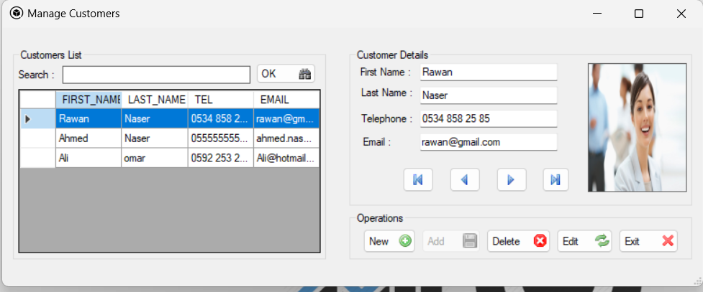
Information on the Operation and Use of the Application

Slide 12
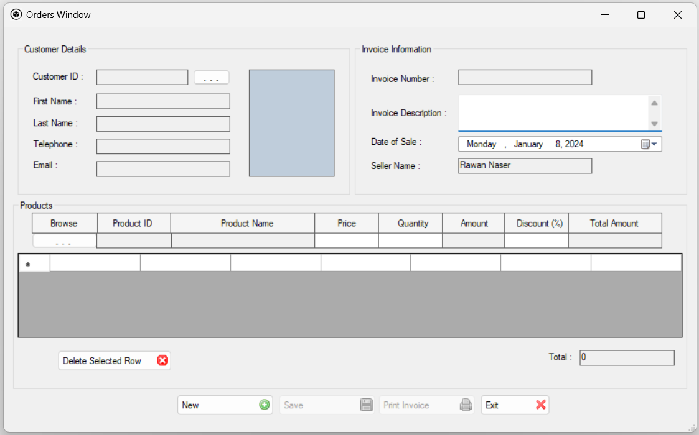
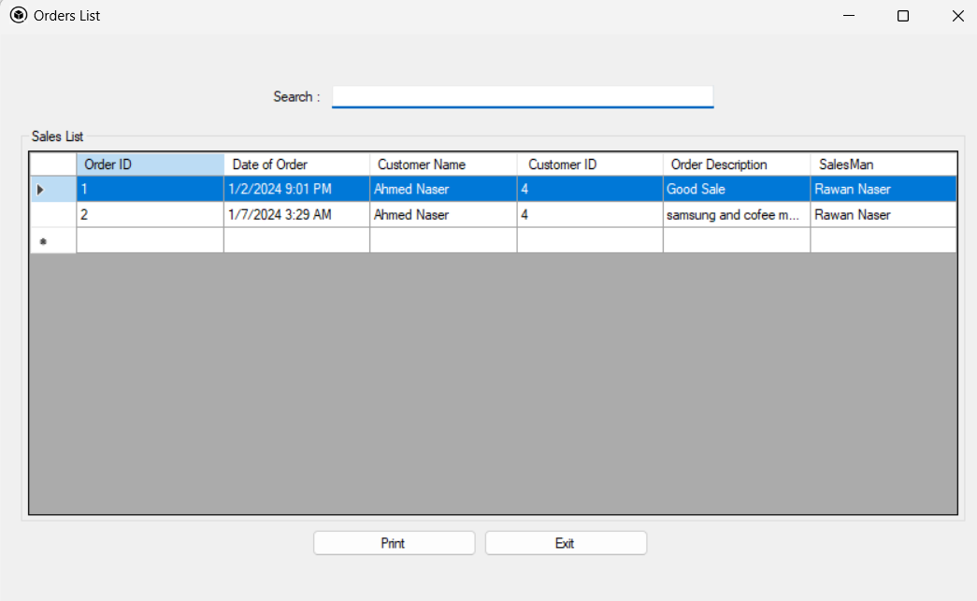
Information on the Operation and Use of the Application

Slide 13
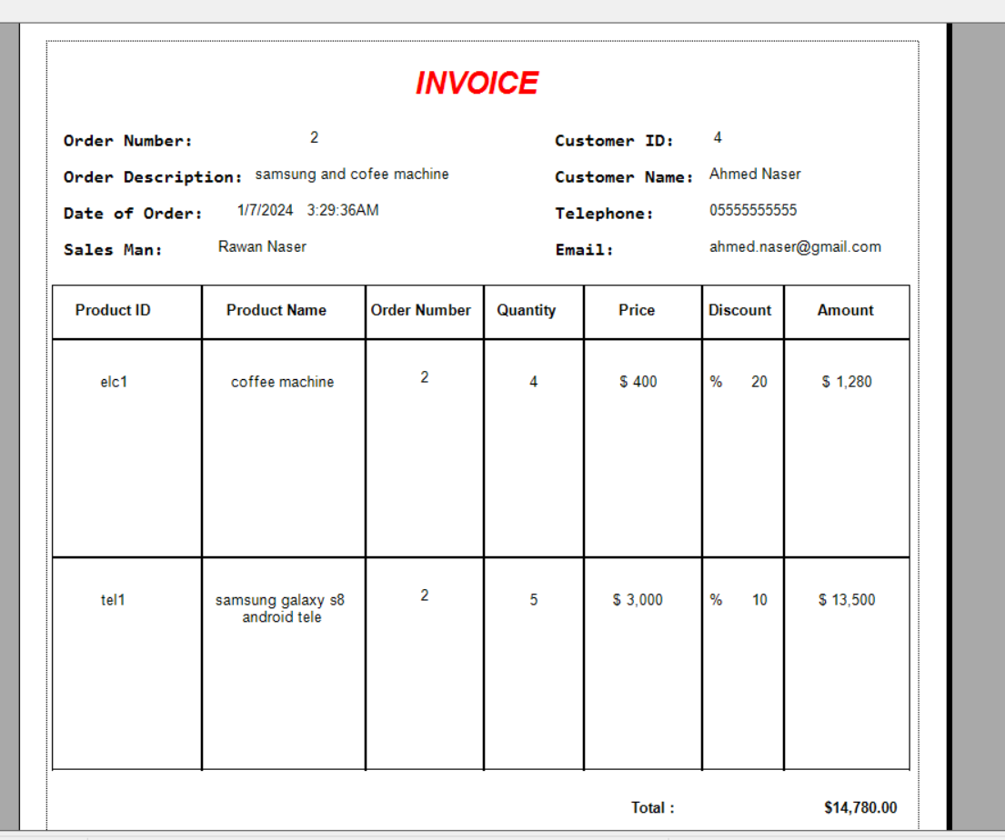
Information on the Operation and Use of the Application

Slide 14
GAINS
Vocationaland Technical Achievements
C# Competence: I have gained advanced-level competence in the C# programming language.
Technical Knowledge and Problem Solving: I acquired a broad range of programming techniques and strengthened my skills in error analysis and problem-solving.
Project Management: I developed my talent for managing project processes effectively.
Experience and Confidence: Through working on projects, I gained valuable experience, which significantly boosted my self-confidence.
Mentoring and Collaboration: I received mentoring from engineers within the company and gained important experience in partnership and collaboration.
Work Preparation: I developed a strong understanding of the work environment and am well-prepared to apply my skills in real-world projects.

Slide 15
THANKS

