Slide 1
USART - Universal Synchronous Asynchronous Receiver Transmitter

Slide 2
Contents
Data Transmission Types.
Introduction to USART.
USART Asynchronous Mode.
Transmitter Block of USART.
Receiver Block of USART.
USART Baud Rate Generator

Slide 3
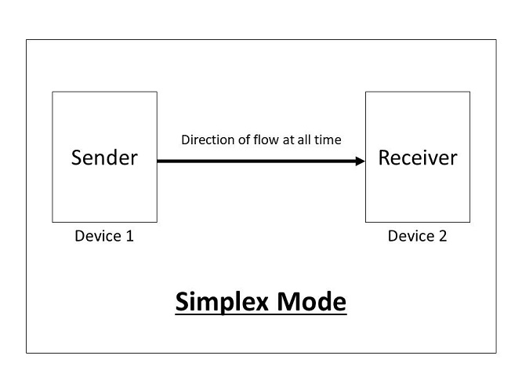
Data Transmission Types
Simplex Mode
Communication is possible in one direction only. Ex: TV

Slide 4
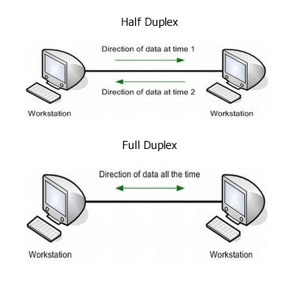
2. Half Duplex Mode
Communication in done in both directions but only on Tx and one Rx at a time. Ex: Police Radio
3. Full Duplex Mode
Communication is possible in both directions, both sides can transmit and receive at the same time.

Slide 5
Introduction to USART
USART - Stands for Universal Synchronous Asynchronous Receiver Transmitter.
The USART module is a full duplex, serial I/O communication peripheral.
It contains all shift registers, clock generators and data buffers needed for serial communication.
It can work in synchronous and asynchronous modes.

Slide 6
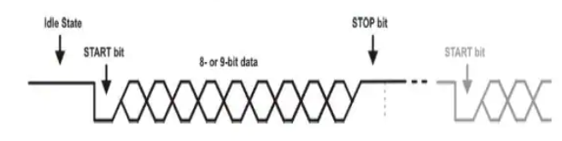
USART Asynchronous Mode
Data transfer happens in the following way:
In idle state, data line has logic high.
Data transfer starts with a start bit, which is always a zero
Data word is transferred (8 or 9 bits), LSB is sent first.
Each word ends with a stop bit, which is always high.
Another byte can be sent directly after, and will start alsi with a start bit before data.

Slide 7
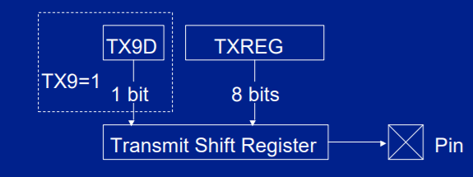
Transmitter Block of USART

Slide 8
Transmitter Block of USART
The module can be enabled to transmit 8 or 9 bits by setting the TX9 bit in the TXSTA register.
Data to be sent should be written into the TXREG register. If nine bits are to be transmitted, the ninth data bit must be placed in the TX9D bit of the TXSTA register before writing the other eight bits to the TXREG register.
Once data has been written to TXREG, the eight or nine bits are moved into the transmit shift register after the STOP bit from the previous load is sent.
From there they are clocked out onto the TX pin preceded by a start bit and followed by a stop bit.

Slide 9
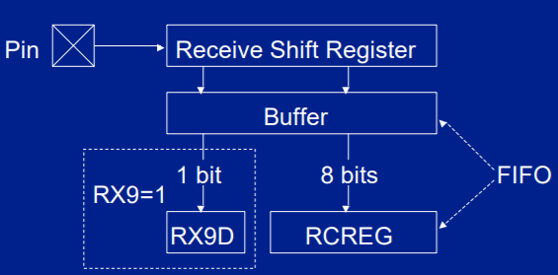
Receiver Block of USART

Slide 10
Receiver Block of USART
The module can be enabled to receive 8 or 9 bits by setting the RX9 bit in the RCSTA register.
If the receiver detects a START bit, eight or nine bits of serial data are shifted from the RX pin into the receive shift register one bit at a time,.
After the last bit has been shifted in, the STOP bit is checked and the data is moved into the FIFO buffer.

Slide 11
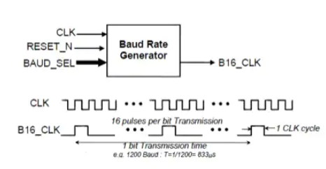
USART Baud Rate

Slide 12
USART Baud Rate
Each bit is received or transmitted using a clock that is a multiple of the bit rate(x16 or x64).
So, we have ro get this clock frequency from the oscillator frequency using the baud rate generator.
This is done by dividing the oscillator frequency by a programmable timing device to synchronize the bit duration for both the transmitter and the receiver.

