Slide 1
Project NLP | Business Case: Automated Customer Reviews
Rawan Alnajim

Slide 2
TABLE OF CONTENTS
01
02
Project Overview
Exploratory Data Analysis
03
Data Wrangling and Cleaning
04
Major Obstacle
05
Conclusion and Insights

Slide 3
01
Project Overview

Slide 4

This project seeks to automate the process using NLP models to extract insights and provide users with valuable product recommendations.

Slide 5
Datasets Used
Two primary datasets from hugging face were utilized in this project:
Datafiniti Amazon Consumer Reviews of Amazon Products
File: Datafiniti_Amazon_Consumer_Reviews_of_Amazon_Products.csv
Amazon Product Reviews Dataset (May 2019)
File: Datafiniti_Amazon_Consumer_Reviews_of_Amazon_Products_May19.csv

Slide 6
02
Data Wrangling and Cleaning

Slide 7
Datasets Used & Preprocessing
Datasets were merged into a single unified dataset.
The review.title and review.text columns were combined into a single text field to enrich the review content.
Generate a new column called Sentiment, it contains the 3 classes (Positive, Neutral and Negative)

Slide 8
03
Exploratory Data Analysis

Slide 9
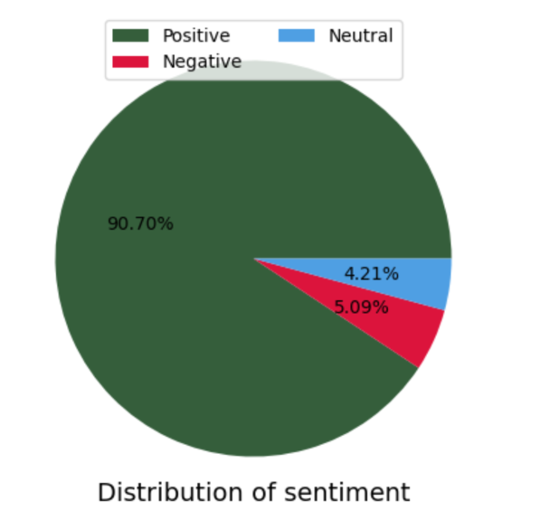
EDA
During the exploratory data analysis phase, I began by mapping star ratings to sentiment classes—ratings 1–2 were labeled as Negative, 3 as Neutral, and 4–5 as Positive. This allowed me to create a new Sentiment column for easier classification. I then analyzed the distribution of these sentiment classes using value_counts() and visualized the results with a pie chart. The visualization revealed a clear class imbalance, with Positive reviews making up the majority of the data.

Slide 10
04
Major Obstacle

Slide 11
EDA
Major Obstacle: Class Imbalance
One of the biggest challenges I encountered during this project was the significant class imbalance in the sentiment labels. The dataset was heavily skewed toward Positive reviews, which could bias the model and hurt performance on minority classes like Neutral and Negative. To address this, I applied two strategies:
Downsampling the Positive class to 8,000 samples to reduce the imbalance.
Using class weights during model training to give more importance to underrepresented classes.

Slide 12
Additionally, I encountered a compatibility error during model compilation:
ValueError: Could not interpret optimizer identifier: <keras.src.optimizers.adam.Adam object>
This happened due to conflicts between keras and tensorflow.keras modules. I resolved it by switching to:
from tf_keras.optimizers import Adam

Slide 13
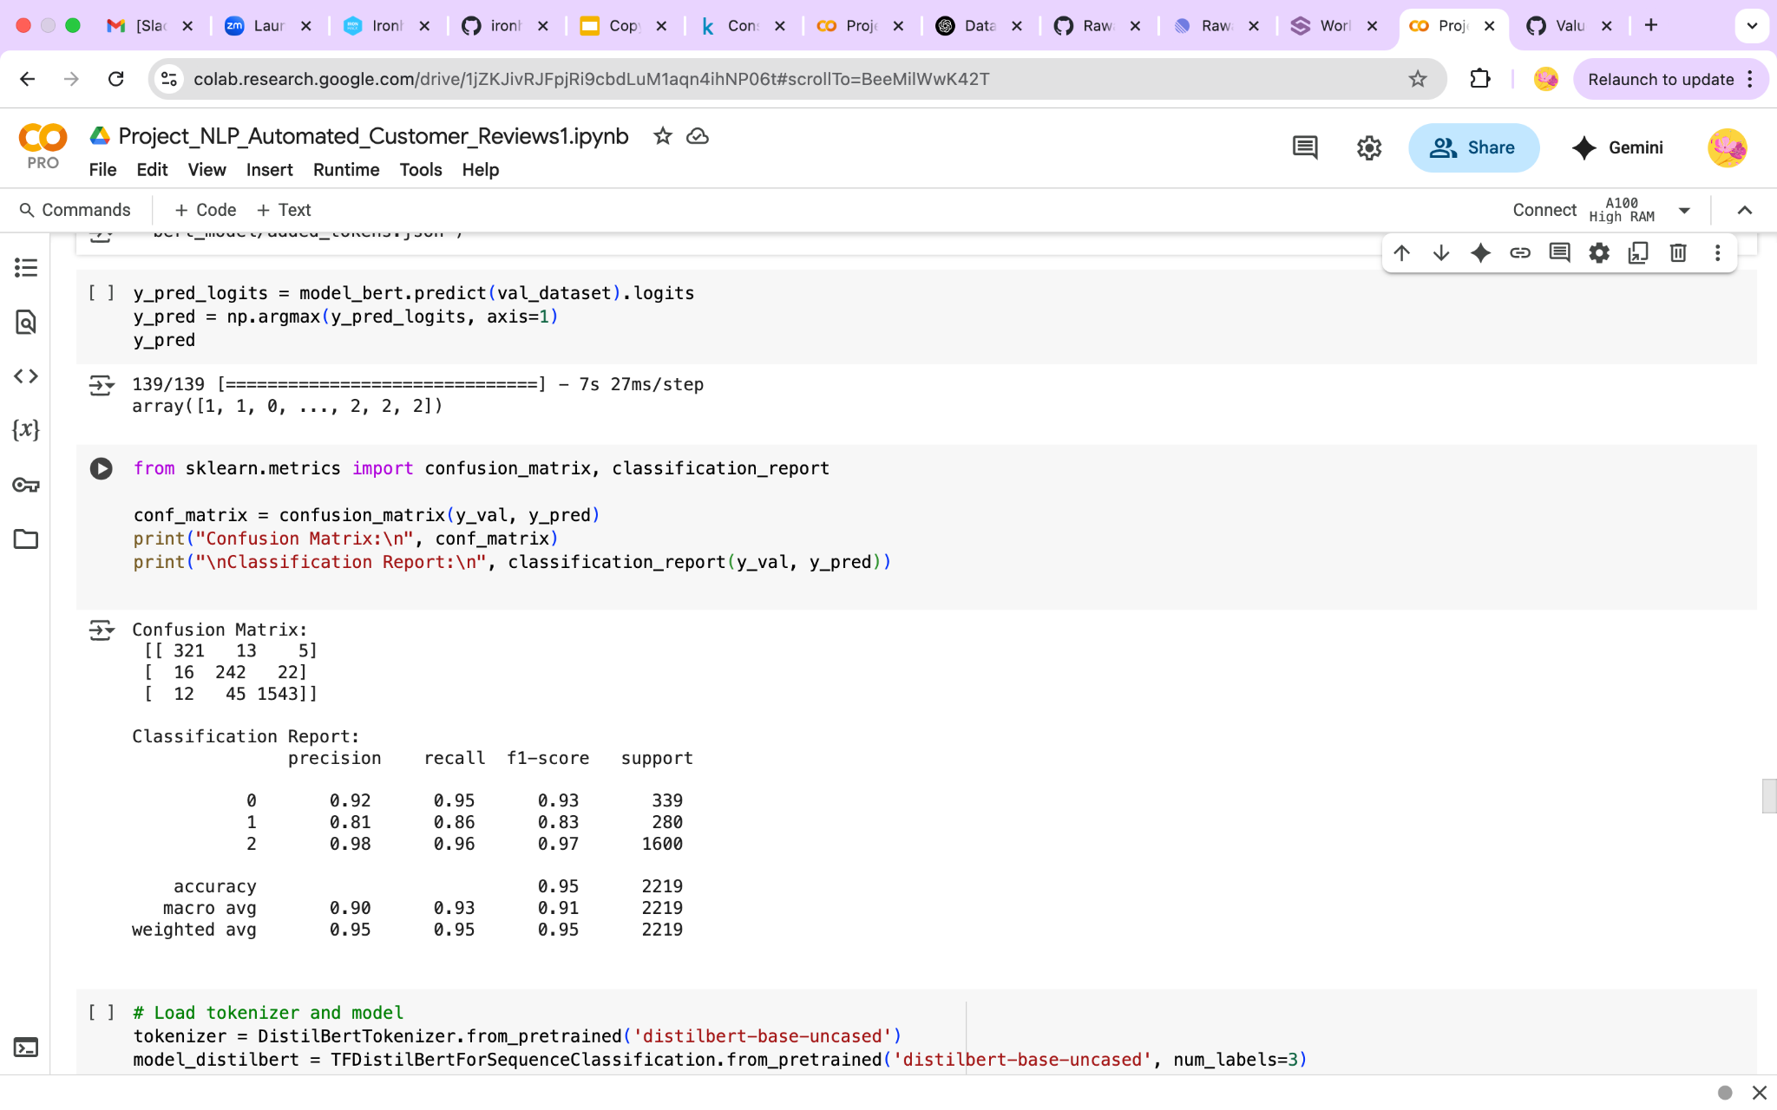
1. Review Classification
For the sentiment classification task, the best-performing model was BERT-base-uncased, a pre-trained transformer model from the Hugging Face library. This model demonstrated superior accuracy and generalization compared to traditional machine learning approaches and other transformer variants. Its deep contextual understanding of language allowed it to effectively capture sentiment nuances within product reviews. Fine-tuning BERT-base-uncased on the labeled dataset, combined with class weights to handle imbalance, resulted in significantly improved performance, especially on the minority classes.

Slide 14
2. Product Category Clustering
To organize and better understand the diverse product categories in the dataset, I applied unsupervised clustering using Sentence-BERT embeddings. Specifically, I used the distilbert-base-nli-stsb-mean-tokens model from SentenceTransformers to generate dense vector representations of the product category text. These embeddings captured semantic similarity between category names. I then applied K-Means clustering on the embeddings to group similar products into broader meta-categories.

Slide 15
3. Review Summarization Using Generative AI
To generate meaningful review summaries, I used the OpenAI API to create article-style outputs highlighting top products, their unique strengths, and key customer complaints. Reviews were grouped by product, and average star ratings were calculated to identify the Top 3 and Worst products within each category. I then extracted key complaints using simple keyword matching from negative review content. This structured input was passed to the generative model, which produced clear summaries for each product category

Slide 16
05
Conclusion and Insights

Slide 17
Through this project, I explored the power of NLP in extracting value from customer reviews. Tackling class imbalance, I enhanced sentiment classification using BERT-base-uncased, and grouped similar products using Sentence-BERT embeddings with K-Means. Finally, with OpenAI's generative models, I produced readable summaries highlighting product strengths and customer pain points. This end-to-end approach not only improved product understanding but also demonstrated how AI can support smarter decision-making in e-commerce.

Slide 18
THANKS!

