Slide 1
The Impact of Oil Price Shocks on GDP and Inflation: Case of Saudi Arabia
Rawan Al Gharib

Slide 2
Outline Introduction
Data
Empirical model
Empirical results
Concluding remarks
Introduction
Motivation
Objective
Related literature
Contribution
Data
Descriptive Statistics
Preliminary Analysis
Unit Root Tests
Empirical model
SVAR model
Empirical Results
Impulse Response Functions
Forecast Error Variance Decomposition
Concluding remarks
Rawan Al Gharib

Slide 3
Outline Introduction
Data
Empirical model
Empirical results
Concluding remarks
Motivation
Objective Related literature
Contribution
Contribution
Motivation
Oil is the cornerstone of Saudi Arabia:
Oil representing around 17% of the world’s discovered petroleum reserves (OPEC)
Oil sector making up 45% of the country’s total GDP
Share of oil exports in total exports is around 80%
Given the uncertainty in global oil market, the oil sector in Saudi Arabia is vulnerable to volatility, thus, affecting the macroeconomy
To mitigate effect of fluctuations, the Kingdom has initiated extensive economic reforms aimed at reducing its reliance on oil
Saudi Vision 2030
Rawan Al Gharib
Impact of Oil Price Shocks on Saudi Arabia

Slide 4
Outline Introduction
Data
Empirical model
Empirical results
Concluding remarks
Motivation
Objective Related literature
Contribution
Objective
The current paper aims at investigating the impact of oil price shocks on real economic growth and inflation rates in Saudi Arabia.
Rawan Al Gharib
Impact of Oil Price Shocks on Saudi Arabia

Slide 5
Outline Introduction
Data
Empirical model
Empirical results
Concluding remarks
Motivation
Related literature
Contribution
Related literature
Theoretical literature:
Kilian (2005) states that higher oil prices are beneficial to oil-exporting countries because they are translated into more money to spend.
Ghalayini (2011) reveals that although a price hike directly increases real national income, part of this gain would be later offset by losses from lower demand due to the economic recession suffered by trading partners.
Ferderer (1996) states that high oil prices may incentivize economies to develop alternative oil substitutes, reducing oil demand.
Rawan Al Gharib

Slide 6
Outline Introduction
Data
Empirical model
Empirical results
Concluding remarks
Motivation
Related literature
Contribution
Related literature
Anandan et al. (2013) state that oil prices and inflation move in the same direction.
Tang et al. (2010) explain this relationship through the cost channel. Higher oil prices increase production and transportation costs, placing a burden on the consumer price index.
Farzanegan (2011) explains it through the fiscal channel. The result suggests that an oil-exporting country may experience high inflation if it exceeds capacity of purchase during positive price shocks.
Rawan Al Gharib

Slide 7
Outline Introduction
Data
Empirical model
Empirical results
Concluding remarks
Motivation
Related literature
Contribution
Related literature
Empirical literature:
Hamilton (1983) suggests a strong relationship between US recessions and oil price spikes.
Mehara and Oskoui(2007) employed a structural VAR model in 4 exporting countries and found that oil price shocks serve a significant role in driving business cycles in Iran and Saudi Arabia.
Berument et al. (2010) examined the effect of oil price shocks in some oil-exporting MENA countries and found a positive and significant impact on economic activity and inflation
Rawan Al Gharib

Slide 8
Outline Introduction
Data
Empirical model
Empirical results
Concluding remarks
Motivation
Related literature
Contribution
Related literature
Alkhathlan and Javid (2018) employed a VECM model and found that oil price shocks have a short-lived positive effect on the economic growth in Saudi Arabia.
Zulfigarov and Nenkirch (2020) utilized a VAR model to study the relationship between fluctuations in oil prices and economic activities in Azerbaijan. Their results revealed that innovation in oil prices leads to higher inflation.
Olomola (2006) conducted a study using VAR approach and found that oil price shocks had no significant effect on inflation and output in Nigeria.
Rawan Al Gharib

Slide 9
Outline Introduction
Data
Empirical model
Empirical results
Concluding remarks
Motivation
Related literature
Contribution
Contribution
This paper contributes to the literature multifold.
First, the current study takes the case of Saudi Arabia, the second largest oil producer in the world, thus highly affected by oil price fluctuations
Second, the study employs data from 2007 to 2022, a critical period which involves many global price shocks.
Lastly, the study may have important policy implications for the government and policymakers, related to economic diversification, energy policies and investment strategies.
Rawan Al Gharib

Slide 10
Outline Introduction
Data
Empirical model
Empirical results
Concluding remarks
Descriptive Statistics
Preliminary Analysis
Unit root tests
Data: Descriptive Statistics:
The study relies on time series data from Federal Reserve Economic Data (FRED)
Data quarterly spans the period from 2005: Q1 to 2022: Q4; data adds up to 71 observations.
Three variables are employed:
1. Real gross domestic product (proxy for deflated total output)
2. Brent crude oil price (benchmark for global oil price)
3. Consumer price index (proxy for inflation)
Rawan Al Gharib

Slide 11
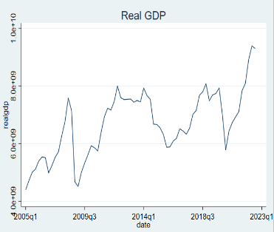
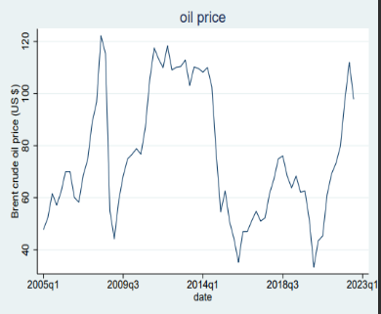
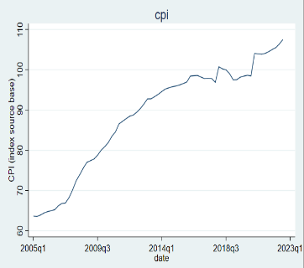
Outline Introduction
Data
Empirical model
Empirical results
Concluding remarks
Descriptive Statistics
Preliminary Analysis
Unit root tests
Data: Descriptive Statistics:
somehow volatile
upward trend
more volatility during the period of study
clear upward trend
Rawan Al Gharib

Slide 12
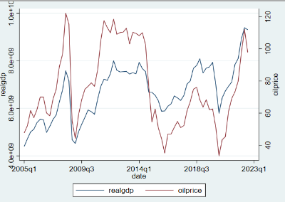
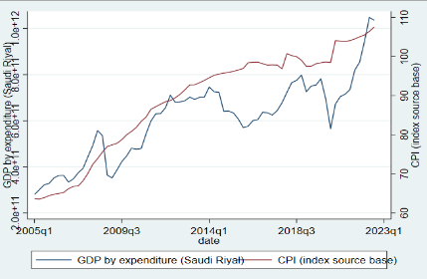
Outline Introduction
Data
Empirical model
Empirical results
Concluding remarks
Descriptive Statistics
Preliminary Analysis
Unit root tests
Data: Preliminary Analysis
Real GDP and oil price
Real GDP and CPI
It is evident how the two variables follow a similar pattern
It is evident how the upward-trend in real GDP is accompanied with an upward-trend in CPI

Slide 13

Outline Introduction
Data
Empirical model
Empirical results
Concluding remarks
Descriptive Statistics
Preliminary Analysis
Unit root tests
Data: Unit Root Tests
Prior to decide on the model, some tests are employed
The Lagrange Multiplier (LM) test is first used to test for serial correlation.
Augmented Dickey-Fuller (ADF) test is next used to check for stationarity.
The variables became stationary after taking the log difference, representing growth rates of the variables:
Rawan Al Gharib

Slide 14
Outline Introduction
Data
Empirical model
Empirical results
Concluding remarks
SVAR model
Empirical model
The implementation of Engle-Granger test shows no co-integration, making the VECM model inappropriate
Following, a structural VAR is employed to analyze the contemporaneous effect of oil price shocks on Saudi Arabia, and the dynamic effects over time.
It allows us to impose restrictions and visualize probable patterns of IRF and FEVD for policy implications (Kilian et al., 2017)
The model identification revealed an optimal lag length of 15.
AIC is minimized and no evidence for serial correlation
Rawan Al Gharib

Slide 15


Outline Introduction
Data
Empirical model
Empirical results
Concluding remarks
SVAR model
Empirical model: SVAR model
Estimating an SVAR(15):
(1)
Where:
$B_{o}$ is a $3×3$ matrix capturing the contemporaneous effects
$T_{i}$ is a $3×3$ matrix of structural-form parameters
$ɛ_{t}$ is a $3×1$ vector of structural-form shocks.
To obtain the reduced-form parameters, the reduced system will be:
(2)
Where:
$A_{i}$ is a $3×3$ matrix of reduced-form parameters
$e_{t}$ is a $3×1$ vector of reduced-form shocks.
Rawan Al Gharib

Slide 16
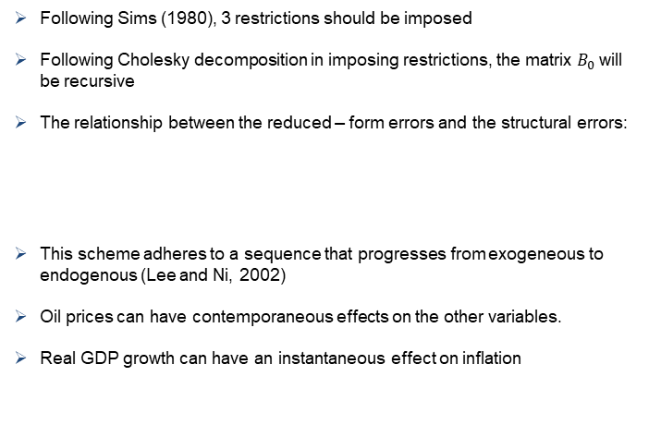
Outline Introduction
Data
Empirical model
Empirical results
Concluding remarks
SVAR model
Empirical model: SVAR model
Following Sims (1980), 3 restrictions should be imposed
Following Cholesky decomposition in imposing restrictions, the matrix $B_{0}$will be recursive
The relationship between the reduced – form errors and the structural errors:
This scheme adheres to a sequence that progresses from exogeneous to endogenous (Lee and Ni, 2002)
Oil prices can have contemporaneous effects on the other variables.
Real GDP growth can have an instantaneous effect on inflation
Rawan Al Gharib

Slide 17
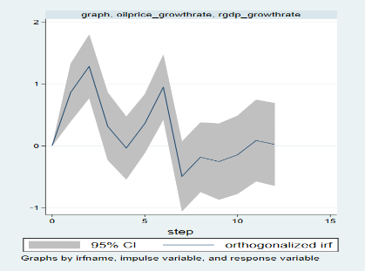
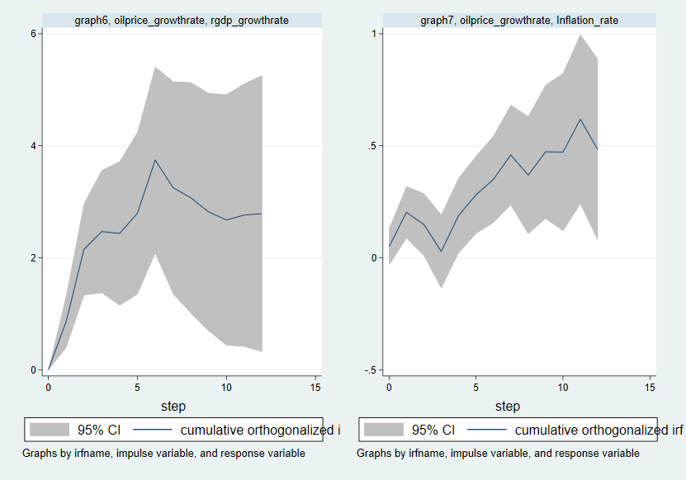
Outline Introduction
Data
Empirical model
Empirical results
Concluding remarks
Impulse Response Analysis
Forecast Error Variance Decomposition
Empirical Results: Impulse Response Analysis
Impact of oil price shock on real GDP growth rate
Orthogonalized Impulse Response Graph
Cumulative Impulse Response Graph
Period 1: statistically significant and positive increase
Periods 3,4: a slow down in the increase
Period 7+: insignificant effect
For the overall effect the plot reveals a clear positive upward trend
Rawan Al Gharib

Slide 18
Outline Introduction
Data
Empirical model
Empirical results
Concluding remarks
Impulse Response Analysis
Forecast Error Variance Decomposition
Empirical Results: Impulse Response Analysis
This result is consistent with:
Ghalayini (2011) :
a rise in oil prices will have a direct impact on the national income
there is a trade-off between this gain and the losses incurred from reduced export demand due to economic stagnation among trading partners
Mendoza and Vera (2010):
showed a significant positive impact of oil price shocks on economic growth in the case of Venezuela
Nazir and Hamed (2015):
oil prices impact real GDP positively
Rawan Al Gharib

Slide 19
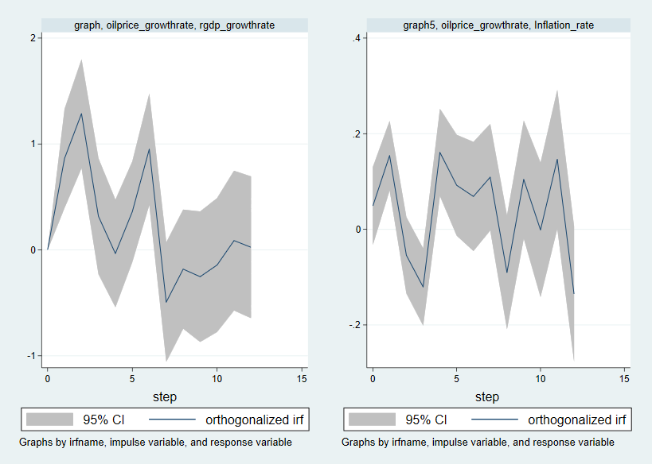
Outline Introduction
Data
Empirical model
Empirical results
Concluding remarks
Impulse Response Analysis
Forecast Error Variance Decomposition
Empirical Results: Impulse Response Analysis
Impact of oil price shock on Inflation rate
Orthogonalized Impulse Response Graph
Cumulative Impulse Response Graph
Period 1: statistically significant and positive increase
Periods 2: a slow down in the increase
Period 3+: insignificant effect
For the overall effect the plot reveals a clear positive upward trend
Rawan Al Gharib

Slide 20
Outline Introduction
Data
Empirical model
Empirical results
Concluding remarks
Impulse Response Analysis
Forecast Error Variance Decomposition
Empirical Results: Impulse Response Analysis
This result is consistent with:
Brini et al. (2016):
- the reaction of Saudi Arabia inflation to the shock in oil price is positive during the first period
Tang et al., (2010) :
a rise in oil prices induces an increase in production costs, that are translated to higher consumer price index
Zulfigarov and Neuenkirch (2020)
an increase in oil prices induce higher inflation rates in the short run.
Rawan Al Gharib

Slide 21
Outline Introduction
Data
Empirical model
Empirical results
Concluding remarks
Impulse Response Analysis
Forecast Error Variance Decomposition
Empirical Results: Forecast Error Variance Decomposition
Forecast Error Variance Decomposition for Real GDP growth rate
Horizon | Oil price shock | Inflation shock | Other shocks
2 | 0.167975 | 0.346762 | 0.485263
4 | 0.353508 | 0.277193 | 0.369299
8 | 0.385735 | 0.282867 | 0.331398
Ꝏ | 0.410685 | 0.30406 | 0.285255
Rawan Al Gharib

Slide 22
Outline Introduction
Data
Empirical model
Empirical results
Concluding remarks
Impulse Response Analysis
Forecast Error Variance Decomposition
Empirical Results: Forecast Error Variance Decomposition
Forecast Error Variance Decomposition for Inflation rate
Horizon | Oil price shocks
2 | 0.191009
4 | 0.265304
8 | 0.315302
Ꝏ | 0.441633
Rawan Al Gharib

Slide 23
Outline Introduction
Data
Empirical model
Empirical results
Concluding remarks
Main findings
Policy Implications
Limitations and Future Research
Concluding remarks: Main Findings
This paper attempts at investigating the impact of oil price shocks on real GDP and inflation in Saudi Arabia, using SVAR (15) model
Main findings:
An increase in oil prices has a direct positive impact on both the country's national income and inflation.
A one-time oil price shock boosts aggregate demand in the case of Saudi Arabia.
Oil price shocks contribute substantially to the forecast error variance for the real economic growth and inflation.
Rawan Al Gharib

Slide 24
Outline Introduction
Data
Empirical model
Empirical results
Concluding remarks
Main findings
Policy Implications
Limitations and Future Research
Concluding remarks: Policy Implications
Given the high contribution of oil price shocks to fluctuations in real GDP and inflation, policymakers must prioritize efforts to lessen the reliance on oil.
1. Focusing on diversifying the economy:
Promoting the growth of non-oil sectors (manufacturing, services and tourism)
2. Efficiently using government’s fiscal policy in allocations during oil price hikes:
Investing in the private sector and promoting industrial constructions
Investing in human capital to equip citizens with the skills needed to work in non-oil sectors
Investing in renewable energies can promote efficiency and sustainability
Rawan Al Gharib

Slide 25
Outline Introduction
Data
Empirical model
Empirical results
Concluding remarks
Main findings
Policy Implications
Limitations and Future Research
Concluding remarks: Limitations and Future Recommendations
While this paper does not consider the asymmetric effects oil price shocks, future research could study the different effects of positive and negative shocks.
While our main focus in this study is on oil price shocks, future research may include other macroeconomic variables that may impact economic growth in Saudi Arabia (fiscal policy, monetary policy, real exchange rate…)
It is interesting for future research to evaluate the effectiveness of diversification efforts and the success of Saudi Vision 2030 by comparing the effect of oil price shocks before and after these efforts.
Rawan Al Gharib

