Slide 1
Is Climate Change a Key Factor Affecting Migration? Evidence from the MENA Region
Rawan Al Gharib
Climate Change and Migration

Slide 2
Outline
Introduction
Data
Empirical Model
Empirical Results
Conclusion
Outline
Introduction
Motivation
Objective
Related literature
Data
Variables
Summary Statistics
Empirical Model
Empirical Results
Conclusion
Rawan Al Gharib
Climate Change and Migration

Slide 3
Outline
Introduction
Data
Empirical Model
Empirical Results
Conclusion
Motivation
Objective
Related literature
Motivation
The Intergovernmental Panel on Climate Change (IPCC 2014) declared that climate change would have its greatest impact on human displacement, predicting 200 million people to migrate by 2050
The MENA region is an interesting spot to tackle the impact of climate change on human displacement for:
MENA’s orography and climatic conditions
Agriculture-based economies
MENA being among the leading regions witnessing migration
Rawan Al Gharib
Climate Change and Migration

Slide 4
Outline
Introduction
Data
Empirical Model
Empirical Results
Conclusion
Motivation
Objective
Related literature
Objective
The aim of this paper is to provide empirical understanding of the correlation between climate and migration in the MENA region.
Rawan Al Gharib
Climate Change and Migration

Slide 5
Outline
Introduction
Data
Empirical Model
Empirical Results
Conclusion
Motivation
Objective
Related literature
Related literature
The literature on the effects of environmental and climate events on migration is relatively new and expanding.
Several studies have examined the impact of climate change episodes on migration in both developed and developing countries.
Rawan Al Gharib
Climate Change and Migration

Slide 6
Outline
Introduction
Data
Empirical Model
Empirical Results
Conclusion
Motivation
Objective
Related literature
Related literature
Developed Countries:
Concerns about the effects of climate change do not appear to be a significant driver of migration from Funafuti (Mortreux and Barnett, 2008).
Benveniste et al. (2022) determined that climate change reduces migration of low-income people by more than 10% and by up to 35% for more pessimistic scenarios in the U.S.
Mcleman and Smit (2006) concluded that the decision to migrate from Oklahoma at the end of a failed harvest was controlled by the land owner rather than the household.
The environment is not the most important factor influencing migration; both social and human capital have far more powerful and consistent effects on migration out of Chitwan (Massey et al., 2010).
Rawan Al Gharib
Climate Change and Migration

Slide 7
Outline
Introduction
Data
Empirical Model
Empirical Results
Conclusion
Motivation
Objective
Related literature
Related literature
Developing Countries:
Mueller et al. (2019) discovered that it is not surprising that climate variability has a significant impact on temporary migration decisions in eastern Africa, indicating that it reduces urban, rather than rural, temporary out-migration.
Cattaneo and Peri (2016) discovered that between 1960 and 2000, higher temperatures in middle-income economies increased migration rates to urban areas and to other countries. On the other side, in poor countries, higher temperatures reduced the probability of migration to cities and to other countries, consistently.
Murakami (2020) discovered that an increase in annual average air temperature and in precipitation will lower migration because international migration is costly.
Delazeri et al. (2022) concluded that income and education are major determinants of migration decision-making. Low-income rural areas cannot stop farming and migrate because they cannot afford it
Henry et al. (2004) discovered that rainfall conditions have no effect on migration from rural areas suggesting that migration behavior is less responsive to environmental factors like rainfall, but rather depends on socio-demographic factors like education
Rawan Al Gharib
Climate Change and Migration

Slide 8
Outline
Introduction
Data
Empirical Model
Empirical Results
Conclusion
Data
Variables
Summary Statistics
Data
This paper draws on data from the Arab Barometer, a large repository of publicly available data covering the Middle East and North Africa.
The data comes from the region's most recent seventh round of polling, which included face-to-face interviews with respondents in their homes. It took place between October 2021 and July 2022.
Algeria, Tunisia, Libya, Morocco, Mauritania, Jordan, Lebanon, Palestine, Iraq, Egypt, and Sudan are among the countries targeted.
More than 26,000 citizens were interviewed by Arab Barometer on a variety of topics, including but not limited to the economy, government trust and performance, gender, education, employment and social inclusion, international relations, mobility, and migration.
We were left with 12,959 observations after data cleaning.
Rawan Al Gharib
Climate Change and Migration

Slide 9
Outline
Introduction
Data
Empirical Model
Empirical Results
Conclusion
Data
Variables
Summary Statistics
Variables
Our dependent variable (migration) is defined to be a binary variable that takes the value of one if the respondent has the willingness to migrate and the value of zero otherwise.
Our study included one key independent variable (climatechange), a binary variable that captured climate change (one if the respondent believes that climate change is a big environmental challenge facing their country and zero otherwise).
The other independent variables were divided into the following categories: socio-demographic and environmental factors:
Socio-demographic factors: male, rural, household income, social status , employment status and age
Environmental factors: water pollution, trash, lack of water resources, and government intervention
Two interaction variables were added to our model.
The first variable takes a continuous form and is defined as ClimateChange × Income (climatecinc)
The second variable takes a binary form and is defined as ClimateChange × Rural (climatecres)
Rawan Al Gharib
Climate Change and Migration

Slide 10
Outline
Introduction
Data
Empirical Model
Empirical Results
Conclusion
Data
Variables
Summary Statistics
Summary Statistics
Variable | Obs | Mean | Std. Dev. | Min | Max
Migration | 12959 | .329 | .47 | 0 | 1
Climatechange | 12959 | .119 | .324 | 0 | 1
Waterpollution | 12959 | .57 | .495 | 0 | 1
Nowater | 12959 | .295 | .456 | 0 | 1
Trash | 12959 | .343 | .475 | 0 | 1
Government | 12959 | .5 | .5 | 0 | 1
Male | 12959 | .52 | .5 | 0 | 1
Youth | 12959 | .171 | .376 | 0 | 1
Adults | 12959 | .772 | .42 | 0 | 1
Income | 12959 | 29,024.442 | 14,518.331 | 0 | 60,690.241
Rural | 12959 | .35 | .477 | 0 | 1
School | 12959 | .537 | .499 | 0 | 1
Uni | 12959 | .206 | .405 | 0 | 1
Inrel | 12959 | .65 | .477 | 0 | 1
Employment | 12959 | .372 | .483 | 0 | 1
Climatecinc | 12959 | 95,451.6 | 87,703.3 | 0 | 149,982.8
Climatecres | 12959 | .069 | .253 | 0 | 1
Rawan Al Gharib
Climate Change and Migration

Slide 11
Outline
Introduction
Data
Empirical Model
Empirical Results
Conclusion
Empirical Model
Through the empirical analysis, the model used to estimate the results is the PROBIT model as the data used is qualitative and the dependent variable is dummy
Rawan Al Gharib
Climate Change and Migration

Slide 12
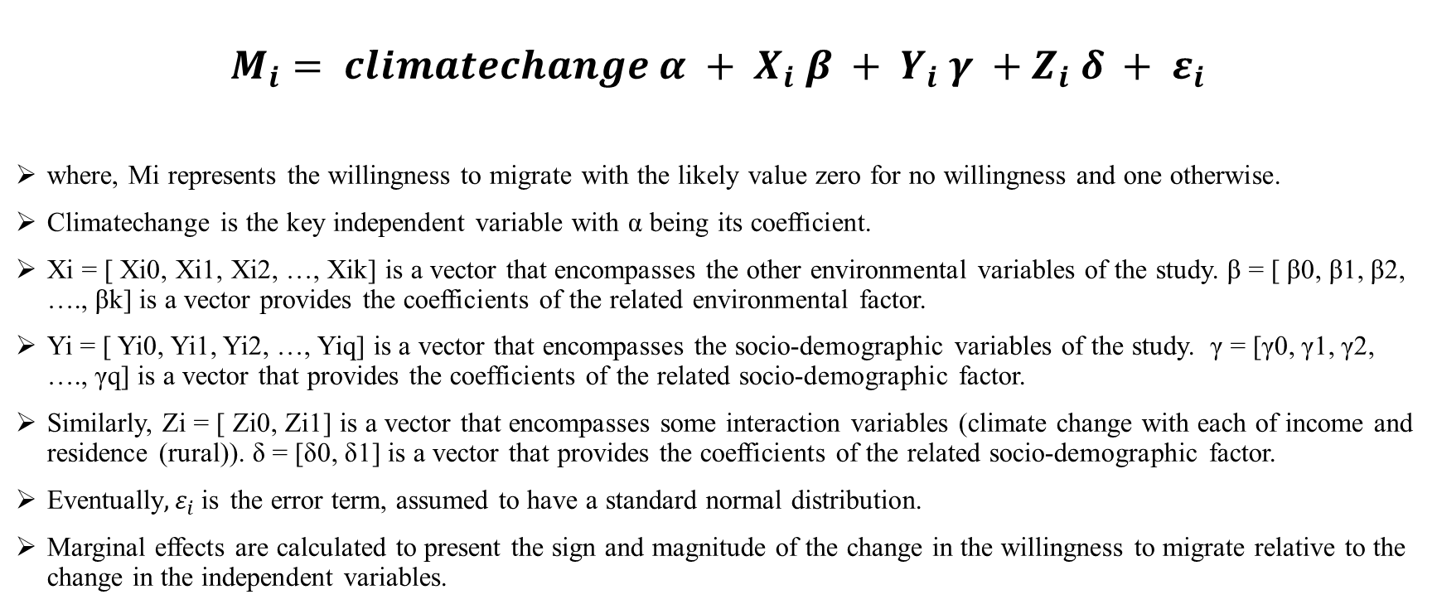
Outline
Introduction
Data
Empirical Model
Empirical Results
Conclusion
Empirical Model
$$M_{i}= climatechange α + X_{i} β + Y_{i} γ +Z_{i} δ + ε_{i}$$
where, Mi represents the willingness to migrate with the likely value zero for no willingness and one otherwise.
Climatechange is the key independent variable with α being its coefficient.
Xi = [ Xi0, Xi1, Xi2, …, Xik] is a vector that encompasses the other environmental variables of the study. β = [ β0, β1, β2, …., βk] is a vector provides the coefficients of the related environmental factor.
Yi = [ Yi0, Yi1, Yi2, …, Yiq] is a vector that encompasses the socio-demographic variables of the study. γ = [γ0, γ1, γ2, …., γq] is a vector that provides the coefficients of the related socio-demographic factor.
Similarly, Zi = [ Zi0, Zi1] is a vector that encompasses some interaction variables (climate change with each of income and residence (rural)). δ = [δ0, δ1] is a vector that provides the coefficients of the related socio-demographic factor.
Eventually$, ε_{i}$is the error term, assumed to have a standard normal distribution.
Marginal effects are calculated to present the sign and magnitude of the change in the willingness to migrate relative to the change in the independent variables.
Rawan Al Gharib
Climate Change and Migration

Slide 13
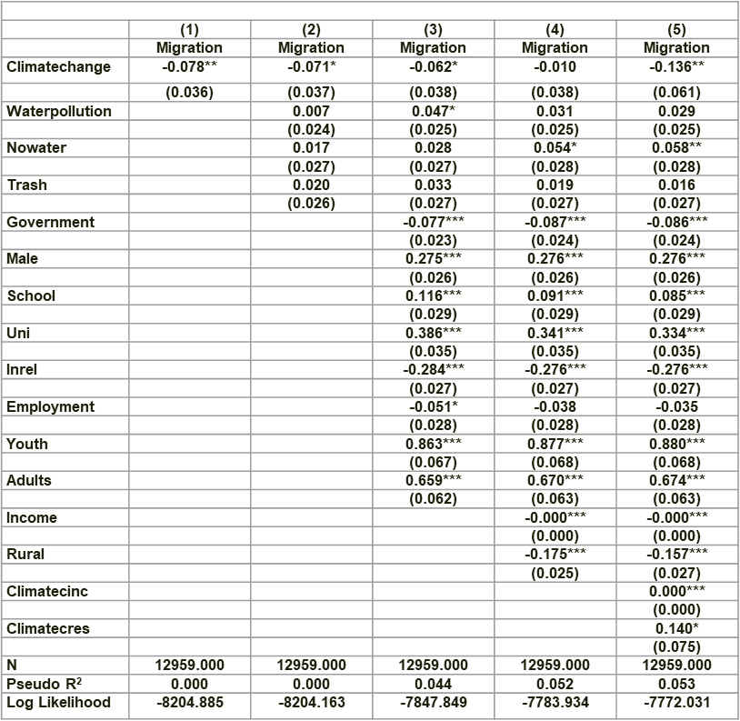
Outline
Introduction
Data
Empirical Model
Empirical Results
Conclusion
Empirical Results
Model 1 contains only the key independent variable, climate change.
Model 2 adds the other environmental factors to model 1.
Model 3 adds the socio-demographic variables, excluding income and residence to model 2.
Model 4 adds to the model 3 both income and residence.
Model 5 includes income and residence as interaction variables each with climate change.
Rawan Al Gharib
Climate Change and Migration

Slide 14
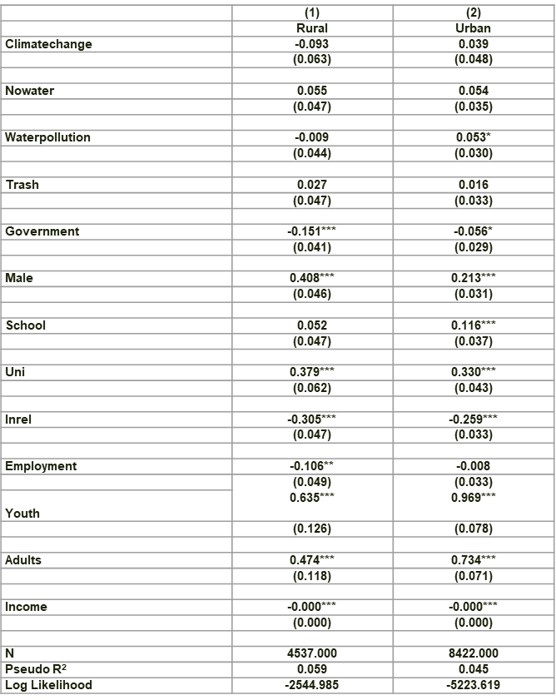
Outline
Introduction
Data
Empirical Model
Empirical Results
Conclusion
Empirical Results
Then, we run two regressions controlling for place of residence: rural and urban.
Rawan Al Gharib
Climate Change and Migration

Slide 15
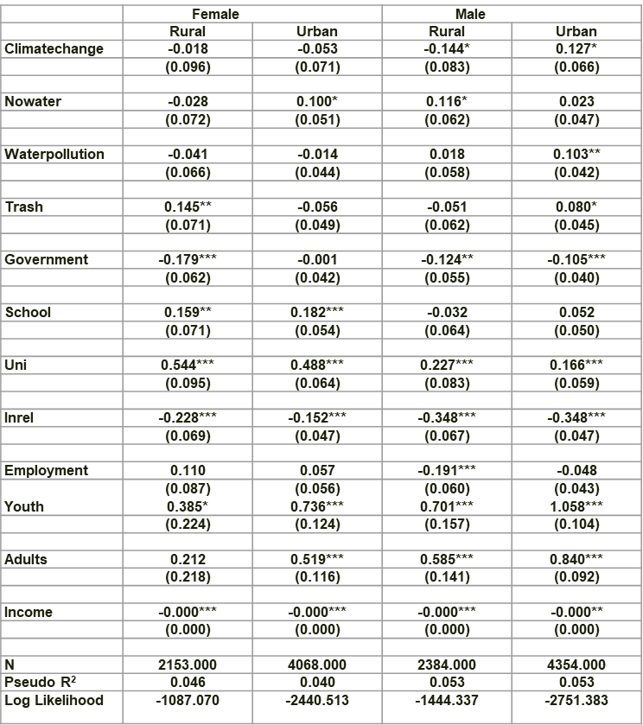
Outline
Introduction
Data
Empirical Model
Empirical Results
Conclusion
Empirical Results
Then, we run four regressions controlling for place of residence across gender.
Rawan Al Gharib
Climate Change and Migration

Slide 16
Outline
Introduction
Data
Empirical Model
Empirical Results
Conclusion
Conclusion
The negative correlation between climate change and migration imposes a critical point for researchers in the field.
The results show the dominance of certain socio-demographic factors (income and residence) on the correlation between climate change and migration
Rawan Al Gharib
Climate Change and Migration

Slide 17
Outline
Introduction
Data
Empirical Model
Empirical Results
Conclusion
Conclusion
Recommendations:
Government promoting green energy and combating short-lived climate pollutants
Disaggregated data is recommended to implement gender-responsive climate policies to mitigate the inequality in the effect of climate change
Future research on the topic of climate change and migration is fundamental to create evidence that permits for designing better policies.

