Slide 1



Identifying loan completion status
Classification Project

Slide 2

Rawan
Prepared by :
MO
Mariam
Eslam
Salah
Sama

Slide 3

Contents
01
02
03
04
05
Overview
Data Preprocessing Techniques
Feature Analysis and Relationships
Power BI
Feature Selection
06
07
08
09
10
Classification Techniques Used
Hyperparameter Tuning
Conclusion
Models Performance
Model Evaluation

Slide 4
Overview
01
Rawan

Slide 5
Analyzing a dataset containing various factors related to companies and their financial information
The objective of this project :
Predict the completion status of a loan
Understand the key determinants that influence whether a loan is successfully completed or not.
It also aims to make informed decisions regarding loan approvals and risk management.

Slide 6
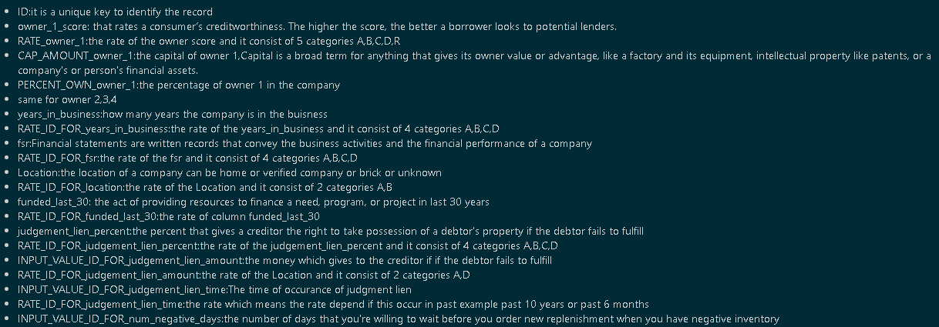
Data Description and Column Explanation

Slide 7
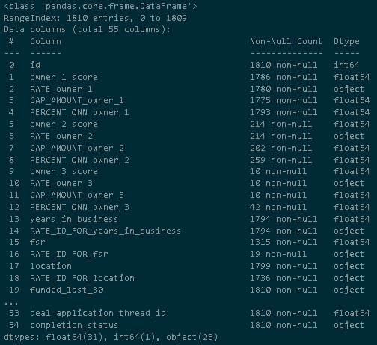
Dataset Overview
The dataset contains information on 1,810 entries and 55 columns related to companies and their financial information.
The dataset includes a variety of data types, including 31 float64, 1 int64, and 23 object.
It’s obvious that many columns contains null values.
Ultimately , This dataset provides valuable insights into the financial aspects of companies

Slide 8
Data Preprocessing Techniques
02
Salah
Rawan

Slide 9
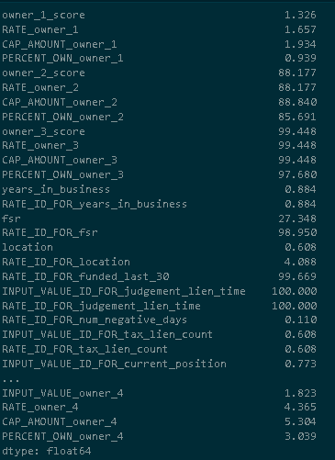
Nulls
The output snippet efficiently displays the percentage of null values in the dataset.
Understanding the presence of null values is crucial for data quality assessment and preprocessing.
Identifying columns with a high percentage of null values can guide decisions on data imputation or exclusion strategies.

Slide 10
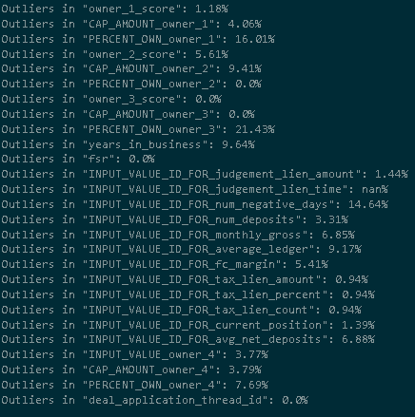
Outliers percentage
Outliers are extreme or unusual data points that deviate significantly from the majority of the data.
The function outlier percent is designed to detect and calculate the percentage of outliers in a given dataset as shown in the output snippet.

Slide 11
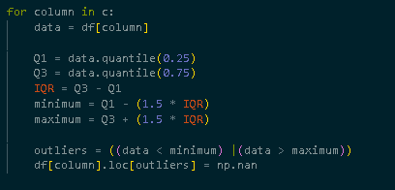
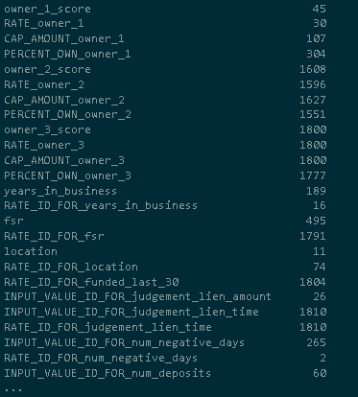
Replace outliers with nulls
By replacing outliers with NaN, it effectively removes them from the dataset, allowing subsequent steps to treat them as missing values.

Slide 12

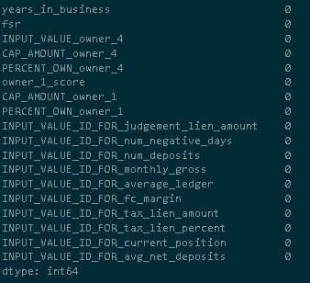
Filling nulls with KNN
This code snippet effectively replaces the missing values in the selected columns using the K-Nearest Neighbors imputation technique, resulting in a Data Frame (df-temp) where missing values are replaced with the mean value of the nearest elements in each column.

Slide 13
Imputing Missing Values in Numeric Column Using Conditional Data
Salah

Slide 14
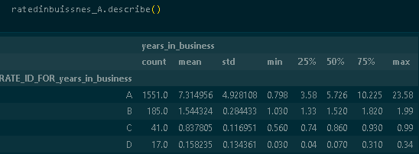
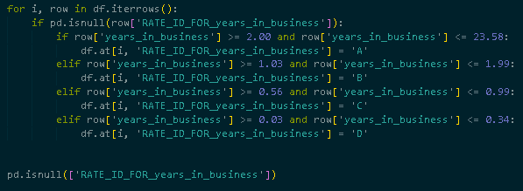
Conditional Filling of Null Values in “RATE-ID-FOR-years-in-business” Column Based on “years-in-business”
Missing values in the "RATE-ID-FOR-years-in-business" column are filled based on conditions and values in the "years-in-business" column.
The purpose is to assign appropriate categories to missing values using observed patterns in "years-in-business".

Slide 15

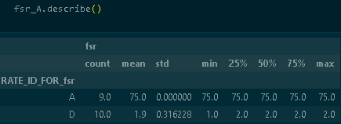
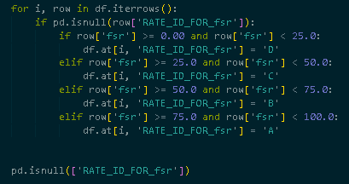
Conditional Filling of Null Values in 'RATE_ID_FOR_fsr' Column Based on 'fsr'
Missing values in the "RATE_ID_FOR_fsr" column are filled based on the values in the "fsr" column and specific conditions.
The goal is to assign appropriate categories to missing values by considering the observed patterns and ranges in the "fsr" column.

Slide 16


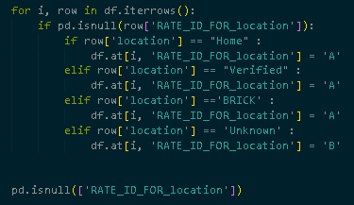

Filling Null and Unknown Values in 'RATE_ID_FOR_location' Column Based on 'location'
Based on the value in the "location" column, we assigned corresponding categories "A" or "B" to the missing values.
The goal is to impute missing values in "RATE_ID_FOR_location" based on available data in the "location" column.

Slide 17
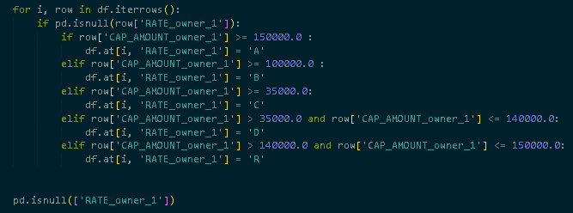
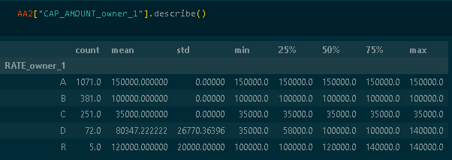
Conditional Filling of Null Values in 'RATE_owner_1' Column Based on 'CAP_AMOUNT_owner_1'
The code fills in missing values in the "RATE_owner_1" column based on the associated "CAP_AMOUNT_owner_1" values, categorizing the data into different groups.

Slide 18
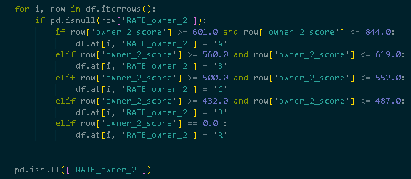
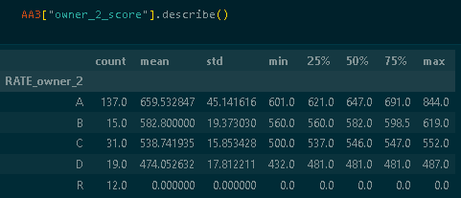
Conditional Filling of Null Values in 'RATE_owner_2' Column Based on 'CAP_AMOUNT_owner_2'
the code fills in missing values in the "RATE_owner_2" column based on the associated "CAP_AMOUNT_owner_2" values, categorizing the data into different groups.

Slide 19
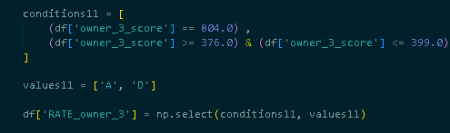
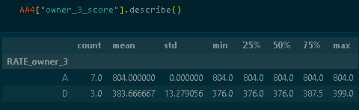
Conditional Filling of Null Values in 'RATE_owner_3' Column Based on 'CAP_AMOUNT_owner_3'
the code assigns values to the "RATE_owner_3" column based on the conditions specified for the "owner_3_score" column.
This operation helps categorize and update the "RATE_owner_3" column based on specific score ranges.

Slide 20
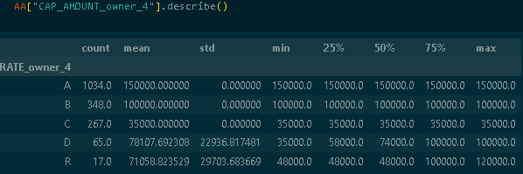
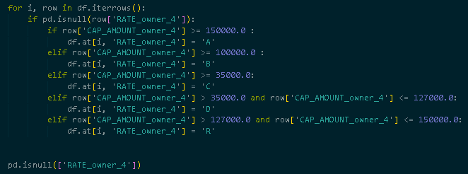
Conditional Filling of Null Values in 'RATE_owner_4' Column Based on 'CAP_AMOUNT_owner_4'
The code analyzes and categorizes the "RATE_owner_4" column based on the "CAP_AMOUNT_owner_4" values.
It calculates summary statistics for the existing data, defines conditions for categorization, assigns values to the "RATE_owner_4" column, and checks for null values.

Slide 21
Completing Dependency Preprocessing

Slide 22
Filling Column with Mode Value
The code replaces the missing values in specific columns with the mode value of each respective column.
This is a common strategy to handle missing data by imputing the most frequent value in categorical columns.

Slide 23
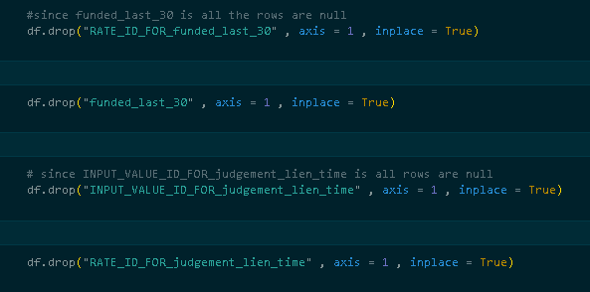
Dropping Columns from DataFrame
The specific columns mentioned in the code snippets were removed because they either contained all null values

Slide 24

Uniform Representation: Replacing 'Preferred' with 'preferred' in Column
By replacing 'Preferred' with 'preferred', the code ensures that the column contains a uniform representation of the category, eliminating any potential discrepancies or confusion caused by different representations of the same value.

Slide 25
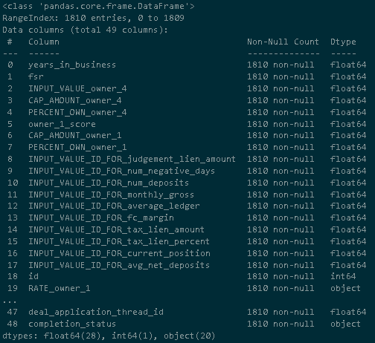
Dataset Preparation: Missing Value Handling and Data Integrity (Post-Filling)
After applying all the preprocessing techniques, we have prepared the dataset for further analysis or modeling by addressing missing values, standardizing values, and ensuring data integrity.

Slide 26
Feature Analysis and Relationships
03
MO

Slide 27
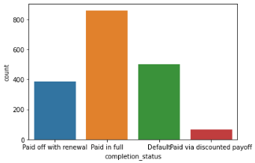
Completion Status Distribution: Insights and Analysis
This visualization helps to understand the distribution and imbalance of the "completion_status" variable in the dataset, providing insights into the frequency of different completion statuses.
These counts provide insights into the distribution of completion statuses in the dataset and can be used to analyze patterns, assess the effectiveness of repayment strategies, or identify potential areas of improvement in the lending process.

Slide 28
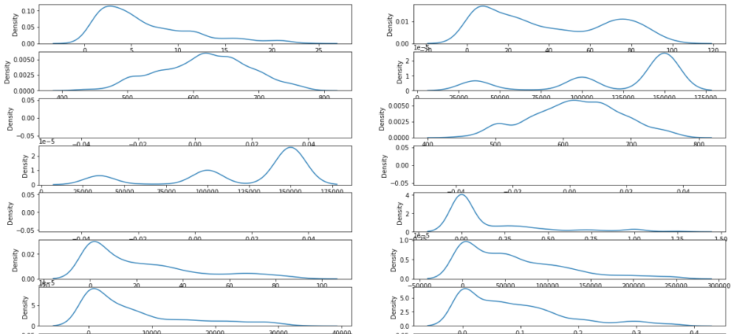
Skewness: Understanding Distribution Shape, Outliers, and Model Performance
Skewness provides insights into the shape and distribution of data, helping to identify symmetry or skewness and the presence of outliers or extreme values. It impacts data interpretation, decision making, and the performance of statistical models.

Slide 29
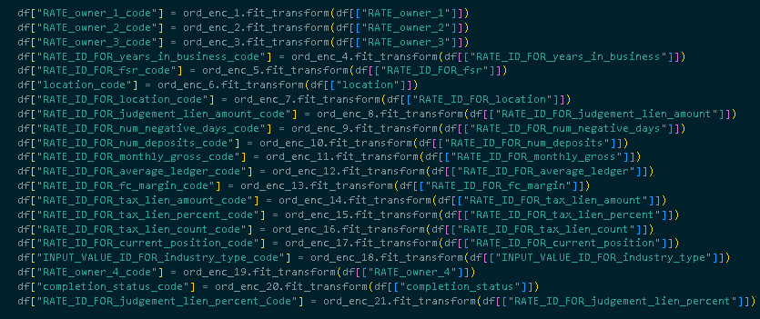
Ordinal Encoding: Transforming Data for Machine Learning and Preserving Ordinal Relationships
The purpose is to transform the data into a format that can be easily processed by machine learning algorithms.
Ordinal encoding allows for the preservation of the ordinal relationship between categories, if any.

Slide 30
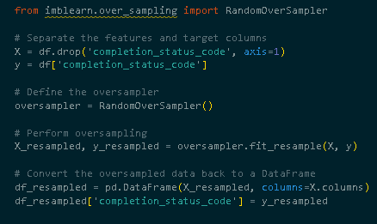
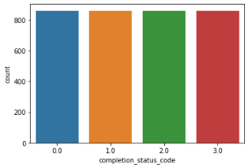
Random Oversampling: Balancing Class Distribution for Enhanced Model Training and Performance
The code performs random oversampling to address class imbalance in the target variable, ensuring a balanced class distribution as shown in the graph for improved model training and performance.

Slide 31
Power BI
04
Eslam

Slide 32
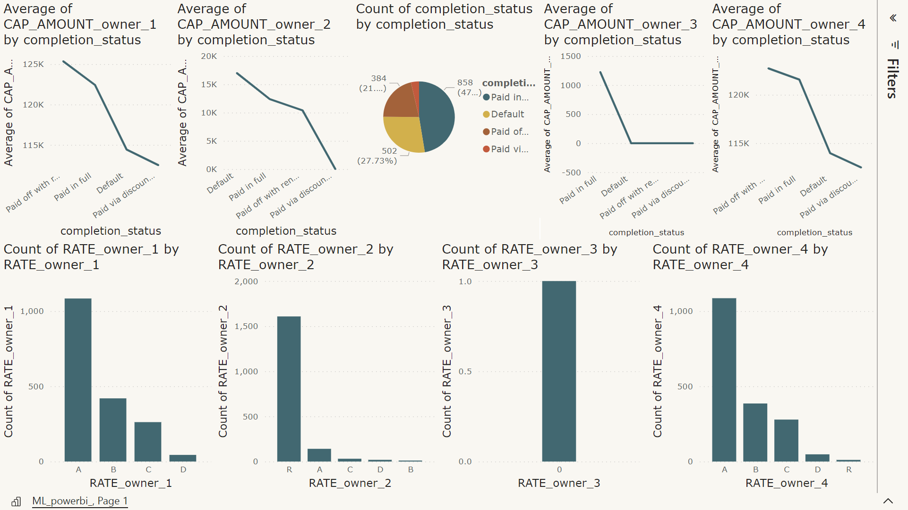

Slide 33
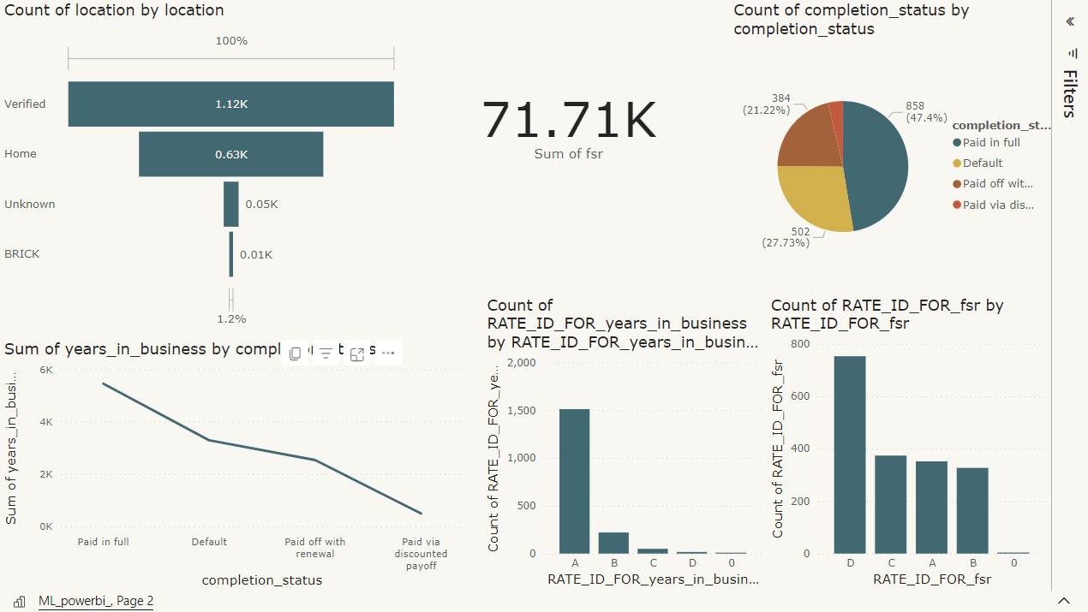

Slide 34
Feature Selection & Extraction
05
Sama

Slide 35

Feature Selection: F-Test and SelectPercentile for Identifying Relevant Features
In feature selection, the F-test is used to measure the relationship between each input feature and the target variable.
Higher F-statistic values indicate stronger relationships between features and the target variable.
The Select Percentile method selects the top percentile (95%) of features with the highest F-statistic scores.

Slide 36

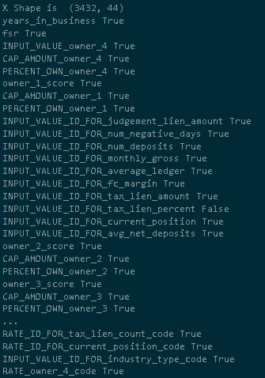
Feature Selection Results: Dropping Irrelevant Columns Based on F-Test and Select Percentile
After applying the F-test and selecting the top percentile of features with the highest F-statistic scores, we dropped columns with “false” from the dataframe

Slide 37
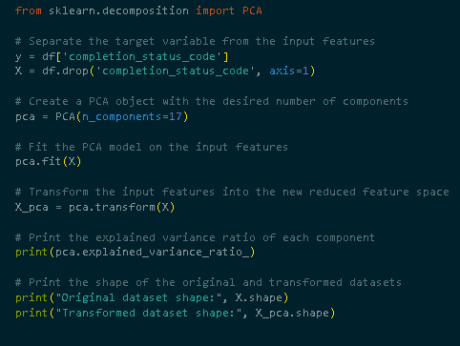
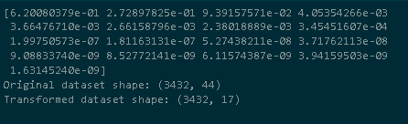
Dimensionality Reduction: Applying PCA for Improved Efficiency and Reduced Overfitting
The provided code applies Principal Component Analysis (PCA) to the input features to reduce their dimensionality while retaining most of the original information.
The transformed dataset 'X_pca' has a reduced number of features (17) compared to the original dataset 'X' (44), potentially improving computational efficiency and reducing the risk of overfitting.

Slide 38
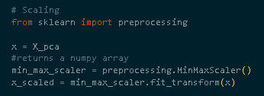
Feature Scaling: Applying Min-Max Scaling to Transformed Dataset
The code applies Min-Max Scaling to the transformed dataset 'X_pca', ensuring consistent feature scales for improved machine learning performance. It reduces feature dimensionality and enhances computational efficiency while mitigating overfitting risks.

Slide 39
Classification Techniques Used
06
Mariam

Slide 40
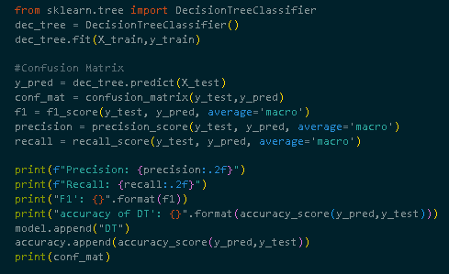
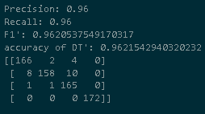
Decision tree
96%
Accuracy

Slide 41
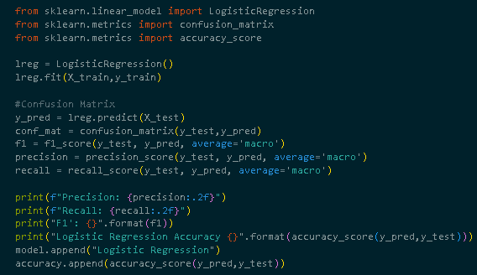

Logistic Regression
32%
Accuracy

Slide 42
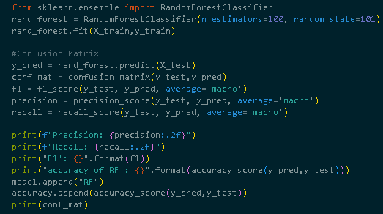
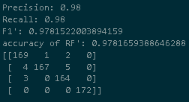
Random Forest
97%
Accuracy

Slide 43
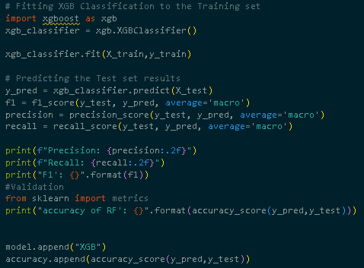

XGB
97%
Accuracy

Slide 44
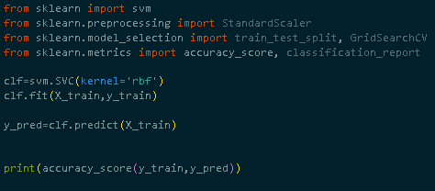
SVM
71%
Accuracy

Slide 45
Models Performance
07
Mariam

Slide 46
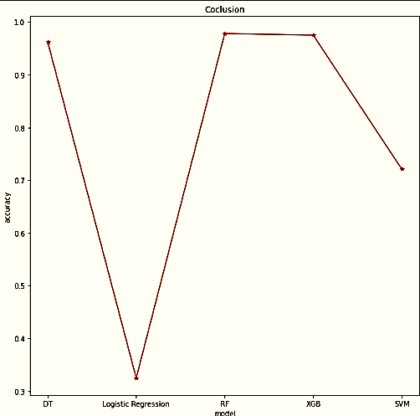
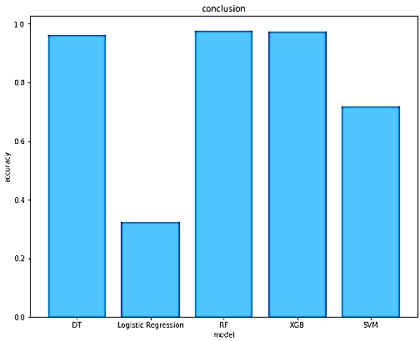
Model Performance: Accuracy Comparison and Conclusion

Slide 47
Hyperparameter Tuning
08
Eslam

Slide 48
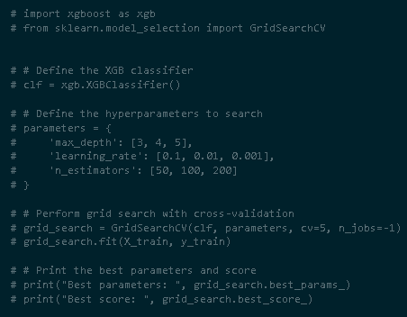
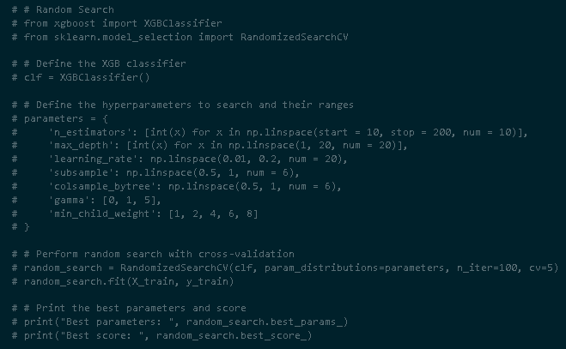
XGB
Grid Search
Random Search

Slide 49
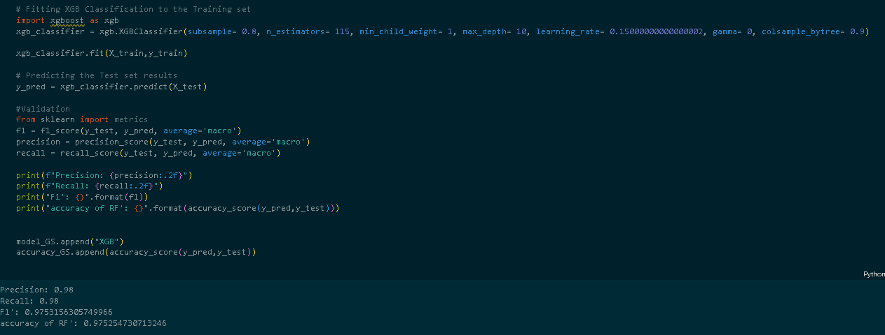
XGB
97%
Accuracy

Slide 50
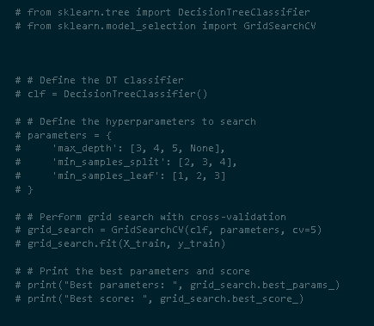
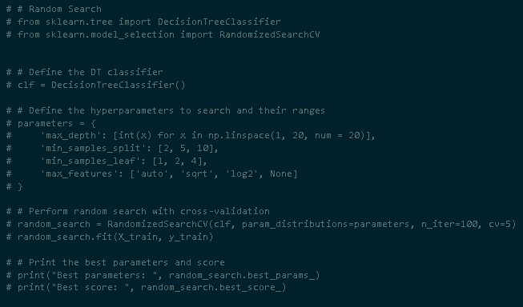
Decision Tree
Grid Search
Random Search

Slide 51
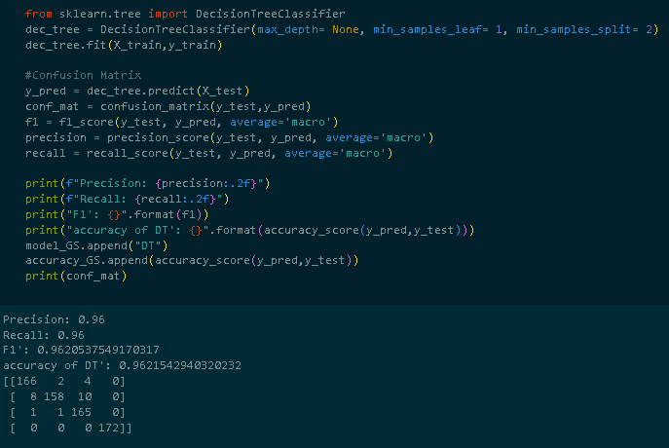
Decision Tree
96%
Accuracy

Slide 52
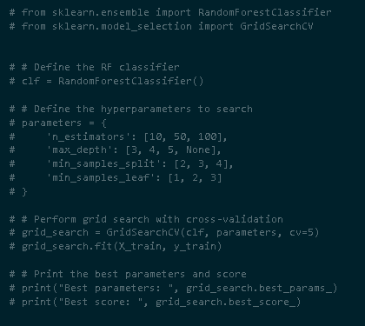
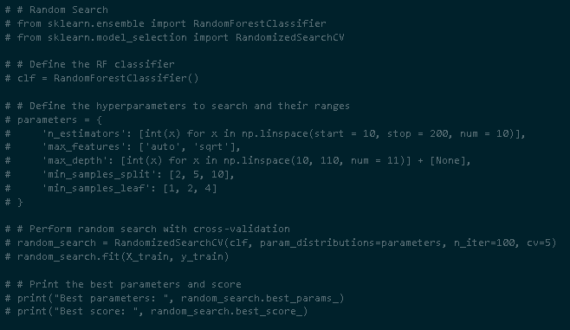
Random Forest
Grid Search
Random Search

Slide 53

Random Forest
98%
Accuracy

Slide 54
Models Evaluation
09
Eslam

Slide 55


Model Performance: Accuracy Comparison and Conclusion

Slide 56

Applying the best model
Random Forest
98%
Accuracy

Slide 57
Conclusion and Intuition
10
Rawan

Slide 58
Project Objective and Scope
Dataset Analysis: The project involves analyzing a dataset that includes various factors related to companies and their financial information.
Conclusion:
The project entails analyzing a dataset of company-related factors to predict loan completion status. By understanding the key determinants of loan completion, informed decisions can be made to improve loan approval processes and manage risks effectively. This project seeks to enhance understanding and decision-making in the lending industry.
Loan Completion Prediction: The objective is to predict the completion status of loans, indicating whether a loan will be successfully completed or not.
Key Determinants: The project aims to identify and understand the key factors that influence the successful completion of loans. By analyzing these determinants, insights can be gained into the factors that contribute to loan completion or non-completion.
Informed Decision-Making: The project intends to utilize the identified determinants to make informed decisions regarding loan approvals and risk management. By leveraging the insights gained from the analysis, the project aims to enhance the decision-making process in terms of loan approvals and mitigating potential risks.

Slide 59
Thank You !

