Slide 1
Title: Enhancing House Prices Prediction Model
Author: Rawan Alturkestani

Slide 2
Introduction
Steps followed toward enhancing the prediction
Observing
houseSmallData.csv dataset
Data Cleaning
cleaning nulls, zeros, and duplicates.
Selection
Selected a three set variables for the analysis.
Correlation
Looked into the correlation of other variables with the selected variables.
Prediction
Using a linear regression as prediction model.
Evaluation
Evaluating the accuracy of the prediction model.
Enhancements
Working on possible enhancements.
Verification
Visualization
Using graphs and figures
Comparison of Selected variables against each other
Comparing dataset with another dataset.

Slide 3
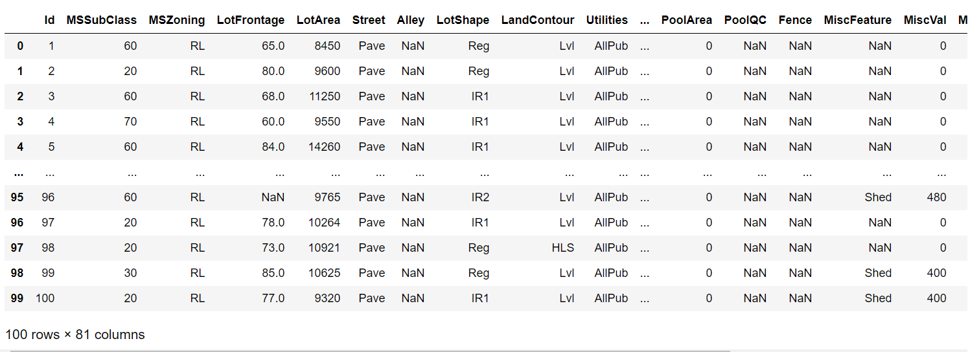

The Data
houseSmallData.csv dataset
Contains:
100 Real Estate House Properties
81 related characteristics
100 rows x 81 columns
Object, integers, strings
Null values and Zeros

Slide 4
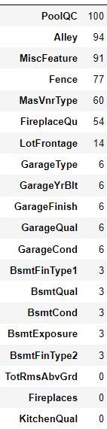
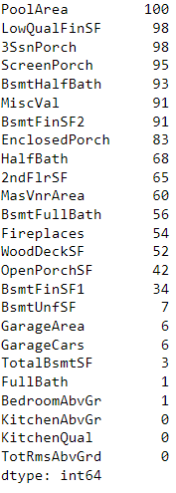
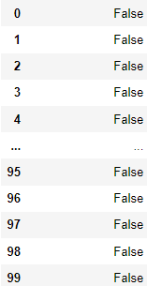
The Data
Nulls
Zeros
Duplicates
4

Slide 5
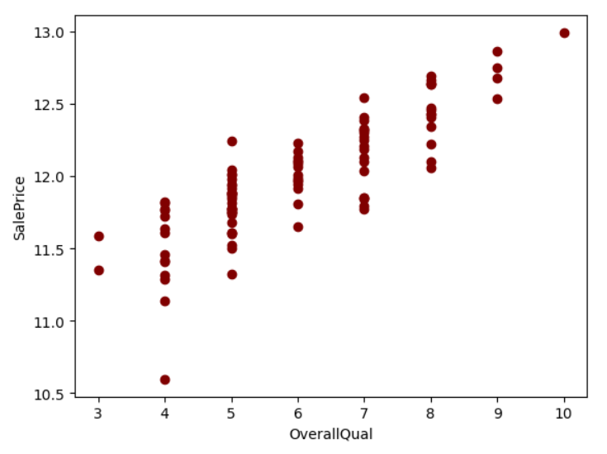
Data Exploration
Generated Graphs of House Price (SalePrice) variable relationship with rates of the overall material and finishing of the house (OverallQual)

Slide 6
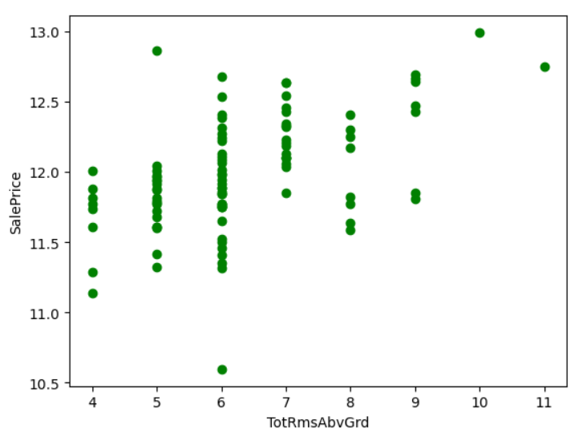
Data Exploration
Generated Graphs of House Price (SalePrice) variable relationship with Total rooms above grade (TotRmsAbvGrd)

Slide 7
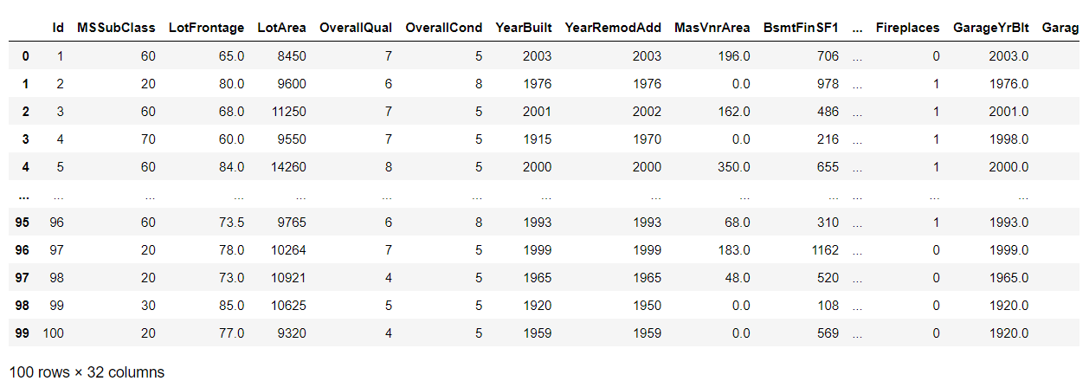
Data Preparation
Following the observation we notice null values and zeros, cleaning Steps
Collect numerical data as appropriate for our calculation
Repair the data by deleting all null values
Removal of columns with majority zero values above 90
Reshaped data 32 columns instead of 81

Slide 8
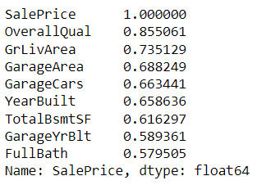
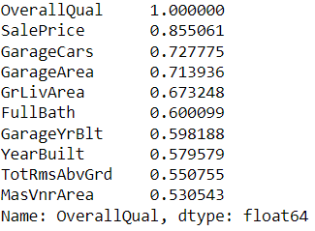
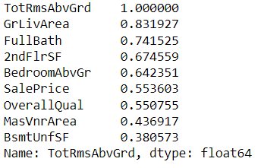
Correlation
SalePrice* top 9 correlated
OverallQual* top 9 correlated
TotRmsAbvGrd* top 9 correlated
Note:
*SalePrice: the total price of the property
*OverallQual: Rates the overall material and finish of the house and represented by 10 different ratings
*TotRmsAbvGrd: Total rooms above grade, which is a portion of a home that is above the ground (does not include bathrooms)

Slide 9

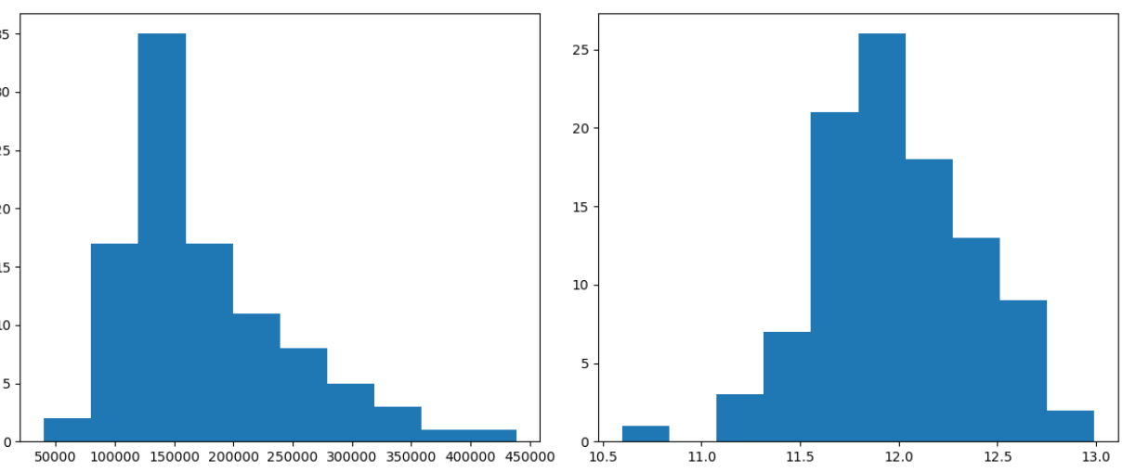
Project Description
Algorithm:
Multiple Linear regression analysis method to predict the value of the dependent variable based on the value of the independent variable.
Suitability :
The normal distribution nature of the data, which is suitable for normal assumption of Linear regression.
Prediction of a dependent variable based on multiple factors, asthe bedrooms, space, …, and multiple independent variables.
Normal Distribution
Log-Normal Distribution

Slide 10
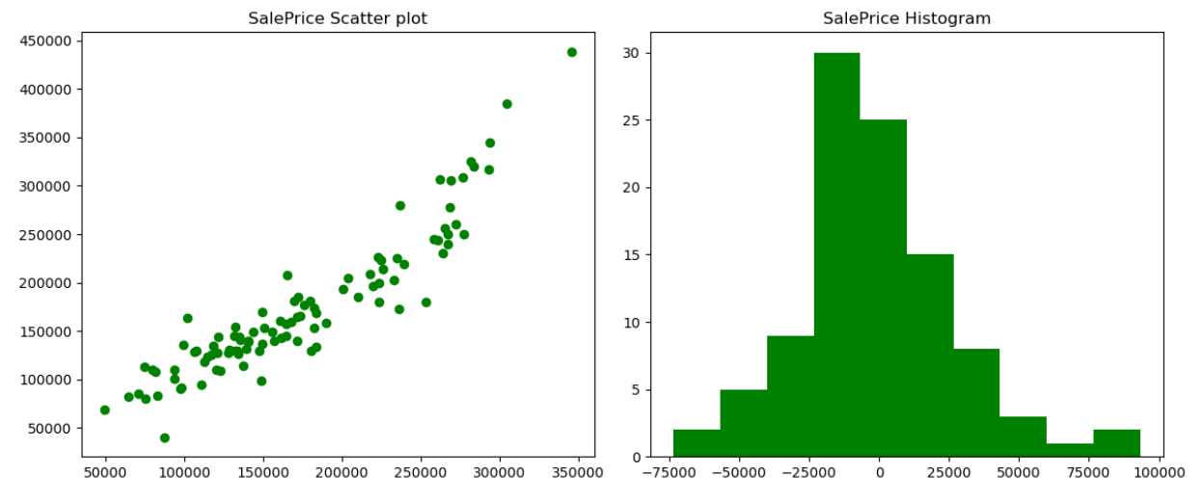
Analysis and Results
Prediction of SalePrice with 9 different dependent variables of highest correlation with SalePrice and the prediction showed increase in score from 0.83 with 6 variable to 0.85 with 9 variables
0.85
10
Notes:
While keeping in mind that a good prediction is the closer it get to 1.0 and it can be negative as the worse the model is. the below sets of variables showed results as below:
+ SalePrice showed 0.85 score with 9 set of variables
+ OverallQual showed 0.72 score with 9 set of variables
+ TotRmsAbvGrd showed 0.80 score with 9 set of variables
Given above results we can see that SalePrice showed the highest prediction score which due to the higher correlation it has multiple variables in the dataset.

Slide 11
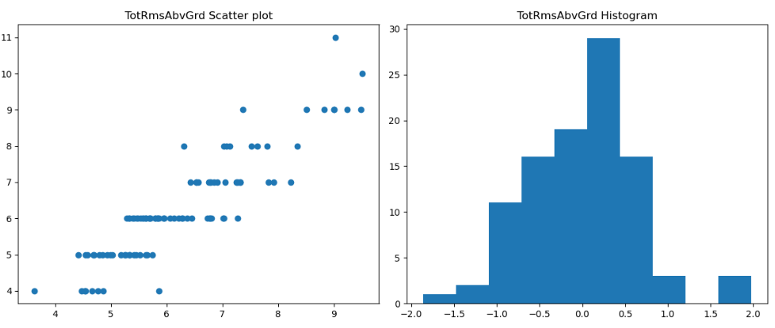
Analysis and Results
Prediction of TotRmsAbvGrd with 9 different dependent variables, it showed a positive prediction due to strong correlation with different dependent variables that impact the value of TotRmsAbvGrd
0.8
Notes:
Finaly, TotRmsAbvGrd showed decent score 0.8 which is most likely due to the fact that the data set included variables such as below, which are by default result on the total rooms above grade:
+ GrLivArea: Above grade (ground) living area square feet
+ FullBath: Full bathrooms above grade, this showed the second highest correlation, which brings a questioning for me if the bathrooms are included in calculating the TotRmsAbvGrd
+ 2ndFlrSF: Second floor square feet
+ BedroomAbvGr: Bedrooms above grade (does NOT include basement bedrooms)

Slide 12
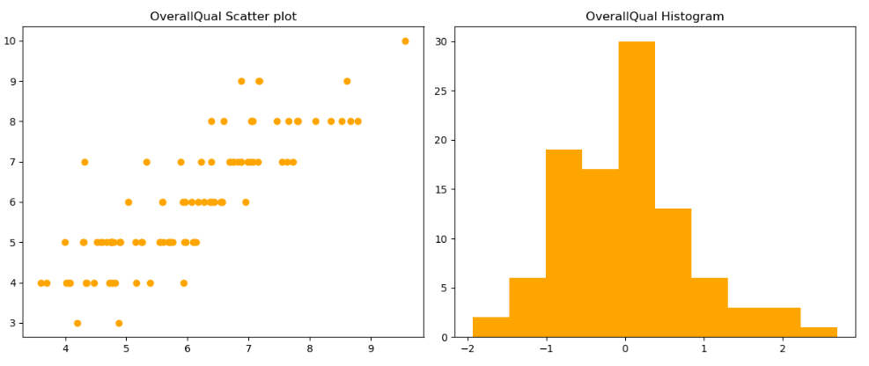
Analysis and Results
Prediction of OverallQual with 9 different dependent variables, it showed the lowest prediction due to the distributed correlation with multiple dependent variables
0.72
Notes:
However, OverallQual showed the lowest prediction which I believe is due to the correlation of this variable across much larger set of variable inside the data set. In another word what impacts the rating of the property are multiple variables inside the data set and its mostly existence of two or more variables together, as well due to the removal of SalePrice which has the highest correlation with OverallQual and increase score to 0.79. I noticed as well that the more the number of variable included the higher the prediction is.

Slide 13
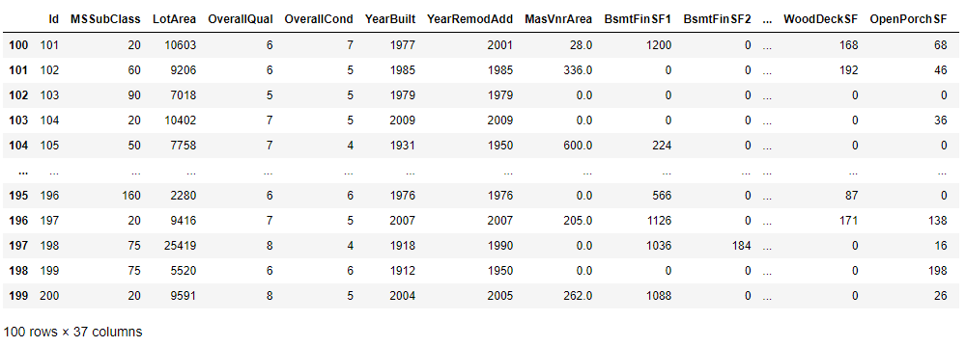
Verification
Verification Steps:
Comparing the prediction of houseSmallData.csv sample dataset with jtest.csv dataset.
Observing jtest.csv dataset
Preparing the dataset for prediction and removing null values
Calculating prediction score of jtest.csv
The result showed 0.75 which is clearly less than the now we have score with houseSmallData.csv 0.85

Slide 14
Conclusion
This project is a work on enhancing the house price prediction with a Linear regression model, in conclusion:
Proper data preparation and cleaning can help make better prediction
Data preparation has to be taken carefully as it could be impactful to the prediction accuracy and can cause data loss
Increasing the sample of dependent variables can increase the prediction score
Linear Regression works well the more correlation the dependent variable has with the independent variables
Final verification can be useful to test the accuracy of the work

Slide 15
References
Wigmore, Ivy. “correlation.” techtarget. 2020. https://www.techtarget.com/whatis/definition/correlation
IBM. “What is linear regression?.” ibm. 2024. https://www.ibm.com/topics/linear-regression
*Please add slides as required.

