Slide 1
MAOA project
Monoamine oxidase A

Slide 2
Have you ever thought that there is a gene that can make us aggressive and sometimes killers?
In fact, there is a gene responsible for this.

Slide 3
Monoamine oxidase A
Monoamine oxidase A, also known as MAO-A, is an enzyme that in humans is encoded by the MAOA gene.
This gene is one of two neighboring gene family members that encode mitochondrial enzymes which catalyze the oxidative deamination of amines, such as dopamine, norepinephrine, and serotonin.
A mutation of this gene results in Brunner syndrome.
This gene has also been associated with a variety of other psychiatric disorders, including antisocial behavior.

Slide 4
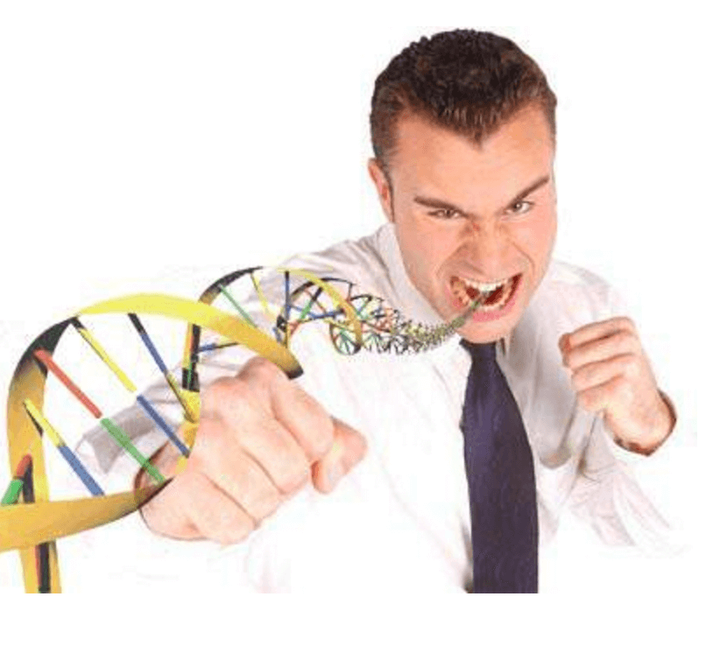
MAO-A’s function

Slide 5
Our project idea
Because of the danger and importance of this gene to individuals and societies, action should have been taken to enable us to determine whether a person is aggressive by nature and should have a special treatment or not.
So, our website will discover it by passing human genome.

Slide 6
Thank you

