Slide 1


NexTor
Presenters:
Hanan Madi
Rawan Sadeq
Supervisor:
Zakharia Frenkel

Slide 2
Problem Statement
Service based businesses face no-shows, last-minute cancellations.
These issues lead to financial losses and inefficient resource use.
Businesses suffer from inconsistent revenue streams and operational inefficiencies without effective management.

Slide 3
Existing Solutions
Current systems offer basic features:
Online self-service booking.
Calendar integration.
Automated reminders.
Basic payment processing.

Slide 4
Proposed Solution
Prepayment ensures steady cash flow and reduces cancellations.
Automated reminders and flexible payments options.
Appointment transfer options prevent revenue loss.
A referral system ('a-friend-brings-a-friend') helps attract more customers and grow the business.
Price reduction for Unbooked Gaps.

Slide 5
Existing platforms

Slide 6
Tor4You
A platform for scheduling appointments with advance payment.
A real-time sync app allowing convenient business management on the go.
Automatically sends SMS and email reminders, reducing cancellations by 90%.
Customers can book appointments via a business website, Facebook, or mobile app.
Facilitates payment collection (advance or after-service) and issues electronic tax invoices.

Slide 7
Pink
Smart system ensures appointments are scheduled without gaps, recommending the best available times for customers.
Customers receive unlimited WhatsApp reminders before appointments, ensuring timely arrival with confirmation of attendance.
Digital management of accounting documents like invoices, receipts, and offers, with automatic receipts sent via WhatsApp.
Payments can be processed via mobile with various methods like credit, cash, Bit, and Apple Pay.

Slide 8
NexTor vs. Tor4You and Pink
Customers can transfer appointments to others, preventing loss of revenue or service.
"A-friend-brings-a-friend" system encourages referrals, allowing customers to invite friends to book new appointments.
Customers can join a waiting list for earlier appointments, and the system sends a SMS notification when an appointment becomes available.

Slide 9
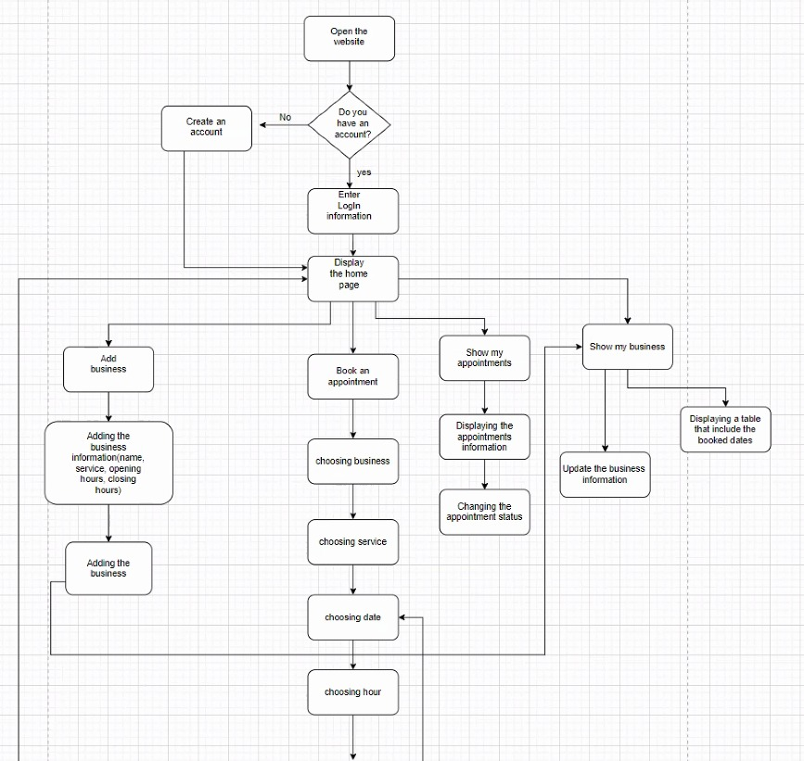
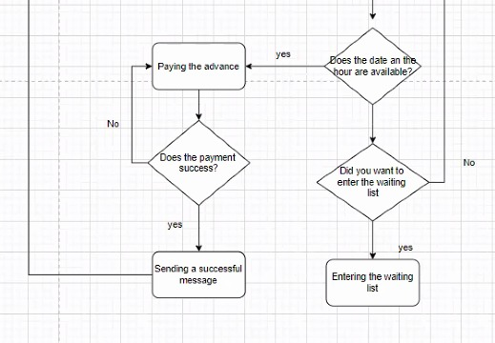
The process-Flow Chart

Slide 10
UML Diagrams

Slide 11
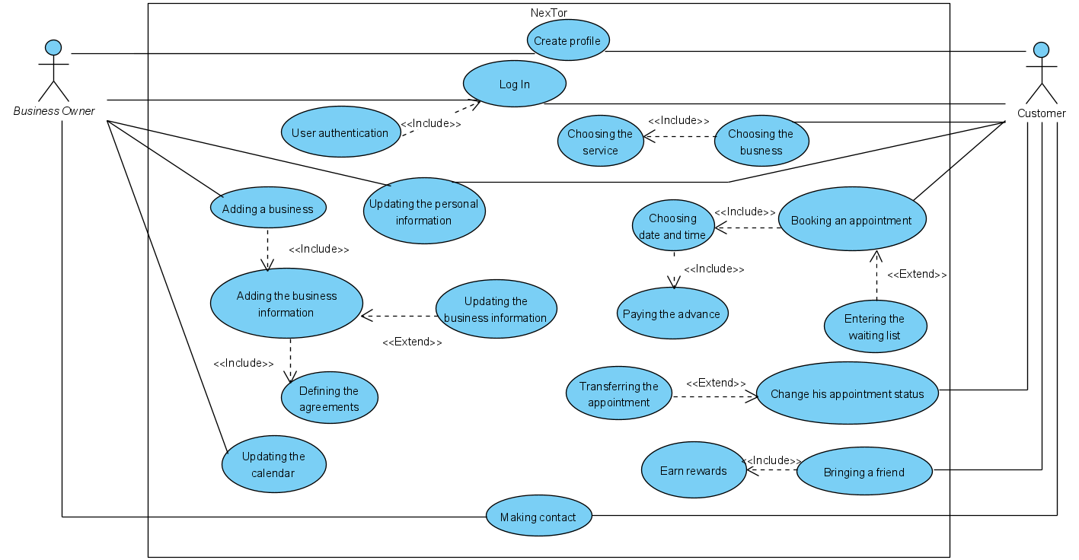
Use Case Diagram

Slide 12
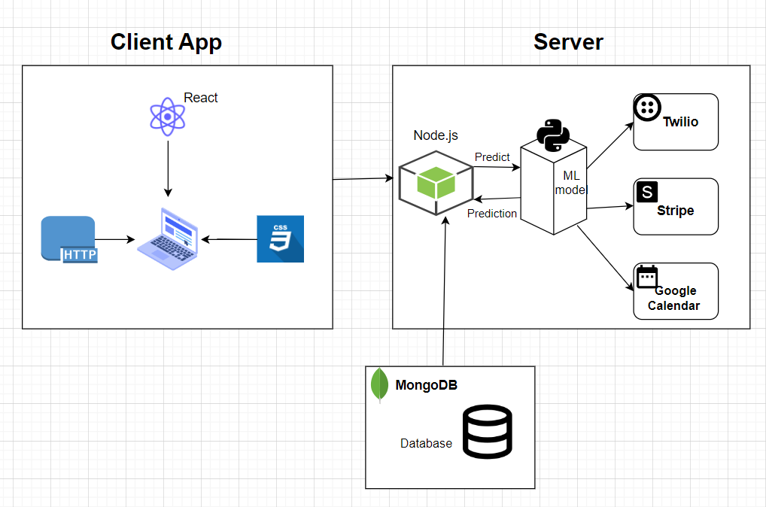
Architecture Diagram

Slide 13
GUI

Slide 14
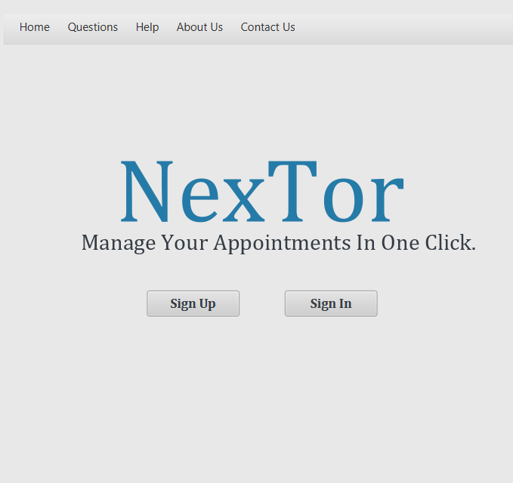
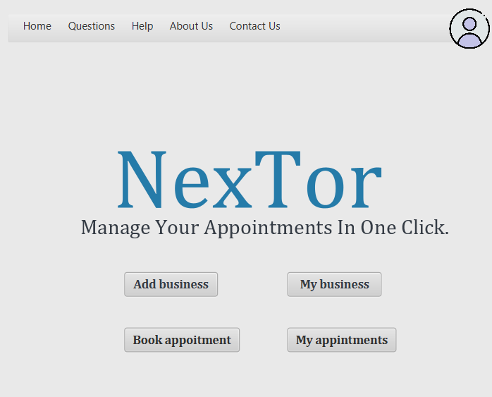
Home Screen

Slide 15
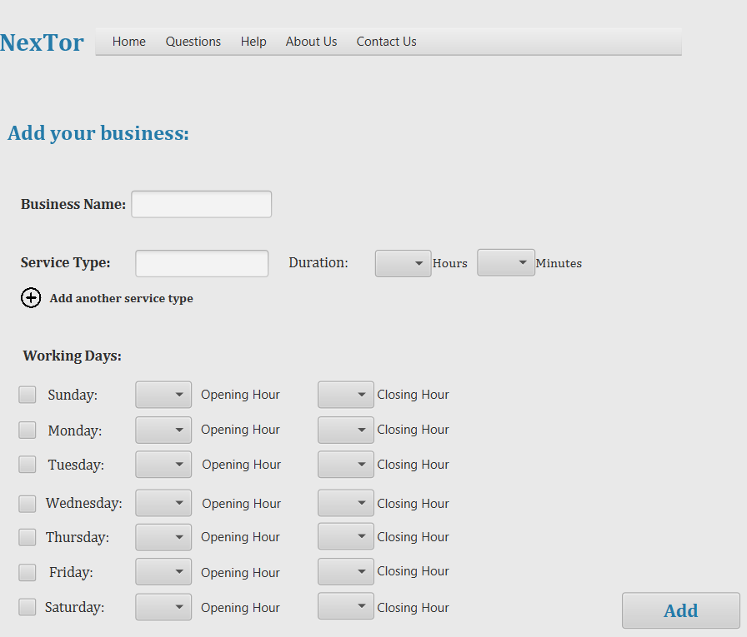
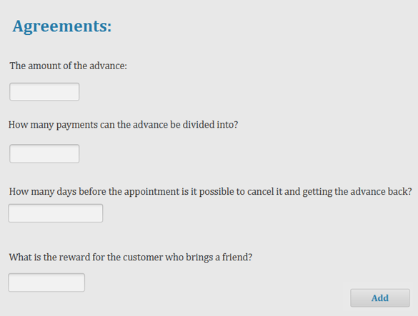
If the user chooses the “Add Business” button

Slide 16
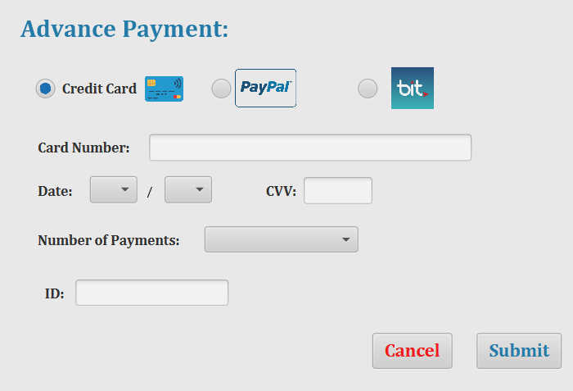
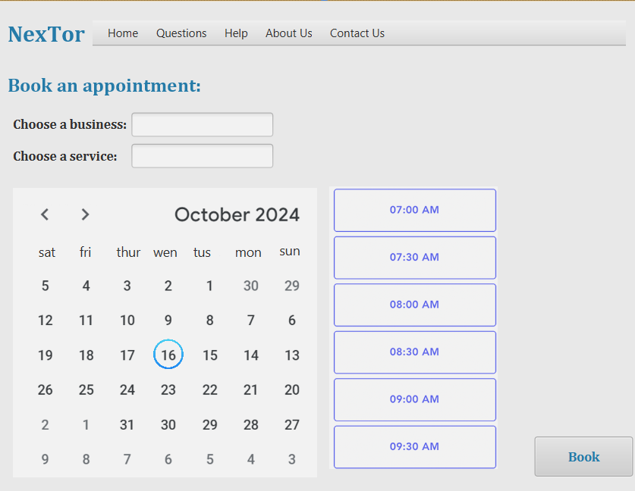
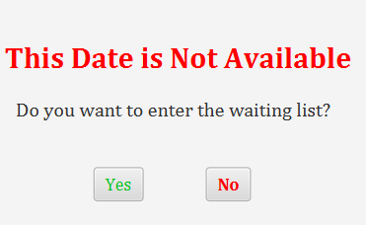
If the user chooses the “Book an Appointment” button

Slide 17
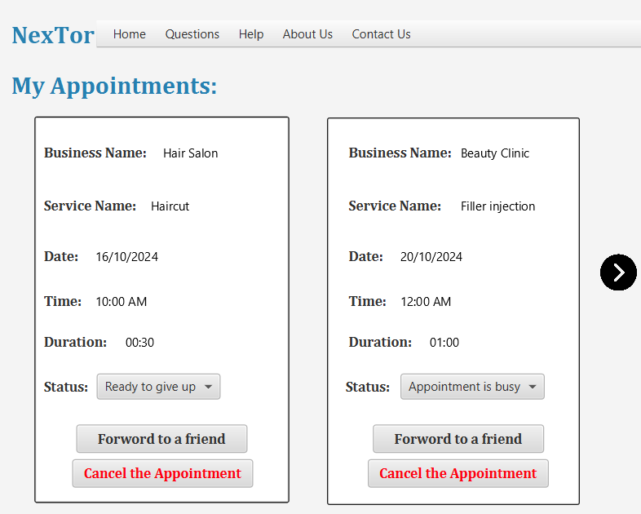
If the user chooses the “My Appointments” button

Slide 18
Testing

Slide 19
Expected Result | Test | No.
User account is successfully created, and a confirmation email is sent. | Test user registration with valid data. | 1
User successfully logs in and is redirected to the dashboard. | Test login with correct email and password. | 2
Appointment is successfully booked, and the customer receives a confirmation SMS. | Test booking an appointment. | 3
Customer is successfully added to the waitlist and is notified if an appointment becomes available. | Test adding a customer to the waiting list for unavailable date. | 4
Payment is processed, payment status is updated to "successful", and a digital receipt is sent to the customer. | Test successful payment using Stripe. | 5
Appointment is successfully transferred, and the new customer receives a confirmation message. | Test transferring an appointment to another user. | 6

Slide 20
Constraints
Managing sensitive customer data, especially payment details, adds complexity to development.
Scalability is crucial as the user base grows, especially for handling real-time transfers and notifications, but initial resources are limited.
Reliance on third-party APIs (e.g., Stripe, Twilio, Google Calendar) poses a risk to platform reliability, necessitating fallback plans and careful integration.
The platform must remain adaptable to different business models and appointment workflows without making the system overly complex.

Slide 21
Thank You

