Slide 1
SQL Lighting Talk
By: Rawan Almobarak

Slide 2

What is SQL?
domain specific computer language
Used to access and manipulate databases

Slide 3
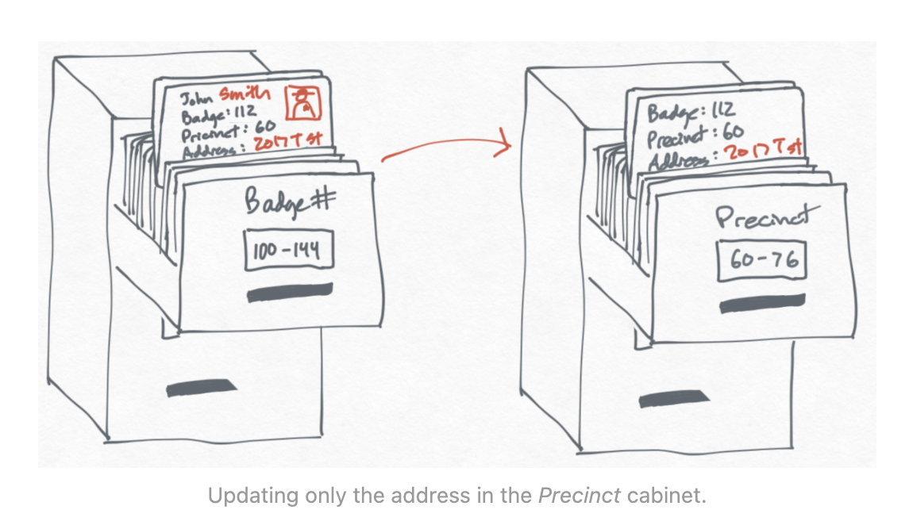
Filing Cabinet Analogy

Slide 4





Companies that require SQL knowledge

Slide 5
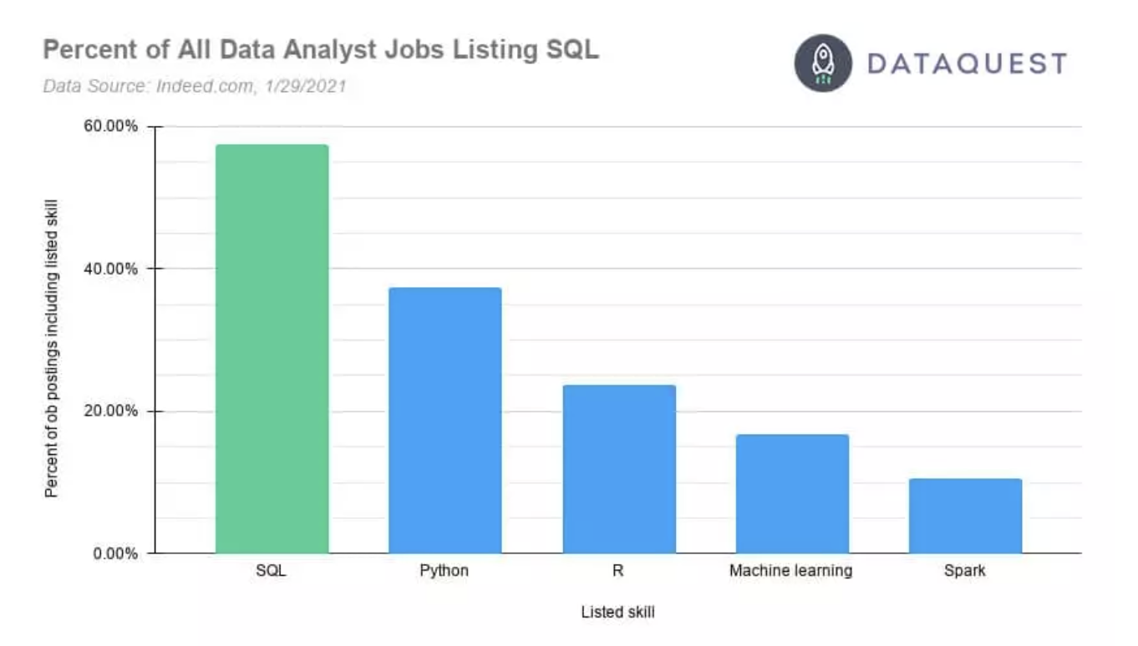

Slide 6
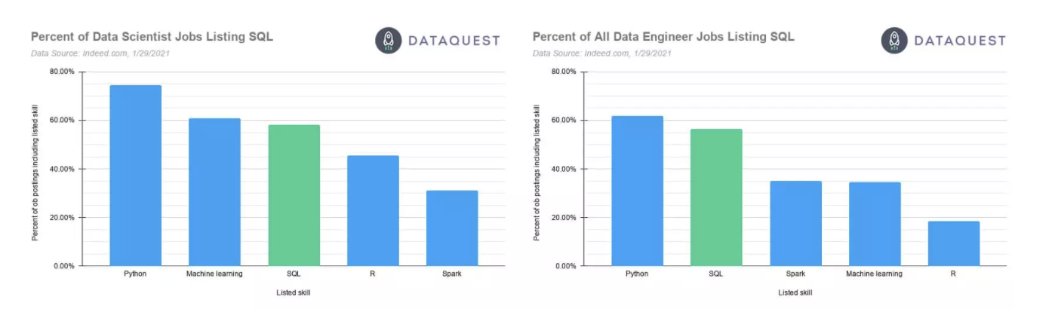

Slide 7




SQL dialects
SQL Server
PostgreSQL
MySQL
SQLite

Slide 8
Learn SQL
https://www.codecademy.com/learn/learn-sql
https://www.datacamp.com/onboarding/learn?technology=sql

Slide 9
Demo
Connect mySQL to Python
SQL Commands

Slide 10
Resources
https://www.w3schools.com/python/python_mysql_getstarted.asp
Filing Cabinet Analogy https://ccorcos.github.io/filing-cabinets/
https://www.dataquest.io/blog/why-sql-is-the-most-important-language-to-learn/

