Slide 1
Capstone Project:
Analytical CRM Development for a Bank
Tech Stack Used : EXCEL,SQL,POWER BI
Made by : Dhirender Singh Rawat
Batch : Dec,2023

Slide 2
Introduction
Analytical Customer Relationship Management (CRM) is pivotal in modern banking, harnessing data insights to drive personalized experiences and strategic decision-making.
Purpose of Document
This document outlines the development of Analytical CRM for banks, focusing on its implementation strategies, benefits, and challenges.
Significance
Understanding Analytical CRM role empowers banks to enhance customer satisfaction, optimize operations, and gain a competitive edge in the dynamic financial landscape.

Slide 3
Problem Statement
You are an analytical CRM (Customer Relationship Management) specialist hired by a bank to extract meaningful insights from various customer-related datasets. The bank aims to reduce customer churn, improve service delivery, and enhance customer satisfaction. They have provided you with datasets including customer demographics, transaction details, customer exit information, and active customer profiles.

Slide 4
Data Overview
RowNumber: The row number in the dataset, likely used for reference or indexing.
CustomerId: A unique identifier for each customer.
Credit Score: A numerical representation of the customer's creditworthiness.
Credit score:
Excellent: 800–850
Very Good: 740–799
Good: 670–739
Fair: 580–669
Poor: 300–579
Geography ID: A numerical identifier that likely corresponds to a geographical location, such as a country or region.
GenderID: A numerical identifier for the customer's gender, where for example, '1' could represent male and '2' could represent female.
Age: The age of the customer.
Tenure: The number of years the customer has been with the bank.
Balance: Current balance in the customer's account.

Slide 5
Data Overview
Num Of Products: refers to the number of products that a customer has purchased through the bank.
HasCrCard: denotes whether or not a customer has a credit card. This column is also relevant, since people with a credit card are less likely to leave the bank.
1 represents credit card holder
0 represents non credit card holder
IsActiveMember: active customers are less likely to leave the bank (as per the criteria defined by the bank for identifying the activeness).
1 represents Active Member
0 represents Inactive Member
Estimated Salary: as with balance, people with lower salaries are more likely to leave the bank compared to those with higher salaries.
Exited: whether or not the customer left the bank.
0 represents Retain
1 represents Exit
Bank DOJ: date when the Customer associated/joined with the bank.

Slide 6
Agenda
Count of Customer vs Year
Sum of Estimated Salary vs Year
Credit Score vs Num Of Product
Sum of Balance vs Tenure
Analysis graphs Based on Exited or Not Exited Customer
Analysis Visuals Based On Active and Not Active Customer
Analysis Visual Based on Gender
Analysis Visual Based on Country
Analysis Visual Based on Time Span
DashBoard

Slide 7
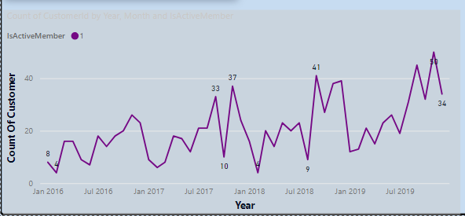
Count Of Customer vs Year
No of Customer is increased year by year ,which is good sign for bank to retain customer and sell products

Slide 8
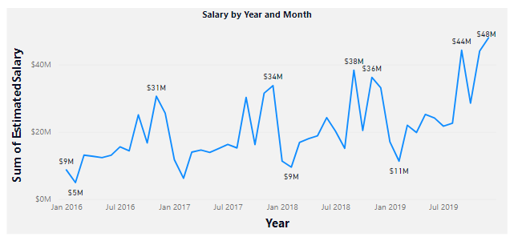
Sum Of Estimated Salary vs Year
Sum of Estimated Salary is increased year by year ,which is good sign for Bank to sell product through new scheme and rewards .

Slide 9
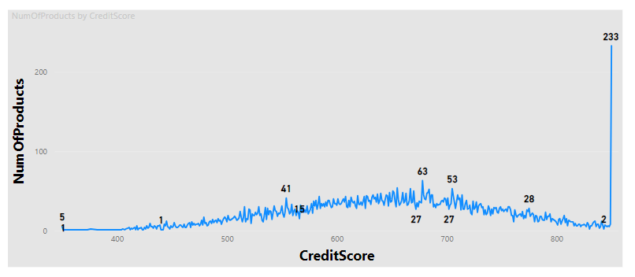
Credit Score vs Num Of Product
A Customer who have credit between 650 to 750 purchase maximum no of product.

Slide 10
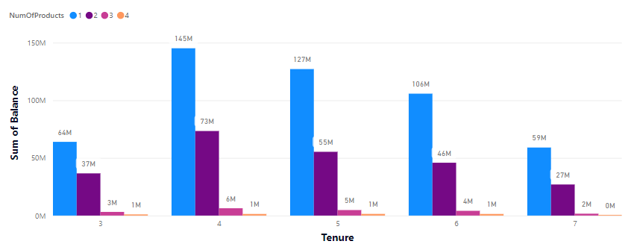
Sum Of Balance vs Tenure
A customer who is at tenure 4 have maximum no of product in bucket.

Slide 11
Conclusion
Customer Dynamics: Monitoring customer count trends guides growth strategies and acquisition efforts.
Financial Health and Behavior: Understanding salary, credit score, and balance dynamics aids in risk assessment and targeted marketing.
Retention and Engagement: Segmenting customers by activity and exit status informs retention strategies and personalized re-engagement campaigns.
Demographic and Geographic Trends: Analysis by gender and country enables tailored marketing and service initiatives to diverse customer segments.

Slide 12
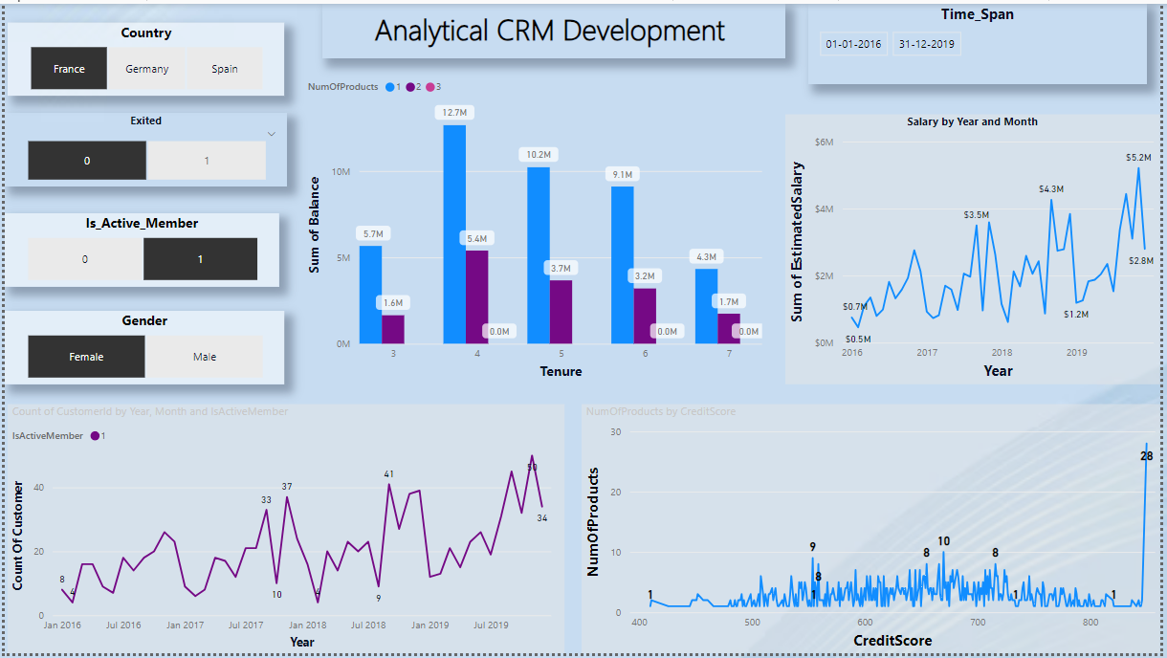
Dashboard

