Slide 1
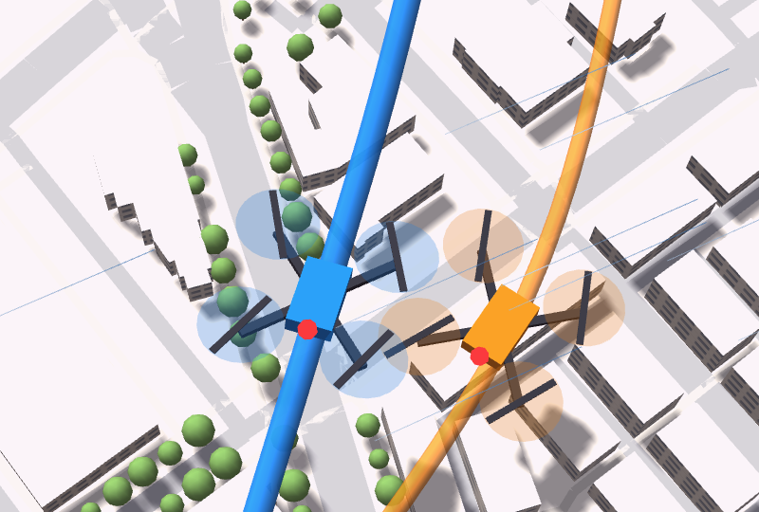
CorridorIQ
Wind-aware drone corridors: plan flights, size the airspace and dispatch traffic using live weather and real city buildings
How it works · User guide
Notes:
CorridorIQ is the product version of the three research papers: wind-aware routing, the shared-intent reservation corridor, and rolling-horizon dispatch. This deck explains how it works and how to use it.

Slide 2
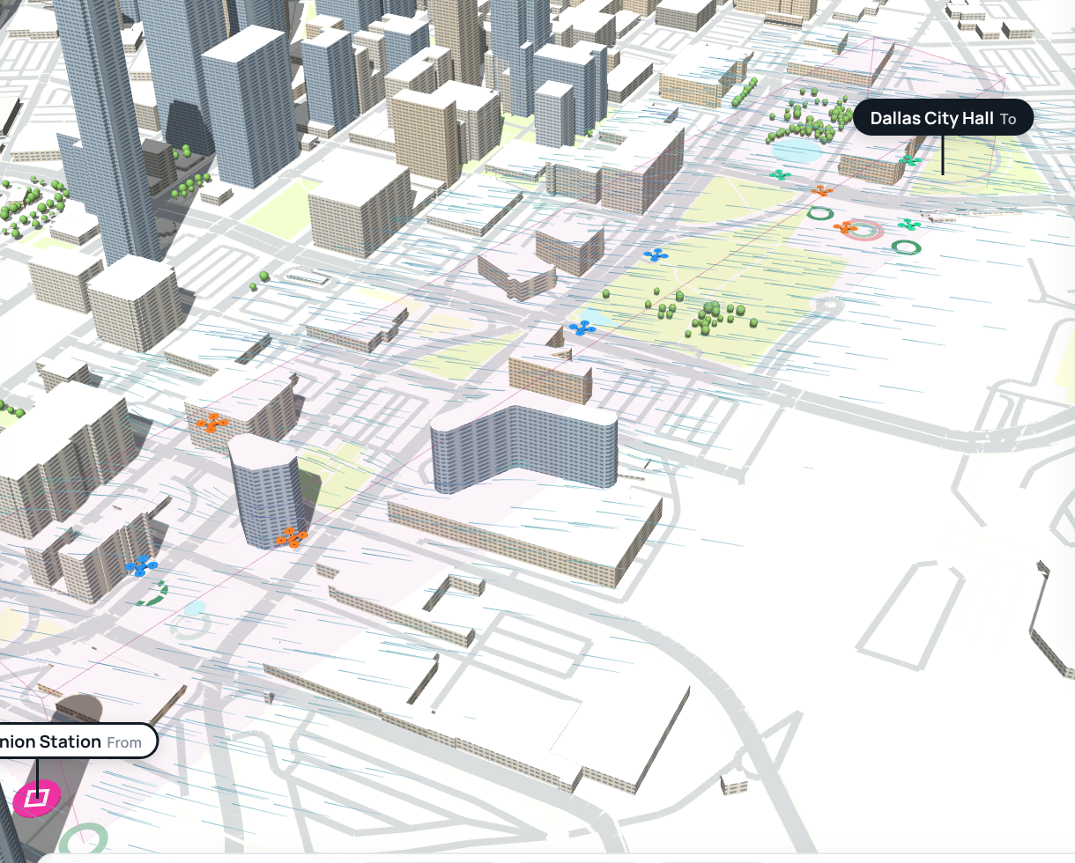
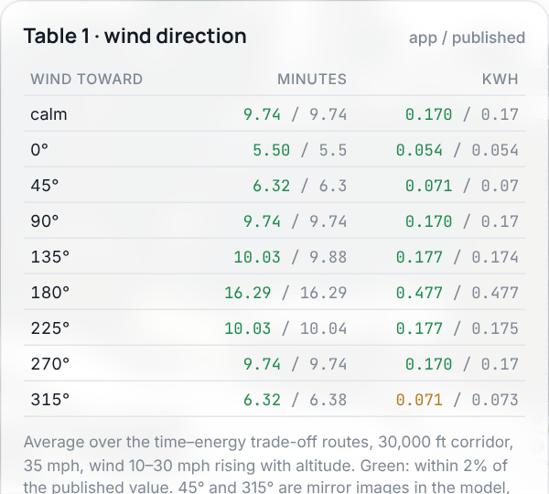
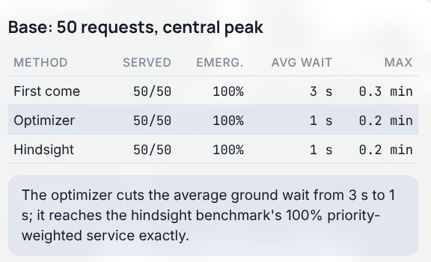
Four screens, four decisions
Plan flights
Corridor capacity
Dispatch
Validation
Which route, altitude and departure time use the least time and energy in today's wind?
How many flights per hour can a corridor approve, and how big must it be?
When should each flight leave, and which path, when requests have different priorities?
Does the app reproduce the published research results?
Used by Drone operators
Used by FAA, city and airspace planners
Used by Fleet and vertiport operations
Used by Researchers, reviewers, investors
Notes:
Each screen answers one decision. Plan flights is paper 1 (wind-aware routing). Corridor capacity is paper 2 (shared-intent reservation). Dispatch is paper 3 (rolling-horizon scheduling). Validation re-runs the published experiments.

Slide 3
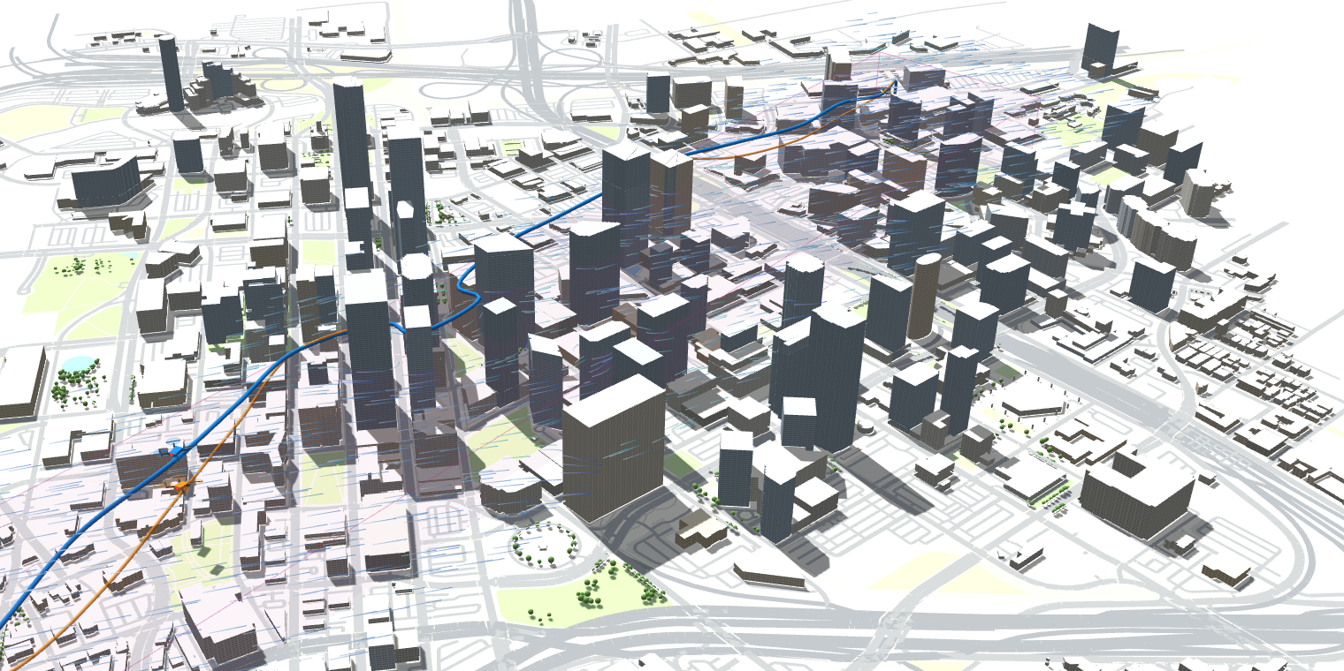
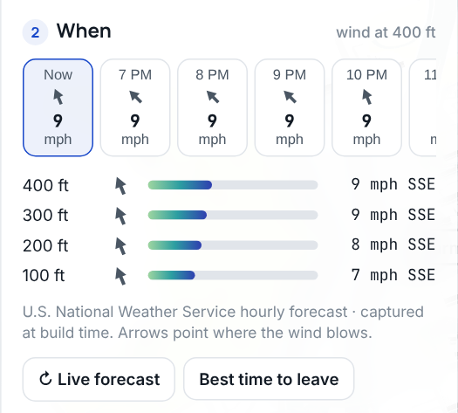
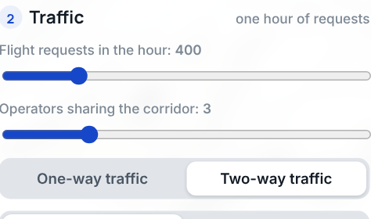
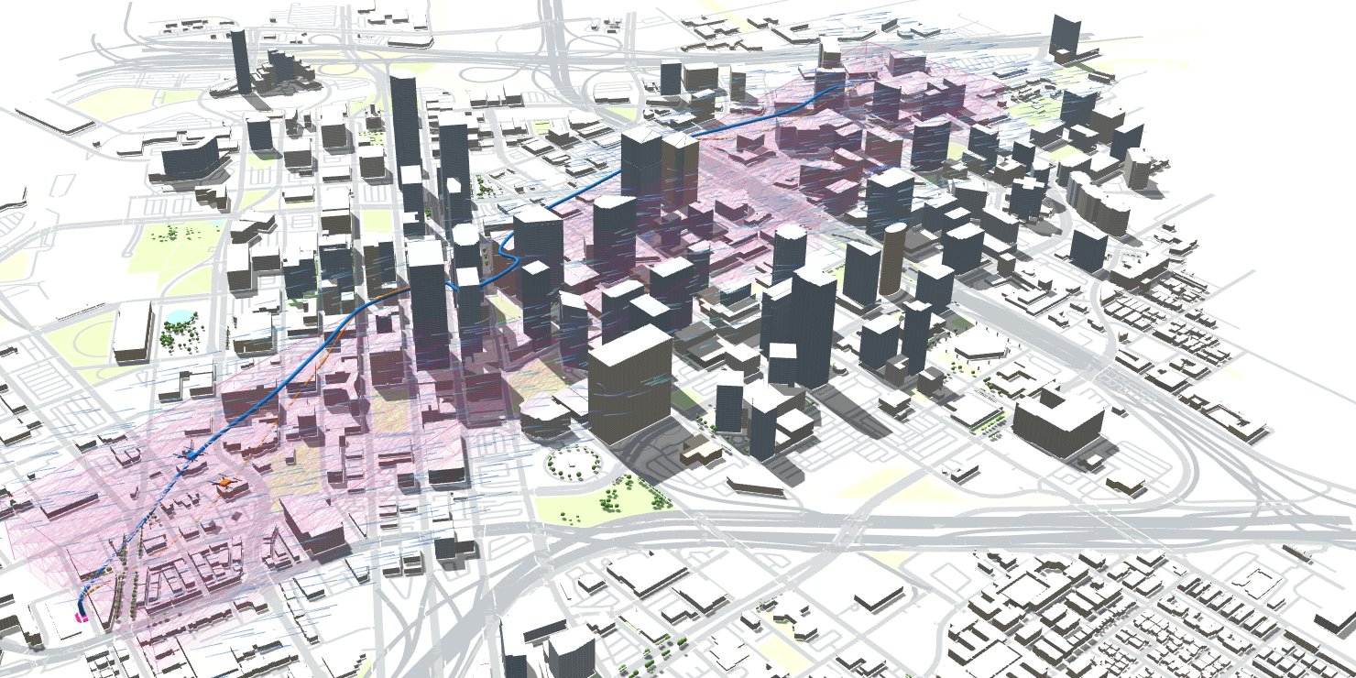
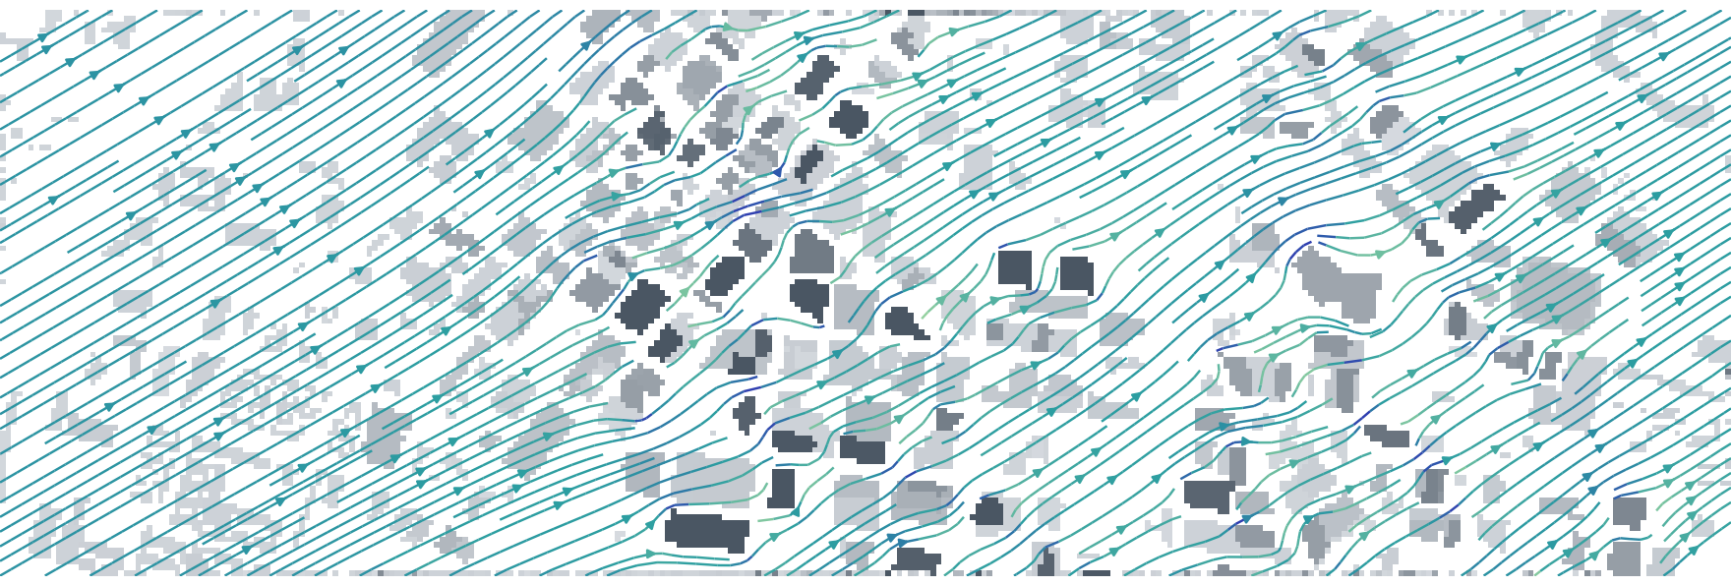
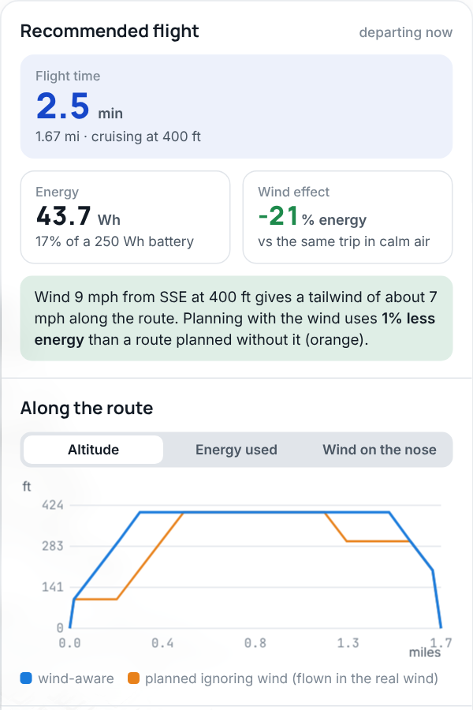
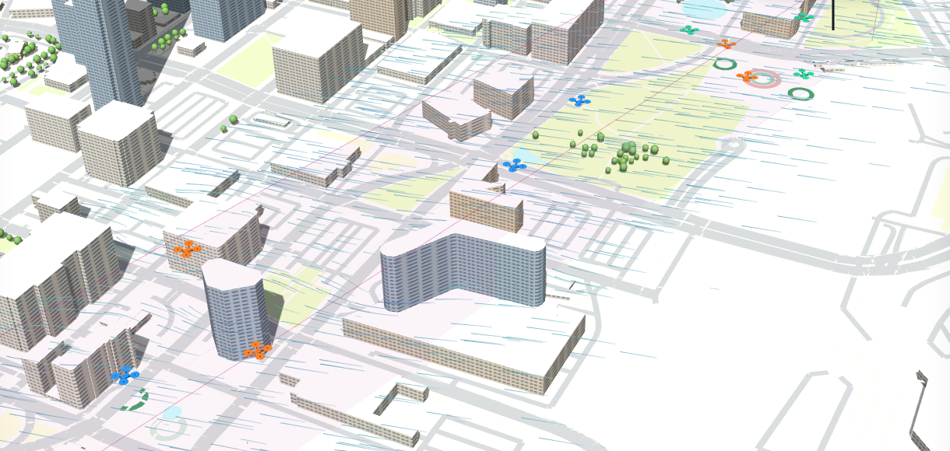
How CorridorIQ works
Inputs
✕
search a place
or click the map
From and To (any place)
Buildings · OpenStreetMap
Wind forecast by altitude
Traffic: requests, operators
Flight planning (Paper 1)
Answers
Flight time
Energy & battery
Cruise altitude
% approved
Wait times
CSV files
1 Corridor around buildings
2 Wind around buildings
3 Best route: time vs energy
Traffic management (Papers 2 and 3)
No two flights share a link at the same time.
Fair access across operators; emergencies first.
4 Book or deny each request
5 Priority dispatch schedule
Notes:
Read top to bottom. Inputs: the From and To places, OpenStreetMap buildings and places, the hourly wind forecast at four heights, and the traffic you want to test. Flight planning: the app lays a 3D corridor of lanes and altitude layers between the two places and removes every link that would hit a building; it computes how the wind flows around the buildings at each altitude; then it searches every route for the best trade-off between flight time and energy. Traffic management: the shared-intent registry books each request on free link-time slots or denies it; the rolling-horizon optimizer schedules prioritized requests. Output: time, energy, altitude, approvals and waits, all exportable as CSV.

Slide 4
What is live, and what is a snapshot
DATA
WHAT IT CONTAINS
SOURCE
HOW FRESH
Wind forecast
Hourly wind at 33, 262, 394 and 591 ft for the next 24 h
Open-Meteo (U.S. National Weather Service as backup)
Captured when the app is built. Live when you open the file from your computer and press Live forecast
Buildings and places
Footprints, heights, roads, parks, named places
OpenStreetMap
Snapshot of the area. Load any other area with Change area
Routes, wind around buildings, capacity
Every number on Plan flights and Corridor capacity
CorridorIQ engine in your browser
Computed live, in about 1 second per route, every time you click
Dispatch schedules
First come vs optimizer vs hindsight
Optimizer run in Python
Pre-computed scenarios replayed in the app
Notes:
The app is live in the calculations: each click re-plans routes and re-simulates traffic in the browser. Weather is a real forecast; the shared web copy uses the forecast captured when it was built, because hosted pages may not call outside services. Opened from disk, the Live forecast button pulls the current Open-Meteo forecast for the area. Buildings are an OpenStreetMap snapshot.

Slide 5
User guide
Plan a flight, read the answer, size a corridor, replay dispatch, export results

Slide 6
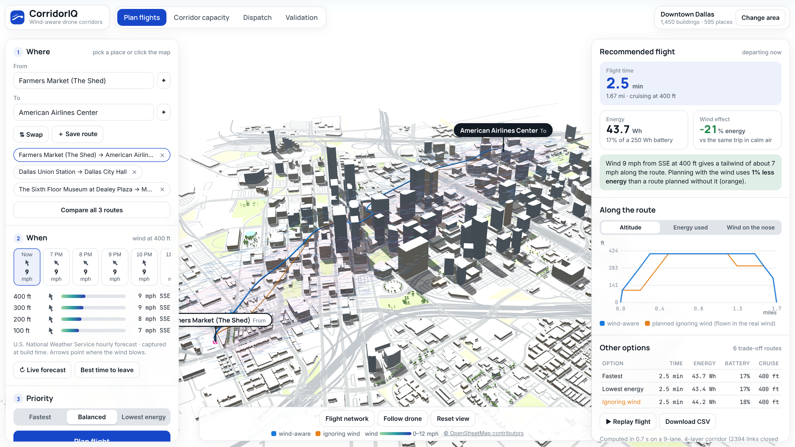
Plan a flight in four steps
1
Where
Type a place in From and To, or press ⌖ and click the map. Save routes to compare them later.
1
2
When
Pick a departure hour. The card shows the forecast wind at 100–400 ft.
2
3
Priority
Fastest, Balanced or Lowest energy, then press Plan flight.
3
4
Watch
The blue drone flies the wind-aware route; the orange drone ignores the wind. Use Follow drone.
The map: buildings and places come from OpenStreetMap; streaks show the wind at the cruise altitude.
Notes:
Orange numbers on the screenshot match the steps on the right.

Slide 7
Reading the answer
Flight time
door-to-door, including climb and descent
Energy
watt-hours and % of a 250 Wh battery (editable in Settings)
Wind effect
energy change against the same trip in calm air
Savings
how much less energy than a route planned without the wind
Wind by altitude. Arrows point where the wind blows; bars show speed.
Along the route
altitude, energy used and head/tailwind mile by mile
Other options
every trade-off route: faster or more efficient
Notes:
The recommended route depends on the priority setting. The orange 'ignoring wind' row is what an operator gets if they plan as if the air were calm and then fly in the real wind.

Slide 8
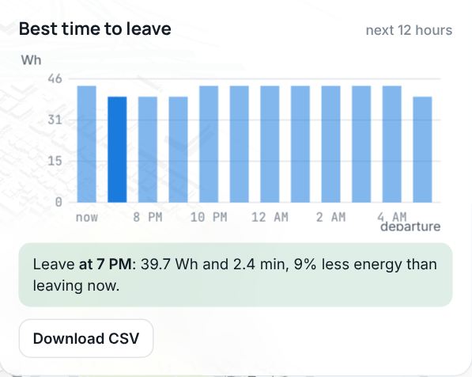
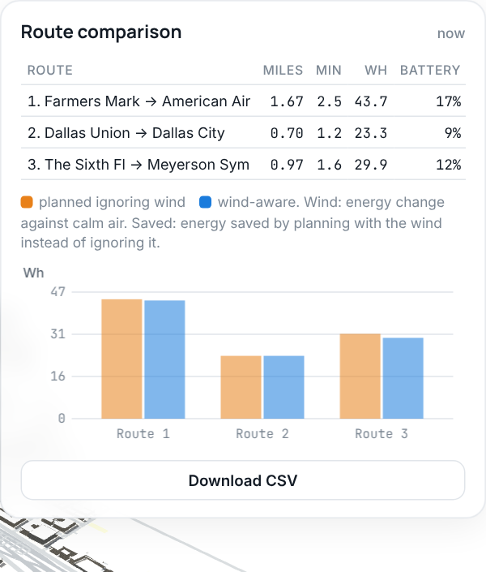
Pick the best departure time and compare routes
Best time to leave re-plans the trip for each of the next 12 forecast hours and highlights the lowest-energy hour.
Compare all routes plans every saved From → To pair at once: miles, minutes, Wh, battery, and the energy saved by using the wind.

Slide 9
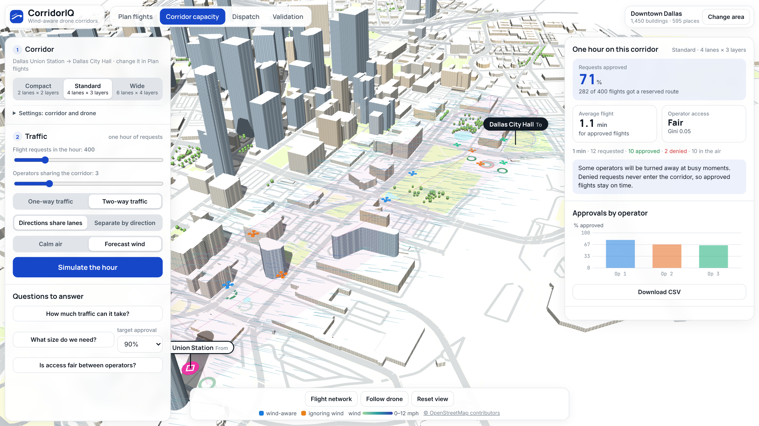
Corridor capacity: simulate one hour of traffic
1
Size
Compact, Standard or Wide (lanes × altitude layers), or set your own in Settings.
2
Traffic
Requests per hour, 1–10 operators, one- or two-way, calm or forecast wind.
3
Simulate the hour
Drones fly their booked routes; green rings are approvals, red rings denials.
4
Read
% approved, average flight time, and whether access is fair between operators.
Denied requests never enter the corridor, so every approved flight keeps its reserved, conflict-free route.

Slide 10
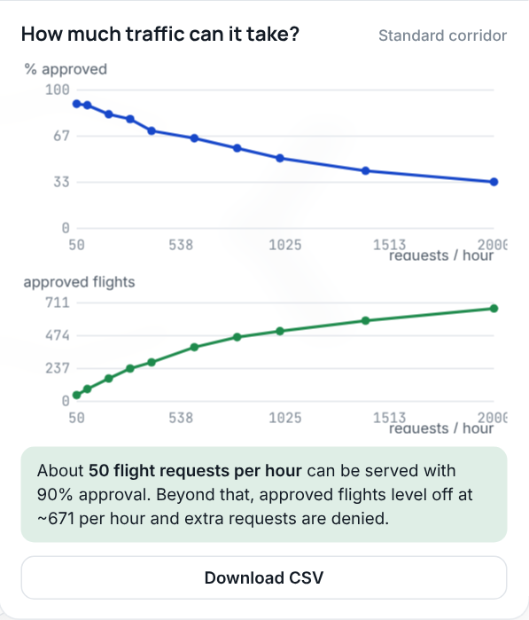
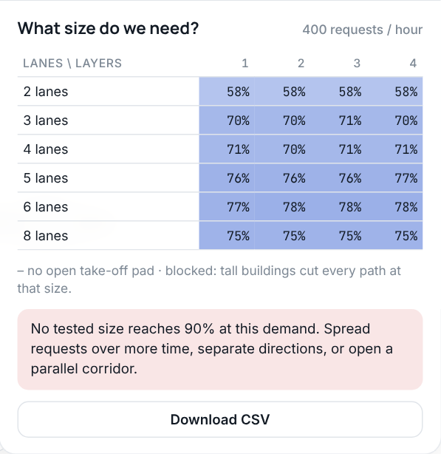
Ask the planning questions
Is access fair?
When the corridor is busy, the order of same-minute requests decides who flies. The app compares today's rule (operator ID) with a lottery and rotating priority.
Direction separation
With balanced two-way traffic, giving each direction its own lanes raised approvals from 44% to 72% at 2,000 requests in the published study.
How much traffic can it take?
What size do we need?
Sweeps 50–2,000 requests per hour and reports the demand served at 90% approval.
Tests 2–8 lanes × 1–4 layers and recommends the smallest corridor that meets the target. One click applies it.
Notes:
These screenshots use Dallas Union Station to Dallas City Hall. Through the tallest downtown towers fewer sizes connect, and the size table marks those cells 'blocked'.

Slide 11
Dispatch: priorities and waiting time
1
Choose a scenario
Load, single path, demand peaks, headwind.
2
Pick a method
First come, optimizer or hindsight.
3
Replay the hour
The board shows when each flight may leave and when it flies.
Notes:
All flights were served in every scenario shown (100% priority-weighted service). The optimizer matches the hindsight benchmark on these four. In the 100-request scenario (not shown) the optimizer's priority-first rule gives a higher average wait than first come (30 s vs 23 s) and the hindsight run hit its solver time limit; see Limits.

Slide 12
Why wind-aware planning matters (downtown Dallas)
25%
less energy in headwinds
9%
less energy on average across all 72 missions
11%
extra energy when the planner ignores wind
Notes:
From results/geo/summary.csv: missions between Dallas Farmers Market and the American Airlines Center, planned on the building-aware wind field and flown in it. Headwind: 30.65 vs 23.06 Wh/km is 25% less. Overall the wind-aware plan saves 8.9% against a wind-agnostic plan, and a wind-agnostic plan uses 11.3% more energy than the best possible.

Slide 13
Validated against the published papers
Wind-aware routing, Table 1: app values next to published values for every wind direction. Green = within 2%.
Shared corridor: the same registry logic gives identical approve/deny decisions to the research code on 2,000 requests.
Notes:
The Validation screen re-runs these in the browser. The 45° and 315° rows of Table 1 are mirror images in the model, so the app gives the same value for both; the paper lists 6.30 and 6.38 min.

Slide 14
Getting results out
corridoriq_flight.csv
corridoriq_departure_times.csv
Plan flights: each option: minutes, Wh, battery %, cruise ft, miles
Best time to leave: per hour: minutes, Wh, wind at 400 ft
corridoriq_routes.csv
corridoriq_capacity_run.csv
Compare all routes: per From → To: miles, minutes, Wh, wind effect, savings
Simulate the hour: every request: operator, time, approved, flight minutes
corridoriq_capacity_curve.csv
corridoriq_corridor_size.csv
How much traffic: requests/hour vs % approved, flights, fairness
What size do we need: lanes × layers vs % approved
corridoriq_dispatch.csv
Every result panel has a Download CSV button. The same numbers can be produced from the Python package for papers (run_*.py scripts).
Dispatch: each flight: priority, departure, arrival, wait

Slide 15
Who uses it for which decision
1
2
3
Drone operators
FAA and airspace authorities
Cities and vertiport planners
Pick the route and altitude for today's wind
Choose the departure hour that saves battery
Check battery margin before dispatch
Size a corridor for expected demand
Decide one-way, two-way or separated lanes
Check fair access between operators
Test corridors between real places
See which towers block which routes
Compare dispatch rules for priorities

Slide 16
Limits today, and what comes next
Wind around buildings
Building heights
Next steps
A fast estimate of how wind flows around footprints, not a full CFD simulation. Good for comparing routes, not for certifying them.
From OpenStreetMap. Where a height is missing it is estimated from floor counts or building type.
Live dispatch service (optimizer on a server)
More cities: load any OpenStreetMap area
Measured wind (weather stations, drone logs) to calibrate
Pilot with one operator and one corridor
Weather freshness
Dispatch
The shared web copy uses the forecast captured when it was built; the downloaded file fetches the live forecast.
Optimizer scenarios are pre-computed in Python and replayed; at 100 requests it trades a longer average wait for priority service.

