Slide 1

Action & Sports Lead Global Sales: Strategic Insights for Market Expansion
STRATEGIC INSIGHTS FOR FUTURE INVESTMENTS

Slide 2




EXECUTIVE SUMMARY
What Happened
Why it Happened
Next Steps
Global sales reached $35,281 across 11,360 games. Market leaders like Wii Sports and GTA V demonstrate the power of established franchises and innovation in capturing global demand.
Success is driven by exclusive platform strategies and strong regional performance. North America remains the primary engine, followed by Europe and Japan, reflecting diverse consumer behaviors.
Strategically target high-growth regional markets and prioritize investment in consistently profitable genres like Action and Sports to mitigate risk and optimize returns.

Slide 3

OBJECTIVE
Identifying Profitable Genres and High-Growth Regional Markets to inform strategic investments and maximize returns.

Slide 4

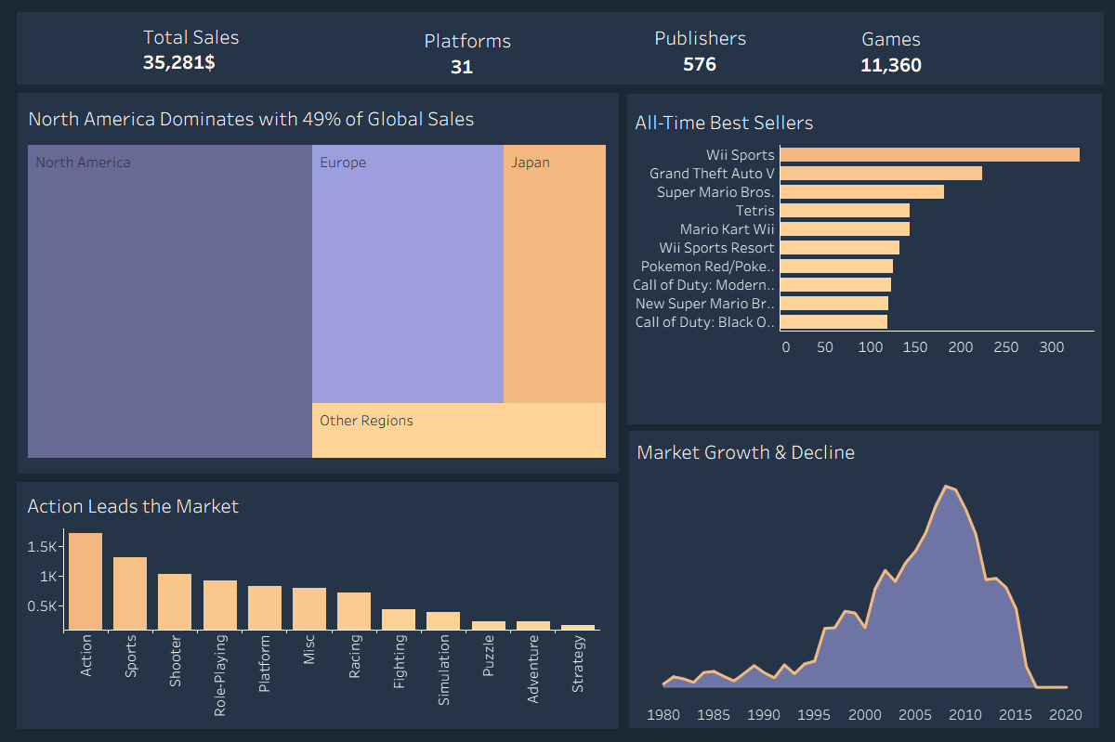
ANALYSIS 1: REGIONAL SALES
North America: The Primary Revenue Engine
North America consistently leads global video game sales, holding the largest market share. This dominance is driven by a mature consumer base and high disposable income.
KEY INSIGHTS
• Market Maturity: NA and Europe represent the most stable revenue streams. • Growth Potential: Japan remains a critical market for specialized genres. • Strategic Focus: Marketing efforts should prioritize the NA region for maximum ROI.

Slide 5
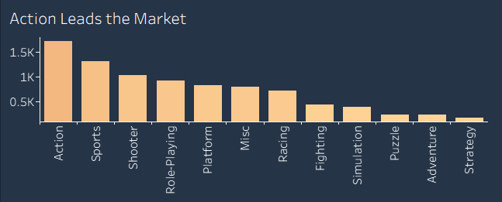
ANALYSIS 2: GENRE PERFORMANCE
Action and Sports: The Pillars of Consistency
Low Investment Risk
Action (1.6K titles) and Sports (1.2K titles) demonstrate robust sales and enduring appeal across all platforms.
Market Saturation vs. Demand
While highly competitive, these genres offer the most predictable returns due to established fan bases.
Strategic Takeaway
Prioritize development in Action/Sports while exploring high-growth niches like Shooters and RPGs.

Slide 6

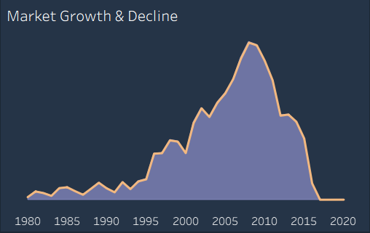
ANALYSIS 3: SALES TREND OVER YEARS
Identifying the Golden Era
The video game market reached its peak "Golden Era" around 2008-2009, fueled by seventh-generation consoles and massive global hits.
CURRENT TRAJECTORY
Since the peak, the market has transitioned toward digital distribution and live-service models, resulting in a consolidation of sales among top-tier franchises.

Slide 7

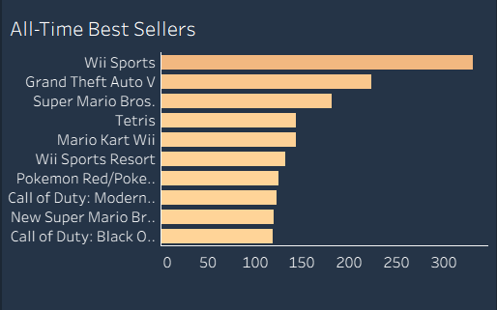
ANALYSIS 4:TOP-PERFORMING GAME TITLES
Dominance of Iconic Franchises
The market is concentrated in a few key franchises, with Nintendo leading through iconic titles like Wii Sports and Super Mario Bros. that have sustained long-term success.
STRATEGIC DOMINANCE
Nintendo maintains market dominance through iconic franchises, highlighting the power of strong brand recognition and long-term customer loyalty.

Slide 8
CONCLUSION & RECOMMENDATIONS
01
Market Expansion (Priority: High)
Focus efforts on North America (NA), as it accounts for 49% of total global sales. Allocate the majority of marketing and distribution budgets to this region to capitalize on its high revenue potential and mature consumer base.
02
Content Development (Strategic)
Prioritize Action and Sports genres, which together contribute over 33% of global volume. Invest in these high-demand categories to mitigate investment risk, as they show the most consistent sales performance.
03
Future Proofing (Long-term)
Adapt to post-peak market consolidation (after the 2009 peak). Focus on digital-first distribution and long-term franchise sustainability (like GTA or Mario) to maintain engagement in a market dominated by established titles.

Slide 9

STRATEGIC INSIGHTS FOR FUTURE INVESTMENTS
THANK YOU

