Slide 1
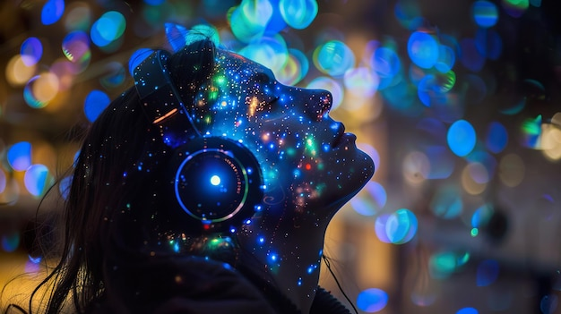
Dream KEEPER
“Capture the Unseen. Relive the Unbelievable.”
Team 5M (5 Miracles) :
Andip Chauhan
Gaurav Prakash Singh
Saif Siddiqui
Shivam Kumar Choudhary Rohit Indwar
Trainer :
Vidya M Purushotham

Slide 2
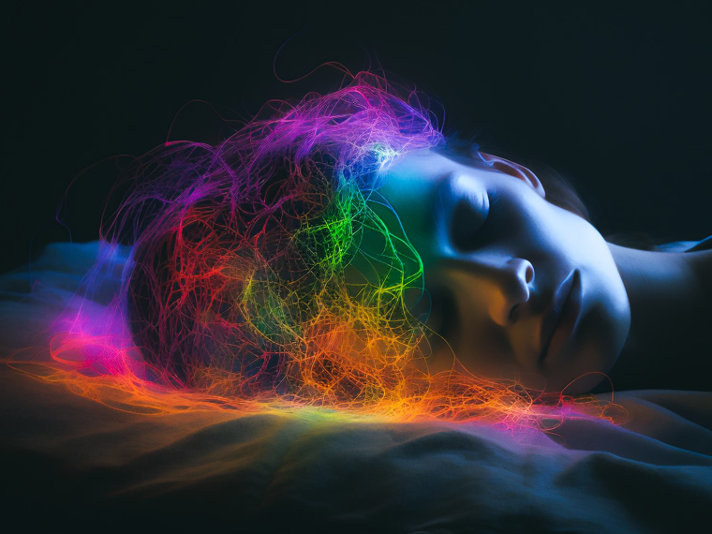
Problem Statement
Waking up and watching your dreams like a movie—sounds unreal! This technology is evolving and could reshape neuroscience, psychology, and entertainment. Would you try it?

Slide 3
How It Works
Capture : Sensors track dream activity.
Reconstruct : AI transforms neural signals into images or video.
Analyze : AI detects emotions, themes and symbols.
Reflect : Dreams are stored in a personal journal.
Interpret : Get expert-backend insights on what they mean.

Slide 4
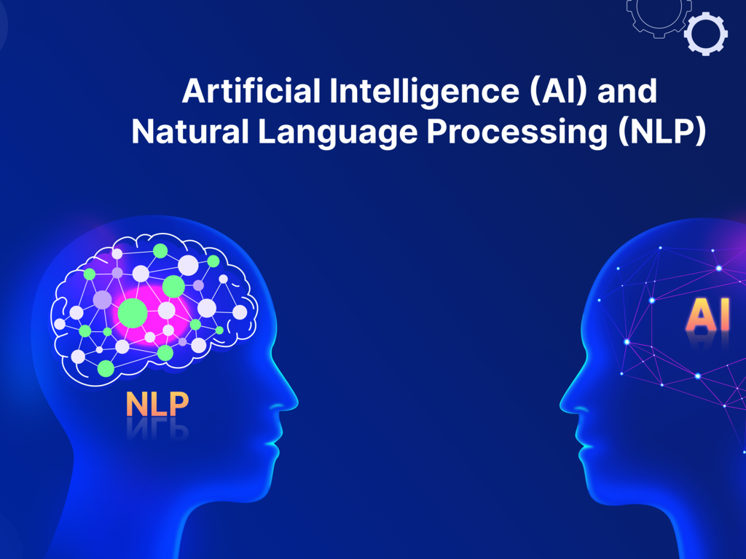
Solution Overview
Automatic Capture
AI Reconstruction
Smart Analysis.
Personal Dream Journal
Interactive Insights.

Slide 5

Key Features
Automatic Dream Capture .
AI Dream: Get Customized Dreams
Smart Analysis & Interpretation.
Personal Dream.
Interactive Insights.

Slide 6

Technology Stack
Brain Monitoring – EEG/fMRI sensors track neural activity.
AI Dream Reconstruction – Deep learning converts signals into visuals.
NLP Processing
Cloud Storage
Cross-Platform App.

Slide 7

Market Opportunity
Mental Health & Therapy
Sleep & Wellness Industry
Education & Self-Discovery
Memory & Cognitive Research
Entertainment & Creativity

Slide 8
Competitive Advantage
1. Unique combination of psychology, creativity, and AI
2. User-friendly interface and seamless experience
3. High accuracy in dream interpretation
4. Strong focus on user privacy and data security

Slide 9

Monetization Strategy
Freemium model, Contains ads only
Deep Dream Analysis
Community Sharing
Cloud Storage
Personalized Dream Coach

Slide 10
Conclusion
Keep a journal by your bed.
Immediate Access.
Helps unlock Good sleep
Review and analyze Through Charts
Keeps you Open Minded

Slide 11
Thankyou

