Slide 1
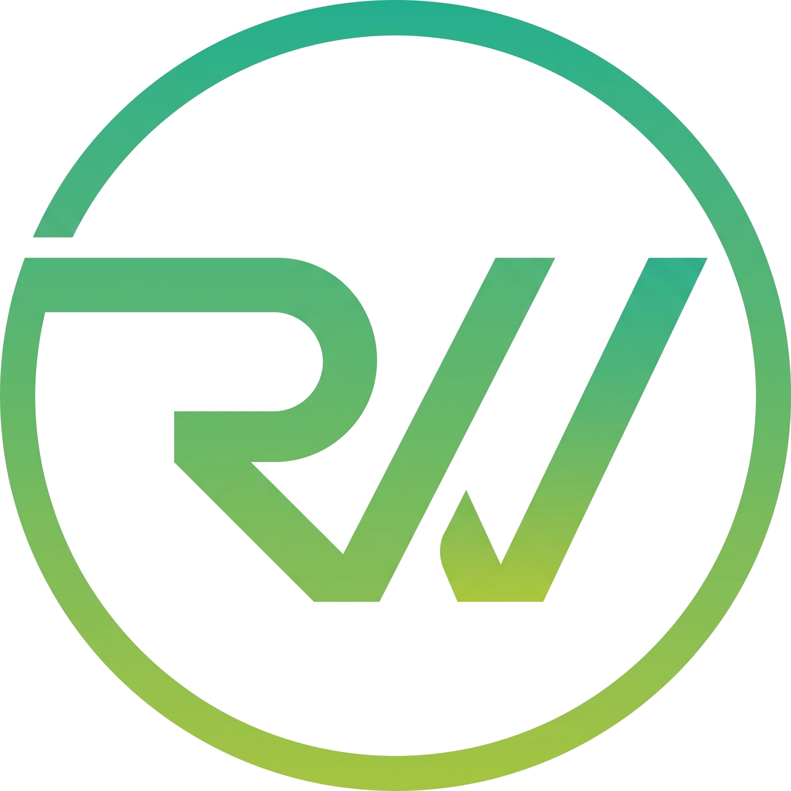
RAWINNIPA
COMPANY CV
Software and Consultants Company
VERSION 1.0 / APRIL 2026
Build what moves.
Design, analysis, and development of technology solutions — tailored to your business, built to last.
12+
50+
8
5
YEARS OF
SYSTEM DELIVERY
PROJECTS
SHIPPED
INTERNATIONAL
AWARDS
CORE SERVICE
PRACTICES
ABOUT
Rawinnipa is a Bangkok-based software and consulting team with over twelve years of experience delivering production systems across fintech, Web3, enterprise AI, education, and manufacturing. We partner with clients to design, build, and operate software that holds up long after launch day — and we've collected a few international awards along the way for the work we do on blockchain and decentralized infrastructure.
WHAT WE DO
01
Blockchain & Web3
02
AI & Automation
Layer 1/2 chains, smart contracts, DEX, oracles, bridges, NFT marketplaces.
AI agents, LLM workflows, Computer Vision, n8n automation, enterprise AI integration.
03
Application Development
04
UX/UI & Systems Analysis
Web, mobile, LINE LIFF/Beacon, Telegram Mini Apps.
User-centered design, system architecture, requirements engineering.
05
Consulting & Training
Architecture planning, AI transformation workshops, technical enablement.
sayhi@rawinsoft.com · rawinsoft.com · +66 98 265 9690
RAWINNIPA / COMPANY CV / V 1.0
1 / 2

Slide 2
RAWINNIPA / COMPANY CV
PAGE 2
SELECTED WORK
Eight projects spanning blockchain, AI, enterprise systems, and hardware integration.
MaxiChain
BLOCKCHAIN
BKCOracle
BLOCKCHAIN
EVM Layer-1 network for Maxion's game platform — block explorer, bridge, DEX, faucet.
Oracle system on Bitkub Chain delivering price feeds and verifiable randomness on-chain.
GoodGeek
WEB PLATFORM
Zchoolmate
ENTERPRISE
Thai crowdfunding platform connecting thinkers and builders with their supporters.
Complete school management system — attendance, cafeteria POS, grading, enrollment, finance.
Carbon Audit
AI / ENTERPRISE
Mattress Defect AI
COMPUTER VISION
AI-powered carbon accounting — automated data entry and emissions calculation.
Custom-trained model detecting manufacturing defects, deployed to quality-control line.
Digital Twin Andaman
GOV / TOURISM
Khaya
AI / LINE
In-depth tourism analytics platform for the Andaman provinces with geospatial data.
LINE chatbot identifying waste types from photos using AI-powered image recognition.
RECOGNITION
ETHGlobal Bangkok 2024
Blockscout Big Pool · Chronicle Protocol
ETHGlobal Singapore 2024
Chainlink · Metamask/Linea · Worldcoin
ETHGlobal Istanbul 2023
Chiliz · Scroll · Waku · Gnosis
CERTIFICATIONS
CompTIA Security+ · (ISC)² Certified in Cybersecurity · NCSA Thailand Cybersecurity Professional · ICT Mahidol Web App Pen-Testing
TECHNOLOGIES
Solidity
Ethereum
EVM Chains
Bitkub Chain
Smart Contracts
IPFS
Node.js
Python
React
Next.js
TypeScript
Flutter
LangChain
OpenAI API
Computer Vision
n8n
Make
Zapier
PostgreSQL
MongoDB
Redis
Kubernetes
Docker
AWS
LINE LIFF
Firebase
RAWINNIPA / COMPANY CV / V 1.0
2 / 2

