Slide 1

RAWINNIPA
Uniform Design
Four concepts for polo & crew-neck tee.
Polo
Crew Tee
4 Colors
4 Concepts
64 Mockups
Build what moves.
Rawinnipa Co., Ltd. · April 2026 · v1.0

Slide 2
Why refresh the uniform?
Turning our brand into something people wear.
01
02
03
Consistent presence
Earned, not loud
Built to last
When the team shows up at an event, client meeting, or office — the uniform tells one story. No accidental off-brand moments.
Most days, one small mark. On stage or at trade shows, the big-back logo does the work. Every concept dials in how loud the brand should be.
Embroidery-first approach, combed cotton, proper GSM. Built for 50+ washes — because a fading logo is a bad brand moment.
BUILD WHAT MOVES.
Rawinnipa Uniform Deck · v1.0
2 / 13

Slide 3
At a glance
Four concepts. Two garments. Four colors. Sixty-four finished mockups.
4
2
4
64
DESIGN CONCEPTS
GARMENT TYPES
SHIRT COLORS
UNIQUE MOCKUPS
Classic — chest logo + sleeve URL + inner-neck tagline.
Bold Back — chest logo + large embroidered back logo + tagline.
Gradient — signature 3-color stripe on the shoulder + hem tagline.
Typography — full RAWINNIPA wordmark on chest + stacked back slogan.
BUILD WHAT MOVES.
Rawinnipa Uniform Deck · v1.0
3 / 13

Slide 4
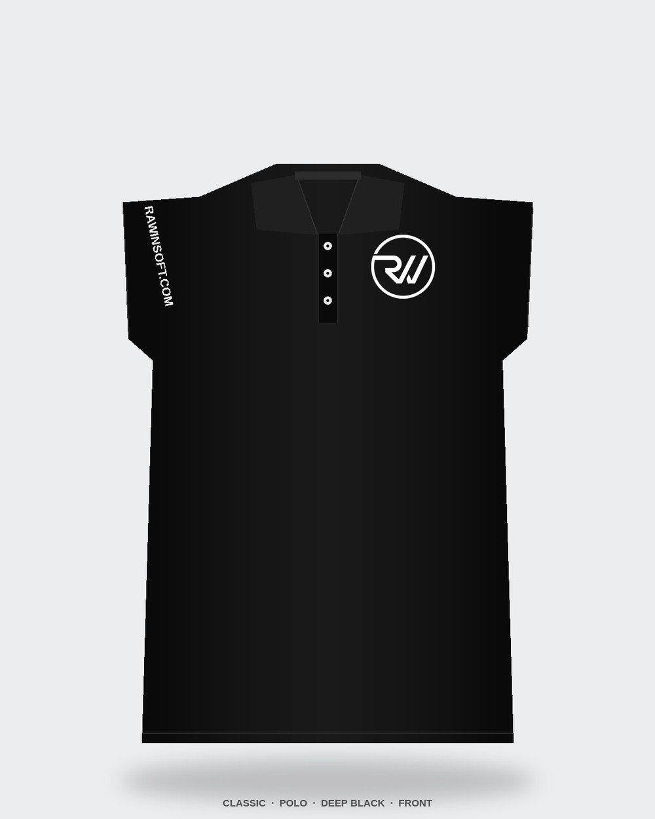
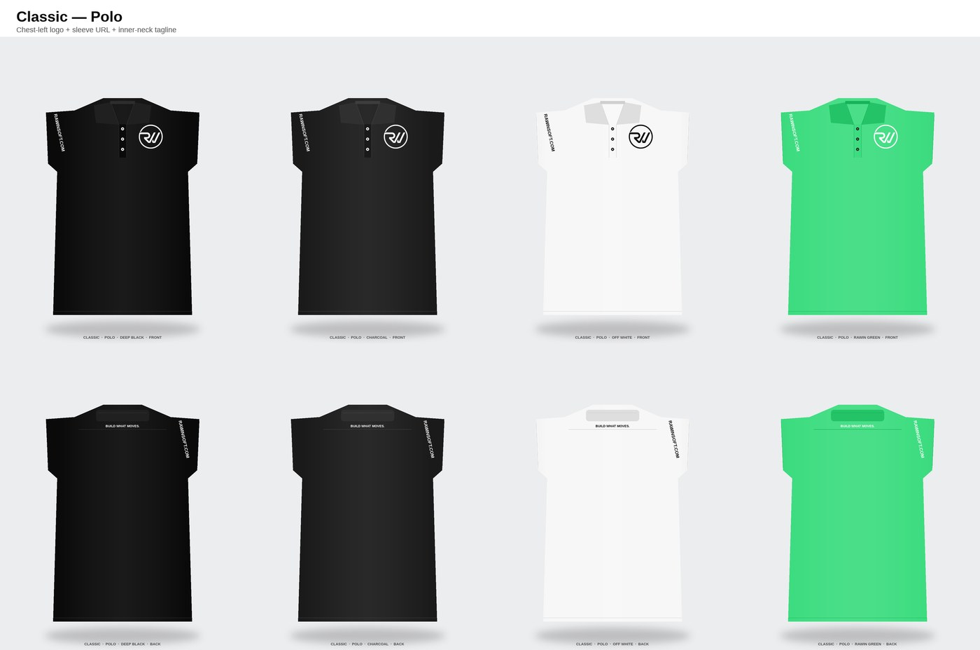

01 — Classic
The everyday uniform. Small chest logo, URL on sleeve, tagline at the inner neck.
POLO
TEE
BUILD WHAT MOVES.
Rawinnipa Uniform Deck · v1.0
4 / 13

Slide 5
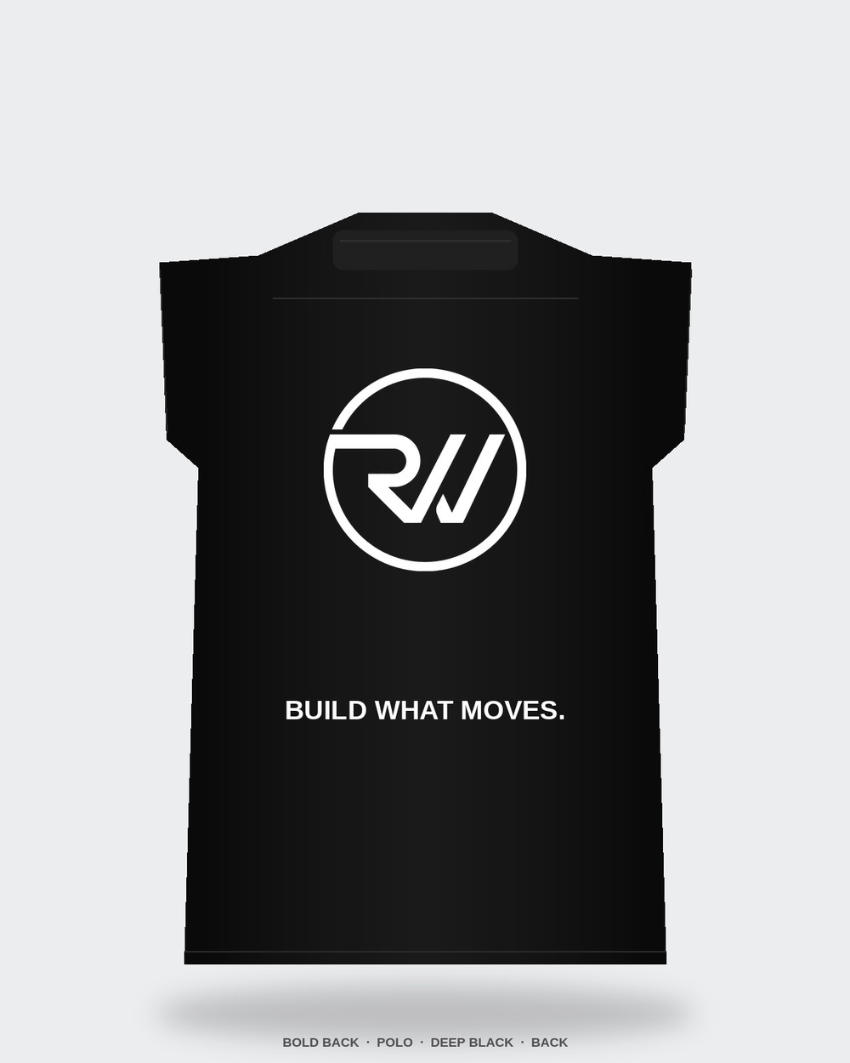
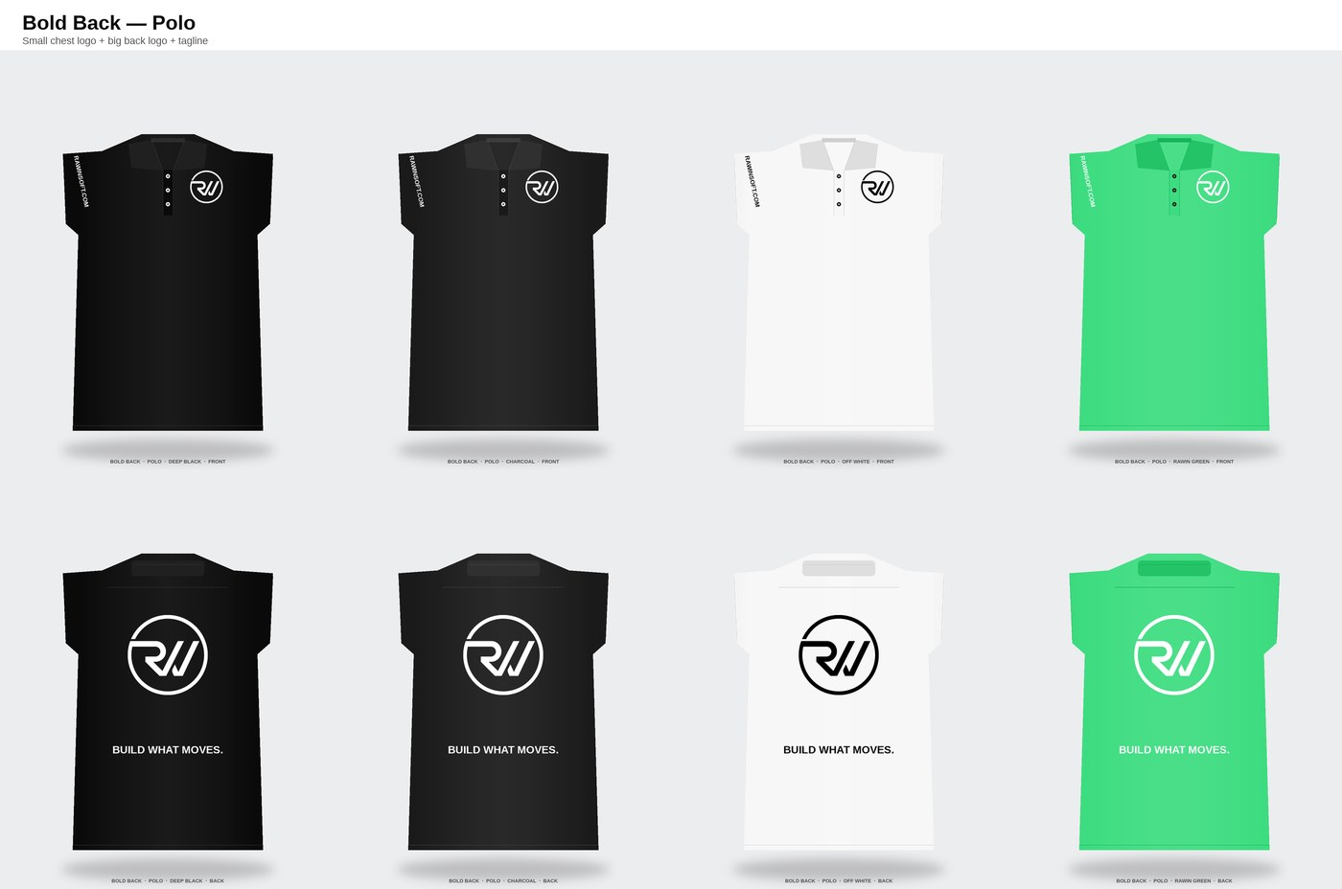

02 — Bold Back
For the days visibility matters. Small front mark, large embroidered logo on the back, tagline beneath.
POLO
TEE
BUILD WHAT MOVES.
Rawinnipa Uniform Deck · v1.0
5 / 13

Slide 6
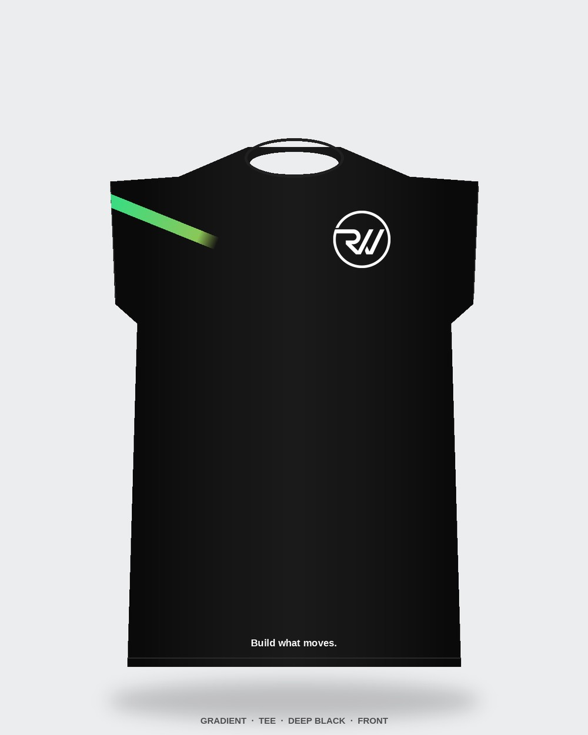
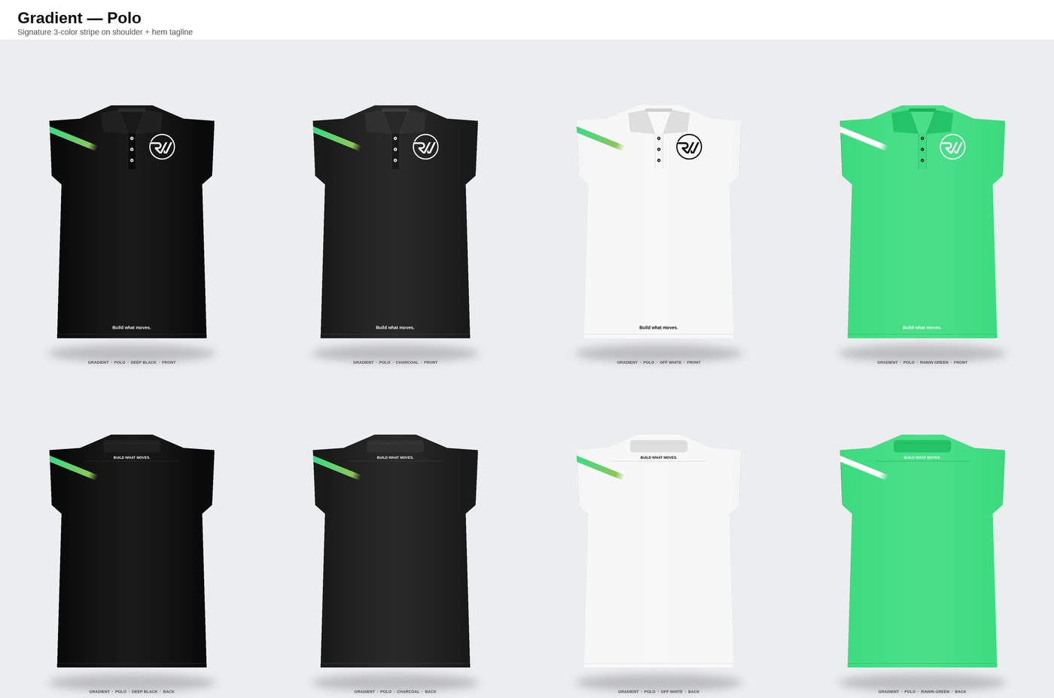
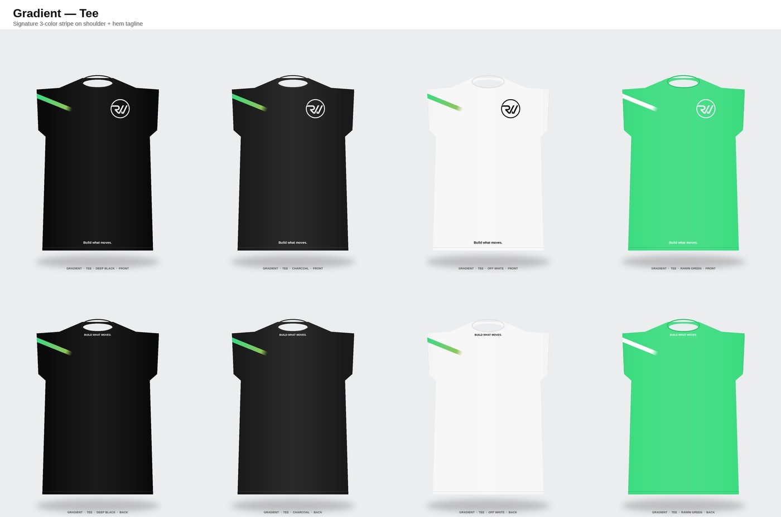
03 — Gradient
The brand signature. Three-color gradient across the shoulder — teal → green → lime — plus hem tagline.
POLO
TEE
BUILD WHAT MOVES.
Rawinnipa Uniform Deck · v1.0
6 / 13

Slide 7
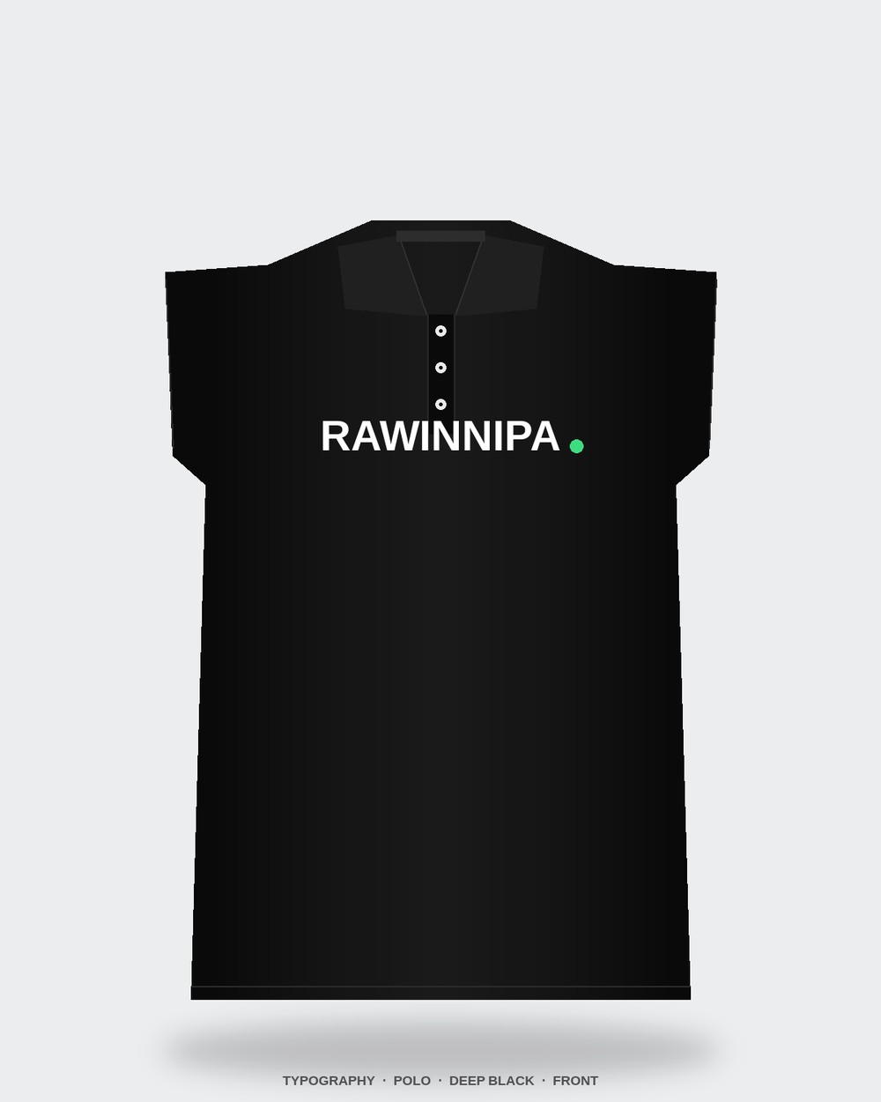


04 — Typography
A confident statement piece. Big RAWINNIPA wordmark on chest + stacked BUILD / WHAT / MOVES. on the back.
POLO
TEE
BUILD WHAT MOVES.
Rawinnipa Uniform Deck · v1.0
7 / 13

Slide 8
Colors
Four approved shirt colors. Ink follows a strict matrix — never green-on-green.
Deep Black
Charcoal
Off White
Rawin Green
#0A0A0A
#1A1A1A
#F7F7F7
#3EDC81
Pantone Black 6 C
Pantone Black 7 C
Pantone 11-0601 TCX
Pantone 2256 C
Ink rules
Dark shirts
Off White
Rawin Green
White logo + white text + green accent.
Black logo + black text + green accent.
White logo + white text — no green-on-green.
BUILD WHAT MOVES.
Rawinnipa Uniform Deck · v1.0
8 / 13

Slide 9
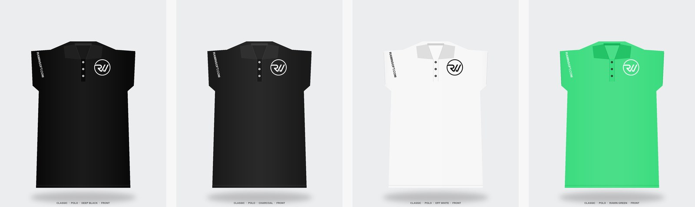
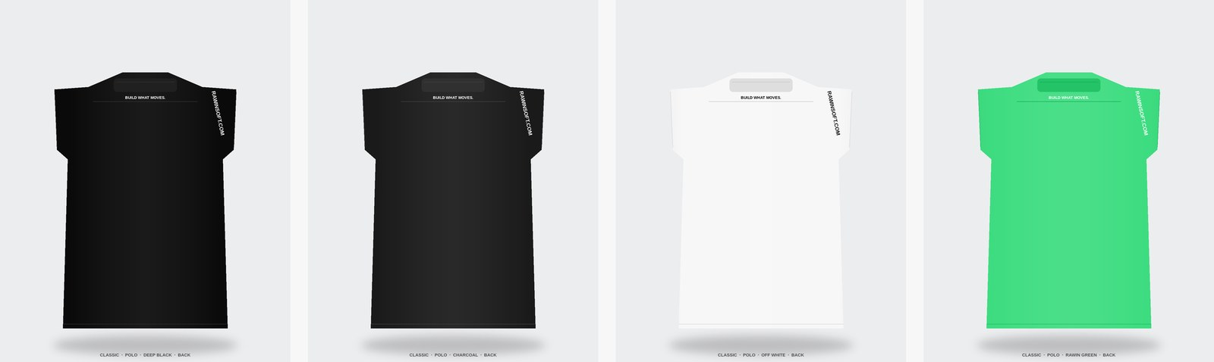
One concept across the palette
Classic polo — Deep Black, Charcoal, Off White, Rawin Green.
FRONT
BACK
BUILD WHAT MOVES.
Rawinnipa Uniform Deck · v1.0
9 / 13

Slide 10
Construction
Hard specs. Everything else lives in the spec sheet.
 | Polo | Crew-neck Tee
Fabric | Cotton 65% / Poly 35% piqué, 200–220 GSM | Combed cotton 100%, jersey, 180–200 GSM
Collar / neck | Self-fabric 2×2 rib, flat-bed knit | Self-fabric 1×1 rib, 2.0 cm band
Placket | 3-button, reinforced, 18 cm | —
Sleeves | Short, self-banded hem 3.5 cm | Short, double-needle hem 3.0 cm
Stitching | Single + 3-needle coverstitch | Single + double-needle coverstitch
Sizes | XS – 3XL (unisex) | XS – 3XL (unisex)
Shrinkage | Max 3% / 3% after wash | Max 4% / 4% after wash
Weight (L) | 210 g ±10 g | 180 g ±10 g
BUILD WHAT MOVES.
Rawinnipa Uniform Deck · v1.0
10 / 13

Slide 11
Decoration
Four methods. Matched to the element, not the cheapest option.
01
Embroidery
02
Screen print
Used for: Chest & back logos
Used for: Text, taglines, wordmark
Polyester thread, stitch density 4.0–4.4 pt, medium cut-away stabilizer. Max 9,000 stitches chest / 22,000 back.
Plastisol + soft-hand additive. Mesh 305 for fine type, 156 for solid blocks. Cure 160°C / 90 s.
03
Sublimation
04
Heat-transfer
Used for: Gradient stripe (polo only)
Used for: Inner-neck tagline
Polyester-blend only. Full-color gradient reproduction, no cracking, matches Pantone references in §2 of spec.
45 µm matte stretch film. 160°C / 15 s / medium pressure. Peel hot. Used only for the inner-neck tag.
BUILD WHAT MOVES.
Rawinnipa Uniform Deck · v1.0
11 / 13

Slide 12
Recommendation
Pick two. Wear both. Rotate by occasion.
EVERYDAY
STATEMENT
Classic — Polo — Deep Black
Gradient — Tee — Deep Black
The default uniform. Subtle, professional, works anywhere. Chest logo does the identity work; the rest disappears into the cut.
For launches, events, and brand moments. The 3-color shoulder stripe is unmistakably Rawinnipa and photographs brilliantly on stage.
BUILD WHAT MOVES.
Rawinnipa Uniform Deck · v1.0
12 / 13

Slide 13

Next steps
1
2
3
Day 1–7
Day 8–21
Day 22–45
Approve concepts
Pre-production samples
Bulk production
Pick final 1–2 concepts and colorways. Signs-off via the spec sheet approval block.
Vendor delivers 1 sample per concept × garment × color. QA per §10 of the spec.
Green-light bulk run after sample approval. 50 pcs per master carton per size.
Questions or approvals: sayhi@rawinsoft.com
BUILD WHAT MOVES.
Rawinnipa Uniform Deck · v1.0
13 / 13

