Slide 1
Kingsong

Slide 2
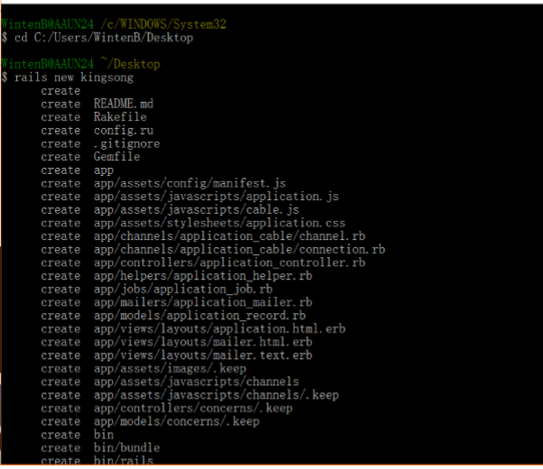
1. rails new kingsong

Slide 3
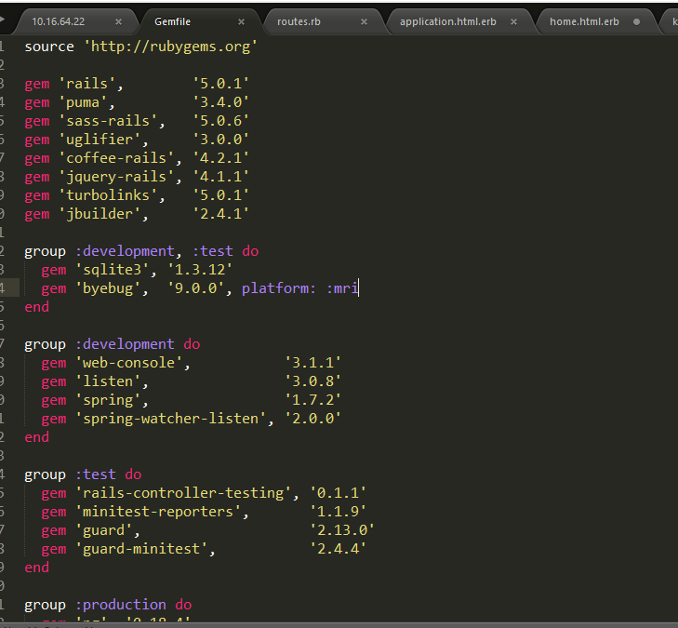
2.แก้ไข Gemfile

Slide 4
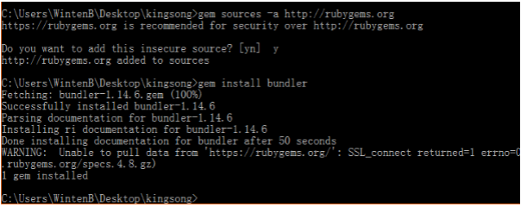
3. cd kingsong 4. gem sources –a http://rubygems.org 5. ตอบ y 6. gem install bundler

Slide 5
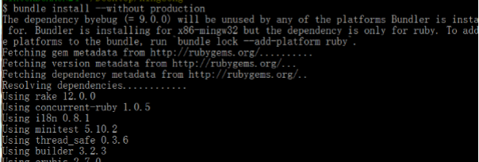
7. bundle install --without production

Slide 6
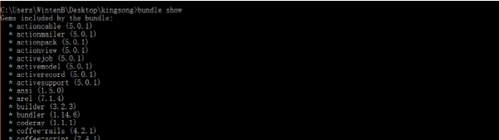
8. bundle show

Slide 7
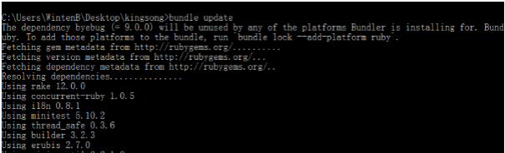
9. bundle update

Slide 8
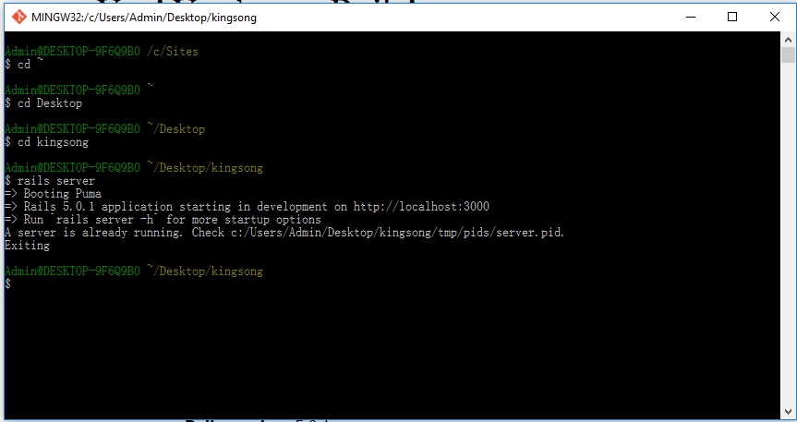
10. rails server

Slide 9
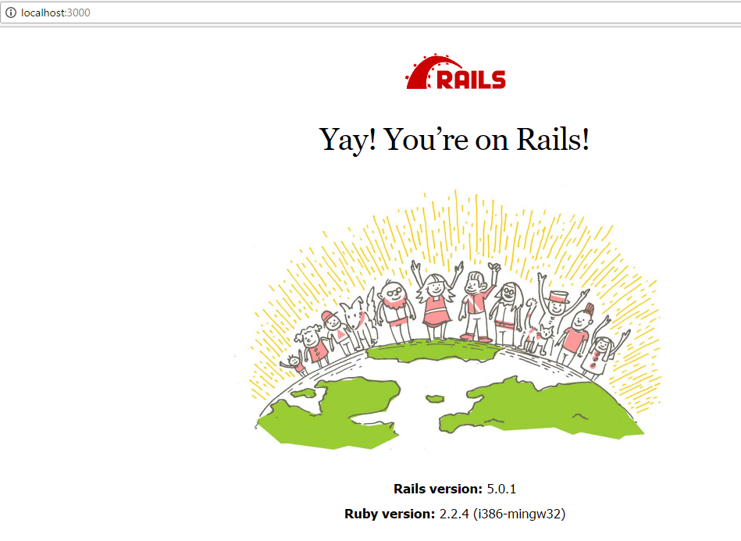
11. open localhost:3000

Slide 10
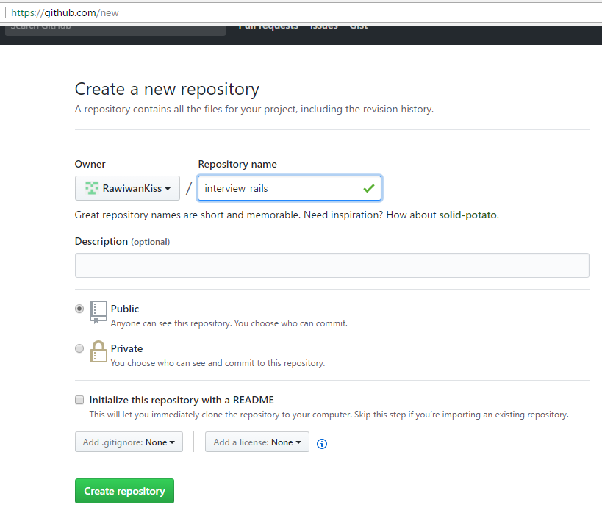
12. create repo at github

Slide 11
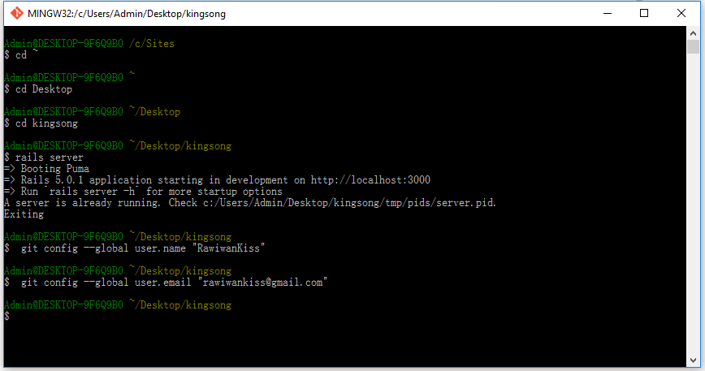
13. git config --global user.name "your username" 14. git config --global user.email "your email"

Slide 12
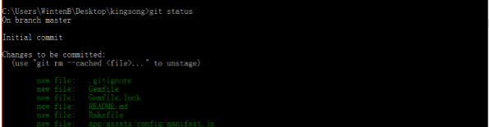
15. git init 17. git add –A 18. git status

Slide 13
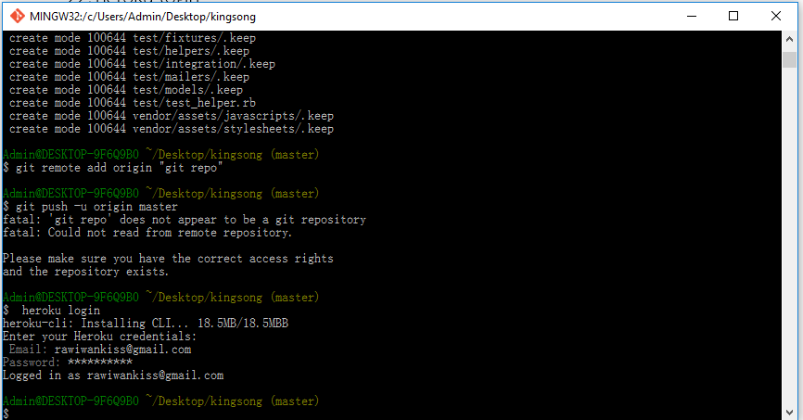
18.git commit –m “create project kingsong” 19. git remote add origin “git repo” 20. git push -u origin master

Slide 14
21. heroku login

Slide 15
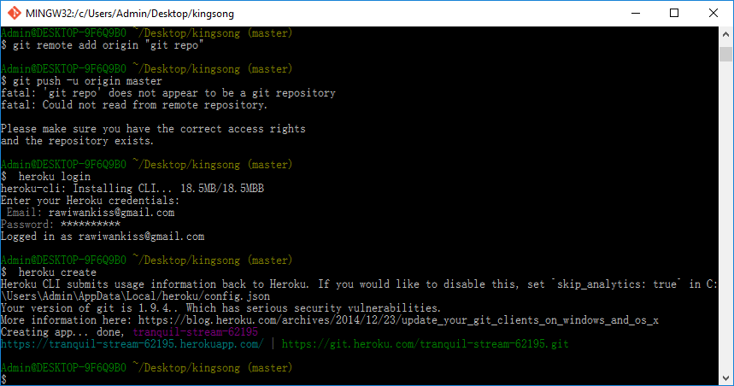
22. heroku create

Slide 16
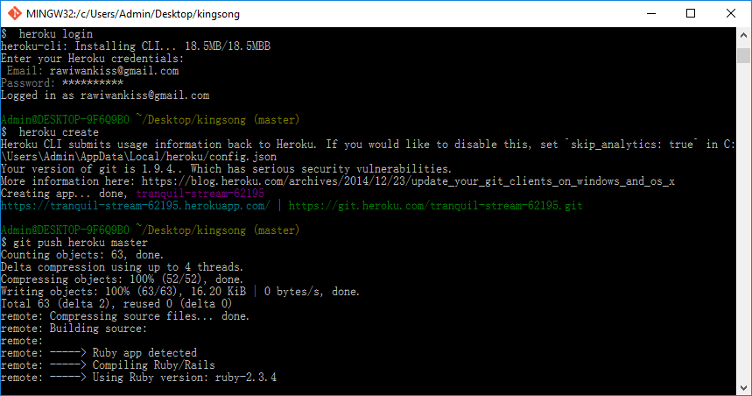
23. git push heroku master

Slide 17
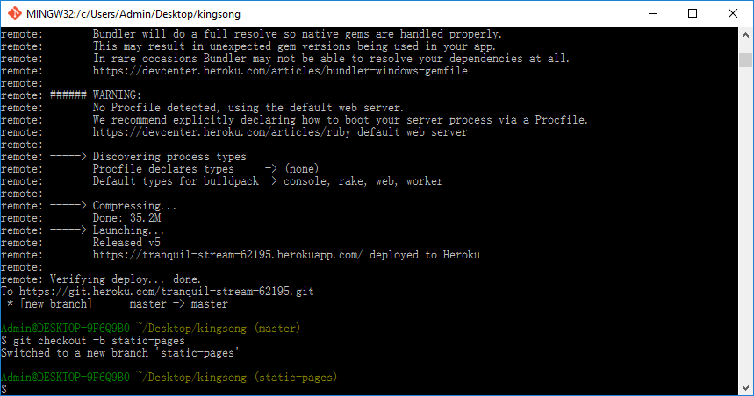
24. git checkout -b static-pages

Slide 18
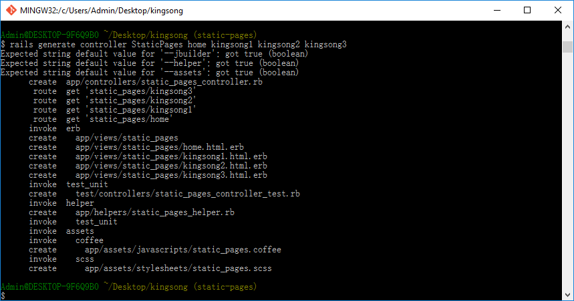
25. rails generate controller StaticPages home kingsong1 kingsong2 kingsong3

Slide 19
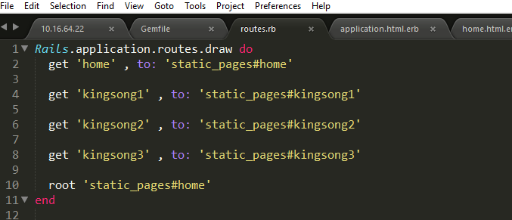
26. edit config/routes

Slide 20
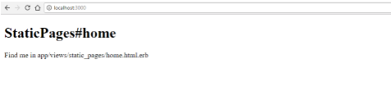
27. ไปดูที่ localhost:3000

Slide 21
28. Edit app/views/static_pages/home.html.erb 29. Edit app/views/static_pages/kingsong1.html.erb 30. Edit app/views/static_pages/ kingsong2.html.erb 31. Edit app/views/static_pages/ kingsong3.html.erb

Slide 22
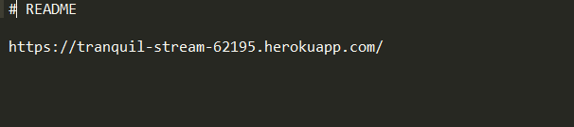
32. Edit Readme

Slide 23
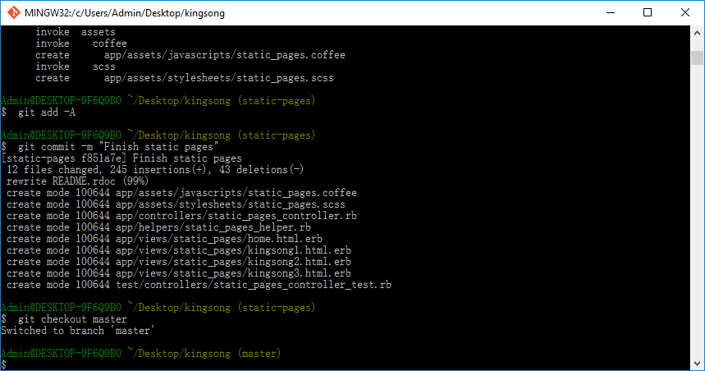
33. git add –A 34. git commit -m "Finish static pages" 35. git checkout master

Slide 24
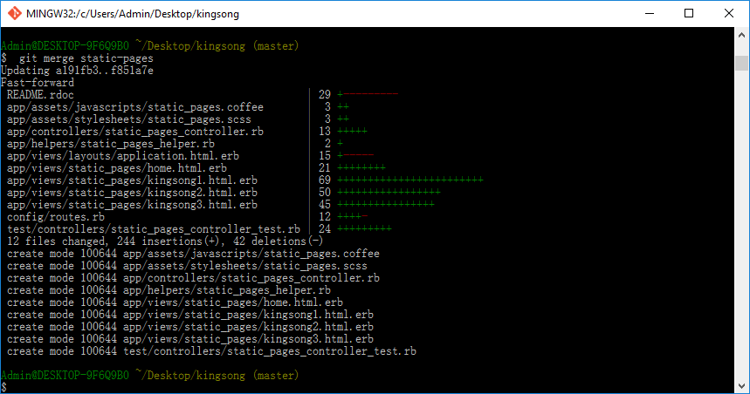
36. git merge static-pages

Slide 25
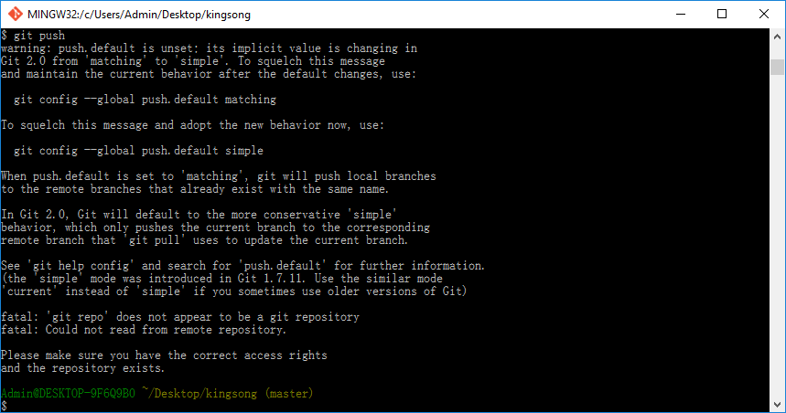
37. git push

Slide 26
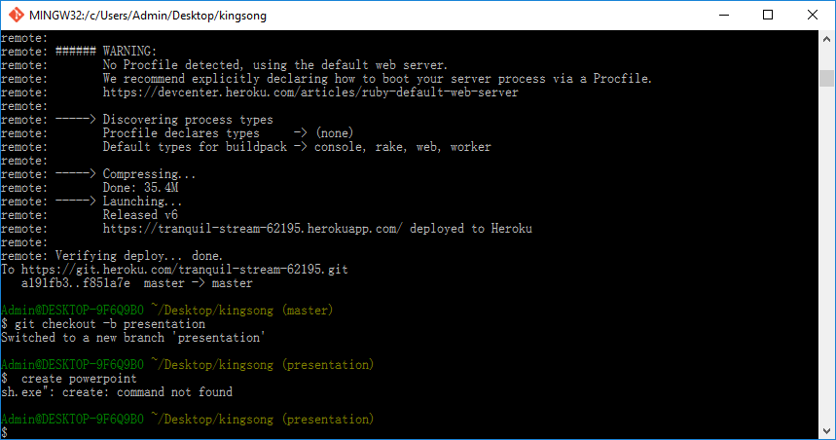
38. git push heroku 39. git checkout –b presentation

Slide 27
40.git add –A 41. git commit -m "Finish presentation" 42. git checkout master 43. git merge presentation 44. git push

